Slide 1


IMMUNOTHERAPY PLATFORM
Mode of Action
Dual-Mechanism Immunomodulatory Platform:
From Patent to Clinical Application
Based on US Patent 8,309,072 B2
April 2026
The Zhabilov Trust | Nov. 13, 2012

Slide 2

PRESENTATION OVERVIEW
Contents
01
Product Foundation
02
Dual-Pathway Mechanism
The IPF platform and active components
Anti-cancer and anti-viral pathways
03
Molecular Interactions
04
Clinical Evidence
IPF-gp96-CD91 complex structure
Biomarker data and immune response
05
Administration Protocol
06
Strategic Positioning
8-week dosing schedule and formulation
Competitive differentiation matrix
07
Patent Translation
From US 8,309,072 claims to clinical application

Slide 3
01 / PRODUCT FOUNDATION
The IPF Platform
Irreversibly inactivated pepsin fragments preserving immunomodulatory structure
Source Material
Key Innovation
Porcine pepsinogen / pepsin (Sigma P7000 or equivalent) undergoes irreversible inactivation at Ph 6.2-6.8
Eliminates Proteolytic Activity
This critical process eliminates proteolytic activity while preserving the immunomodulatory structure essential for therapeutic function.
Irreversible inactivation at controlled pH ensures safety
Preserves Immunomodulatory Structure
Maintains therapeutic binding domains
Primary Active Components
Dual-Mechanism Platform
A
IPF-1 through IPF-5
~45 kDa fragments with anti-cancer activity
Single scaffold, two distinct therapeutic applications
Mechanism: gp96 binding affinity → immune activation
B
IPF-6
Patent Reference
14-mer peptide: GDEPLENYLDTEYF (SEQ ID NO:6)
US 8,309,072 B2
Mechanism: Binds HIV-1 gp120, gp41, and human CD4
The Zhabilov Trust | Nov. 13, 2012

Slide 4
02 / DUAL-PATHWAY MECHANISM
One Scaffold, Two Therapeutic Applications
Convergent design enabling oncology and infectious disease treatment
Pathway A
Pathway B
Oncology / Immune Activation
Infectious Disease
Anti-Cancer Immune Activation
Anti-Viral Entry Inhibition
IPF binds gp96 → CD91 engagement → DC maturation → CTL activation → Tumor cell killing/ Th1 Response
IPF-6 binds gp41/gp120/CD4 → Steric interference → Membrane fusion blockade → Viral clearance / γδ T-Cell Activation
gp96 Chaperoning
DC Maturation
Th1 Response
Multi-Target Binding
Entry Blockade
γδ T-Cell Activation
Platform Convergence
IPF-1→5
IPF-6
IPF
Single molecular scaffold, distinct therapeutic mechanisms
Oncology/ Immune Focus
Virology Focus
Common Scaffold

Slide 5
02A / ANTI-CANCER / Immune Activation PATHWAY
Immune Activation via gp96 Chaperoning
Complete mechanism cascade from IPF binding to tumor cell elimination
Mechanism Cascade
Secondary Effects
1
IPF binds gp96
γδ T-cell activation
96 kDa ER-resident heat shock protein glycoprotein
Non-conventional immune recognition
NK cell engagement
2
gp96-IPF engages CD91
Innate immune response enhancement
Receptor on dendritic cells and macrophages
Antibody production
Humoral immune response boost
3
CD91-mediated internalization
Triggers DC maturation and cytokine release
Clinical Proof-of-Concept
4
Antigen cross-presentation
gp96 chaperones tumor peptides → MHC class I pathway
Pancreatic carcinoma case study
CA19-9 normalization observed
5
Th1 polarization & CTL activation
Tumor shrinkage documented
CD8+ T-cells mediate tumor cell killing
Active Components
DC Maturation Markers
Cytokine Release
T-Cell Polarization
IPF-1 through IPF-5
MHC II, CD86, CD83 ↑
IL-12, TNF-α ↑
Th1 (↑ IFN-γ, ↓ IL-4)
~45 kDa fragments

Slide 6
02B / ANTI-VIRAL PATHWAY
Entry Inhibition & Immune Enhancement
Dual-action mechanism targeting HIV envelope proteins and host receptor
Direct Physical Blockade Mechanism
Superantigen Formation
1
IPF-6 binds HIV-1 envelope proteins
IPF-6-gp41 Complex
gp41 (non-glycosylated fragment 579-601) + gp120 (surface glycoprotein)
3:2 stoichiometry triggers non-conventional immune recognition
2
IPF-6 binds human CD4 receptor
γδ T-cell receptor engagement
Primary HIV receptor on T-helper cells
CD3+ T-cells with γδ chains activated
Enhanced viral clearance
3
Steric/conformational interference
Non-conventional immune pathway activation
Prevents gp120-CD4 engagement and gp41-mediated membrane fusion
4
Entry blockade & viral clearance
Clinical Markers
Membrane fusion prevented, virus cannot enter host cells
CD4+ Memory T-cells
↑
CD4+ Naive T-cells
↑
HIV-1 RNA
CD8+CCR5+
CD8+CD38+
1-2 log decrease
Significant increase
Reduced activation
p24 Seroconversion
Negative
Active Component
IPF-6
14-mer peptide (SEQ ID NO:6)

Slide 7
03 / MOLECULAR INTERACTIONS
The IPF-gp96-CD91 Complex
Structural basis of immunomodulatory activity
Pathway A: IPF-gp96-CD91 Axis
Pathway B: IPF-6 Multi-Target Binding
6
IPF-6
IPF
gp96
CD91
14-mer peptide
GDEPLENYLDTEYF
gp96 (96 kDa glycoprotein) is an ER-resident heat shock protein that functions as a molecular chaperone, binding to immunogenic peptides and facilitating their presentation to the immune system.
Target 1
Target 2
Target 3
gp41
gp120
CD4
Binding Kinetics
Structural Insights
IPF-gp96 affinity
High affinity binding
Apparent molecular weight: ~45 kDa (IPF-1→5)
gp96-CD91 engagement
Receptor-mediated
Source: Porcine (Sus scrofa) pepsinogen
Internalization rate
Rapid uptake
Inactivation: Irreversible at pH 6.2-6.8

Slide 8
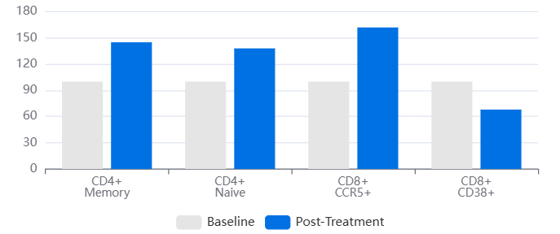
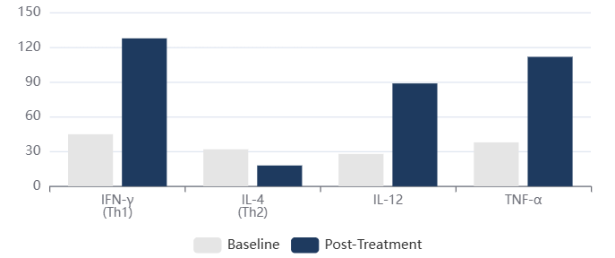
04 / CLINICAL EVIDENCE
Immune Reconstitution & Viral Response
Before/after biomarker changes demonstrating therapeutic efficacy
T-Cell Population Changes
Cytokine Response
CD4 + CD45RO +
CD4+CD45RA+
HIV-1 RNA
p24 Seroconversion
Memory T-cell expansion
Naive T-cell preservation
1-2 log decrease
Negative (clearance)
MHC II / HLA-DR
CD8+CCR5+
CD8+CD38+
2× increase
↑
↓
APC activation
HIV-targeted cytotoxic
Reduced Exhaustion

Slide 9
05 / ADMINISTRATION PROTOCOL
8-Week Dosing Schedule
Intramuscular injection protocol with biomarker response phases
Injection Timeline
Formulation Components
1-4
Weeks 1-2: Initial Priming
Aluminum phosphate
0.016 M
2 injections/week • 4 total • Immune recognition initiation
Sodium citrate
Buffer
5-8
Weeks 3-4: Amplification
Sodium acetate
Buffer
2 injections/week • 4 total • DC maturation peak
IL-2 (optional)
Adjuvant
9-12
Weeks 5-6: Effector Response
2 injections/week • 4 total • CTL activation
gp96 Component
13-16
Weeks 7-8: Consolidation
2 injections/week • 4 total • Memory formation
Concentration range
10-100 μg/mL
Low dose (10-30): Pro-inflammatory
High dose (70-100): Regulatory immunity
Total Injections
Dose per Injection
Route
16
4-8 mg
IM
Over 8 weeks
IPF per 2 mL vial
Intramuscular

Slide 10
06 / STRATEGIC POSITIONING
Competitive Differentiation Matrix
Enzomune vs. standard of care across therapeutic categories
Vaccines
Immunotherapy
Traditional Approach
Traditional Approach
Exogenous antigen + adjuvant; requires epitope prediction
Checkpoint inhibitors (anti-PD-1, anti-CTLA-4)
Enzomune Differentiation
Enzomune Differentiation
Endogenous antigen chaperoning via gp96; "universal" tumor/viral peptide presentation
Active immune priming via DC maturation; converts "cold" to "hot" tumors
Antivirals
Fusion Inhibitors
Traditional Approach
Traditional Approach
Direct-acting (reverse transcriptase, protease inhibitors)
T-20 (enfuvirtide); peptide-based entry blockade
Enzomune Differentiation
Enzomune Differentiation
Entry inhibition + immune activation; no resistance selection pressure
Naturally derived, multi-target binding (gp120 + gp41 + CD4); superantigen immune enhancement
Core Differentiator
Two therapeutic applications
Natural product advantage with dual-mechanism platform
Single Scaffold

Slide 11
07 / PATENT TRANSLATION
From Patent to Product
Visual bridge from US 8,309,072 claims to clinical application
Patent Foundation
Inventor
US 8,309,072 B2 | Nov. 13, 2012
Harry H. Zhabilov
The Zhabilov Trust
Patent Claims
Continuation Patents
Priority Date
Irreversibly-inactivated pepsinogen fragments for modulating immune function
US 8,067,531 and US 8,066,982
Established intellectual property protection
1
Manufacturing
2
Preclinical
3
Clinical
Source: Porcine pepsinogen/pepsin (Sigma P7000)
Binding assays: gp96 affinity confirmed
Oncology: Pancreatic carcinoma case study
Inactivation: pH 6.2-6.8 (irreversible)
DC maturation: MHC II, CD86, CD83 upregulation
Tumor response: CA19-9 normalization
Quality: Proteolytic activity eliminated
Cytokine profile: IL-12, TNF-α induction
HIV markers: Immunological reconstitution
Structure: Immunomodulatory domains preserved
T-cell polarization: Th1 response
Viral load: 1-2 log decrease
Natural Product Advantage
Platform
Porcine-derived • Irreversibly inactivated • No synthetic complexity
Universal immunomodulation

Slide 12

PLATFORM POTENTIAL
Universal Immunomodulation
Enzomune represents a paradigm shift from exogenous antigen design to leveraging endogenous danger signaling through gp96 as a universal adapter
Active Priming
Dual Mechanism
Converts "cold" to "hot" tumors through DC maturation and Th1 polarization, fundamentally different from checkpoint disinhibition
Single molecular scaffold enables both oncology/ Immune Activation and infectious disease applications with distinct but complementary pathways
Applications Spanning
Based on
Oncology
Infectious Disease
Immunotherapy
US Patent 8,309,072 B2
The Zhabilov Trust
April 2026
Inventor: Harry H. Zhabilov

