Slide 1
📝
ResuMatrix
B.Sc. CSIT
AI-Powered Resume Analysis & Job Matching Platform
Final Year Project
Amrit College, Tribhuvan University
Final Defense
Presentation
Alex Phuyal (79010151) • Abishek Khadka (79010149) • Biraj Sapkota (79010173)
Supervisor: Er. Akkal Bist
July 2026

Slide 2
Presentation Agenda
01
Introduction & Problem Statement
05
System Architecture & Design
02
Project Objectives
06
Technology Stack
03
Literature Review
07
Implementation & Testing
04
System Flows — Auth, Parsing, Scoring & Optimization
08
Conclusion & Future Recommendations
ResuMatrix · 02/15

Slide 3
Introduction & Problem Statement
100s
Zero
Manual
of listings scanned manually per search, most irrelevant to the candidate
objective personalized fit signal offered by today's job boards
resume tailoring per posting — slow, inconsistent, often skipped entirely
Problem Statement
!
Job seekers must manually cross-reference every listing against their own resume — slow, inconsistent, and easy to get wrong
!
Existing job boards surface listings but compute no personalized fit signal; resume tools improve writing but never compare against a specific job
!
No single tool closes the loop: parse the resume once, then use it to both rank incoming listings and generate job-specific edit suggestions
💡 Solution: ResuMatrix — parse a resume once, then use it to score, rank & optimize applications against live job listings, end-to-end
ResuMatrix · 03/15

Slide 4
Project Objectives
📄 Resume Parsing
🎯 Job Match Scoring
Extract contact info, skills, experience & education from PDF/DOCX via regex + fuzzy/TF-IDF segmenter + BERT NER + gazetteer
Blend lexical (TF-IDF), semantic (sentence embeddings) & skill-overlap signals into a single 1–10 match score
✍️ Resume Optimization
🔐 Secure Authentication
Suggest job-targeted skill & bullet edits from the same scoring signals — never fabricating a claim the user didn't make
Local email/password (Argon2 + JWT) and Google OAuth 2.0 sign-in converge on one session mechanism
📋 Application Tracking
📑 Optimized PDF Export
Track saved jobs through Saved → Applied → Interview → Offer / Rejected stages with timestamps
Downloadable, ATS-formatted resume PDF tailored to a specific job, generated server-side with ReportLab
ResuMatrix · 04/15

Slide 5
Literature Review
BERT
Pretrained bidirectional transformer for language understanding — foundation of the NER model used for name / organization / location extraction.
Devlin et al., 2019
Sentence-BERT
Siamese BERT sentence embeddings for semantic similarity — basis of the semantic-match signal in job scoring.
Reimers & Gurevych, 2019
TF-IDF Term Weighting
Classical term-weighting for text retrieval — used for lexical resume-job similarity and section classification.
Salton & Buckley, 1988
spaCy / Industrial NLP
Industrial-strength NLP with Bloom embeddings — powers the gazetteer-based skill / title / degree matcher.
Honnibal & Montani, 2017
ResuMatrix · 05/15

Slide 6
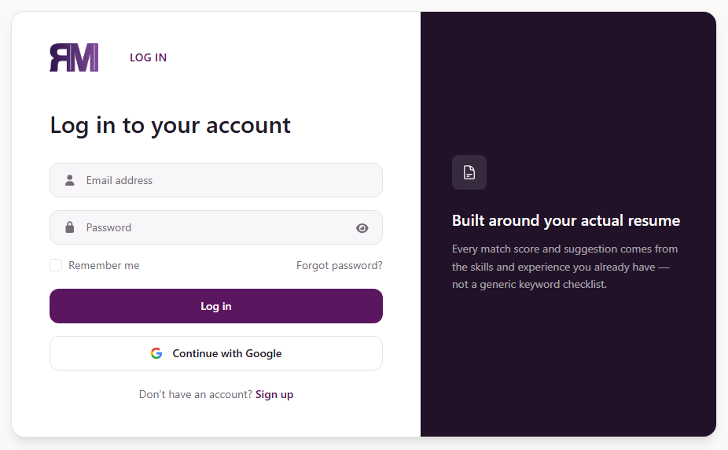
System Flow — Authentication
① Registration, Login & Google OAuth 2.0
Example Output — Live UI
USER Submits email/password, or clicks Google Sign-In
▼
FRONTEND POST /api/auth/register or /api/auth/login
▼
BACKEND Argon2 hash / verify password (security.py)
▼
GOOGLE OAuth 2.0 code exchange → verified email
▼
BACKEND Issues signed JWT (HS256), 7-day expiry
▼
FRONTEND Stores token, redirects to Job Board
Login screen — local email/password + Google OAuth entry points
ResuMatrix · 06/15

Slide 7
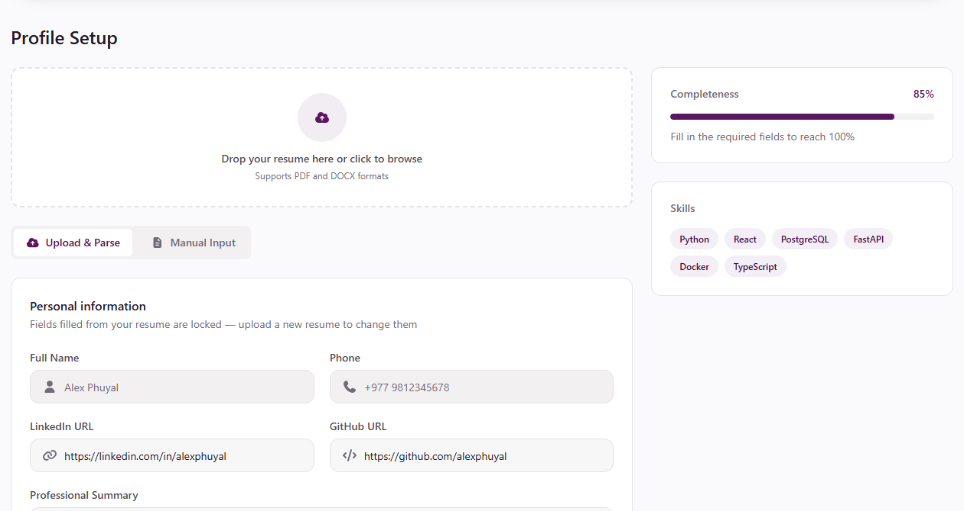
System Flow — Resume Upload & Parsing
② Unstructured Resume → Structured Profile
Example Output — Live UI
USER Uploads resume — PDF or DOCX (up to 5 MB)
▼
BACKEND POST /api/resume/upload extracts raw text
▼
REGEX Extracts email, phone, links, date ranges
▼
SEGMENTER Fuzzy match + TF-IDF/LogReg fallback
▼
BERT + GAZETTEER Extracts entities & canonical skills
▼
BACKEND Profile saved to PostgreSQL, shown to user
Profile Setup — fields auto-populated from an uploaded resume (85% complete)
ResuMatrix · 07/15

Slide 8
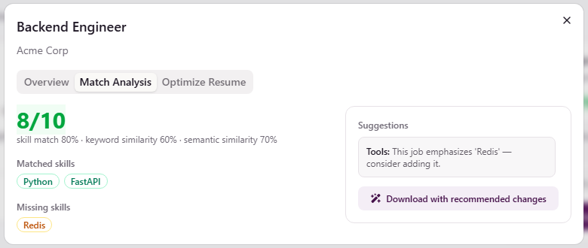
System Flow — Job Search & Match Scoring
③ Live Listings → Ranked, Scored Jobs
Example Output — Live UI
USER Searches jobs by title, location, filters
▼
BACKEND GET /api/jobs/search → JSearch API (15-min cache)
▼
ATS SERVICE TF-IDF cosine similarity (lexical match)
▼
ATS SERVICE Sentence-BERT cosine similarity (semantic match)
▼
ATS SERVICE Skill overlap + weighted blend → 1–10 score
▼
FRONTEND Ranked jobs shown with match-score badge
Match Analysis tab — 8/10 score: 80% skill match, 60% keyword, 70% semantic similarity
ResuMatrix · 08/15

Slide 9
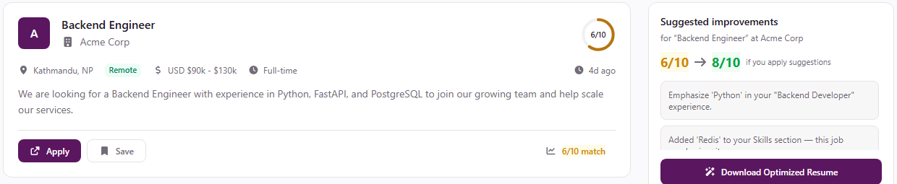
System Flow — Resume Optimization
④ Job-Targeted, Non-Fabricated Edit Suggestions
Example Output — Live UI
USER Clicks Optimize Resume for a specific job
▼
BACKEND POST /api/jobs/optimize-resume
▼
OPTIMIZER Embeds bullets — places missing skills by best match
▼
OPTIMIZER Ranks missing skills by term frequency
▼
OPTIMIZER Flags un-quantified bullets (regex digit check)
▼
BACKEND Rescores before → after, returns optimized PDF
Job Board suggestions panel — projected score lift 6/10 → 8/10 if suggestions are applied
ResuMatrix · 09/15

Slide 10
System Architecture & Design
CLIENT SIDE (React 19 + TypeScript SPA)
BACKEND SERVER (FastAPI — Railway)
Pages
React Router v7 — public Landing/Login/Register; Dashboard/JobBoard/ProfileSetup behind ProtectedRoute
FastAPI Gateway
7 routers under /api — auth, google, profile, resume, jobs, applications, alerts
State
TanStack Query (server-state cache) + Zustand (auth identity store)
ML Resume Parser
Regex + fuzzy/TF-IDF segmenter + BERT NER + gazetteer, run via run_in_threadpool
HTTPS
▶▶
REST API
API Client
axios instance — JWT-attaching request interceptor; 401 auto-redirect to Login
ATS Scoring Service
TF-IDF + sentence embeddings + skill overlap → blended 1–10 score
ProfileSetup
Gap-filling form — resume-locked fields disabled; location/experience required via Zod + RHF
Resume Optimizer
Reuses ATS scoring; bullet-injection + missing-skill + quantification-gap detection
JobBoard
Job cards with match-score badge; JobDetailModal lazily fetches ATS analysis on open
job_service.py
JSearch API wrapper behind a 15-minute in-memory cache keyed on query params
ResuMatrix · 10/15

Slide 11
Technology Stack
Frontend
Backend
AI / NLP
Dev & Deployment
React 19.2 + TypeScript
Python 3.13 — FastAPI 0.136
spaCy 3.8 (en_core_web_sm)
Git & GitHub — version control
Vite 8 — build tool
Uvicorn ASGI server
scikit-learn 1.5 (TF-IDF, LogReg)
Railway — backend + PostgreSQL
Tailwind CSS v4 + shadcn/ui
transformers + torch (BERT NER)
pwdlib (Argon2) + python-jose (JWT)
SQL Alchemy 2.0 + Alembic
TanStack Query v5 + Zustand
PostgreSQL
Sentence embeddings (MiniLM-L6-v2)
Authlib — Google OAuth 2.0
ResuMatrix · 11/15

Slide 12
Implementation
Frontend Modules
Backend Modules (FastAPI)
ProtectedRoute.tsx
main.py
Checks for a stored JWT; redirects unauthenticated users to Login
Mounts 7 routers under /api; CORS scoped to frontend origin; creates schema on startup
services/api.ts
ml_resume_parser/
Axios interceptors: attach Bearer JWT; clear token + redirect on 401
Regex → fuzzy/TF-IDF segmenter → BERT NER → gazetteer, dispatched via run_in_threadpool
ProfileSetup.tsx
ats_service.py
Gap-filling flow — resume-locked fields disabled, required fields via Zod + RHF
Blended TF-IDF + semantic + skill-overlap scoring, shared by optimizer service
JobBoard / JobDetailModal
job_service.py / pdf_service.py
Job cards with match badge; modal lazily fetches ATS analysis on open
JSearch cache (15-min TTL) + ReportLab-rendered optimized resume PDF
ResuMatrix · 12/15

Slide 13
Testing & Results
Unit Testing
Integration Testing
System Testing
✓ 14 test cases — all PASS
✓ 10 test cases — all PASS
✓ End-to-end — all PASS
✓ Regex extraction (email, phone, dates)
✓ Register → login returns JWT + Profile row
✓ Varying resume formats (headers, layouts)
✓ Section header detection + LogReg fallback
✓ Resume upload → profile fields populated
✓ Common vs. narrow/location job queries
✓ BERT NER — person name extraction
✓ Job search returns sorted match scores
✓ Score direction verified as skills change
✓ Gazetteer skill categorization
✓ ATS analysis → matched/missing skills
✓ Boundary: empty upload, 5MB limit, 0 skills
✓ Experience entry splitting by date range
✓ Optimize resume → download updated PDF
✓ Error handling: JSearch failure, bad JWT
✓ ATS blend score upper/lower bounds
✓ Application status update via Dashboard
✓ Cross-browser manual verification
✓ Quantification-gap detection (regex)
✓ Google OAuth callback issues valid JWT
All stated objectives met — parsing, scoring, optimization, auth, tracking & PDF export verified end-to-end

Slide 14
Conclusion & Future Recommendations
✓ Project Achievements
🚀 Future Recommendations
Resume Parsing Pipeline
Automated Test Suite
Regex + fuzzy/TF-IDF segmenter + BERT NER + gazetteer extract structured profiles reliably
pytest-based suite wired into CI to replace manual testing
Verified App Tracking
Blended Match Scoring
Corroborate self-reported status via email parsing or ATS webhooks
TF-IDF + sentence embeddings + skill overlap → interpretable 1–10 score, monotonic with overlap
Job Alerts Frontend
Resume Optimization
Expose the complete /api/alerts backend through a dedicated UI
Job-targeted suggestions placed via semantic similarity, never fabricating claims
OCR for Scanned Resumes
Tesseract fallback for image-only PDF uploads
Dual-Mode Authentication
Fine-Tuned NER
Argon2 + JWT local auth and Google OAuth 2.0 converge on one session mechanism
Domain fine-tuning to reduce organization-tag false positives
Learned Score Weights
Application Tracking
Replace fixed 0.5/0.25/0.25 blend with weights learned from labeled data
Saved → Applied → Interview → Offer/Rejected transitions verified against the state model
Employer-Facing Features
Fully Deployed
An employer portal for posting jobs directly is a natural extension
Packaged for Railway; all config externalized through environment variables
ResuMatrix · 14/15

Slide 15
📝
Thank You
Amrit College
Tribhuvan University
ResuMatrix — Turning One Resume Upload Into a Live-Scored Job Search
Supervisor:
Er. Akkal Bist
Open for Questions & Discussion
B.Sc. CSIT | July 2026
Alex Phuyal (79010151)
Abishek Khadka (79010149)
Biraj Sapkota (79010173)
github.com/Abishek-khadka01/
resume-parser
Supervisor: Er. Akkal Bist

