Slide 1


XPLOREATHON 2025
TITLE PAGE
Problem Track ID: 5
Problem Statement Title: Cloud Credential Leakage Detection & Auto-Revocation System
PS Category: Software
Team Name: CyberTech
College Name: GRT INSTITUTE OF ENGINEERING AND TECHNOLOGY

Slide 2
Cloud Credential Leakage Detection & Auto-Revocation System (AI-driven automation for preventing cloud credential leaks in real time)
CyberTech
Problem:
Every day “10,000 cloud API keys leak” on GitHub, Discord & Pastebin.
“Attackers exploit them within minutes → data breaches & crypto-mining losses”.
Existing tools only detect leaks — “none can auto-revoke credentials”.
Our Solution:
Real-time monitor of GitHub / Pastebin / local repos.
AI + Regex detects secret patterns & context.
Cloud APIs validate and auto-revoke active keys.
Instant Slack/Email alerts + live dashboard.
Optional voice alerts & predictive analytics.
“Our solution automatically detects and fixes credential leaks before damage occurs.”
Innovation & Uniqueness:
Combines AI (NLP + Transformers) with DevSecOps automation.
Provides self-healing cloud security in seconds.
Multi-cloud coverage (AWS, Azure, GCP).
First open model that detects + fixes + alerts automatically.

Slide 3
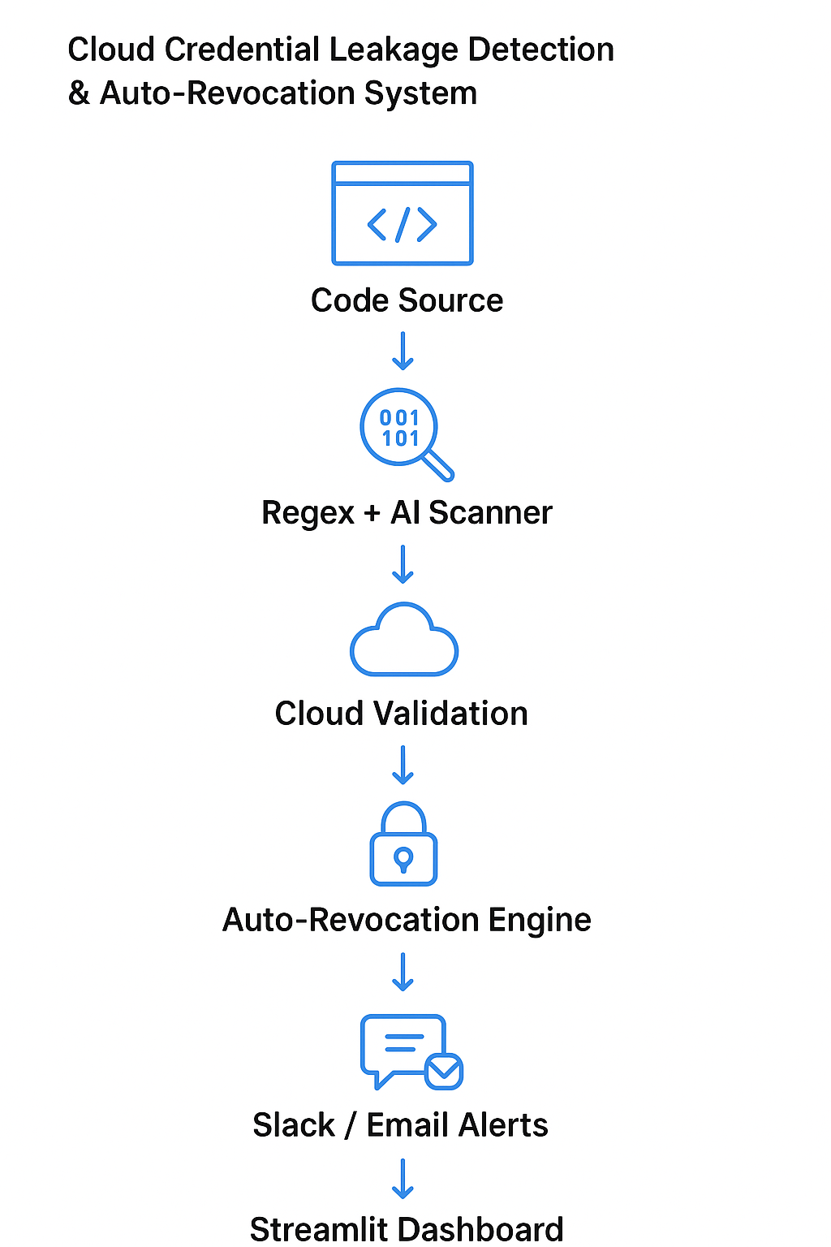
IMPLEMENTATION STRATEGY
CyberTech
Technologies Used:
Frameworks: FastAPI + Streamlit + Celery
AI model that understands context to avoid
false alarms.
Cloud APIs: AWS boto3 | GCP SDK | Azure Identity
Database: SQLite / PostgreSQL
Automation: Redis + Cron Jobs
Notification: Slack Webhook + Email API
layers:
Detection Layer → Regex + AI
Validation Layer → Cloud API Check
Response Layer → Auto Revocation + Alerts
Visualization Layer → Streamlit Dashboard
Our Model Highlights:
DistilBERT model scores leaks by confidence level.
Auto-revokes live keys via secure API calls.
Dashboard shows risk level + time-to-detection.
Fully async Celery workers handle real-time load.
Flow chart:

Slide 4
OVERCOMING BARRIERS
CyberTech
Challenges
High false positives in regex-based scans.
Safe validation without triggering abuse.
Secure storage of admin credentials.
Ensuring scans respect data privacy and legal boundaries.
Feasibility
Built entirely on open APIs & cloud SDKs.
Runs on Docker / Kubernetes for scale.
Integrates with CI/CD pipelines for continuous protection.
Solutions
“AI filter (Transformer + context learning) reduces false alerts by 80%”.
Scan only authorized repositories / sanitized feeds.
Store admin keys in AWS Secrets Manager / Vault.
Include human approval step before revocation for safety.

Slide 5
KEY BENEFITS
CyberTech
Impact:
Prevents real-time cloud breaches in < 60 seconds.
Saves enterprises from unauthorized cloud charges.
Strengthens DevSecOps culture through automation.
Type | Description
Security | Blocks live credential exploitation instantly
Automation | End-to-end self-healing without manual steps
Economic | Avoids millions in breach / compute losses
AI | Understands code context for accurate detections
Social | Promotes secure coding & responsible DevOps

Slide 6
RESEARCH AND REFERENCES
CyberTech
Research Base
IBM Cybersecurity Report 2025: “80% of breaches start with leaked credentials.”
Microsoft Security Blog 2024: GitHub token leak trends.
AWS Docs: Access Key Management & Revocation API Guides.
IEEE 2023: “Automating Secret Detection Using NLP.”
GitHub API v3: Code Search & Webhook Event Integration.
Future Scope
Expand to multi-cloud GCP & Azure auto-fix.
Add predictive AI to detect leaks before commit.
Integrate voice alert assistant for SOC teams.
Launch as SaaS platform for enterprises with API access.

