Slide 1

DevOps
Abishek S K

Slide 2



Agenda
Waterfall model
Agile model
DevOps

Slide 3
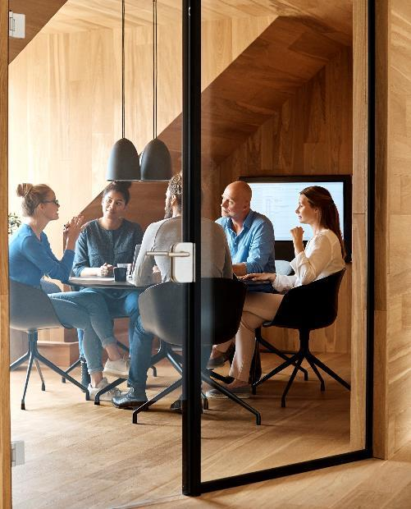



Introduction
With PowerPoint, you can create presentations and share your work with others, wherever they are. Type the text you want here to get started. You can also add images, art, and videos on this template. Save to OneDrive and access your presentations from your computer, tablet, or phone.

Slide 4

Waterfall Model

Slide 5
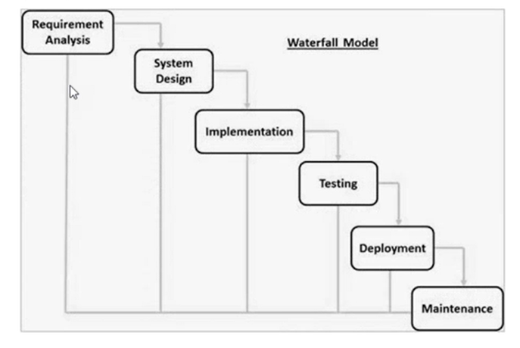
Waterfall Model
The waterfall model is a linear, sequential approach to the software development lifecycle (SDLC).

Slide 6
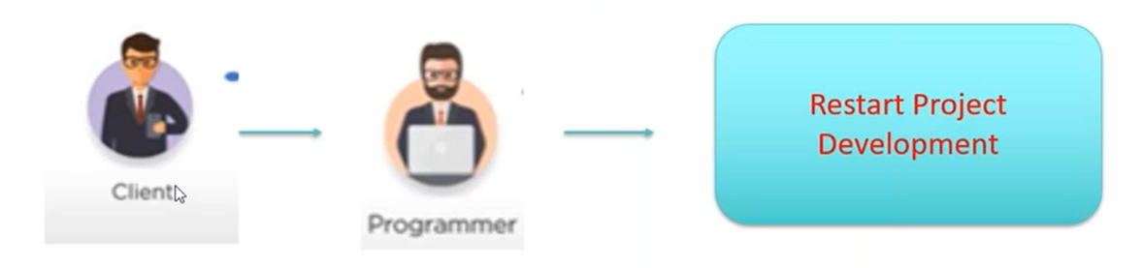
Waterfall Model Disadvantages
Any new requirement from the client will restart the development cycle.

Slide 7
Agile Model

Slide 8
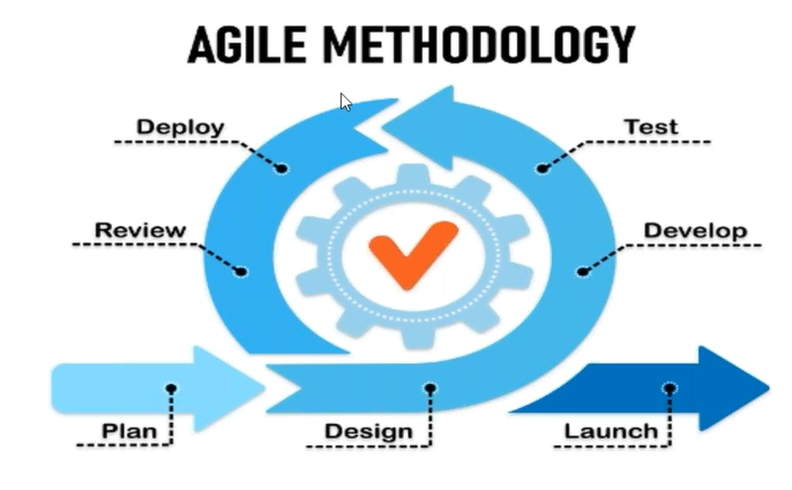
Agile Model
The Agile methodology is a project management approach that involves breaking the project into phases and emphasizes continuous collaboration and improvement.

Slide 9
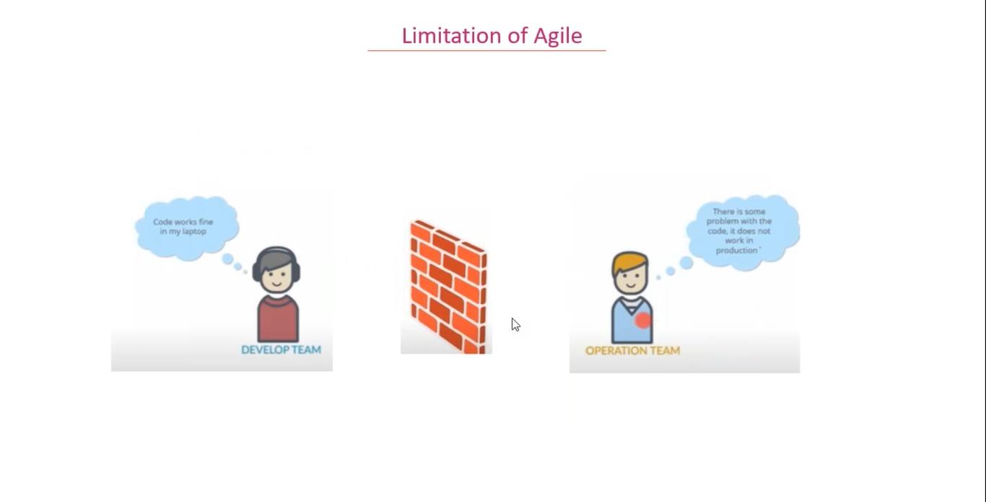

Slide 10
DevOps

Slide 11
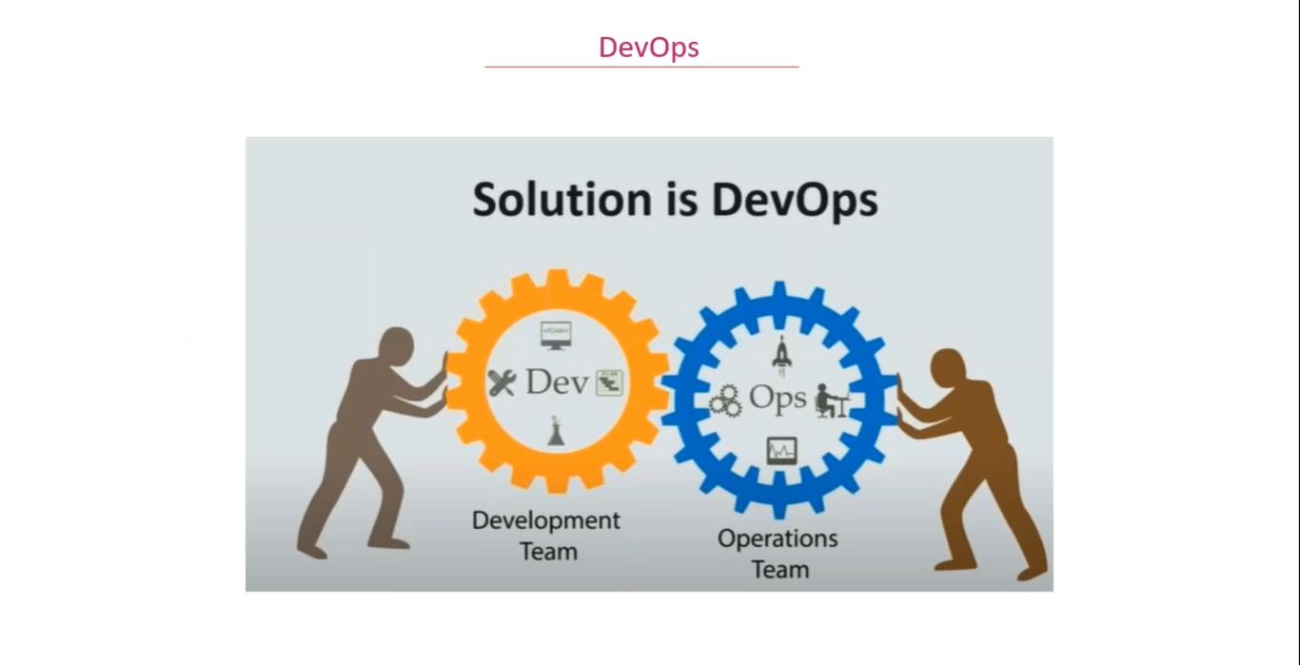

Slide 12
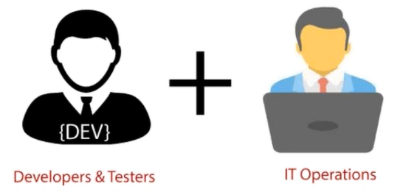
DevOps
The DevOps life cycle is working with two major parts, one is software Development, and second is Operations. This allows a single team to handle the entire application lifecycle, from development to testing, deployment, and operations. DevOps helps you to reduce the disconnection between software developers, quality assurance (QA) engineers, and system administrators.

Slide 13
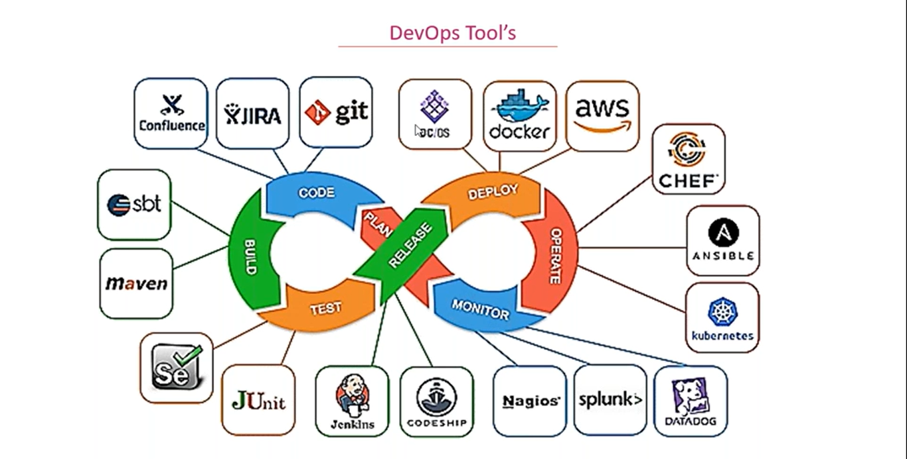

Slide 14
Git
Git is an open-source distributed version control system that is freely available for everyone. It is designed to handle minor to major projects with speed and efficiency. It is developed to co-ordinate the work among programmers. The version control allows you to track and work together with your team members at the same workspace. It is used as a critical distributed version-control for the DevOps tool.

Slide 15
Docker
Docker is a platform for developing, shipping, and running applications. Docker enables you to separate your applications from your infrastructure so you can deliver software quickly. With Docker, you can manage your infrastructure in the same ways you manage your applications. By taking advantage of Docker's methodologies for shipping, testing, and deploying code quickly, you can significantly reduce the delay between writing code and running it in production.

Slide 16
Docker Container
A container is a running instance of an image. You can create, start, stop, move, or delete a container using the Docker API or CLI. You can connect a container to single or multiple networks, attach storage to it, or even create a new image based on its current state.
By default, a container is relatively well isolated from other containers and its host machine. You can control how isolated a container's network, storage, or other underlying subsystems are from other containers or from the host machine.

Slide 17
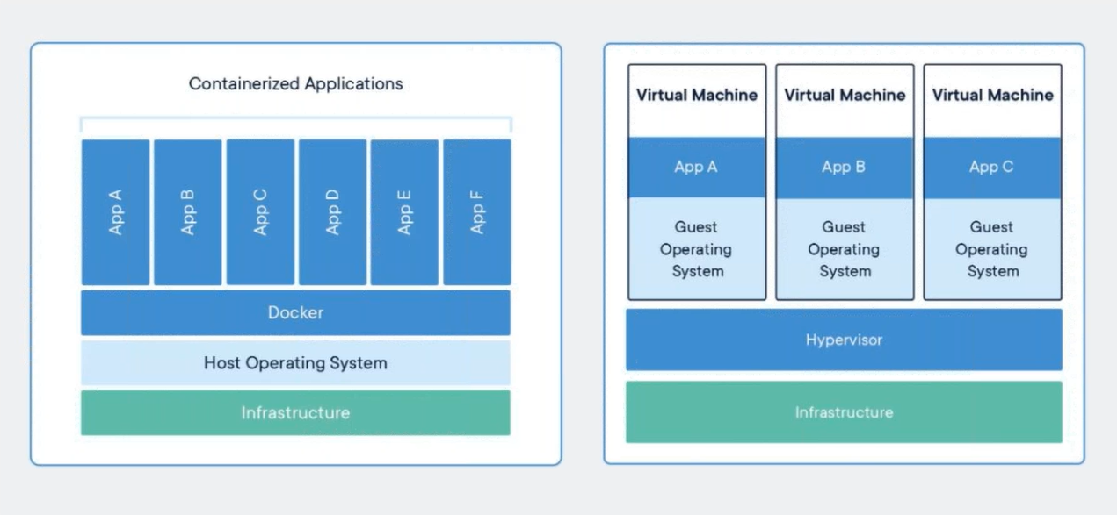

Slide 18
Jenkins
Jenkins is an open-source continuous integration/continuous delivery and deployment (CI/CD) automation software DevOps tool written in the Java Programming language. It is used to implement CI/CD workflows called pipelines.

Slide 19

Summary
With PowerPoint, you can create presentations and share your work with others, wherever they are. Type the text you want here to get started. You can also add images, art, and videos on this template. Save to OneDrive and access your presentations from your computer, tablet, or phone.

Slide 20


Thank You
Abishek S K
abishek.sk@mphasis.com

Slide 21
Content 2
Subtitle
subtitle
subtitle
Add text, images, art, and videos.
Add transitions, animations, and motion.
Save to OneDrive, to get to your presentations from your computer, tablet, or phone.
Open the Design Ideas pane for instant slide makeovers.
When we have design ideas, we’ll show them to you right there.
Add text, images, art, and videos.
Add transitions, animations, and motion.
Save to OneDrive, to get to your presentations from your computer, tablet, or phone.
Open the Design Ideas pane for instant slide makeovers.
When we have design ideas, we’ll show them to you right there.
Add text, images, art, and videos.
Add transitions, animations, and motion.
Save to OneDrive, to get to your presentations from your computer, tablet, or phone.
Open the Design Ideas pane for instant slide makeovers.
When we have design ideas, we’ll show them to you right there.

Slide 22
Timeline
Title
To start a presentation, go to the Slide Show tab, and select From Beginning.
Title
To display Presenter view, in Slide Show view, on the control bar at the bottom left select the three dots, and then Show Presenter View.
Title
During your presentation, the speaker notes are visible on your monitor, but aren't visible to the audience.
Title
Title
If you don’t see the Notes pane or it is completely minimized, click Notes on the task bar across the bottom of the PowerPoint window.
The Notes pane is a box that appears below each slide. Tap it to add notes.

