Slide 1







ETL Process: ETL Automation Using Python
A Comprehensive Approach to Efficient Data Integration
By Abishek Kumar

Slide 2



What is the ETL
ETL stands for Extract, Transform, Load a data integration process used to combine data from multiple sources into a single, centralized location.
Extract
Retrieve data from heterogeneous data sources like databases (Oracle, MySQL) or flat files..
Ensure data integrity by using filters or query-based extraction.
Minimize resource usage with incremental extraction instead of full loads.
Transform
Cleanse data by handling nulls, duplicates, and type mismatches.
Apply business rules to standardize and enrich data for downstream processes.
Ensure schema mapping between source and target to avoid structural conflicts.
Load
Insert transformed data into the destination system, ensuring consistency.
Optimize performance by using batch inserts and parallel processing.
Validate the load process with error tracking and log updates.

Slide 3








ETL is Crucial for Data Management and Analysis.
Data Integration
Historical Data Analysis
Combines data from different sources into a single view.
Enables tracking of data changes over time for better insights.
Data Quality
Compliance and Governance
Cleans and standardizes data to ensure accuracy and consistency.
Cleans and standardizes data to ensure accuracy and consistency.
Improved Accessibility
Scalability
Makes data readily available for analysis and reporting.
Adapts to growing data volumes without losing performance.
Enhanced Performance
Better Decision-Making
Optimizes data for faster query responses and analysis.
Provides reliable data that supports informed business decisions.

Slide 4




Schema :
HR user schema, a sample schema in Oracle used for practice and demos.
Schema :
Public user schema: a sample schema in PostgreSQL used for data loading.
Key Table :
SQL QUERY:
Employees
:
Stores employee details such as employee ID, name, job ID, and salary.
SELECT D.DEPARTMENT_NAME,MAX(E.SALARY),MIN(E.SALARY),AVG(E.SALARY),SUM(E.SALARY),COUNT(*)
FROM EMPLOYEES E,DEPARTMENTS D
WHERE E.DEPARTMENT_ID =D.DEPARTMENT_ID
GROUP BY D.DEPARTMENT_NAME
Departments
:
Contains department IDs, names, and manager IDs.
Jobs
:
Defines job roles, job IDs, titles, and minimum/maximum salary.
(OR)
Locations
:
Holds location IDs, city, and country IDs.
Countries
:
Stores country codes and country names.
Regions
:
Represents regions with region IDs and names.

Slide 5





Tools and Technologies
Data Extraction
Load Process
Data Integration
Python scripts use cx_Oracle to pull data from Oracle databases and psycopg2 for PostgreSQL.
SQLAlchemy provides a unified interface to load the processed data into various databases.
It connects multiple databases, making data integration across platforms seamless.
Transformation
Automation
pandas handles data cleaning, filtering, and transformation tasks efficiently.
Python’s scripting capabilities automate ETL workflows, scheduling, and error handling.

Slide 6








ETL Process
Extract
Load
Transform
Source
Destination

Slide 7
Advantages :
Scalable ETL Process
Supports multiple databases (Oracle, MySQL, PostgreSQL, etc.) and Excel files.
Error Handling
Comprehensive logging and error handling ensure easy tracking of issues.
Data Type Mismatch Checking
Ensures data compatibility between source and destination databases.
Transformations and Data Cleaning
Allows customizable transformations (e.g., handling nulls) before loading data.
Automated Process Logging
Logs ETL status and performance for monitoring and troubleshooting.
Disadvantages :
Complex Configuration
Requires correct database credentials and configurations.
Manual Schema Specification
Needs explicit schema names for some databases.
Error-Prone with Large Datasets
May struggle with very large datasets, leading to memory issues.
Limited to Specific Database Types
Doesn't support all database types (e.g., NoSQL).
Dependency on External Connections
Relies heavily on external DB connections, which can fail or slow down the process.

Slide 8



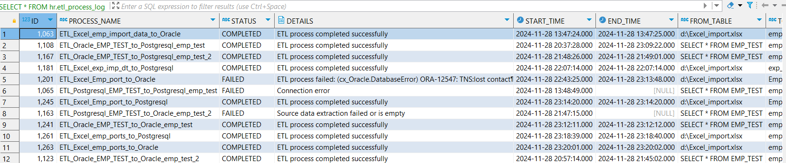
Error Handling and Logging
Identifying Errors :
Finds issues during each step of ETL: extract, transform, and load.
Catches common problems like missing data, wrong formats, or duplicate entries.
Fixing and Alerts :
Allows fixing only the failed parts without starting everything again.
Sends alerts when big problems occur, so they can be fixed quickly.
Keeping Logs :
Records everything: successful actions, warnings, and errors.
Logs include helpful details like time, type of error, and where it happened.

Slide 9

Let’s see a live demo.

Slide 10


Conclusion and Future Scope
Conclusion :
The ETL process successfully manages data extraction, transformation, and loading.
It ensures accurate, clean, and ready-to-use data for decision-making.
Error handling and logging make the system reliable and easy to monitor.
Future Scope :
Automate more steps to make the process faster and reduce manual work.
Integrate with advanced tools for better reporting and visualization.
Add features like real-time data processing and machine learning for smarter insights.

Slide 11

"Thank You!"
Any Questions ?

