Slide 1
ABISHEK P
Final Project
3/21/2024 Annual Review

Slide 2
PROJECT TITLE
Sentiment Analysis for Review Data
3/21/2024 Annual Review

Slide 3


AGENDA
Problem Statement
Project Overview
Who are the end users?
Solutions and value of propositions
WOW factor in the solution
Modelling
Results
3/21/2024 Annual Review

Slide 4

PROBLEM STATEMENT
The problem being addressed is the sentiment classification of reviews into positive or negative sentiments
3/21/2024 Annual Review

Slide 5

PROJECT OVERVIEW
The project aims to build a machine learning model that can automatically classify the sentiment of reviews as positive or negative based on their content..
3/21/2024 Annual Review

Slide 6

WHO ARE THE END USERS?
E-commerce Platforms:
Online retail platforms can utilize the sentiment analysis model to understand customer feedback on products and services.
App Developers:
Developers of mobile applications can employ the sentiment analysis model to analyze user reviews and ratings of their apps.
Service Providers:
Service-oriented businesses, such as restaurants, hotels, or ride-sharing companies, can benefit from the sentiment analysis model to analyze customer reviews and feedback.
Market Researchers:
Market research firms can leverage the sentiment analysis model to analyze consumer sentiment trends across various industries and product categories.
By analyzing sentiment data from online reviews and social media platforms, researchers can identify consumer preferences, market trends, and brand perceptions to inform strategic decision-making and marketing campaigns.
3/21/2024 Annual Review

Slide 7

YOUR SOLUTION AND ITS VALUE PROPOSITION
Your solution employs LSTM-based sentiment analysis to process customer reviews, enhancing understanding of sentiment nuances. By preprocessing and tokenizing text data, it trains a model to predict sentiment accurately. The model undergoes rigorous evaluation to ensure reliability and efficiency in sentiment analysis tasks.
Offering automated sentiment analysis, your solution delivers real-time insights for data-driven decision-making. It empowers businesses to improve customer experiences by promptly addressing feedback and tailoring strategies. Through agile responses to sentiment trends, businesses can optimize products and services, fostering long-term customer satisfaction and loyalty.
3/21/2024 Annual Review

Slide 8

THE WOW IN YOUR SOLUTION
The "wow" factor in this solution lies in its ability to accurately analyze the sentiment of reviews, thereby providing valuable insights for businesses to improve their products or services and enhance customer satisfaction.
3/21/2024 Annual Review
8

Slide 9
MODELLING
Teams cam add wireframes
Data preprocessing: Tokenization and padding of text sequences.
Train-test split: Splitting the data into training and testing sets.
Model architecture: Utilizes an Embedding layer followed by an LSTM layer for sequential data processing.
Model compilation: Specifies loss function, optimizer, and evaluation metric for training.
Model training: Fits the model on the training data.
Model evaluation: Evaluates the trained model on the test data and prints the accuracy.
3/21/2024 Annual Review
9

Slide 10
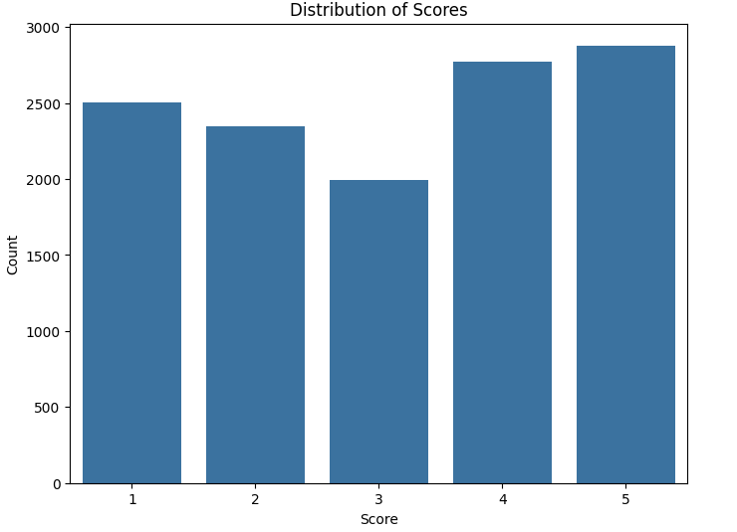
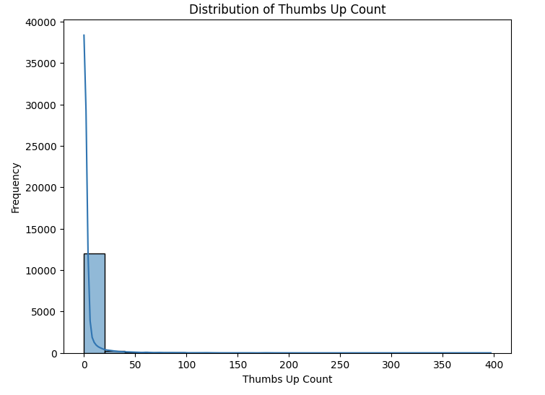
RESULTS
3/21/2024 Annual Review
10

