Slide 1
Global Healthcare Data ETL & Analysis CLIa
By
Abishek M

Slide 2
TABLE OF CONTENTS
INTRODUCTION
PROJECT OVERVIEW
OBJECTIVE
Data source
Technology
SYSTEM ARCHITECTURE
Project structure
etL PROCESS
DATABASE SCHEMA
IMPLEMENTATION DETAILS
Data analysis & results
conclusion

Slide 3
INTRODUCTION
This project delivers a robust command-line tool for the extraction, transformation, loading (ETL), and analysis of global health care data. A public dataset from public API, it automates the collection and cleaning of country-wise daily data statistics, including cases, deaths, and vaccinations. The processed data is structured and stored in a MySQL database, enabling users to easily run analytical queries and track trends directly from the CLI. With modular Python design and clear database schema, the project facilitates fast and scriptable healthcare data analysis for research and reporting purposes.

Slide 4
Project Overview
This project is a Python-based command-line tool that performs ETL (extract, transform, load) operations on global data from the public dataset. It automates the retrieval, cleaning, and storage of daily country-wise data statistics—including cases and vaccinations—into a MySQL database. Users can easily fetch data and run analytics queries via the CLI, providing a fast and reproducible solution for healthcare data analysis and research.

Slide 5
OBJECTIVES
Automate Data Retrieval: Efficiently fetch daily global health case and vaccination data from the Data public dataset.
Data Cleaning and Transformation: Process and normalize raw data to ensure accuracy, consistency, and suitability for analysis.
Reliable Data Storage: Store the cleaned data in a well-structured MySQL database for easy querying and long-term preservation.
Command-Line Analytics: Provide a user-friendly CLI to enable quick, flexible querying and analysis of trends and statistics.

Slide 6
DATA SOURCE
Public Data Provider: Our World in Data (OWID)
API Link: https://github.com/owid/covid-19-data/raw/master/public/data/owid-covid-data.csv
Included Data Points:
Format: CSV / JSON.
Per-country, daily records
Example Fields: date, location, new_cases, new_deaths, total_cases

Slide 7
TECHNOLOGY
Programming Language: Python
Libraries: Requests, Pandas, MySQL Connector
Database: MySQL
Environment: CLI-based application
Tools: VS Code, GitHub

Slide 8
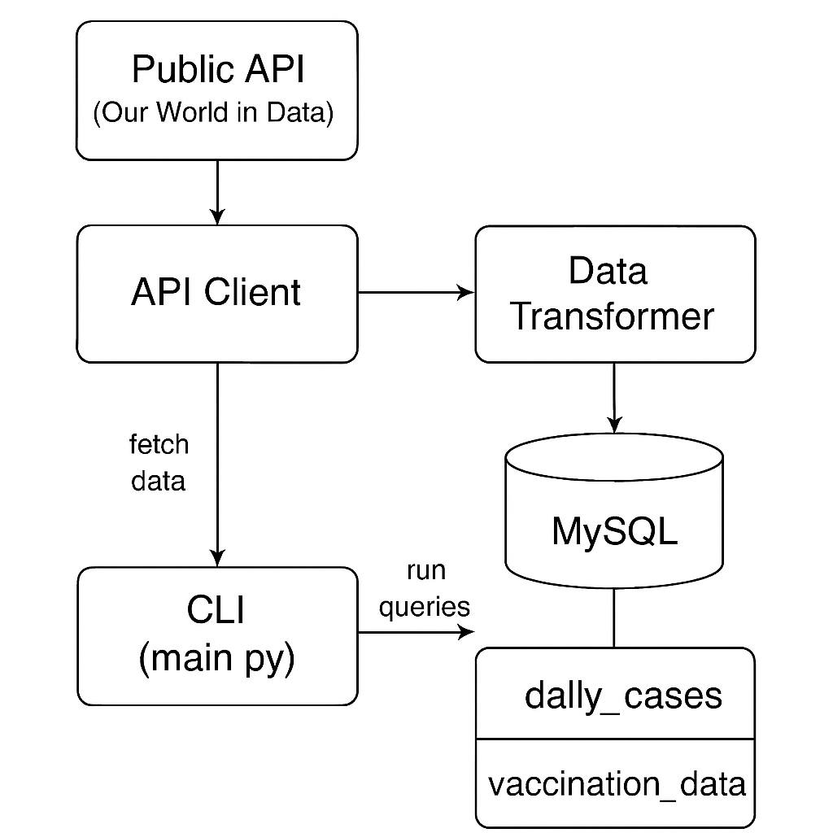
SYSTEM ARCHITECTURE

Slide 9
ARICHTECTURE EXPLANATION
LI Interface (User Input): Main entry point where users enter commands to fetch data, update the database, or view reports.
API Fetcher (OWID COVID-19 API): Retrieves live data from the public API, handling HTTP requests, parsing, and validation.
Database Module (MySQL Storage): Stores cleaned and structured data in MySQL for efficient querying, indexing, and long-term storage.
Analytics Module (Data Processing & Trends): Processes stored data to generate trends, comparisons, and insights using queries and visualizations.
Output (Reports, Charts, CLI Display): Delivers processed results as CLI text, tables.

Slide 10
PROJECT STRUCTURE
main.py: CLI entry point
api_client.py: Extracts data
data_transformer.py: Data cleaning & structuring
mysql_handler.py: Database operations
config.ini: Settings (DB credentials, etc.)
sql/create_tables.sql: Table schemas
requirements.txt, README.md, docs/

Slide 11
ETL PROCESS
Extract: Retrieve COVID-19 data from the API.
Transform: Filter data by country and date ranges.
Transform: Structure data into a standard format ready for storage.
Load: Insert cleaned data into MySQL tables (daily_cases, vaccination_data),
handling duplicates and preserving data integrity.

Slide 12
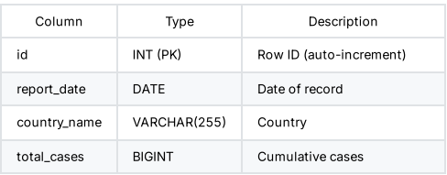
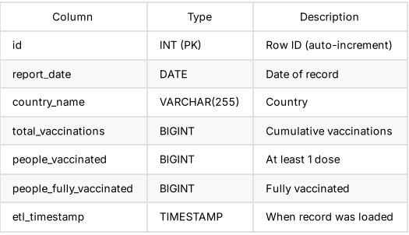
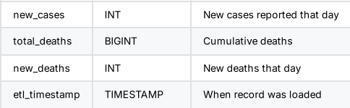
DATABASE SCHEMA
Daily cases:
Vaccination data:

Slide 13
IMPLEMENTATION DETAILS
Data Ingestion:
Fetches raw data CSV from public API
API Client module downloads and loads data into Pandas Data Frame
Data Transformation:
Data Transformer filters by country and date range
Handles missing/null values and converts data types
Normalizes data to fit database schema

Slide 14
Database Storage:
Uses MySQL with two tables: daily cases and vaccination data
MySQLHandler module creates tables, inserts data with duplicate checks, runs queries
Command-Line Interface:
main.py uses arg parse for command parsing
Supports fetching data, querying analytics, listing/dropping tables
Enables flexible user interaction and analysis via CLI commands

Slide 15
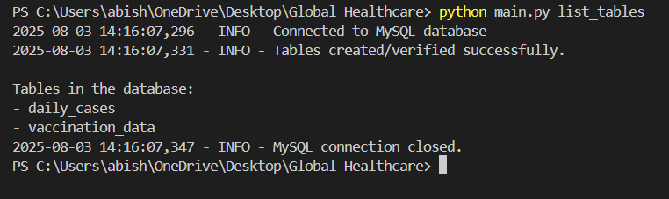
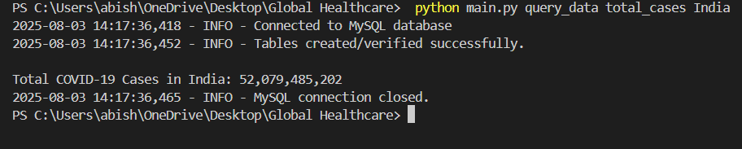
DATA ANALYSIS & RESULTS

Slide 16
CONCLUSION
This project successfully delivers a robust command-line tool for extracting, transforming, and loading global healthcare data into a MySQL database, enabling efficient and reproducible healthcare data analysis. Leveraging a trusted public dataset from public API it provides automated data processing and flexible querying capabilities via a user-friendly CLI. The modular design ensures maintainability and extensibility, making it a valuable resource for researchers and analysts. Future enhancements can further improve performance, usability, and analytical depth.

