Slide 1
Benchmarking Machine Learning for Anomaly-Based Intrusion Detection
Teammates:
22MIA1003 - Abishek R
22MIA1014 - M Vishal

Slide 2
Introduction
An Intrusion Detection System (IDS) is a critical tool for identifying complex network attacks. Over time, various machine learning (ML) and deep learning (DL) algorithms have been proposed to implement anomaly-based IDS (AIDS), which detects abnormal activities in networks. However, many existing studies suffer from limitations such as randomness in algorithm selection, outdated datasets, and superficial analysis. This research aims to address these issues by conducting a comprehensive review of AIDS approaches, benchmarking the performance of 10 ML models using different datasets and attack types. The study focuses on identifying the most effective and efficient ML-AIDS models for network and computer intrusion detection, using supervised and unsupervised algorithms tested with the highly unbalanced CICIDS2017 dataset.

Slide 3
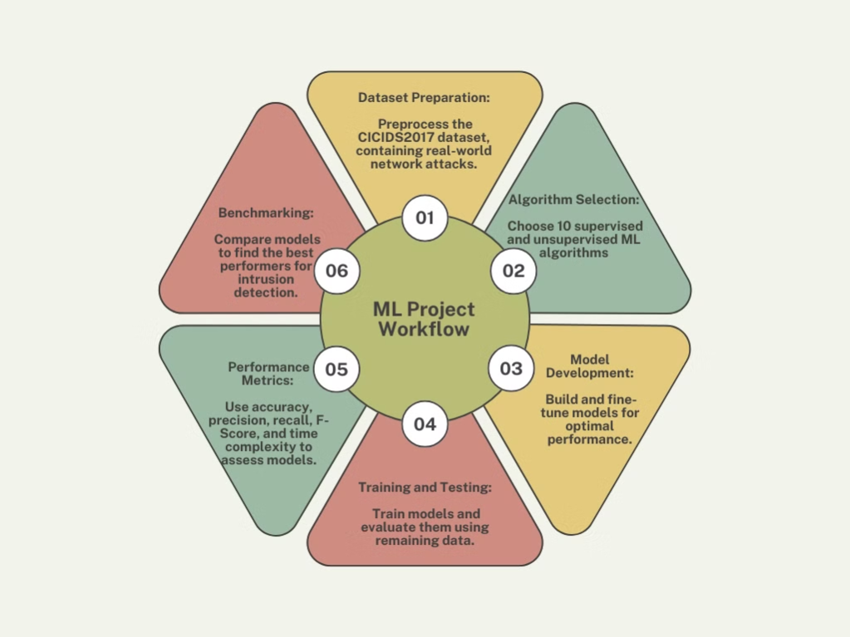
Project Workflow

Slide 4
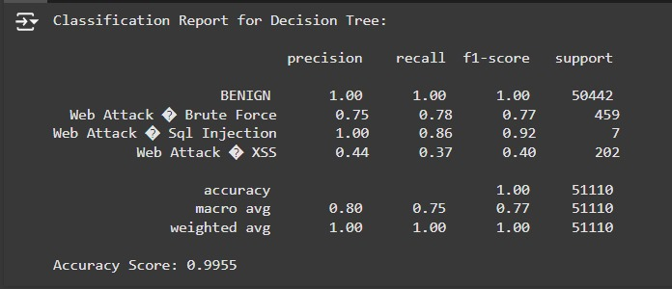
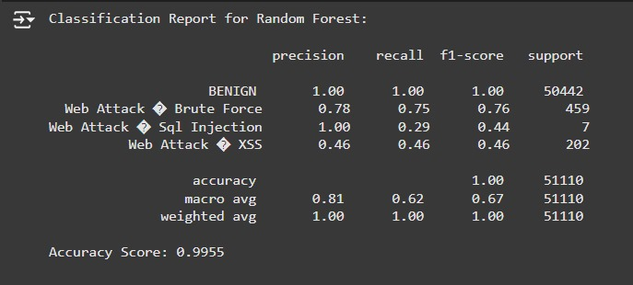
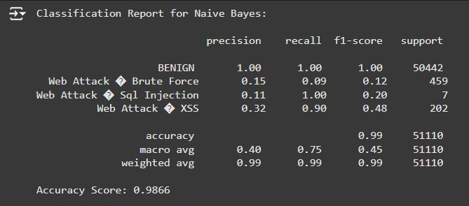
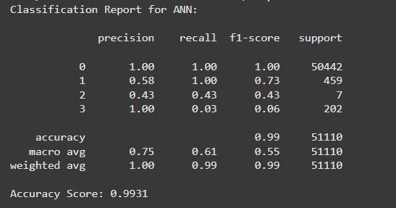
Evaluation Metrics For Supervised Models
Decision Tree
2. Random Forest
3. Naive Bayes
4. ANN

Slide 5
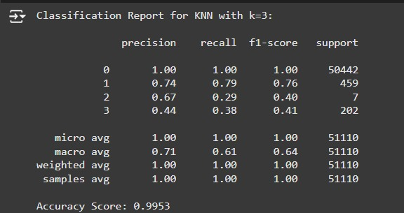
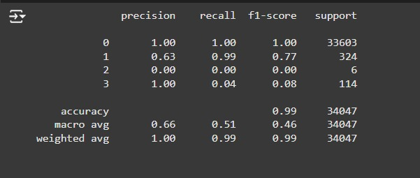
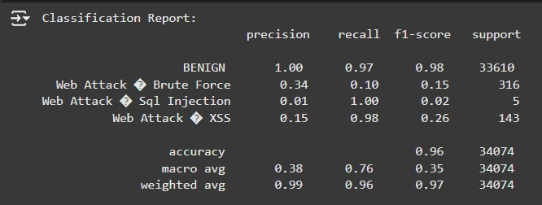
Evaluation Metrics For Supervised Models
5. KNN
6. CNN
7. SVM

Slide 6
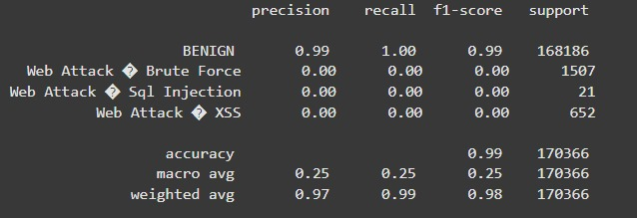
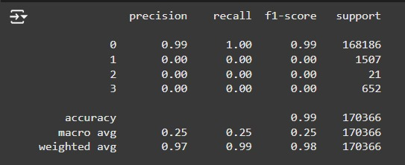
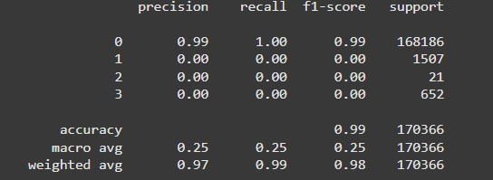
Evaluation Metrics For Unsupervised Models
8. K-Means
9. EM
10. SOM

Slide 7
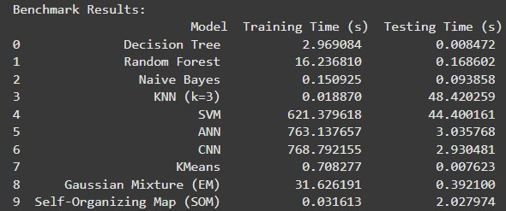
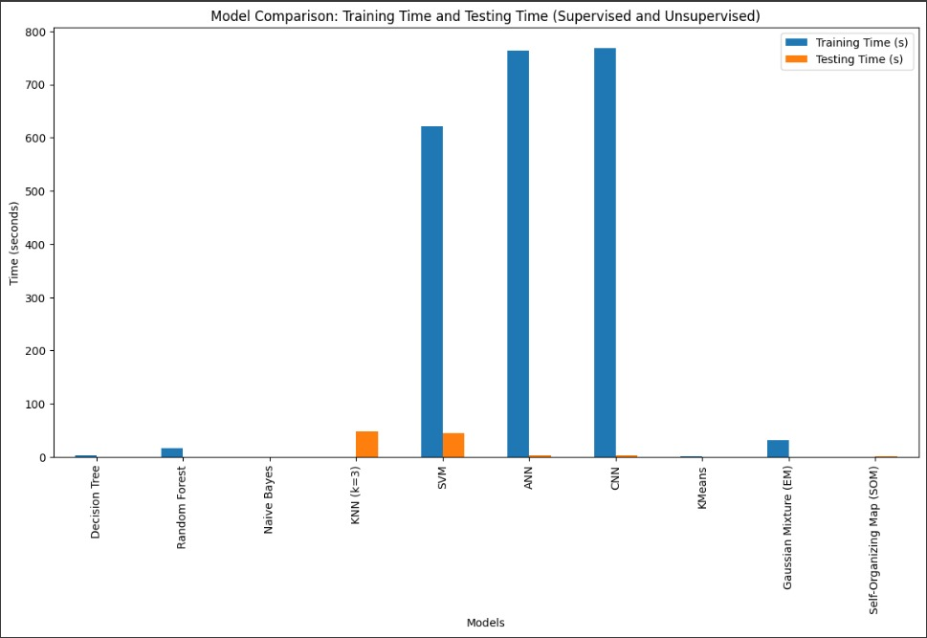
Benchmark Results:
Comparison of Model Training and Testing Efficiency

Slide 8
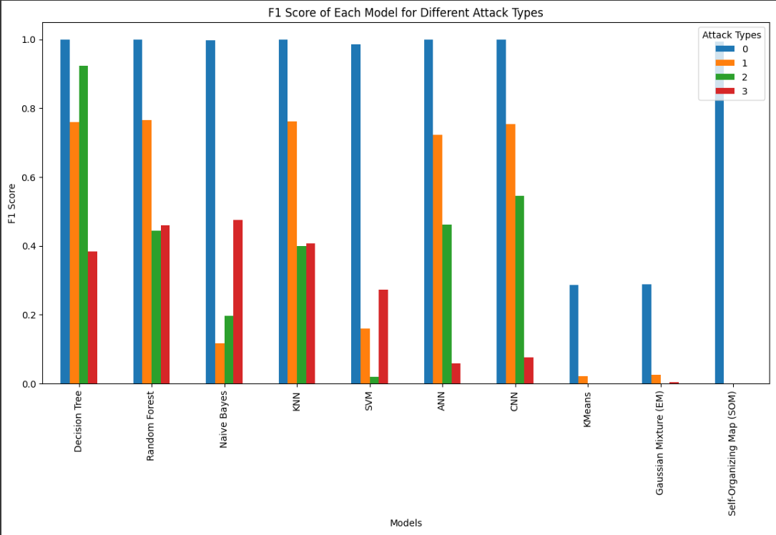
Comparison of F1 Scores of Different Attack Types

Slide 9
Experimental Results
The experiments evaluated the performance of 10 ML-AIDS models using the CICIDS2017 dataset. The k-nearest neighbor (k-NN), decision tree (DT), and Random Forest (RF) models outperformed other models, showing superior ability in detecting web attacks. These models achieved the highest results in terms of accuracy, precision, recall, and F-Score. Additionally, the study considered time complexity, noting the training and testing times for each model. Models like k-NN-AIDS, DT-AIDS, and RF-AIDS not only demonstrated better detection capabilities but also showed efficiency in processing times. Other models yielded irregular and inferior results when tested with this multiclass, real-world dataset.

