Slide 1
Book1
File created on: 3/6/2022 8:06:42 PM

Slide 2
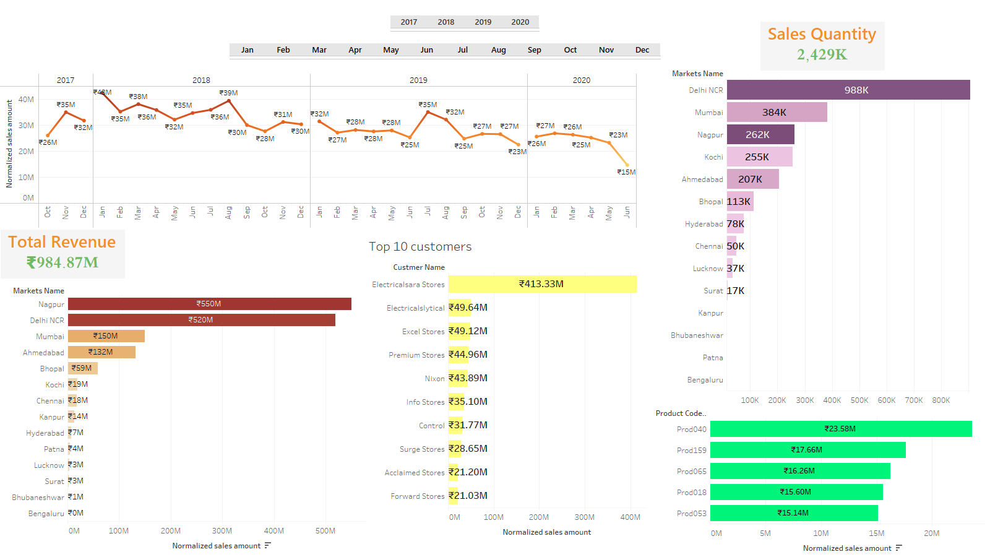

Slide 3
