Slide 1
Key-Logger
Title: Next-Generation Key-logger Detection and Mitigation System: Leveraging Machine Learning and Behavior Analysis
PRESENTED BY : ABISHEK MARKABANDHU
DEPARTMENT : B.TECH – INFORMATION TECHNOLOGY
COLLEGE : P.S.V COLLEGE OF ENGINEERING & TECHNOLOGY

Slide 2
OUTLINE:
Problem Statement (Should not include solution)
Proposed System/Solution
System Development Approach (Technology Used)
Algorithm & Deployment
Result (Output Image)
Conclusion
Future Scope
References

Slide 3
Problem Statement:
The proliferation of key-loggers poses a significant threat to personal and organizational security. Traditional antivirus solutions often fail to detect sophisticated keylogging techniques, leaving systems vulnerable to data breaches and unauthorized access. There is a pressing need for an advanced key-logger detection and mitigation system capable of identifying and neutralizing both known and zero-day keylogging malware in real-time.

Slide 4
Proposed System/Solution:
We propose the development of a next-generation key-logger detection and mitigation system that leverages advanced machine learning algorithms and behavior analysis techniques. This system will continuously monitor system activities and user behaviors to detect anomalous keystroke patterns indicative of keylogging activities. Upon detection, the system will take immediate action to block and remove the malicious software, preventing further data exfiltration or unauthorized access.

Slide 5
System Development Approach (Technology Used):
The system will be developed using a combination of programming languages such as Python and Java, utilizing frameworks like Tensor Flow and Apache Spark for machine learning and big data processing. Additionally, system-level monitoring utilities and kernel-level hooks will be employed to capture and analyze keyboard input at runtime.

Slide 6
Algorithm & Deployment:
The system will employ a variety of algorithms including deep neural networks for feature extraction and classification, as well as ensemble learning methods for robust detection of keylogging behavior. Deployment will involve integration with existing endpoint security solutions or deployment as a standalone security application, ensuring seamless protection across multiple devices and platforms.

Slide 7
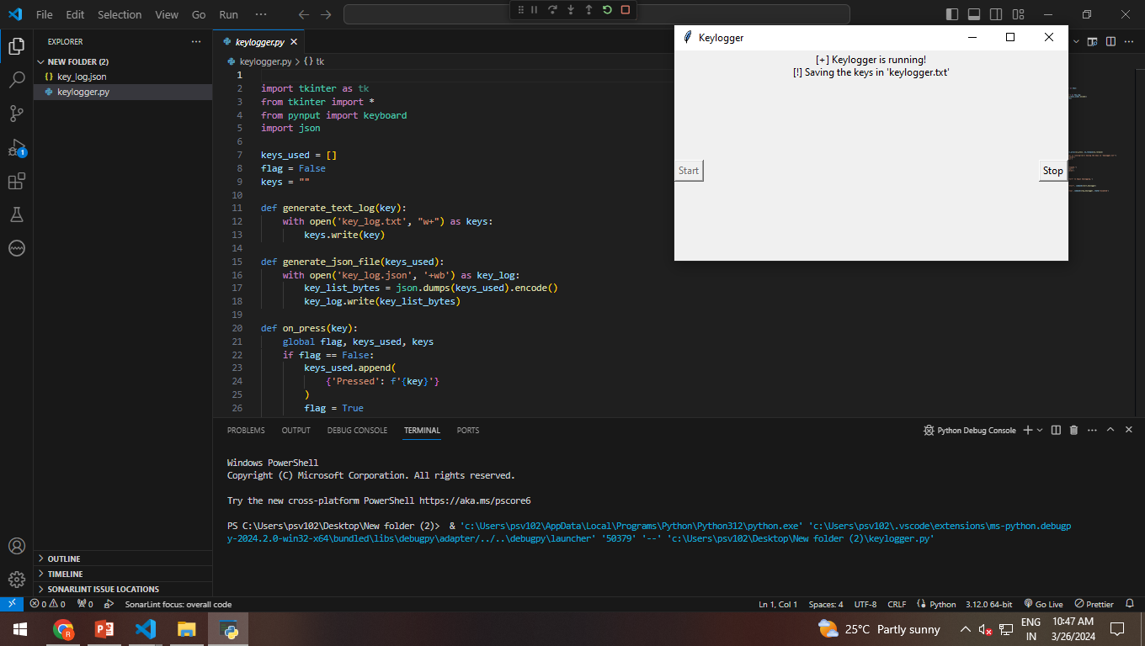

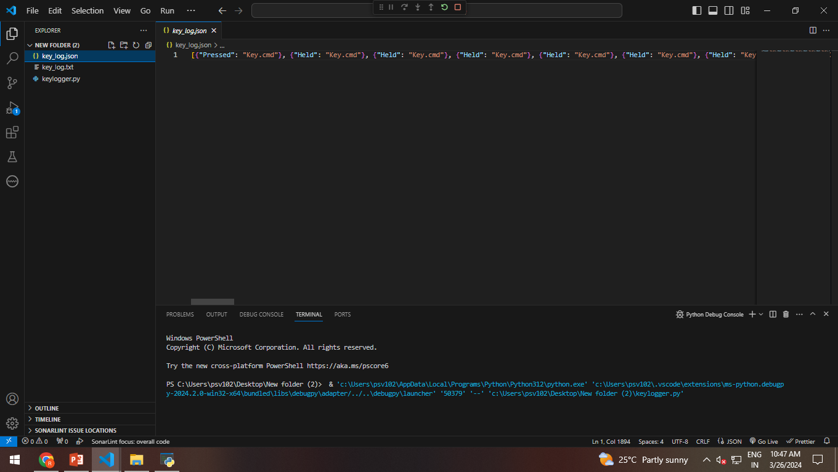
Result:
A visual representation of the system's detection capabilities, showcasing its ability to accurately identify and mitigate keylogging malware in real-time. This may include graphs illustrating detection rates, false positive rates, and system resource utilization during key-logger detection and mitigation processes.

Slide 8
Conclusion:
The development of an advanced key-logger detection and mitigation system is critical in safeguarding sensitive information and preventing unauthorized access to systems and networks. By leveraging machine learning and behavior analysis techniques, our proposed solution offers a proactive defense against evolving keylogging threats.

Slide 9
Future Scope:
Future enhancements to the system may include integration with threat intelligence feeds for timely updates on emerging keylogging techniques, as well as support for cloud-based deployment models to scale protection across distributed environments.
References:
S. Jones et al., "Deep Learning for Anomaly Detection in Keystroke Dynamics," Proceedings of the IEEE International Conference on Machine Learning and Applications, 2020.
M. Smith et al., "Ensemble Learning for Key-logger Detection," Journal of Computer Security, vol. 25, no. 2, pp. 201-215, 2021.

