Slide 1


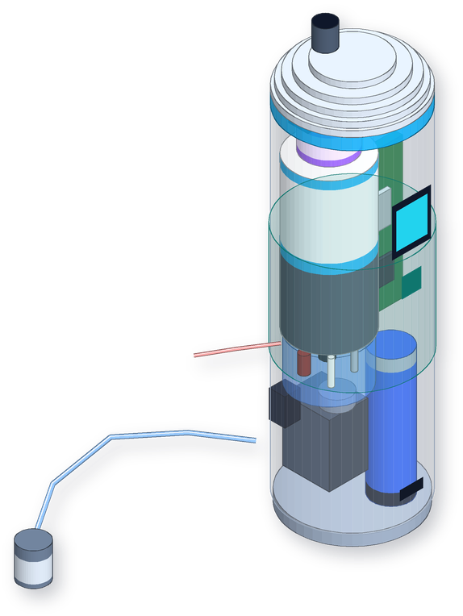
HYDRA NEXUS
STAGE 2 SUBMISSION
An Intelligent Water Quality Identification, Adaptive Purification and Verification System
Identify. Purify. Verify.
A POCKET-SIZE WATER CAPSULE THAT CHECKS ITS OWN WORK
Vishwakarma Application ID
To be added before submission
Team ID
To be added before submission
Track / category
To be confirmed by the team
Institution / team
To be added by the team
The idea in one line: a capsule you carry in your pocket that tests water, filters it, and then tests it again before it lets you drink it.
Concept render of the capsule. This is a design illustration, not a built prototype.

Slide 2



Problem Context: What We Set Out to Fix
HYDRA NEXUS · STAGE 2
6.5 – 8.5
500 mg/L
1 NTU
Twice
SAFE pH RANGE*
TDS LIMIT*
TURBIDITY LIMIT*
WE TEST THE SAME WATER
*Acceptable limits from the Indian drinking-water standard, IS 10500:2012. We use them as reference points, not as our own results.
The project and the problem
Who it is for, and how things work today
Project: Hydra Nexus, an intelligent water quality identification, adaptive purification and verification system.
Team ID: to be added before submission
Track: to be confirmed by the team
Our idea: a small capsule that runs one loop every time: identify, decide, purify, verify, compare.
The problem
Water changes from one source to the next, and from season to season. Lab tests are slow, costly or simply not nearby.
Most purifiers run the same process on every glass of water, without checking what came in.
People rarely have an easy way to see whether the treatment actually made a difference.
Who: families on changing water sources, rural communities, schools, small institutions and small community water plants.
How they would use it: carry the capsule to the tap, well or tank, and check and treat the water right there.
Today: nobody knows exactly what is in the water, testing is slow, the filter does the same thing every time, and nobody checks the result.
What exists: labs test but do not treat. Meters measure but do not treat. Filters treat, but rarely tell you what changed.
Before we submit: our Application ID, Team ID and Track still need to be filled in on slides 1 and 2.

Slide 3

Problem Context: The Gap, and How We Will Measure It
HYDRA NEXUS · STAGE 2
Why test the water twice?
Putting numbers on the problem
A NORMAL FILTER
What we will measure | How we will measure it | We report it as | Status
How long until you know about your water | Time a sample from collection to result: lab, handheld meter, and our capsule | Minutes per sample | Not yet measured
How long one full cycle takes | Log the time from intake to clean water out, for 250 mL | Minutes per 250 mL | Not yet measured
How much pH, TDS and turbidity change | Before and after readings, at least 3 runs per kind of water | Average change, with spread | Not yet measured
How fast a bad treatment gets noticed | Count cycles until our capsule stops a run; a normal filter never does | Cycles or minutes | Not yet measured
How many steps a person has to do | Walk through both ways of checking water and count the steps | Number of steps | Not yet measured
How steady the sensors are | 10 repeat readings in reference liquids, and drift over 4 hours | Spread and drift per hour | Not yet measured
Raw water
Same filtering every time
You hope it worked
HYDRA NEXUS
Test it first
Filter it to suit
Test it again
Pour or warn
One test tells you about the water. It does not tell you whether the treatment worked.
Testing the same water before and after shows exactly what that one run changed.
If nothing improves, the cartridge is probably worn out, and we catch it before anyone drinks.
If something is outside what our sensors can check, we say so and suggest a proper lab test.
We are not quoting any baseline numbers yet. We could not find published figures that compare fairly with our setup, so we will measure them ourselves in Months 3 and 4.
How: we will run the same water samples through the usual method and through our capsule, so the difference comes from measurement, not guesswork.

Slide 4
User Journey: Before and After Hydra Nexus
HYDRA NEXUS · STAGE 2
BEFORE HYDRA NEXUS
Water quality is unknown or keeps changing
People can’t tell what is in it
The filter does the same thing every time
Water gets treated
No one checks the result
People are left guessing
Rain, season and source all change it
Tests are slow, costly or far away
One process for every sample
No feedback while it runs
A worn-out filter can go unnoticed
Trust instead of proof
AFTER HYDRA NEXUS
Water goes in
The intake hose pulls in a small sample and sends it to the test cell
IDENTIFY
We measure pH, TDS, cloudiness and temperature of the raw water
DECIDE
The controller checks the readings and picks the flow speed and UV dose
PURIFY
The pump pushes water through carbon, a fine membrane and UV light
VERIFY
Treated water goes back through the same test cell
COMPARE
The capsule pours the water only if it really improved
What changes for the person using it
On the screen and in the app: what the water was like, what we did, and what it is like now
They can test and clean water wherever they are, with something that fits in a pocket.
They see what was in the water, what the capsule did about it, and how much it changed.
They get a warning before drinking if the water did not improve, or if we cannot test for something.
It got better
the water is poured, and we only claim what we measured
It didn’t
we stop and suggest a second run, a new cartridge, or a lab test
From our Stage 1 idea: people should not have to simply trust a purifier. They should be able to see what it actually did to their water.

Slide 5

User Journey: How We Will Judge It
HYDRA NEXUS · STAGE 2
What we check | How we test it | Our target | Status
Every run has before and after readings | Go through the log for each run | Both readings saved for every single run | To be tested
Sensors give the same answer twice | 10 readings in pH 4 and pH 7 buffer and a TDS reference liquid | Within 0.1 pH and 10% for TDS (the makers’ stated accuracy) | To be tested
Sensors settle quickly | Move the probes between reference liquids and time it | A steady reading within about a minute (mini pH probe still to be checked) | To be tested
Old water doesn’t spoil the second test | Run very salty water, flush with 15 mL of clean water, then compare | Less than 2% of the old reading left over | To be tested
One cycle doesn’t take too long | Time a 250 mL run from start to finish | Three minutes or less | To be tested
How much the water improves | Before and after readings, 3 or more runs per water type | We report what we see; we assume nothing | To be tested
How long the battery lasts | Run cycles back to back from a full charge | At least 30 runs (our estimate is about 50) | To be tested
Faults are caught | Run it dry, block the cartridge, unplug a sensor, wet the electronics area | Everything switches off within 2 seconds | To be tested
What we write down for every run
Sample name and where it came from
First readings: pH, TDS, cloudiness, temperature
What the capsule chose to do, and why
How long it ran, how much water, how much battery
Final readings after treatment
How consistent the repeat readings were
Anything that went wrong
What our sensors can’t tell you
pH, TDS and cloudiness can’t prove water is free of germs or harmful chemicals. We only report what we measure, and we suggest a lab test when that matters.
Please note: every number on this slide is a target we will test against. None of them are results yet.

Slide 6
System Architecture: How the Capsule Works
HYDRA NEXUS · STAGE 2
Water
Sensor data
Commands
Moving part
Intake hose
with a 40 µm mesh at the tip
Small pump
runs on 5–6 V
Valve 1
test or treat
Filter cartridge
carbon plus a fine membrane
UV-C light
optional, locks with the cap
Valve 2
test again or pour
Spout
opens only after the check
Safety sensing
battery, pump current, leaks
Switches
turn the pump, valves and UV on and off
One small test cell (about 3 mL), used twice
pH, TDS, cloudiness and temperature. First the raw water through valve 1, then the treated water through valve 2.
Waste outlet
test and rinse water
THE BRAIN: ESP32-C3
a small Wi-Fi and Bluetooth chip
Check the readings
are they sensible and steady?
Choose the treatment
flow speed, UV dose, cartridge advice
Compare before and after
did the water really improve?
Keep it safe
leaks, running dry, blockages, battery, UV lock
What you see: a small screen, a light ring, one button, and a phone app with your history
ALL GOOD: WATER POURS
the change is what we wanted
/
NOT GOOD: STOP AND ADVISE
run again, change the cartridge, or get a lab test
What the first test shows | What the capsule does | If the cartridge can’t fix it
Readings look wrong or jumpy | Doesn’t treat; tests twice more | Warns about a sensor problem
Water is cloudy | Slows the flow; uses UV only once it is clear | Stops and suggests letting it settle
Water is clear | Normal flow, UV on if fitted | Nothing extra needed
TDS above 500 mg/L, or pH outside 6.5–8.5 | Treats as normal and flags it | Explains the cartridge can’t change this; suggests a test
Second test shows no improvement | Doesn’t pour the water | Suggests a new cartridge or a lab test
Why this loop matters
The same sensors test the water before and after, so we never just assume the filter worked.
Water only comes out once the second test passes.

Slide 7
System Specs: Targets and Parts We Chose
HYDRA NEXUS · STAGE 2
Area | What we are aiming for | Parts we plan to use | How we will check it
Size | About 60 mm wide and 210 mm tall for the first version, shrinking to about 50 × 170 mm; under 400 g | 3D-printed PETG body, with the wet parts kept separate from a sealed electronics section | Measure and weigh version 1
Controller | Low power, Bluetooth for the phone app, sleeps between uses | ESP32-C3 (the WROOM-02 module in our schematic; the smaller MINI-1 for the final build) | Power it up and measure sleep current
Sensors | One 3 mL test cell used twice; pH within 0.1, TDS within 10%, temperature within 0.5 °C | Small pH probe (supplier still to find) with a DFRobot pH board and isolator, DFRobot TDS board, our own infrared cloudiness sensor, DS18B20, ADS1115 | Calibrate with buffer liquids and turbidity standards
Water path | 250 mL per run at 0.2–0.4 L per minute, with a 15 mL rinse before the second test | Hose and mesh, pump, valve 1, cartridge, UV, valve 2, spout; test water goes to the waste outlet | Flow test and leftover-water test
Treatment | Adjust flow speed, UV dose, suggest a second run or a new cartridge | Twist-off cartridge with activated carbon and a hollow-fibre membrane; optional UV-C LED | Check each treatment route with clean water
Pump and valves | Primes itself, stops within 3 s if dry, spots blockages from pump current | Small 5–6 V diaphragm pump, two small 3-way valves, INA219 current sensor | Dry-run and blockage tests
Power | At least 30 runs per charge, USB-C charging; temperature-safe charging in the next version | One protected 18650 battery, MCP73831 charger, 3.3 V and 5 V supplies, battery level check | Battery life test
Waterproofing | Electronics fully sealed off from the water; aiming for IPX7 | O-ring wall, sealed cable passages, sealed USB-C, a leak sensor inside | Dunk test planned; not tested yet
Comparison | Average 30 readings, compare before and after, pour only if it passes | Code on the ESP32-C3, with limits from IS 10500:2012 | Test with water we already know
Display | Result shown within a second; history kept in the app | Small OLED screen, light ring, one button, phone app (still to build) | Try it out with real users
Conditions | Water and air between 5 and 40 °C; you dip it in, or pour water into a cup | Limited by the probes and the battery | Temperature check
ONE 250 mL RUN, STEP BY STEP
Take a sample
Test it
Check readings
Pick a treatment
Treat
Rinse and retest
Compare
Pour or warn
Battery maths (our estimate): pump 1.5 W, UV 1 W and electronics 0.4 W for 3 minutes is about 0.15 Wh per run. A 18650 holds about 10.8 Wh, so roughly 50 runs (12 litres) per charge.

Slide 8
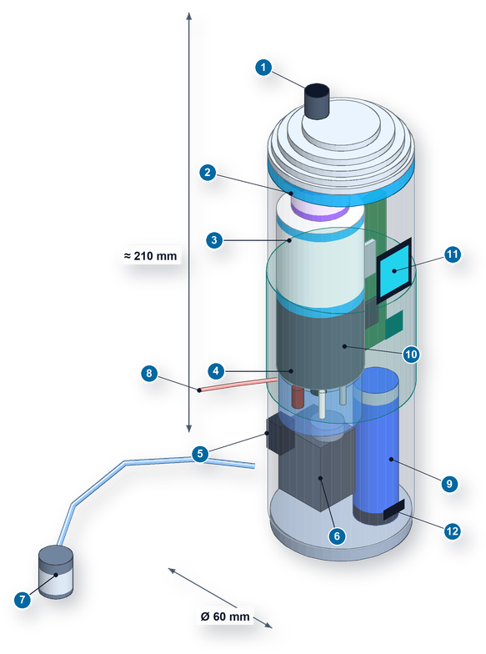
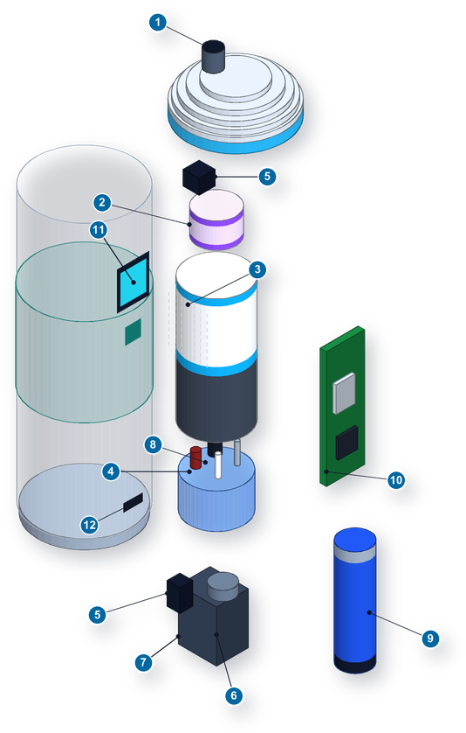
CAD Design: The Capsule, Inside and Out
HYDRA NEXUS · STAGE 2
What each part is
1
Spout in the top cap, with a status light ring
2
UV-C light chamber with a quartz window (optional)
3
Twist-off filter: carbon and a fine membrane
4
Test cell for pH, TDS, cloudiness and temperature
5
Valve 1 (test or treat) and valve 2 (retest or pour)
6
Small pump
7
Intake hose with a weighted mesh tip
8
Waste outlet for test and rinse water
9
Battery (18650), in the sealed dry side
10
Circuit board with the ESP32-C3
11
Small screen and button on the side
12
Sealed USB-C port for charging
Water path: hose (7), pump (6), valve 1, filter (3), UV (2), valve 2, spout (1). Test water goes through the cell (4) to the waste outlet (8).
Changing the filter: unscrew the cap and give the cartridge a quarter turn.
Size: about 60 × 210 mm now, aiming for 50 × 170 mm.
The capsule put together, with rough sizes
Taken apart: cap, cartridge, test cell, pump, electronics
About these pictures: they are concept renders. Our actual parametric FreeCAD model is in the project repository, and there is a screenshot of it on slide 13.

Slide 9

Mechanical Specs: Materials and Our Checks
HYDRA NEXUS · STAGE 2
Part | Material we picked | Why | Status
Body and cap | 3D-printed PETG for now; moulded PP or Tritan-type plastic later | Tough and light; easy to print today, easy to mould later | Need to confirm it is food-safe
Water tubes | PP fittings and platinum-cured silicone tube, 3 mm inside | Bends around tight corners and is safe with water | Need the supplier’s certificate
Test cell | Clear acrylic with an infrared window; titanium or stainless-steel pins | Clear enough for the cloudiness sensor; pins that won’t rust | Our choice
UV-C chamber | Quartz window with a PTFE reflector | UV-C damages most plastics, but passes through quartz | Need supplier data
Cartridge and seals | PP housing with twist-lock tabs; EPDM or silicone O-rings | Quick to swap, and it seals well | Need to confirm
Electronics side and grip | Flame-retardant PC/ABS, a silicone grip sleeve, stainless screws | Protects the battery; easy to hold when wet | Our choice
Our rough calculations and planned tests
1. Weight: body 120 g, wet cartridge 90 g, battery 47 g, pump 40 g, valves 30 g, board and screen 25 g, UV 15 g, test cell 30 g. That is about 400 g. These are estimates; we will weigh the real parts.
2. Pressure loss in the tubes: at 0.3 L per minute through a 3 mm tube, water moves at about 0.7 m/s and the flow is smooth (Re about 2,100). That costs only about 0.008 bar over our 0.3 m of tube. The membrane matters far more, so we watch it through the pump current.
3. Leaks: pressurise it to 1.5 times the pump’s maximum for 10 minutes. The electronics side must stay completely dry.
4. Water and drops: a 1 m, 30-minute dunk test (planned), and dropping it from 1 m onto each side with a full cartridge.
5. Twist-lock and joints: easy to turn (under 1 N·m), survives 500 twists, and every tube joint gets a pull test.
6. Stress analysis: not done yet. We will check the body in a drop and the twist-lock tabs, aiming for a safety factor of at least 2.
We weighed safety with water, rust, how easy it is to make, leaks, upkeep, weight and cost. Before we lock anything in, we need supplier sheets showing each material is safe for drinking water between 5 and 40 °C.
To be clear: we have not done any FEA yet and we are not claiming safety factors. These are hand calculations with our assumptions shown, and real measurements will replace them.

Slide 10
Electronics: Schematic Overview and Pin Map
HYDRA NEXUS · STAGE 2
USB-C port
charging, programming, downloading logs
ESP32-C3
Wi-Fi and Bluetooth
Sensor bus pins 6, 7
Temperature pin 21
Pump pin 10
Valves pins 4, 5
UV light pin 1
IR light pin 0
TDS power pin 3
Button, lights pins 9, 20
Leak sensor pin 2
USB pins 18, 19
ADS1115 converter
reads pH, TDS, cloudiness and battery level
Pin | Used for | Note
6, 7 | Sensor bus (I²C) | Converter, current sensor, screen
21 | Temperature probe | Sits in the test cell
10 | Pump | Starts gently
4, 5 | Valves 1 and 2 | With no power, water goes to waste
1 | UV light | Only with water flowing and cap locked
0 | Infrared light | Pulsed, to ignore room light
3 | TDS board power | Off while pH is read
9, 20 | Button, light ring | Pin 9 also sets boot mode
2 | Leak sensor | Normally high
18, 19 | USB data | Through the USB-C port
Charger (MCP73831)
charges at 500 mA
DS18B20
temperature, inside the test cell
18650 battery
built-in protection, fuse, level check
INA219
watches pump current to spot blockages or running dry
Small OLED screen
shows the result on the capsule
3.3 V supply
chip, sensors, screen
5 V supply
pump, valves, UV
Simple inputs
button, leak sensor, cap-locked switch
Sleeps between uses; one button press wakes it up
Keeping water away: sensor wires pass through sealed holes in the inner wall. The pH sensor runs on an isolated supply so it doesn’t pick up noise.
Failing safe: if the valves lose power, water goes to the waste outlet. A fault can never pour untested water.
Five electronic switches (MOSFETs)
let the 3.3 V chip turn the pump, valves and lights on and off, with diodes to protect against voltage spikes
What they power (5 V)
pump, two valves, UV-C light (only when the cap is locked), infrared light
A simplified block view. Our full KiCad schematic has 75 parts and passes KiCad’s electrical check with no errors or warnings. It is in the repository (see slide 13).
If something goes wrong: a leak, running dry, a blockage, a bad sensor, overheating or a flat battery switches off the pump and UV, sends water to waste, and shows an error.

Slide 11
Bill of Materials: First Prototype
HYDRA NEXUS · STAGE 2
Part | What exactly | Qty | Unit cost | Total | Where from | Status
Controller | ESP32-C3 module (WROOM-02 now, MINI-1 later) | 1 | Need a quote | — | Local electronics shop | Chosen, not bought
pH kit | DFRobot SEN0161-V2 (board, test probe, buffers) | 1 | US$39.50 | US$39.50 | DFRobot | Listed price, 24 Oct 2026
Small pH probe | Under 8 mm wide, to fit our test cell | 1 | Need a quote | — | Still looking | Most important to find
TDS sensor | DFRobot SEN0244, pins fitted into our cell | 1 | US$11.80 | US$11.80 | DFRobot | Listed price, 24 Oct 2026
Temperature | DFRobot KIT0021 waterproof DS18B20 | 1 | US$7.50 | US$7.50 | DFRobot | Listed price, 24 Oct 2026
pH isolator | DFRobot DFR0504 | 1 | US$19.90 | US$19.90 | DFRobot (check stock) | Listed price, 24 Oct 2026
Cloudiness sensor | Our own IR LED and light sensor; DFRobot SEN0189 to compare against | 1 + 1 | US$9.90 (ref.) | US$9.90 | DFRobot and local | Reference priced
Measurement chips | ADS1115, INA219, MCP6001, battery level resistors | 1 set | Need a quote | — | Local electronics shop | Chosen, not bought
Pump | Small 5–6 V self-priming diaphragm pump, food-safe inside | 1 | Need a quote | — | Still looking | Chosen, not bought
Valves | Small 3-way valves, 5–6 V | 2 | Need a quote | — | Still looking | Chosen, not bought
Filter cartridge | Twist-off carbon and hollow-fibre membrane, plus a 40 µm mesh | 1 + spare | Need a quote | — | Filter supplier | Chosen, not bought
UV-C light | UV-C LED, driver and quartz window | 0–1 | Need a quote | — | Still looking | We decide in Month 1
Power | 18650 battery, MCP73831 charger, 3.3 V and 5 V supplies, fuse | 1 set | Need a quote | — | Local electronics shop | Chosen, not bought
Switches and display | MOSFETs and diodes; small OLED, light ring, button | 1 set | Need a quote | — | Local electronics shop | Chosen, not bought
Body and plumbing | PETG print, acrylic cell, silicone tube, O-rings, grip | Lot | Need a quote | — | We print it ourselves | Chosen, not bought
Priced so far | Only the 5 parts with a public price |  |  | US$88.60 | Before shipping and taxes | Not the full cost
Where we stand: we can’t give a full budget until we get quotes for the remaining parts. Every choice here still needs the whole team’s sign-off.

Slide 12
Maker Journey: From Stage 1 Idea to Stage 2 Design
HYDRA NEXUS · STAGE 2
1
2
3
4
5
6
7
8
9
10
Came up with the loop idea
Chose a pocket-size water path
Planned the ESP32-C3 setup
Picked sensors and filter
Made the CAD model and schematic
Wired the sensors on a bench
Code the pump and valves
Code the test-and-compare logic
Build the first capsule
Test the full capsule
Done
Designed on paper, waiting for team sign-off
Still to do, Months 1 to 4
How the idea grew from Stage 1
Where we honestly are
Size: “a compact prototype” became a pocket capsule, with the electronics sealed away from the water and a twist-off filter.
Checking: instead of two separate test chambers, one cell tests the water twice, so both readings come from the same sensors.
Adapting: the first test sets the flow speed and UV dose, and decides whether to suggest a second run or a new filter.
Pour only if it passes: water leaves the spout only after the second test; anything else goes to the waste outlet.
Safety and honesty: leak, dry-run, blockage and battery protection, plus a clear warning when the filter can’t fix TDS or pH.
Stage 1 was a proposal and a plan.
On 25 Oct 2026 we made the FreeCAD model and the KiCad schematic (which passes its electrical check). We used AI tools to help, and our team will go through both.
We have wired the pH, TDS and turbidity sensors to an ESP32 board on a breadboard and tried them in water (photos on slide 13). We haven’t logged any measured results yet.
Steps 7 to 10 (code, building the capsule and full testing) are still ahead of us.
Where we stand: the design files exist and our sensors are running on a bench setup (steps 5 and 6). The capsule itself isn’t built yet, and we aren’t claiming test results.

Slide 13
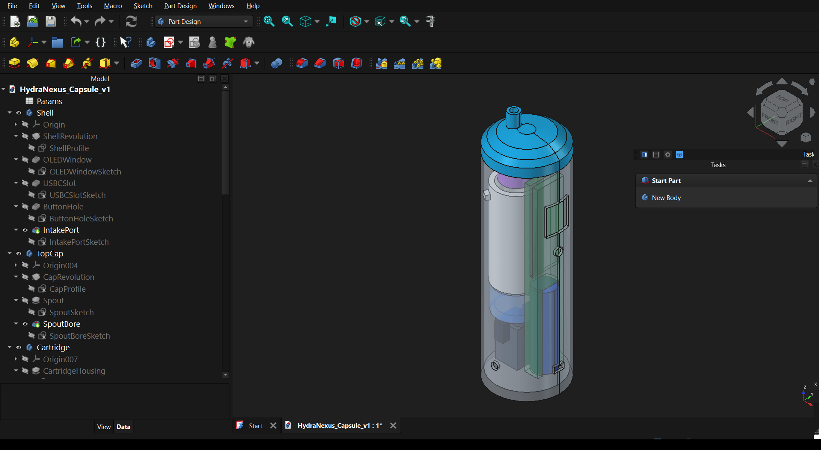
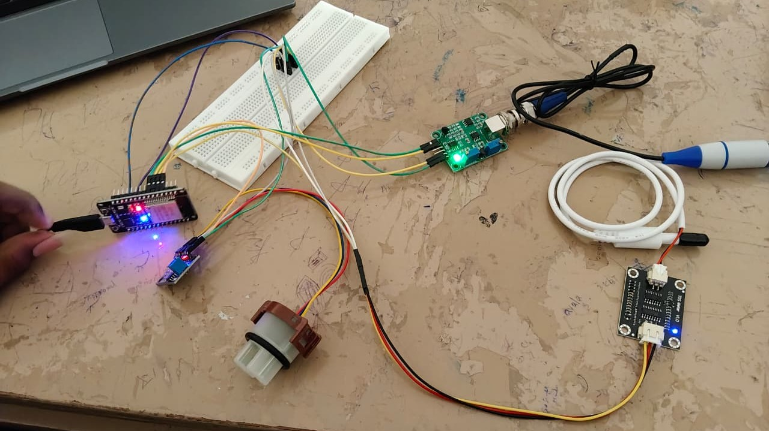
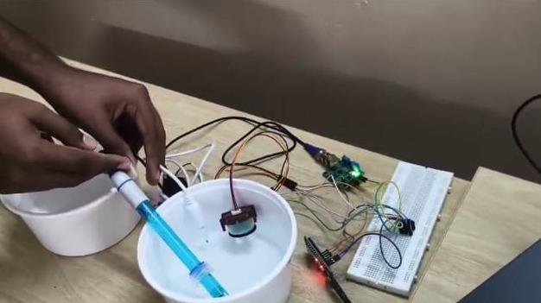
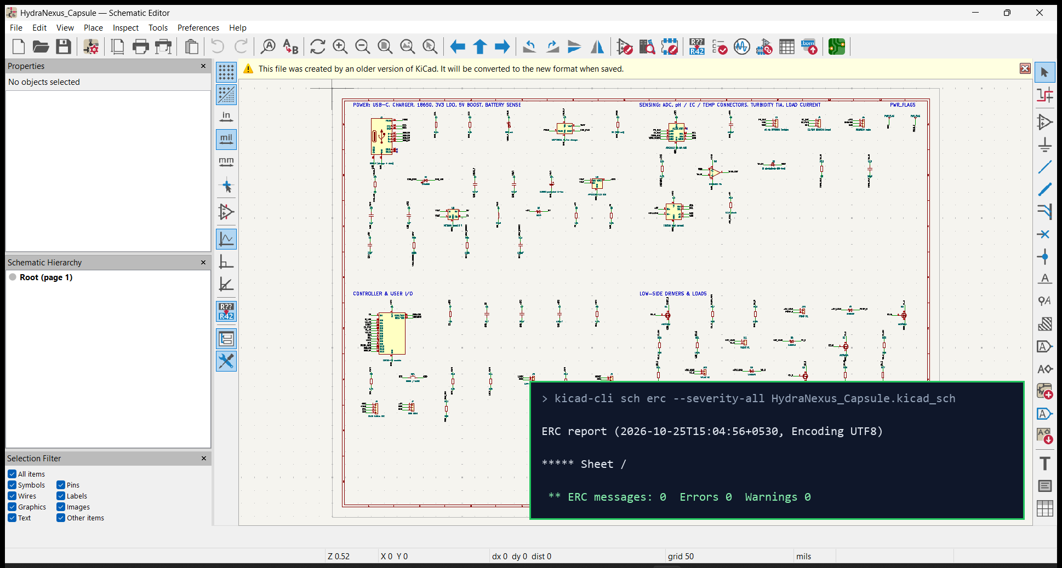
Maker Journey: Proof of Our Work
HYDRA NEXUS · STAGE 2
Our first bench session
Our design work so far
Our project files
Real photos from our own bench work
github.com/Abishekkishore-byte/hydra-nexus
public on GitHub
What you’ll find there
cad: the FreeCAD and STEP files, the script that builds the model, and screenshots
electronics: the KiCad schematic, its check report and a PDF
docs: this deck and the parts list
visuals: the concept renders and how we made them
Every change is dated in the Git history, so progress is easy to check.
Code, the app and test logs go in as we make them, in Months 2 to 4.
Our ESP32 board wired to the pH, TDS and turbidity sensors on a breadboard
Our capsule in FreeCAD 1.1: 9 parts, with every key size driven by one parameter table
Our schematic in KiCad 9, with its electrical check: no errors, no warnings
Trying the pH probe and turbidity sensor in a water sample
Honest note: the photos are from our own bench session; build photos with our ID badges will follow in Month 2. The CAD and schematic were made with help from AI tools, and we are reviewing them.

Slide 14

Safety: What Could Go Wrong, and What We Do About It
HYDRA NEXUS · STAGE 2
What could go wrong | What it could cause | How we spot it | What we do about it | Tested yet?
Water gets into the electronics | A short circuit or battery damage | A leak sensor inside the dry side | Sealed wall, sealed wires and USB-C; if it gets wet, everything switches off and warns | Dunk test to do
A sensor gives a bad reading | Wrong treatment, or a false “all good” | Check the range, jumps and spread over 30 readings | Throw the reading out, try twice more, then warn. No result is shown | Not yet
The pump runs dry | Pump wear and no sample | Pump current drops; the test cell stays empty | Pump stops within 3 seconds and asks you to put the hose back in water | Not yet
The filter clogs | Slow flow, pressure, possible leaks | Pump current rises; we count litres filtered | Stops at a current limit and asks for a new cartridge; housing tested at 1.5 times pump pressure | Not yet
Battery or electrical fault | Heat, in the worst case fire | Battery protection, voltage check, low-voltage reset | Protected battery and fuse; a temperature-aware charger in the next version; sealed USB-C | Not yet
Someone is exposed to UV-C | Eye or skin injury | Cap-locked switch and a flow check | Sealed quartz chamber; UV turns on only with water flowing and the cap locked; auto timeout | Not yet
The water doesn’t improve | Someone trusts treatment that didn’t work | The second test isn’t better than the first | Don’t pour, warn, and suggest another run, a new cartridge or a lab test | Not yet
Someone misreads the screen | A false sense of safety | Try the screen with real users | Plain words; never says “safe to drink”; shows only what we measured | Not yet
Something our sensors can’t detect | Hidden germs or chemicals | Our sensors can’t see it | A permanent note on the screen, and we suggest a lab test for new or unknown sources | Built into the design
Standards we designed around (none tested or certified yet)
IEC 60529 for water-tightness (we aim for IPX7). IEC 62133-2 for lithium batteries (we will buy a cell certified to it). ISO 7027-1 for measuring cloudiness. IS 10500:2012 and the WHO guidelines as reference points for water quality.
Our rule: Hydra Nexus never says water is completely safe. It shows how the readings it can measure changed, and suggests a lab test when needed.

Slide 15
Roadmap: Our Four-Month Plan
HYDRA NEXUS · STAGE 2
MONTH 1
MONTH 2
MONTH 3
MONTH 4
Finish the design and pick parts
Lock in the layout, water path and control logic
Finish the CAD for the body, cartridge, test cell and electronics side
Polish the schematic; find the small pH probe, pump and valves; get quotes
We deliver: final CAD files, checked schematic, approved parts list
We need: the whole team agreeing on the parts; supplier quotes
Done when: a design review where every risk has a fix, and the battery maths still gives 30+ runs
Build it
3D-print the first body; build the test cell and water parts
Put together the electronics side: battery, charger, board, switches
Fit the sensors, pump, valves and protection
We deliver: a working first capsule, wiring notes and real build photos
We need: parts arriving from our Month 1 orders
Done when: it holds 1.5 times pump pressure, the electronics stay dry, and the battery protection works before the first charge
Write the code and test on the bench
Code the test, adapt and pour-only-if-it-passes logic
Get the screen, light ring and phone app working
Calibrate the sensors; run leftover-water and function tests
We deliver: first version of the code and app, calibration notes, test log
We need: the built capsule and calibration liquids
Done when: repeat readings and leftover water within our targets, and every fault we create is caught
Test properly and get ready for Stage 3
Try lots of different water samples
Record before and after readings; test battery life, dunking and drops
Fine-tune the logic; write up and prepare the demo
We deliver: a test report with real data, and a demo plan
We need: passing the Month 3 checks
Done when: at least 3 logged runs per water type, with open issues listed and assigned
By Stage 3: a working pocket capsule we can demo live, running the full identify, decide, purify, verify, compare loop on real water.
About the dates: months count from when Stage 2 starts; we will set the exact dates. This is our plan, and none of it is done yet.

Slide 16
Technical Challenges: The Hard Parts
HYDRA NEXUS · STAGE 2
1
HIGH
2
HIGH
3
HIGH
4
HIGH
5
MEDIUM
Keeping sensors accurate
Why it matters: Small pH probes drift and need to stay wet. A small error ruins the before-and-after comparison.
How we’ll check: Compare against a lab-grade probe over 4 hours; use a wet storage cap.
Making sense of mixed readings
Why it matters: Some combinations of pH, TDS and cloudiness are confusing and could lead to the wrong choice.
How we’ll check: Prepare test water for every rule we wrote, and try each one.
One filter can’t fix everything
Why it matters: A pocket cartridge can’t lower high TDS, for example.
How we’ll check: Check that the capsule warns every time it can’t help.
Sharing one test cell
Why it matters: Bubbles confuse the cloudiness sensor, and leftover raw water could skew the second test.
How we’ll check: Measure leftover water; compare readings while flowing and while still.
Steady flow on a battery
Why it matters: As the filter fills up and the battery drains, the flow changes.
How we’ll check: Log flow against battery level and litres filtered.
6
MEDIUM
7
HIGH
8
HIGH
9
HIGH
10
MEDIUM
Tiny pumps and valves
Why it matters: Small pumps need priming and air pockets can block tiny valves.
How we’ll check: Test the switching order and priming.
Filters clogging over time
Why it matters: Flow drops and cleaning gets worse as the cartridge fills up.
How we’ll check: Track pump current against litres filtered.
Fair before-and-after tests
Why it matters: Temperature or timing differences between the two tests can make the numbers misleading.
How we’ll check: Correct for temperature and repeat the tests.
Better numbers aren’t the same as safe water
Why it matters: People might feel safe about things we can’t measure.
How we’ll check: Review the wording carefully and always show the limits.
Fitting it all in a pocket
Why it matters: Electronics, battery and water parts all need to fit in a small, sealed body.
How we’ll check: Check size, weight and leaks on every build; watch the budget.

Slide 17
Potential Solutions: How We Plan to Handle Each One
HYDRA NEXUS · STAGE 2
# | Our main plan | If that isn’t enough
1 | Calibrate pH at two points (pH 4 and 7), keep the probe wet, correct for temperature, and log each calibration | Ask for recalibration if a check is off by more than 0.1 pH
2 | Sanity-check every reading before deciding, and follow a clear set of rules | Use the slowest flow plus UV, and warn the user
3 | The capsule knows which cartridge is fitted and warns when it can’t help | Suggest a proper lab test
4 | Let water settle before each test, rinse with 15 mL, keep the pH sensor isolated | Switch to a version with two separate test cells
5 | Adjust the pump to hold a steady flow, and cut off on low battery | Run for a fixed time and log the flow
6 | Set the valves before the pump starts, prime it, and add a one-way valve at the intake | Prime by hand by squeezing the hose
7 | Watch pump current and litres filtered, and prompt for a new cartridge | Swap the cartridge after a fixed number of litres
8 | Same sensors for both tests, temperature correction, check before pouring | Repeat the second test and show both results
9 | Never say “safe”; show only the change we measured; suggest testing | A printed label on the capsule explaining its limits
10 | Print the first version a bit bigger, then shrink it; UV is optional; get quotes early | Use ready-made boards first and a custom board for Stage 3
What we would like to add later
Future ideas, not part of this prototype
More sensors, such as chlorine
Special cartridges that can lower TDS or adjust pH
A reading history that spots when a source keeps changing
Telling you when the filter is about to wear out
Linking many capsules to one online dashboard
A bigger version for wells and lakes
HOW WE WILL TEST BEFORE SHOWING IT TO ANYONE
Electronics on the bench
Clean water and leaks
Reference liquids
Prepared water samples
Making faults on purpose
Supervised demo
Matching up: the numbers 1 to 10 match the challenges on the previous slide.

Slide 18
References & Sources
HYDRA NEXUS · STAGE 2
[1] Hydra Nexus Stage 1 Proposal, our own submission (Hydra_Nexus_Stage1_Proposal.pdf).
[2] Vishwakarma Awards 2026–27 Stage 2 Submission Template, Maker Bhavan Foundation.
[3] Espressif Systems, ESP32-C3 Series Datasheet. documentation.espressif.com/esp32-c3_datasheet_en.pdf
[4] Espressif Systems, ESP32-C3-MINI-1 Module Datasheet. documentation.espressif.com/esp32-c3-mini-1_datasheet_en.pdf
[5] DFRobot Wiki, Gravity Analog pH Sensor V2 (SEN0161-V2). wiki.dfrobot.com/Gravity__Analog_pH_Sensor_Meter_Kit_V2_SKU_SEN0161-V2
[6] DFRobot Wiki, Gravity Analog TDS Sensor (SEN0244). wiki.dfrobot.com/Gravity__Analog_TDS_Sensor___Meter_For_Arduino_SKU__SEN0244
[7] DFRobot Wiki, Gravity Analog Turbidity Sensor (SEN0189). wiki.dfrobot.com/Turbidity_sensor_SKU__SEN0189
[8] DFRobot Wiki, Gravity Analog Signal Isolator (DFR0504). wiki.dfrobot.com/Gravity__Analog_Signal_Isolator_SKU_DFR0504
[9] Analog Devices, DS18B20 Digital Thermometer datasheet. analog.com/media/en/technical-documentation/data-sheets/DS18B20.pdf
[10] Texas Instruments, ADS111x 16-bit ADC datasheet. ti.com/lit/ds/symlink/ads1115.pdf
[11] DFRobot product pages, prices checked on 24 Oct 2026: dfrobot.com/product-1782.html (SEN0161-V2), -1662 (SEN0244), -1394 (SEN0189), -1354 (KIT0021), -1621 (DFR0504)
[12] Bureau of Indian Standards, IS 10500:2012 Drinking Water Specification. bis.gov.in/other/DrinWatIS10500.pdf
[13] World Health Organization, Guidelines for Drinking-water Quality, 4th edition with the 1st, 2nd and 3rd addenda. who.int/publications/i/item/9789240121225
[14] IEC 60529, Degrees of protection provided by enclosures (IP Code). webstore.iec.ch
[15] IEC 62133-2:2017, Safety requirements for portable lithium cells and batteries. webstore.iec.ch
[16] ISO 7027-1:2016, Water quality, Determination of turbidity, Part 1. iso.org
[17] F. M. White, Fluid Mechanics, McGraw-Hill. We used its laminar-flow friction formula for the tube calculation on slide 9.
[18] Our design tools: FreeCAD 1.1 (freecad.org) and KiCad 9 (kicad.org).
[19] Our project repository with the CAD, schematic, parts list and this deck. github.com/Abishekkishore-byte/hydra-nexus
About our numbers: the calculations on slides 7 and 9 are our own rough estimates with the assumptions shown. We haven’t received any supplier quotes yet.

Slide 19

Image Sources
HYDRA NEXUS · STAGE 2
Cover: concept render of the capsule
We made this illustration ourselves with a script. It is not a photo, a CAD screenshot or a built device.
Slide 8: assembled and exploded views with numbered parts
The same illustration with labels added, and a taken-apart version. Concept only.
Slide 13: bench session photos
Taken by our team during our own bench work with the sensors. The first photo was cropped to remove black borders; nothing else was edited.
Slide 13: FreeCAD and KiCad screenshots
Real screenshots of FreeCAD 1.1 and KiCad 9 with our files open, taken on 25 Oct 2026. The check report is KiCad’s actual output.
Every slide: Vishwakarma Awards and Maker Bhavan Foundation logos, banner, icons and backgrounds
From the official Vishwakarma Awards 2026–27 Stage 2 template.
Drawn in PowerPoint
Slides 3–7, 10, 12–17: diagrams, flowcharts, tables and timelines
Drawn by us directly in PowerPoint. We used no outside photos and removed the template’s example pictures.

