Slide 1

FOSS TOOL
GIT TOOL
Team members:
S.R.Abisini
G.Dharshini
N.Jaffar Nisha

Slide 2
INTRODUCTION OF GIT:
Git is a free, open source ,distributed version control system tool that supports distributed non-linear workflows by providing data assurance for developing quality software.
It is designed to handle everything from small to very large projects with speed and efficiency.
Git was created by Linus Torvalds in 2005 to develop Linux Kernel. Git has the functionality, performance, security and flexibility that most teams and individual developers need.

Slide 3
LICENSES OF THE TOOL
Git is released under the GNU General Public License version 2.0.
This version is an open source license.
Git project chose to guarantee the freedom to share and change free software
Git makes sure the software is free for all users.

Slide 4
ALTERNATIVES FOR THE TOOL
CVS (Concurrent Versions System):
CVS is a centralized version control system, an important component of Source Configuration Management (SCM). Using it, you can record the history of changes to individual text-based files.
Veracity:
An open source, distributed version control and bug tracking system for Windows, Mac OS X, and Linux. Taking a different approach to the DVCS world with bug tracking, build status tracking, and wiki included together with the versioned code.

Slide 5
3) Apache Subversion (SVN) :
It is a centralized version control system similar to CVS (Concurrent Versions System) , but based on the concept of change-sets instead.
4) Mercurial:
Mercurial is a free, distributed source control management tool. It efficiently handles projects of any size and offers an easy and intuitive command line interface. Mercurial efficiently handles projects of any size and kind.
5) Fossil:
Simple, high-reliability, distributed software configuration management. Fossil is a distributed version control system, bug tracking system and wiki software server for use in software development.

Slide 6
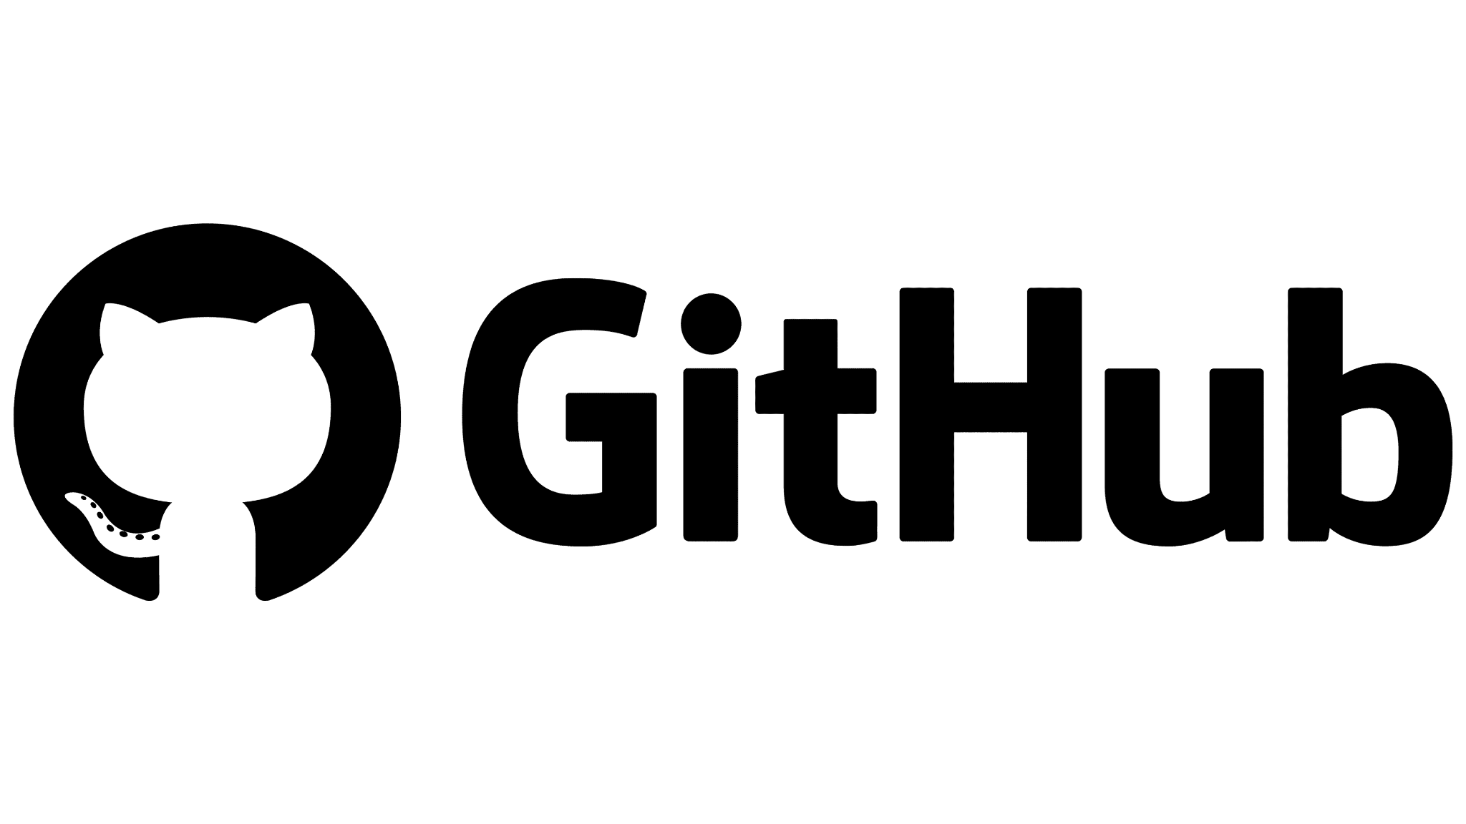
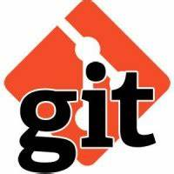

Is Git and GitHub Same ?

Slide 7
ADVANTAGES OF USING THE TOOL
Free and open source
Speed
Scalable and Reliable
Secure and Economical
Supports non-linear development
Easy branching
Distributed development
Compatibility with existing systems or protocol

Slide 8
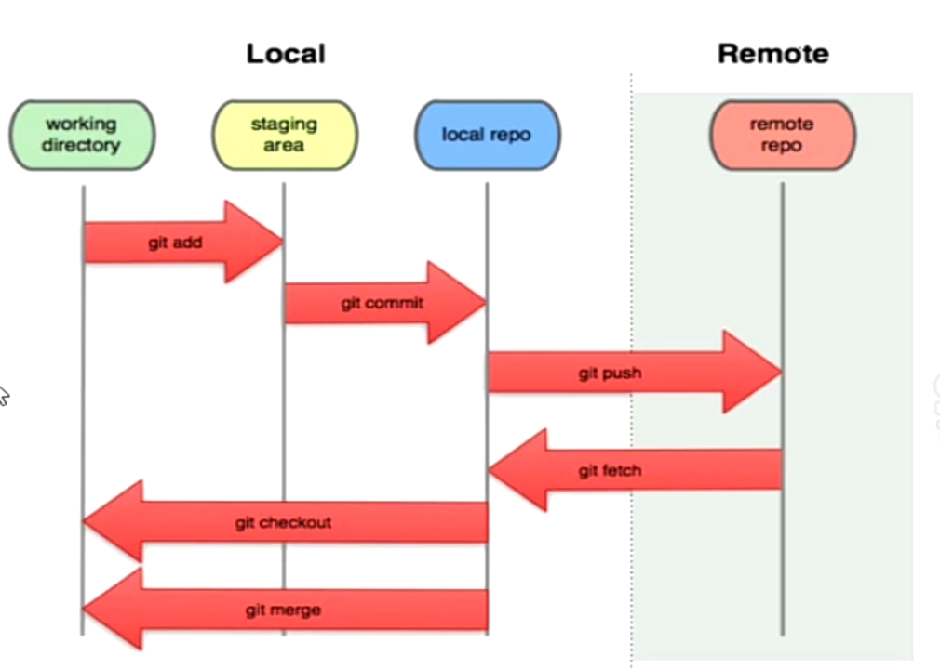
Working
Flow of
Git

