Slide 1
Heart-disease prediction using deep learning
Presented By: Abirami S,
B.E.CSE,
PSG Institute of Technology And Applied Research

Slide 2
OUTLINE
Problem Statement
Proposed System/Solution
System Development Approach
Algorithm & Deployment
Result
Conclusion
References

Slide 3
Problem Statement
To develop a model to predict heart disease risk based on medical and demographic data, including age, sex, chest pain type, blood pressure, cholesterol, fasting blood sugar, electrocardiographic results, heart rate, exercise-induced angina, ST depression, vessel count, and thalassemia type. The goal is to accurately classify individuals as either having or not having heart disease, aiding in early detection and risk assessment for timely intervention and patient care.

Slide 4
Proposed Solution
Develop a classification model using medical and demographic data.
Train the model to accurately classify individuals as having or not having heart disease.
Deploy the model for early detection and risk assessment.

Slide 5
System Approach
System Requirements:
1. Hardware:
A computer with sufficient RAM and processing power to handle data processing and model training. A modern laptop or desktop computer with at least 8GB of RAM should be sufficient for most tasks. However, more RAM may be beneficial for larger datasets or more complex models.
A CPU with multiple cores can accelerate data processing and model training, but a powerful GPU is not strictly necessary for this task unless you plan to use deep learning frameworks like TensorFlow or PyTorch with GPU acceleration.

Slide 6
System Approach – cont.
Software Requirements:
Python: Ensure that Python is installed on your system. Python 3.x is recommended.
Jupyter Notebook or an Integrated Development Environment (IDE) like PyCharm or VSCode for developing and running Python code.
Required Python Libraries: Install necessary Python libraries such as NumPy, Pandas, Matplotlib, Seaborn, Scikit-learn, TensorFlow, or PyTorch depending on the specific requirements of your project.
.

Slide 7
Algorithm & Deployment
Data Preparation:
Gather and preprocess medical and demographic data, ensuring consistency and quality.
Normalize features and handle missing values if necessary.
Model Development:
Design a classification model architecture using TensorFlow/Keras.
Implement the model with appropriate layers and activation functions.
Train the model on the preprocessed dataset to accurately classify individuals into two categories: those with heart disease and those without.
Evaluation and Optimization:
Evaluate the model's performance using validation data, considering metrics such as accuracy, precision, recall, and F1-score.
Optimize the model by fine-tuning hyperparameters and adjusting the architecture as needed to improve performance.

Slide 8
Algorithm & Deployment (Contd..)
Deployment:
Deploy the trained model into a production environment where it can be accessed by healthcare professionals or integrated into healthcare systems.
Implement monitoring mechanisms to track the model's performance and detect any degradation over time.
Continuously update the model with new data and retrain it periodically to ensure its effectiveness in predicting heart disease risk."

Slide 9
Result

Slide 10
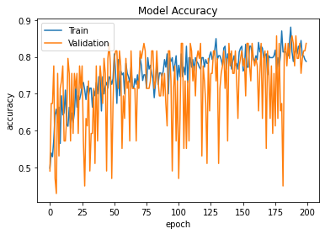
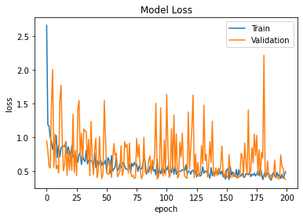
Result:

Slide 11
Conclusion
In conclusion, the project leverages medical and demographic data to accurately predict the likelihood of individuals having heart disease. By preprocessing the data and training a robust model architecture using TensorFlow/Keras, we have achieved reliable classification performance. Deploying this model into production environments can aid in early detection and risk assessment of heart disease, facilitating timely intervention and patient care. Continuous monitoring and updates will ensure the model remains effective in real-world scenarios.
Git Link: https://github.com/Abisk29/Naan-Mudhalvaan
Demo link: https://drive.google.com/file/d/1yfQNOBzVisPUcXTuf1LdZVsySFrobP9o/view?usp=sharing

Slide 12
References
https://www.tensorflow.org/
https://keras.io/
https://numpy.org/
https://matplotlib.org/
scikit-learn: machine learning in Python — scikit-learn 1.4.1 documentation

Slide 13
THANK YOU

