Slide 1
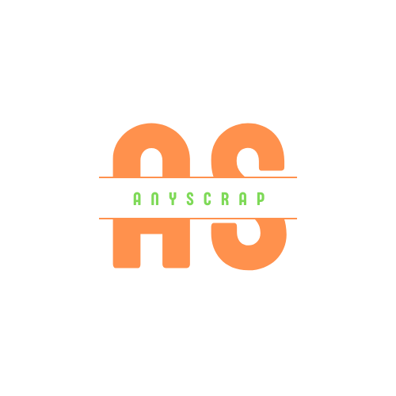
ANYSCRAP
FINAL YEAR PROJECT ON
ANYSCRAP-A NODE JS BASED WEB SCAPPING TOOL
UNDER THE GUIDANCE OF MR. SAROJ SHARMA
PRESENTED BY: ABIT MAHATO( C 7227208 )

Slide 2
CONTENT INDEX
PROJECT SUMMARY INTRODUCTION
PROBLEM STATEMENT
OBJECTIVES
METHODOLOGY WORK PLAN
REQUIREMENT DESIGN
EVALUATION AND CONCLUSION

Slide 3
PROJECT SUMMARY
THE IDEA OFTHIS PROJECT IS TO BUILD A NODE JS BASED WEB SCRAPING TOOL
USING THIRD PARTY WEB SCRAPING APIS AND CUSTOM APIS BUILT ON THIS WEB
TOOL AS WELL WHICH SCRAPS MULTIPLE SETS OF PREDEFINED WEBSITES AND
USER PROVIDED URLS AS WELL.

Slide 4
WHAT IS ANYSCRAP?
IT IS AN APPLICATION WHICH HELPS TO COMPARE PRODUCTS FROM DIFFERENT E-
COMMERCE WEBSITE AND HELPS US TO SCRAP DATA FROM PROVIDED URL ALONG WITH
MARKETPLACE FOR API SHARING. IT ALSO HAS A NEWS PORTAL WHERE NEWS FROM DIFFERENT SITES ARE SCRAPPED AND DISPLAYED
FRAMEWORKS USED ARE: REACT JS : FRONTEND NODE JS : BACKEND
MONGODB: DATABASE
WWW. ANYSCRAP. VERCEL. APP

Slide 5
PROBLEM STATEMENT
SOME APP ONLY CONSISTS OF WEB SCRAPPING WHEREAS SOME ONLY CONSISTS OF
COMPARING OR USING SCRAPED DATA
ITS TIME CONSUMING WHEN WE HAVE TO VISIT DIFFERENT PAGES TO SEARCH A PRODUCT
MOST OF THE WEB SCRAPPING TOOLS ARE PAID ITS HARD TO ANALYSE MARKET AT SCALE

Slide 6
SOME EXISTING SOLUTIONS
DHEWA. COM
I t lacks data scrapping service for user and lacks marketplace
WEBSCRAPPER. IO
I t only let users to scrap data but don' t show the use of scrapped data and lacks
marketplace

Slide 7
OBJECTIVES
. TO CREATE CUSTOM METHODS AND APIS FOR WEB SCRAPING ALSO TO SHOWCASE THE USE
OF A THIRD PARTY API.
. TO USE CLOUD STORAGE SERVICES FOR
SAVING THE SCRAPED RESULTS FOR LATER USE.
. TO PROVIDE A DEVELOPER FRIENDLY
DASHBOARD FOR CREATING AND MONITORING API CALLS.
. TO SHOW THE USE OF SCRAPPED DATA.

Slide 8
METHODOLOGY
WATERFALL METHODOLOGY IS USED MY
PROJECT AND THE REASONS ARE AS FOLLOWS:
IT IS BASED ON
REQUIEMENT, DESIGN, DEVELOPMENT, TESTING AND THE SAME PROCESS IS USED ON MY
PROJECT
IT IS SIMPLER TO GROW SEVERAL
APPLICATIONS CONCLUDES USING THIS METHOD IN BRIEF SPAN OF TIME.
SIMPLE TO CATEGORIZE AND PRIORITIZED WORKS.
IT IS SUITABLE FOR SMALL AS WELL AS MEDIUM SCALE PROJECT

Slide 9
WORK PLAN
TIME FRAME ALLOCATED: 3 MONTHS PROJECT INITIATION: MARCH 2022
PROJECT COMPLETION: JUNE 2022
MILESTONES
DATA SCRAPPING
USE OF SCRAPPED DATA
DATA STORED FOR FUTURE REFERENCES

Slide 10
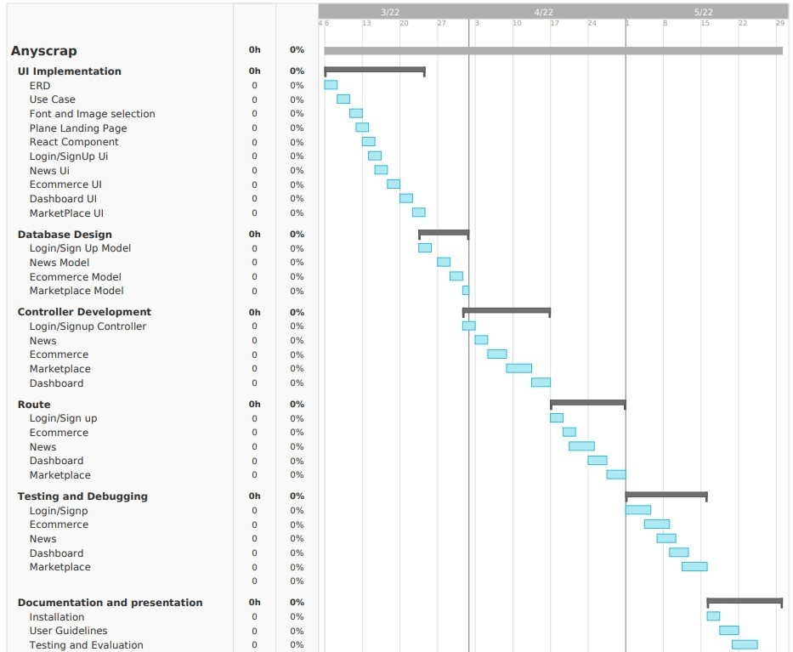
WORK PLAN
GANTT CHART

Slide 11
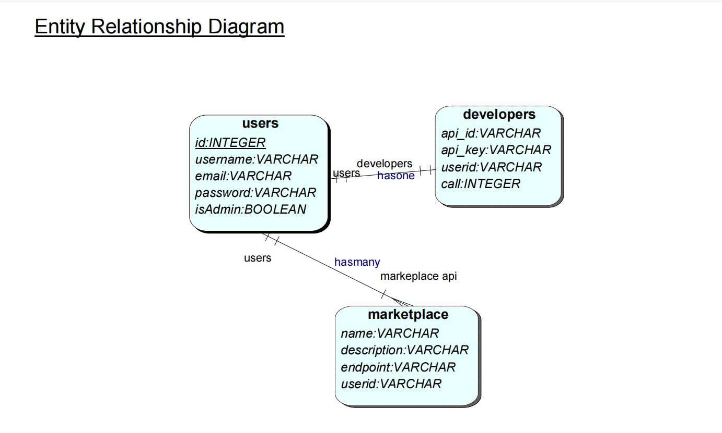
REQUIREMENT MODELS
ERD

Slide 12
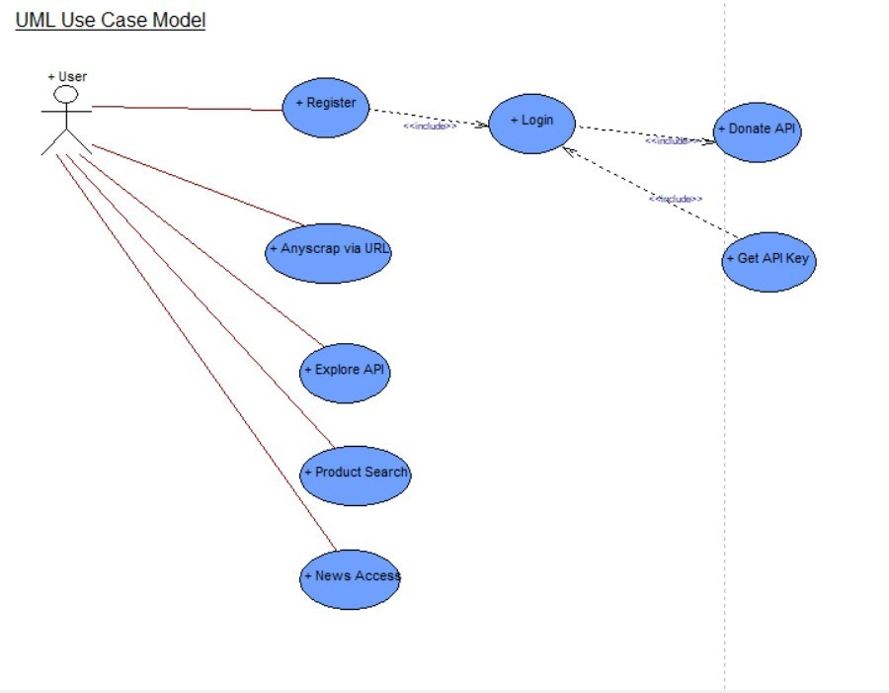
REQUIREMENT MODELS
USE CASE

Slide 13
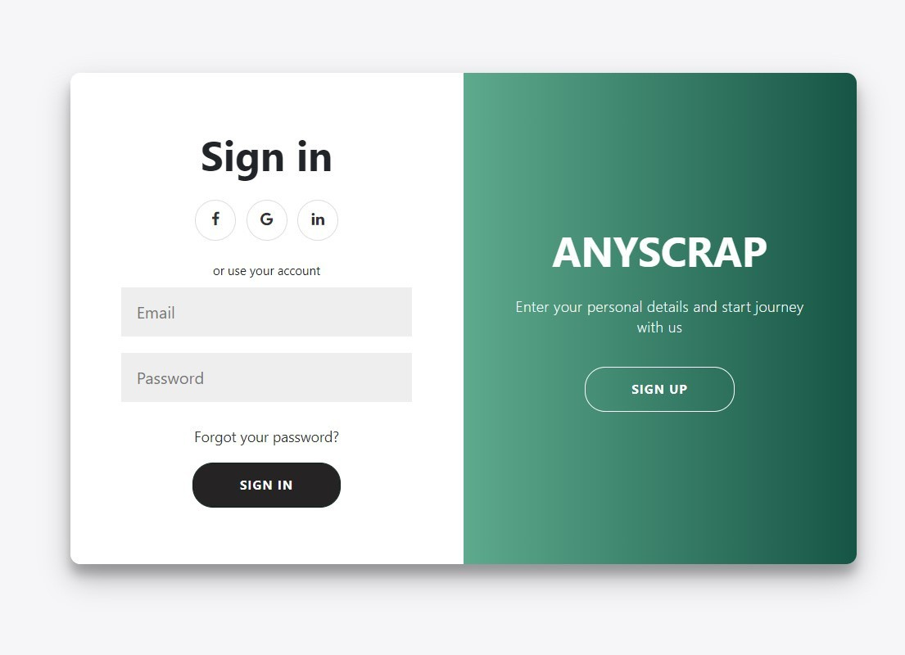
DESIGN-SAMPLE SCREENSHOTS

Slide 14
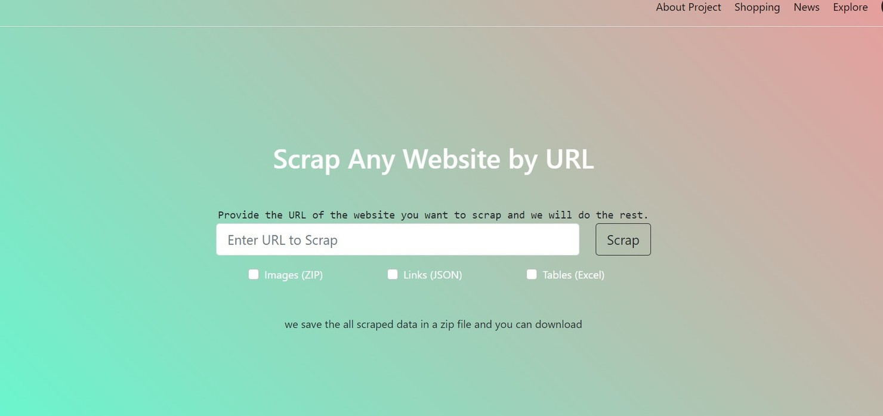
DESIGN-SAMPLE SCREENSHOTS

Slide 15
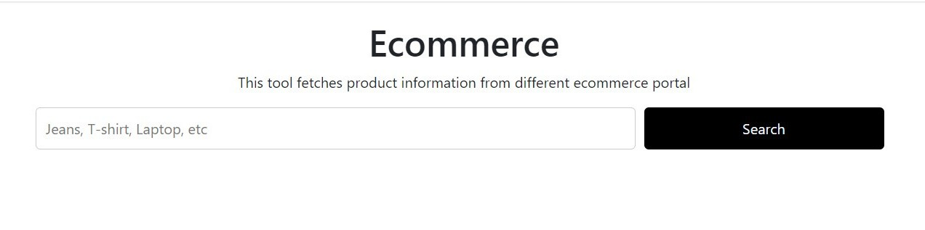
DESIGN-SAMPLE SCREENSHOTS

Slide 16
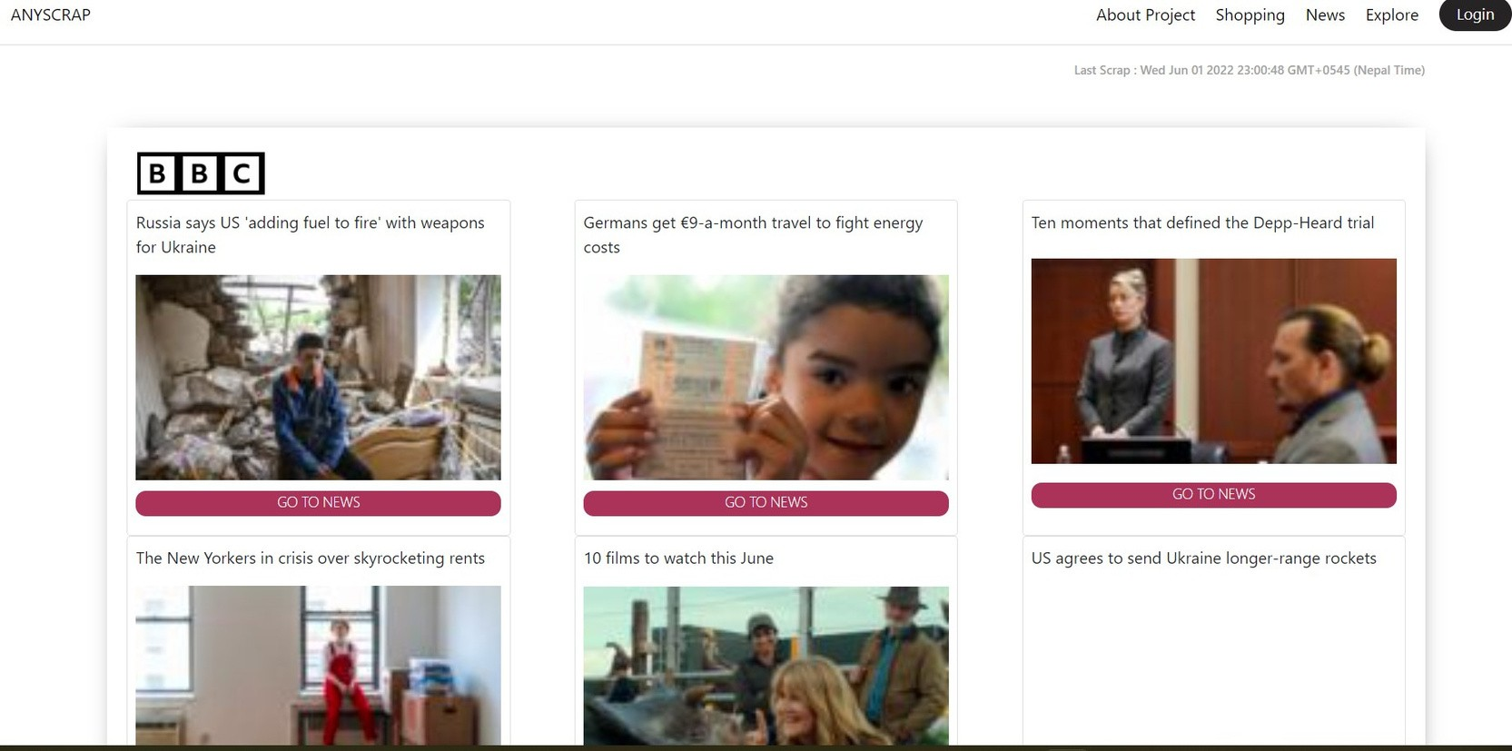
DESIGN-SAMPLE SCREENSHOTS

Slide 17
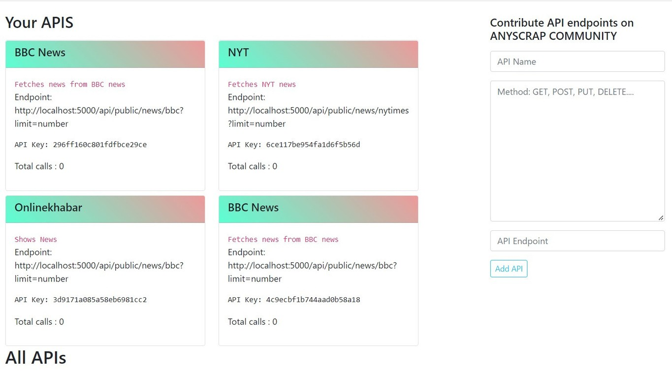
DESIGN-SAMPLE SCREENSHOTS

Slide 18
PRODUCT EVALUATION
. THIS PROJECT MEETS THE DESCRIPTION AS MENTIONED IN THE INITIAL PROJECT PAL
. THIS PRODUCT FULFILLS THE REQUIREMENT
THAT IS IT LET USERS TO SCRAP DATA AND ALSO SHOWS THE USE OF SCRAPPED DATA.
. FREE MARKETPLACE FOR USERS TO SHARE APIS AND THE APP IS HOSTED ON
WWW. ANYSCRAP. VERCEL. APP

Slide 19
FURTHER DEVELOPMENT
. MULTIPLE ECOMMERCE SITE CAN BE SCRAPPED AND DATA CAN BE USED FOR BETTER
EXPERIENCE OF USERS
. THE DATA STORED IN THE CLOUD STORAGE
CAN BE SOLD IN THE FUTURE FOR RESEARCH OR FURTHER PROCESS.
. A BIG MARKETPLACE FOR SHARING API CAN BE CREATED.
. MULTIPLE API' S CAN BE INTEGRATED . NOT ONLY LIMITING IN NEWS AND ECOMMERCE.

Slide 20
CONCLUSION
MOST OF THE PEOPLE FIND PROBLEMS IN SEARCHING FOR PRODUCTS ONLINE AND COMPARING THEM. PEOPLE ALSO FIND IT DIFFICULT TO EXTRACT DATA AND SEARCH THE
PREVIOUS DATA FOR ANALYSIS. SO A WEB SCRAPPING
NODE JS BASED WEB APPLICATION IS MADE WITH THE HELP OF REACT JS WHICH MAKES UI MORE INTERACTIVE AND
EASY TO DEVELOP WITH SCRAPPING FEATURE AND CLOUD DATA STORAGE WHICH CAN BE RETRIEVED FURTHER AND
SHOWS THE USE OF API AND ACTS AS A MARKETPLACE TOO. THIS PROCESS ENCHANCED MY RESEARCH ABILITIES TOO.

Slide 21

THANK
YOU

