Slide 1

Project management
Team 2
Abit Mahato
Apil Parajuli
Pratish Joshi
Bibek Shah
Bibek Maharjan

Slide 2
INITIATION PHASE

Slide 3
PROJECT CHARTER

Slide 4
Project Justification
The current version is the initial 1.0 version started on the 2nd of May.
As the national chains extend their reach to Cleckhuddersfax the local traders decided to band together and explore the idea of an e-commerce portal site. The traders believe that initiating the portal can make it easier for their customers to browse their shops and products at any time even when their shops would usually be closed. By working together they can also compete with the convenience stores with selection of their products.

Slide 5
Duration and Estimated Budget
Project started on the 2nd of May and is estimated to be completed on the 2nd of July. There will be a work in progress check by the project manager during the month of 2nd Week of June.
Each member is expected to contribute 4 hours of work each working day resulting in 20 hours of work per week for each member.
The total hour of work per person will be 240 hours (20*12).
Hence, total hours for work completion by the group will be 960 hours (20*5*12).

Slide 6
Project Scope
S – A site that allows the customers to easily navigate and buy all the available products.
M – Will add 2 to 3 features every week.
A – Will begin with the frontend first and match it with its backend gradually.
R –Team Work and research through the internet will help to build a better site.
T – This site will be completed within 60 days.

Slide 7
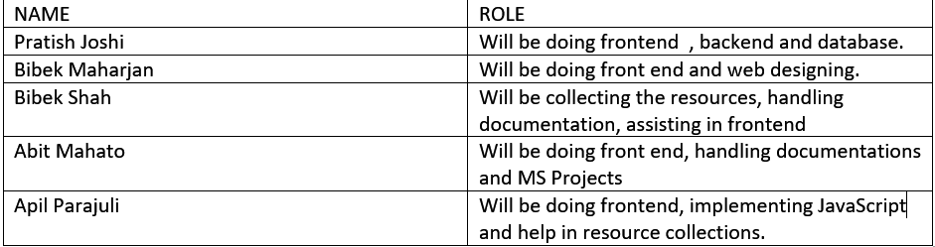
Roles and Responsibility

Slide 8
Team Contract

Slide 9
Team Contract
This team contract of Group 2 is to ensure the proper development of an e-commerce prototype website. This team contract is used to make sure that every team members will be held accountable for any consequences, setbacks or mistakes. This contract will show how the team functions and what sort of actions the team will take in securing for completing the project.

Slide 10
Team Structure
Team leadership will be handled by a particular individual throughout the project so that we can have single individual who can make logical decisions that can be worked throughout the whole project.
Pratish Joshi will be responsible for the proper leadership of the team because of his ability to take charge and properly lead the team.

Slide 11
Team Procedures
The meeting agendas will be set by our team leader.
Team leader will be taking full responsibility and making sure that the team is following the meeting agendas during the team meeting.
All the team members will be notified about the team meeting ahead of the time using Gmail and Discord.

Slide 12
Team Participation
Team members will get the chance to select the tasks they would like to perform in an allocated time.
Team members can help each other if they get any issues while performing their tasks and can help other members if someone finishes their tasks before deadlines.
Members will be asked to provide a rough weekly report.

Slide 13
Consequences of Breach of Contract
Consequences will be based upon how a team or a certain individual performs. In order to ensure the proper work by honouring the contract, everybody's full commitment is a must. For every consequence a strike program is implemented for maintaining a consistent and proper flow of the work. Due to various reasons strikes may be given:
- Low commitment, misconduct or dishonest work presented during assigned tasks.
- Not attending meetings, not performing the task on given time without notifying the team members or the instructor

Slide 14
Personal Accountability
Team members should have at least 80% of attendance.
Interruption is only allowed after the member who is speaking finished his/her statement so that every member will be able to share his/her views.
Team members will be penalized if any members are to join the meeting late.
Every team member should actively participate in each and every meeting.

Slide 15
Planning Phase

Slide 16
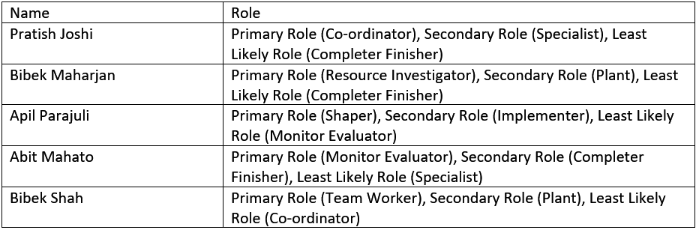
Team Belbin Analysis

Slide 17
SKILL AUDIT
Major Required Skills and skills level | Methods taken to get those skills score
1). Php(2.9) 10). Documentation(3.9) 2). Html(4) 11). CSS/Bootstrap(3) 3). Oracle Database(3.1) 12). Javascript(3) 4). Photoshop(3.7) 13). Qsee(2.9) 5). Illustrator(3.7) 6). Moqups(2.7), 7). Xampp/Ampp(3.5) 9). API(1.2) | 1.Youtube, Udemy tutorials 2. Documentation 3.Previous Semester revision..

Slide 18
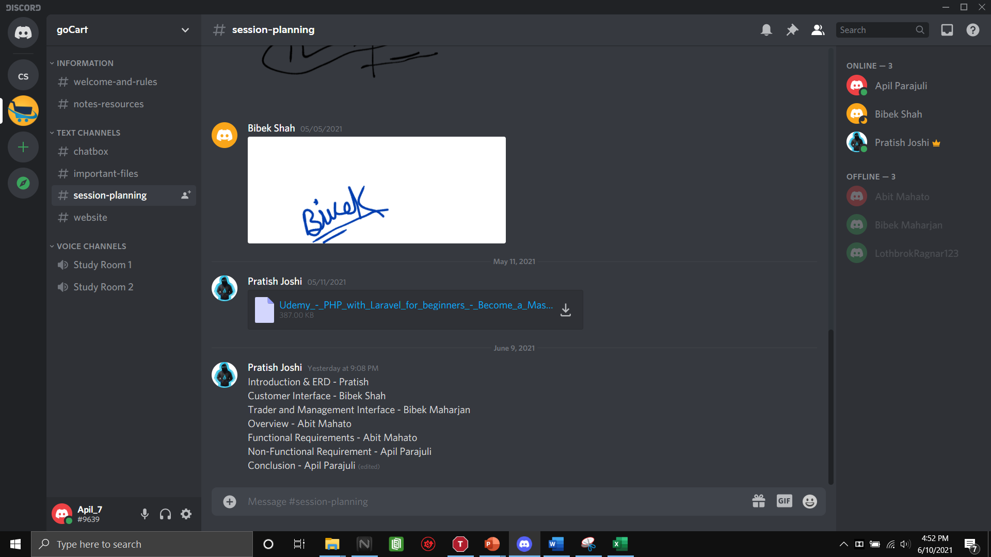
Communication Methods
Through Discord
Through Google Drive
Through Gmail

Slide 19
Meetings
Meeting Agenda | Meeting Location | Meeting Duration(minutes)
Project Charter | Through Discord | 53
Skill Audit and Belbin Analysis. | Through Discord | 61
MoSCoW, EERD, ERD, composite ERD | Through Discord | 70
Use Case diagrams and Work In Progress. | Through Discord | 55
Work In Progress, logo, wireframe | Through Discord | 58

Slide 20
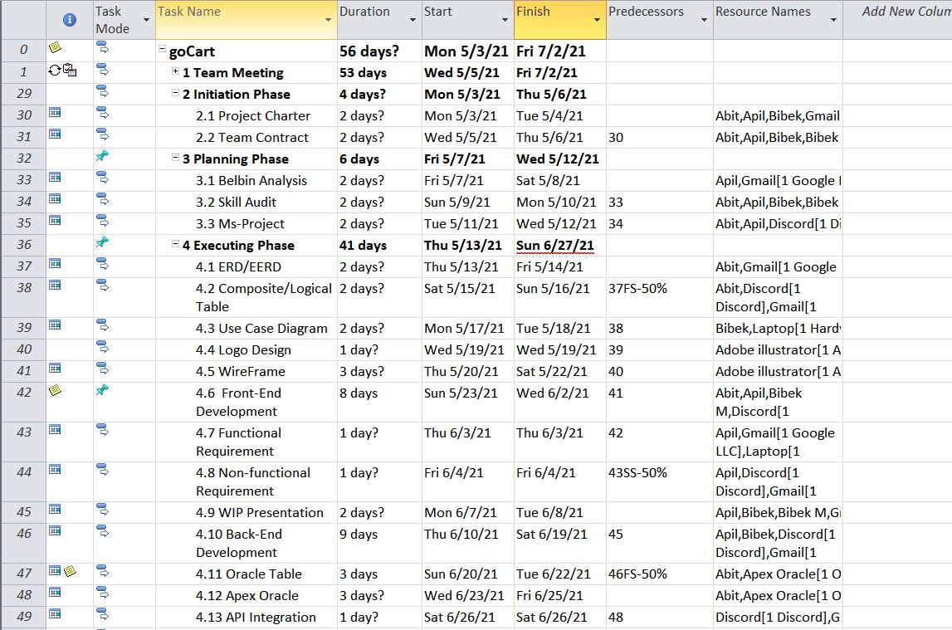
MS Project
Fig. Gnatt Chart

Slide 21
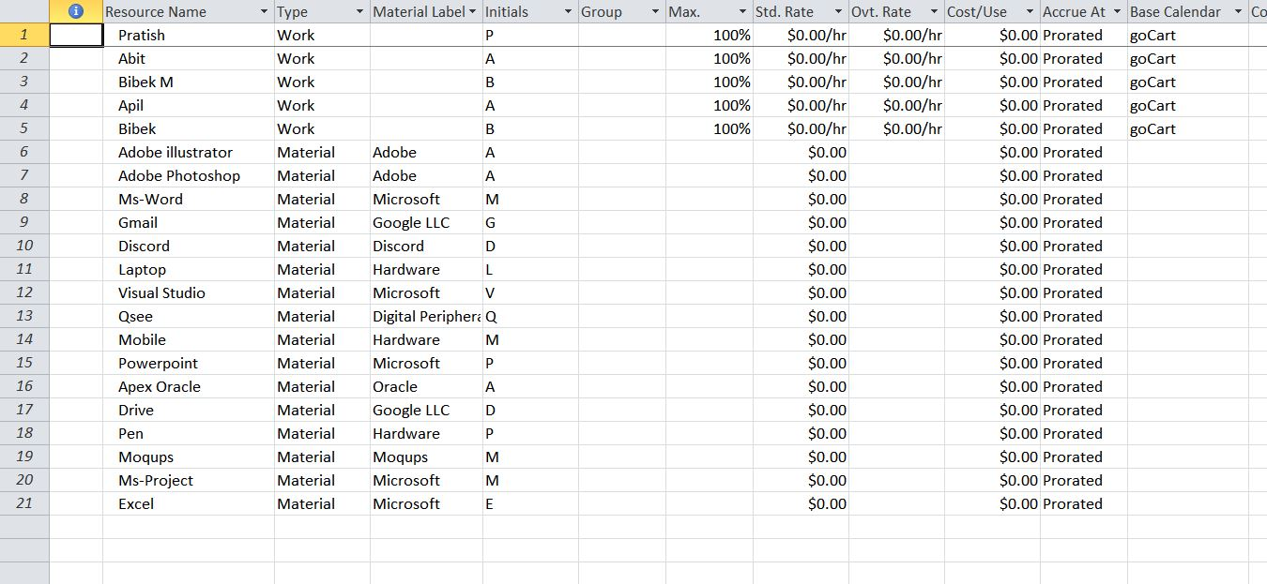
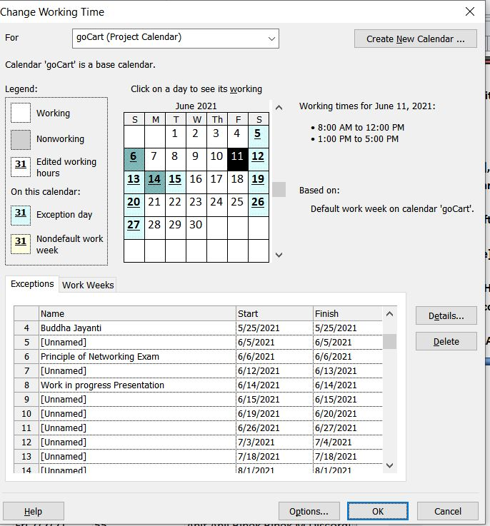
MS Project
Fig. Resource Sheet Fig. Change Working Time

Slide 22
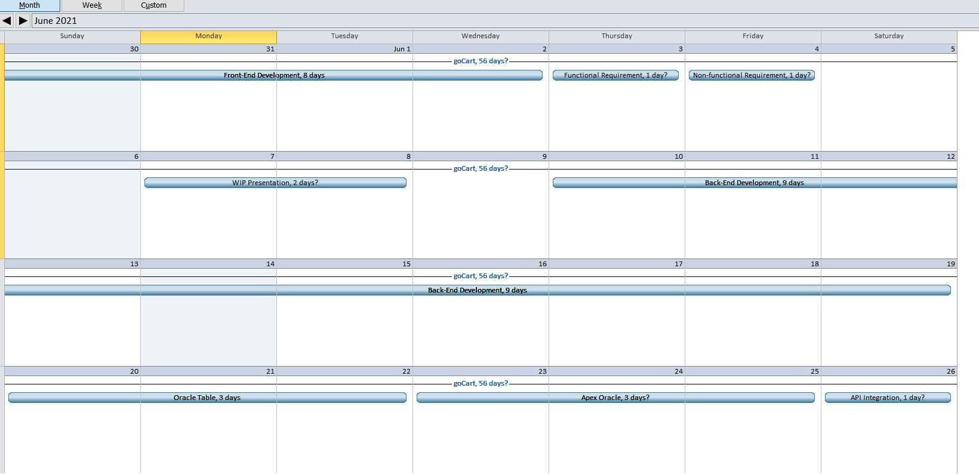
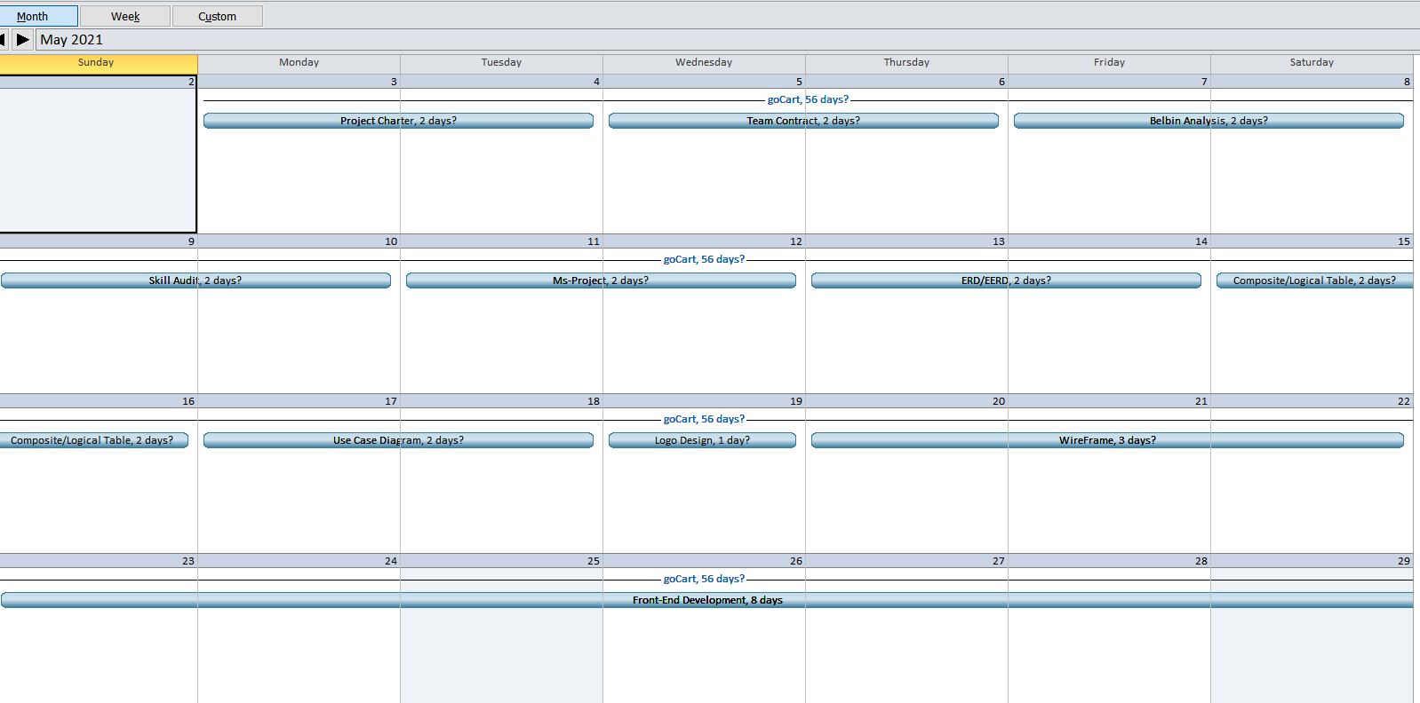
MS Project
Fig Calendar Fig. Calendar of May

Slide 23
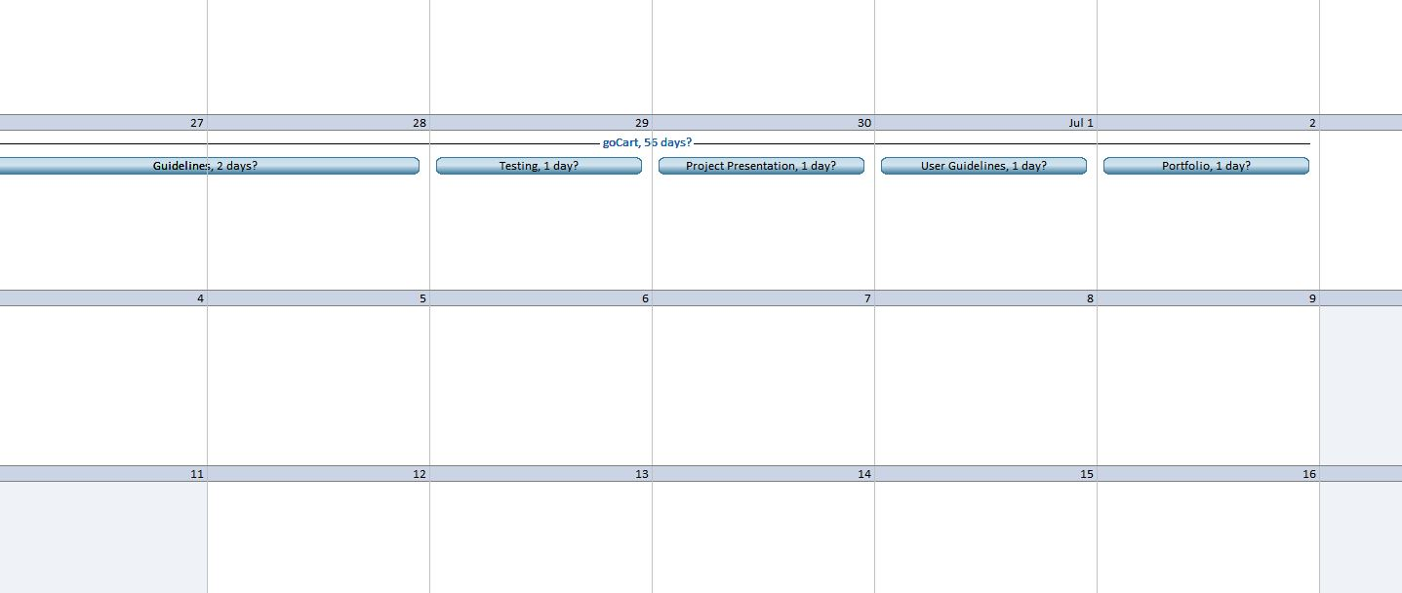
MS Project
Fig. Calendar 2

Slide 24
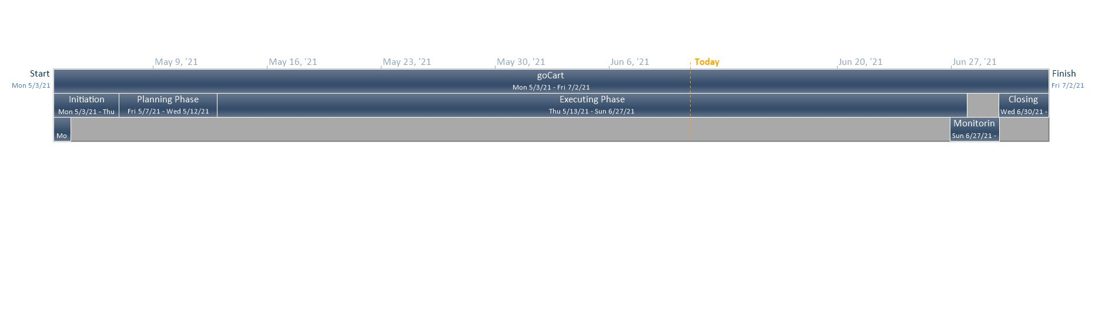
MS Project
Fig. Timeline

Slide 25
Execution Phase

Slide 26
Executing Phase
This phase includes Entity Relationship Diagrams, Use Case Diagrams.
We also designed wireframes, website logo and made a requirement catalogue to ensure the proper development of the site.

Slide 27
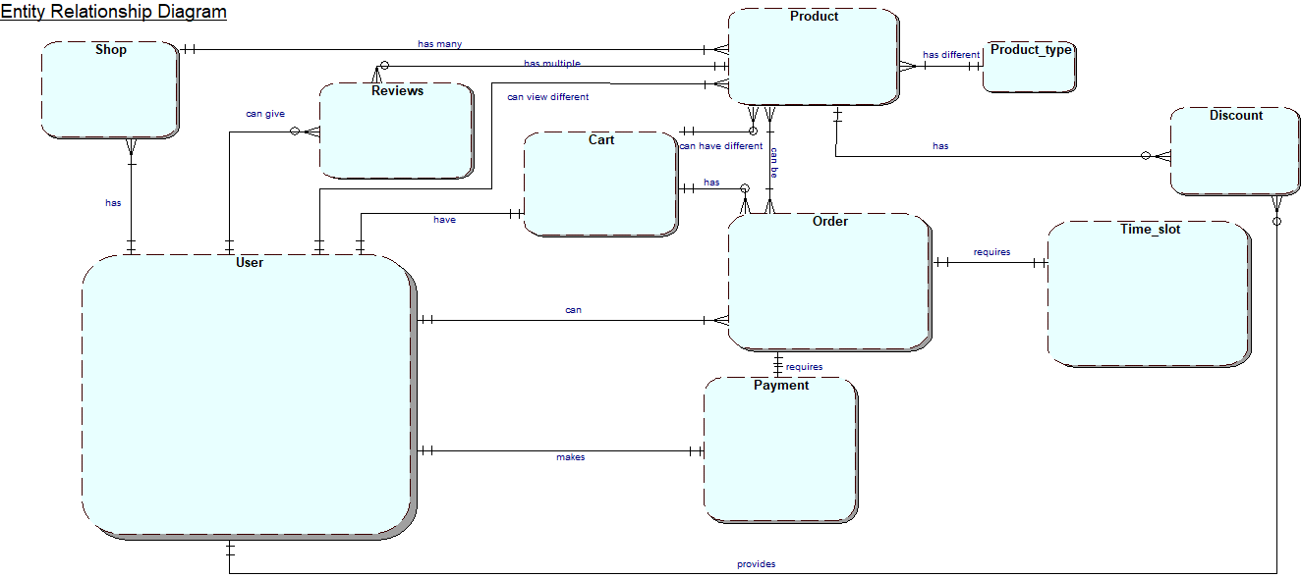
Entity Relationship Diagram

Slide 28
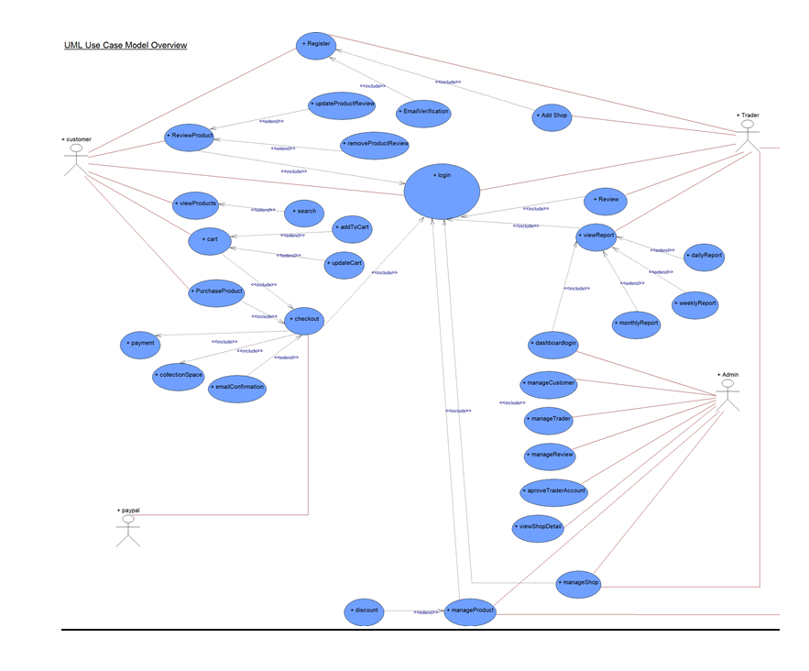
Use Case Diagram

Slide 29
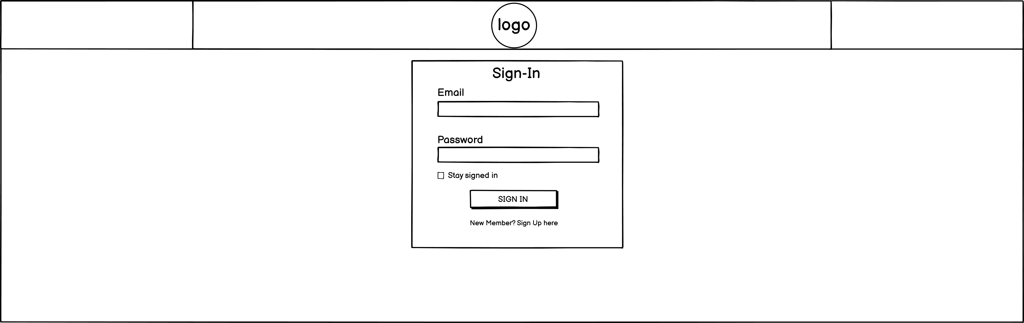
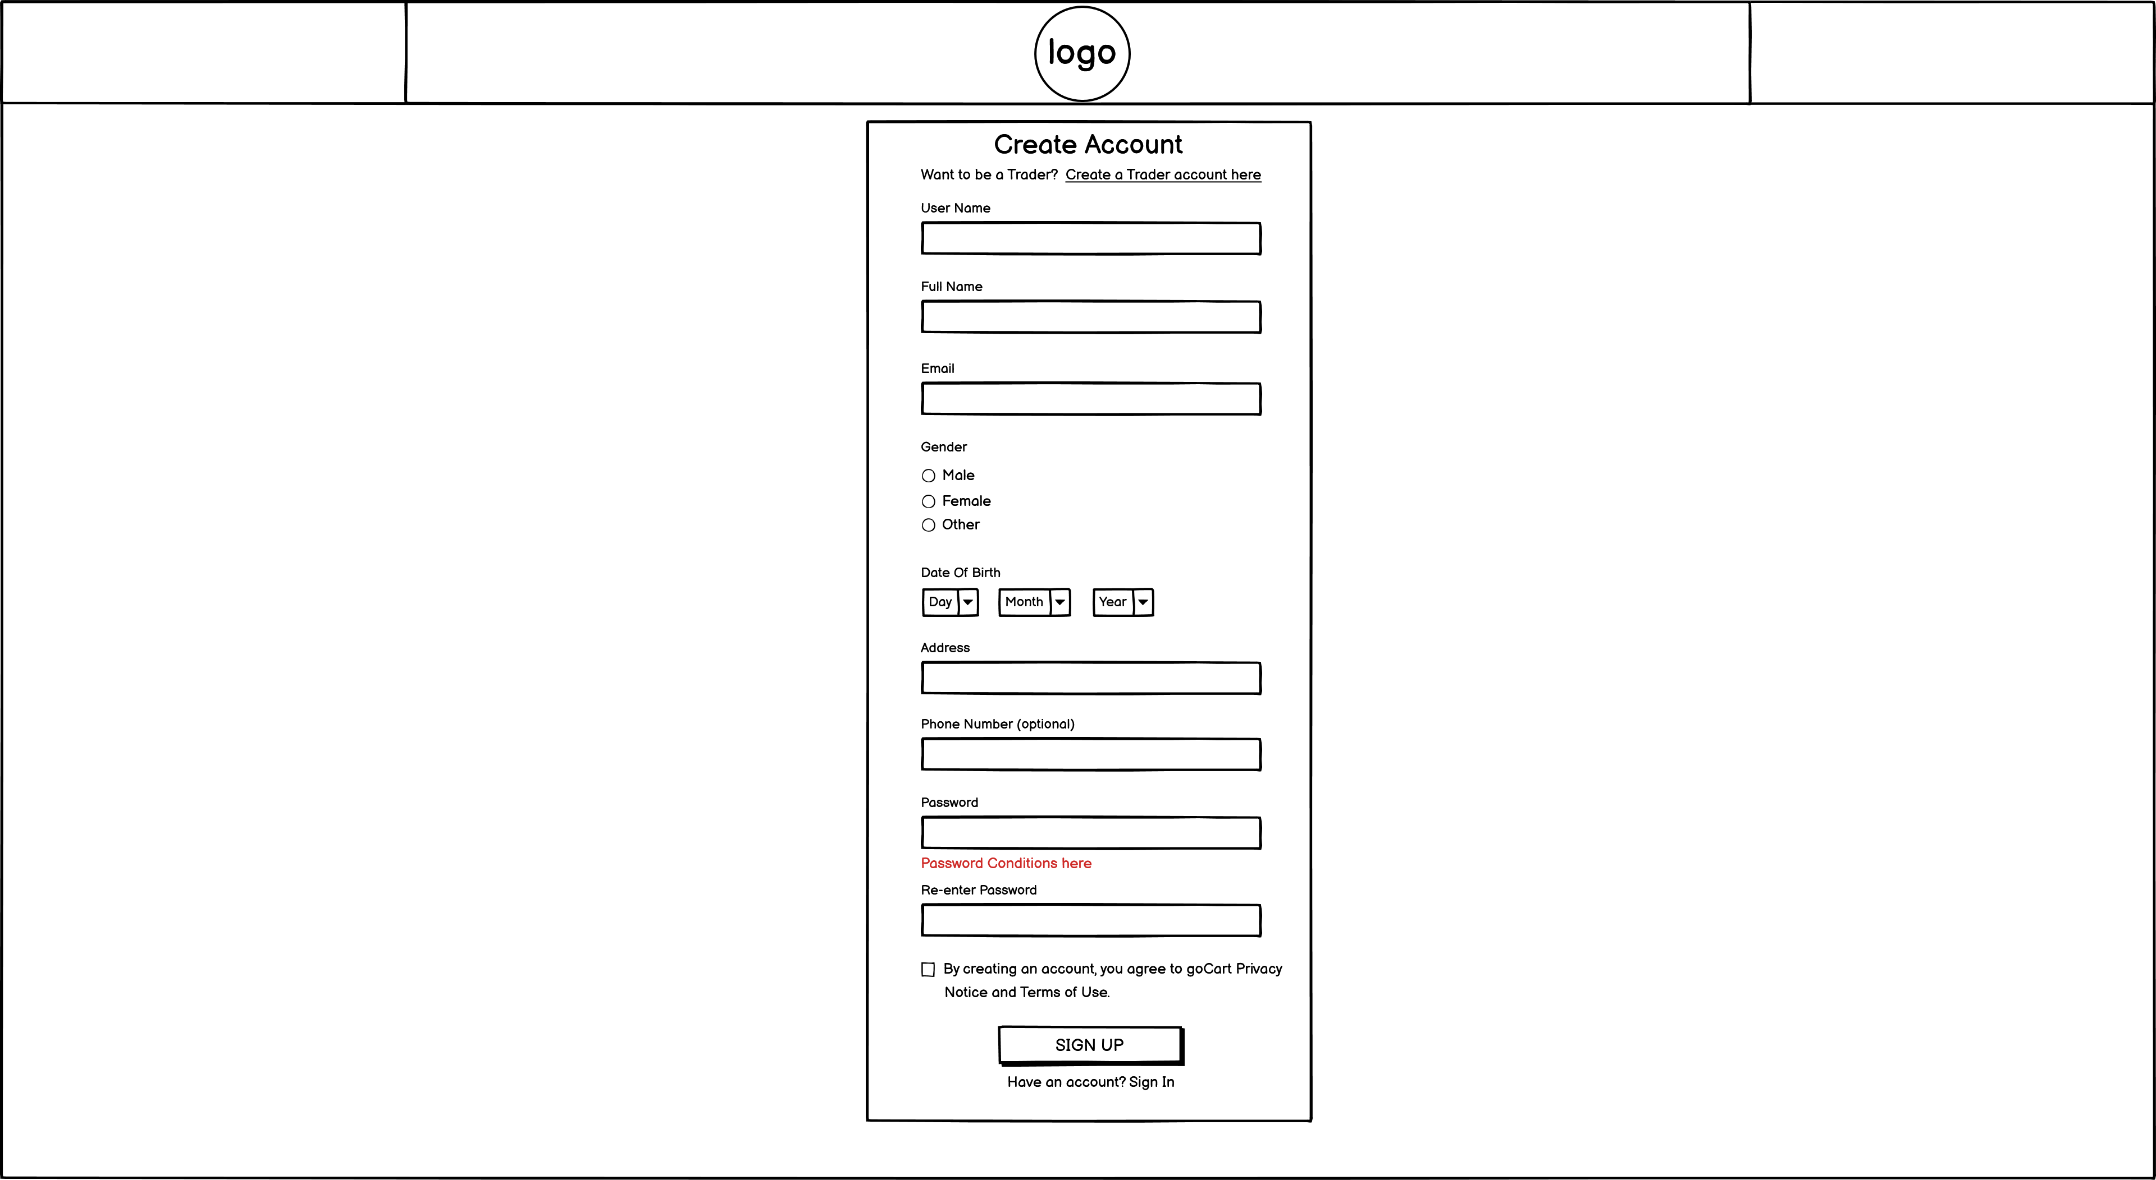
Customer Wireframe
Fig. Sign In Fig. Sign Up

Slide 30
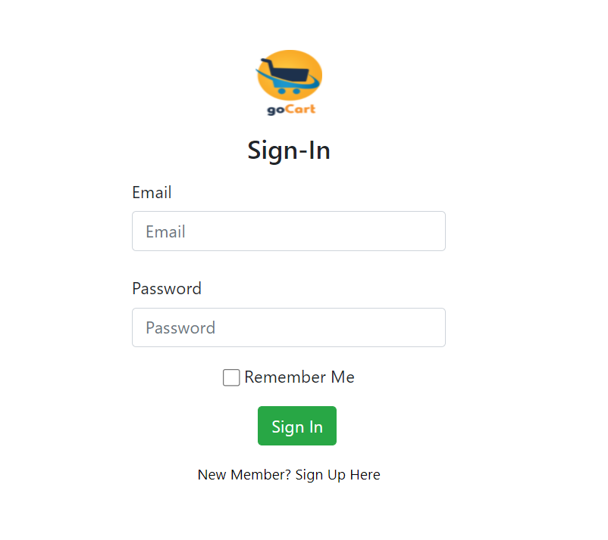
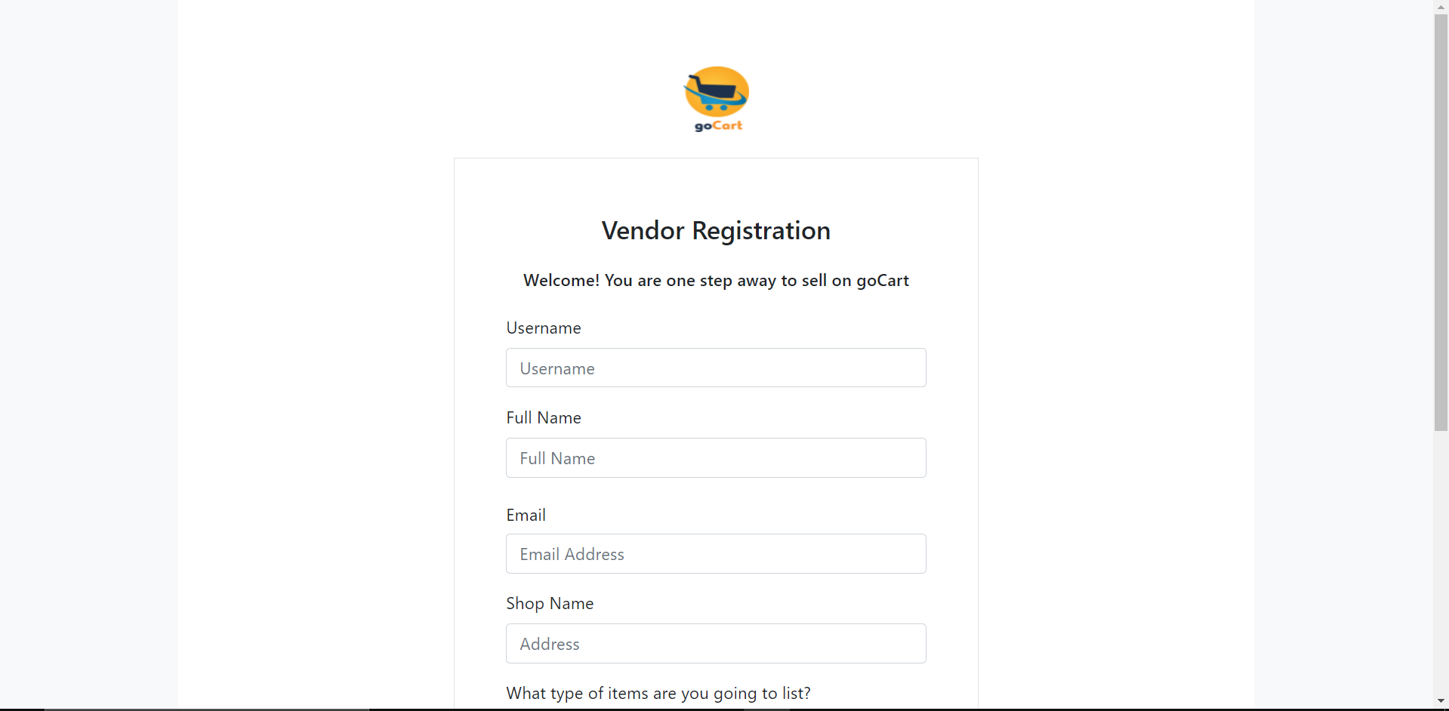
Work in Progress
Fig. Sign in Fig. Sign Up

Slide 31
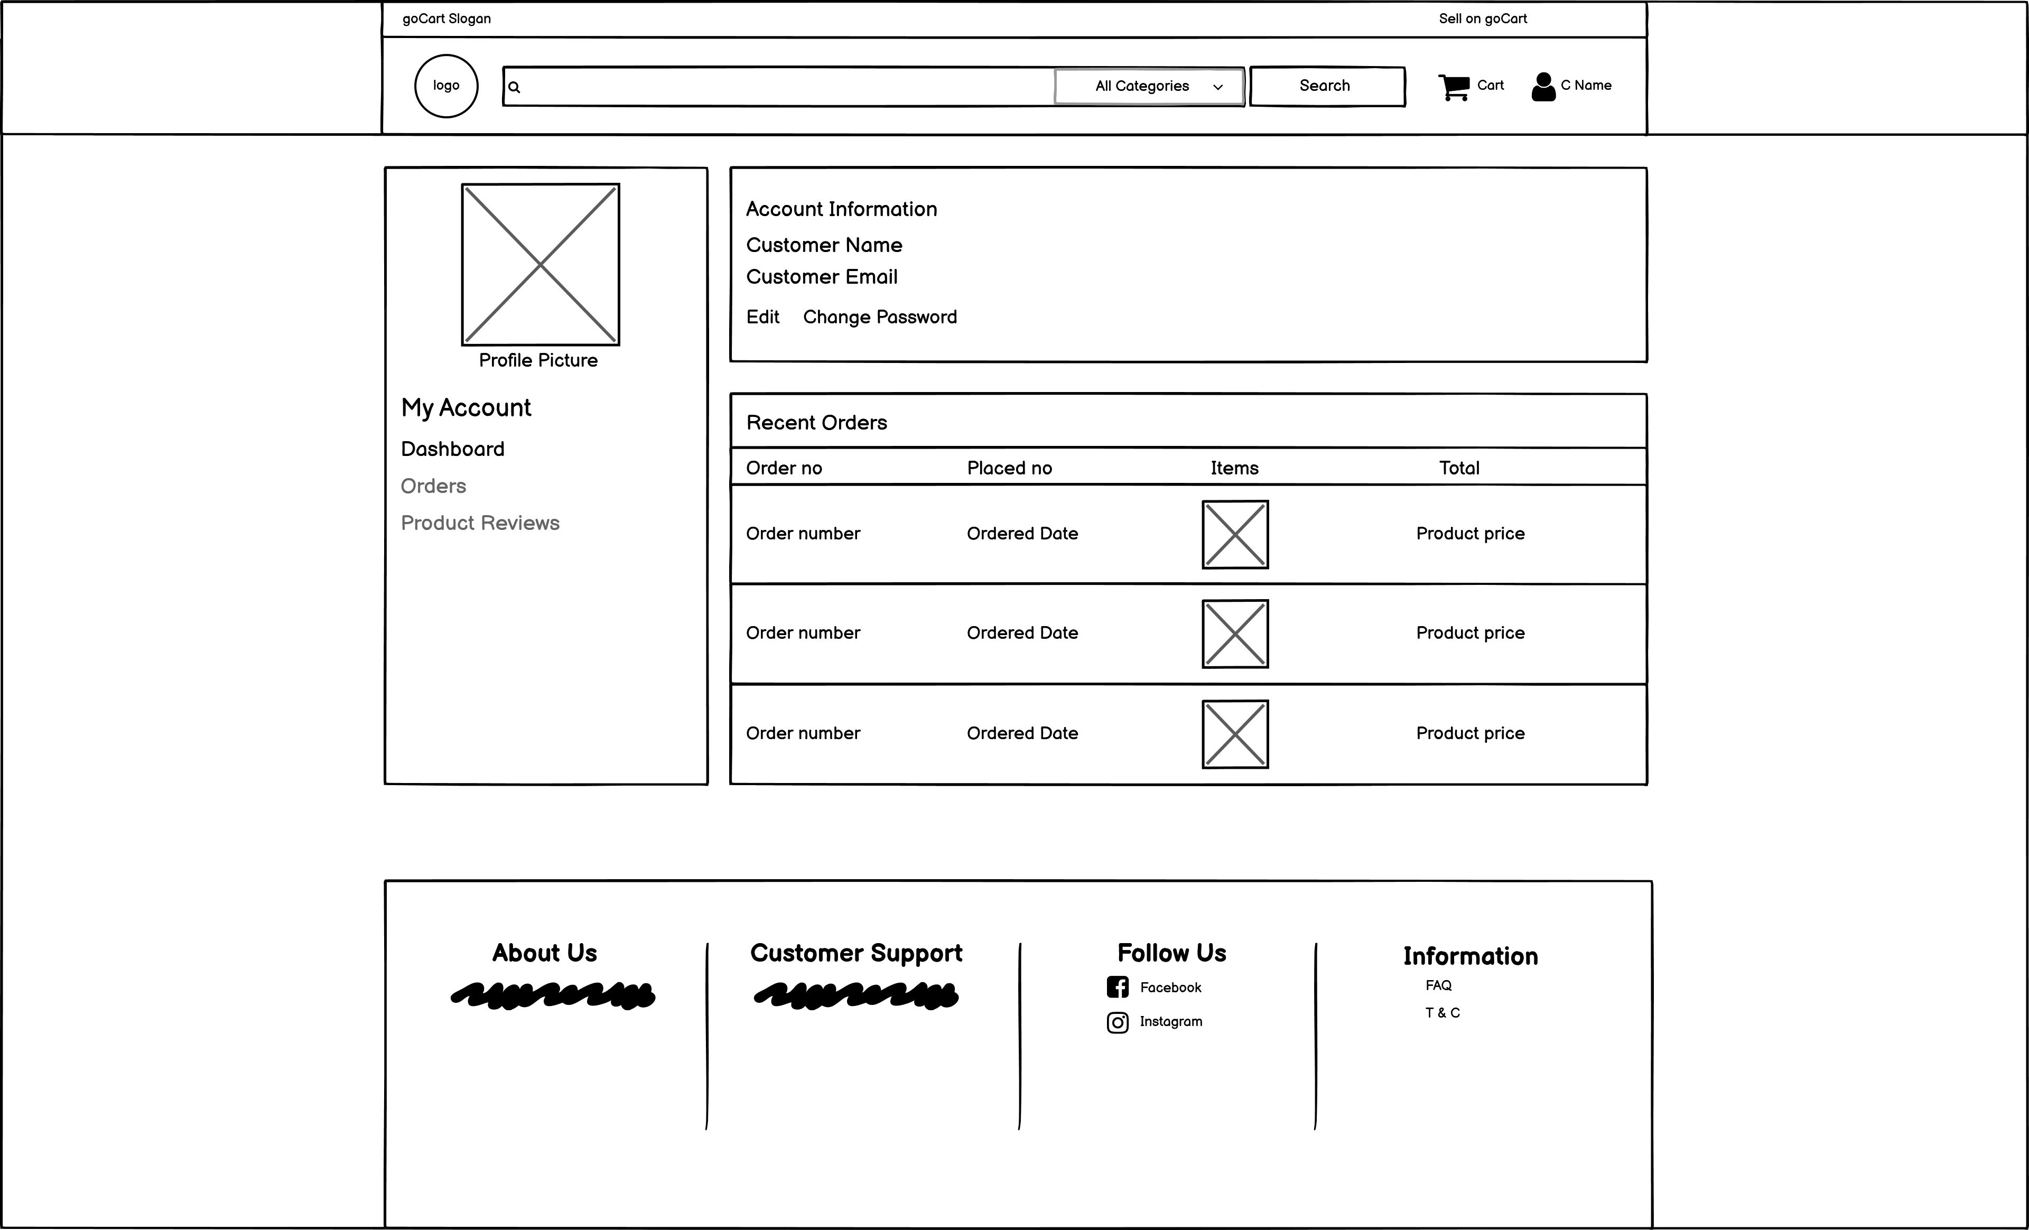
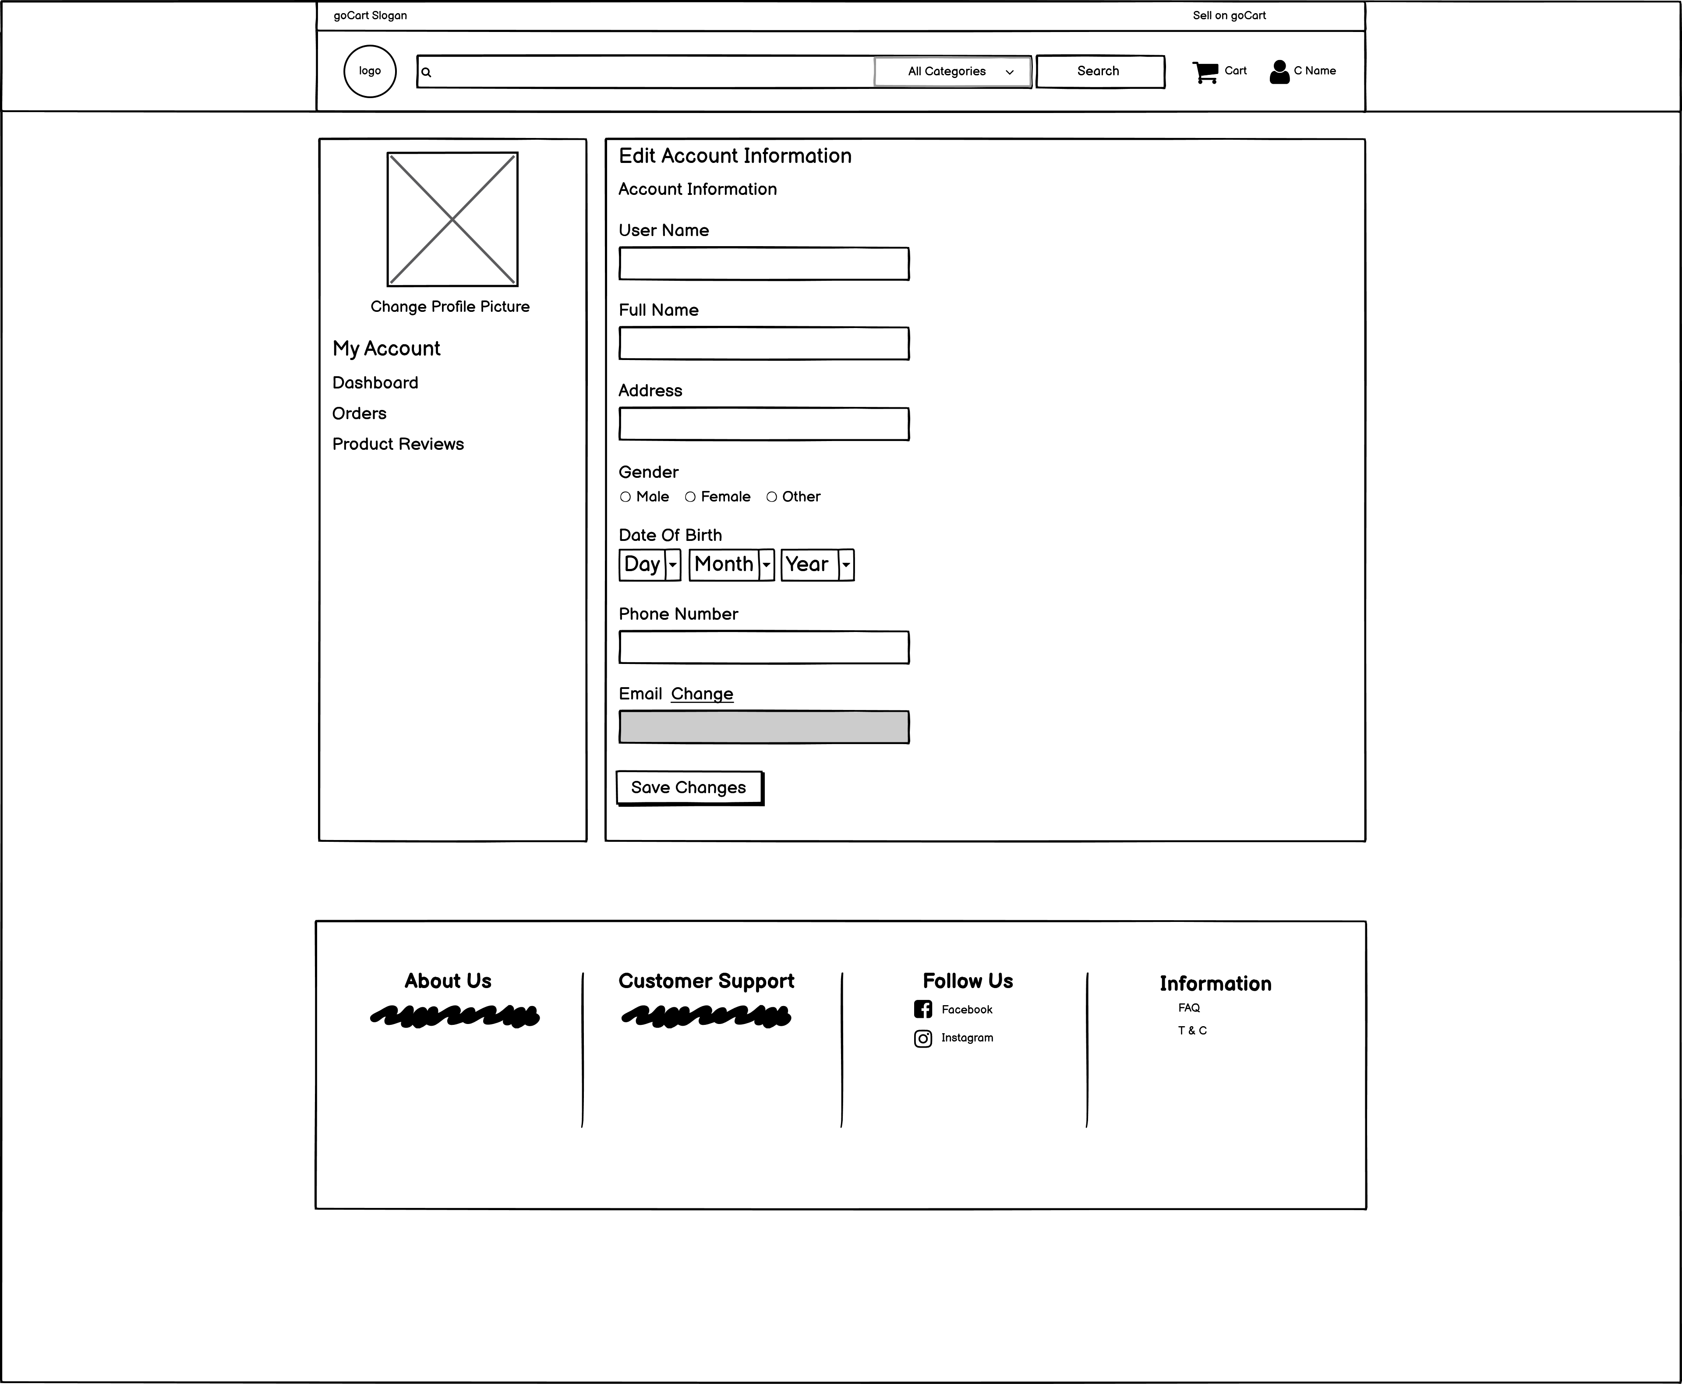
Customer Wireframe
Fig. Customer Profile Fig. Account Update

Slide 32
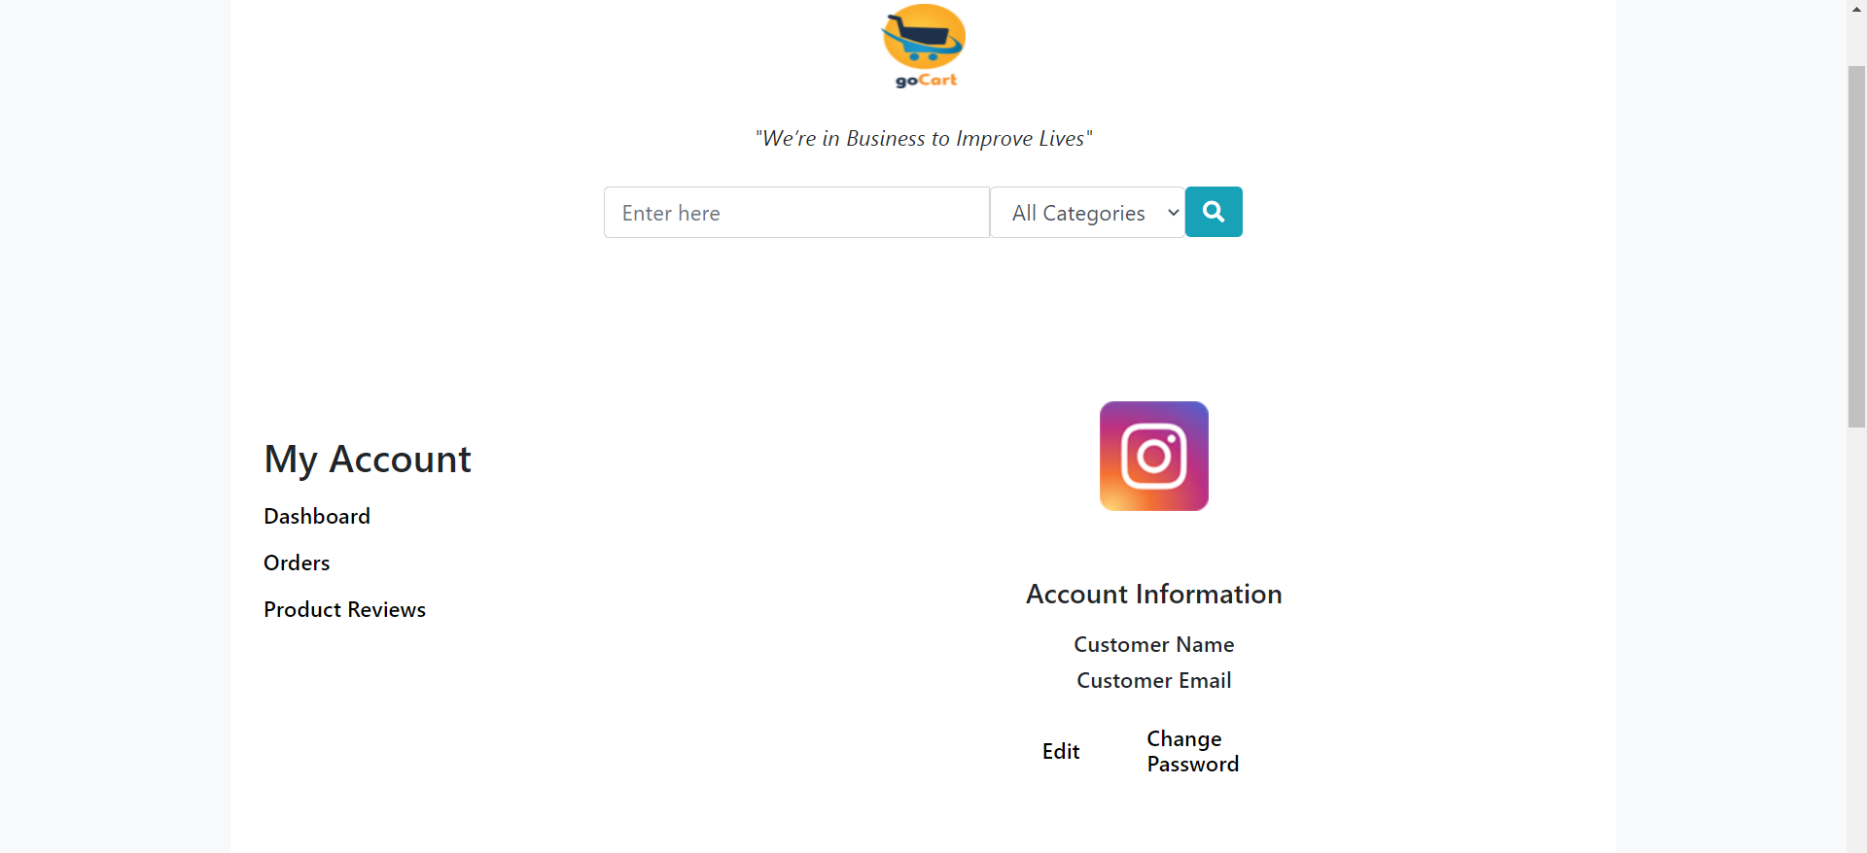
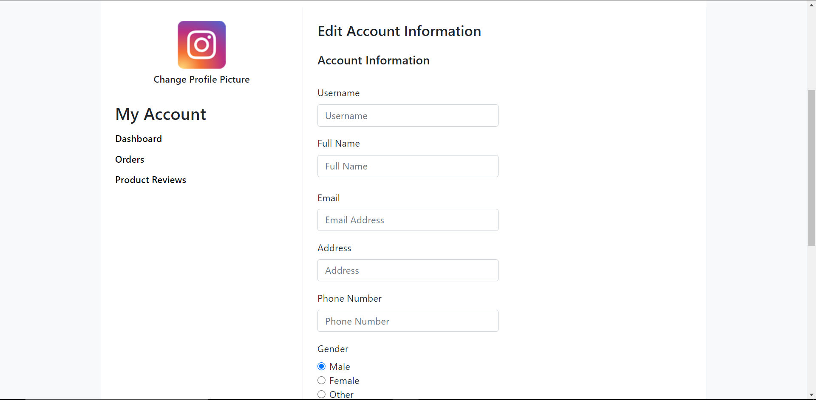
Work in Progress
Fig. Customer Profile Fig. Customer Edit Profile

Slide 33
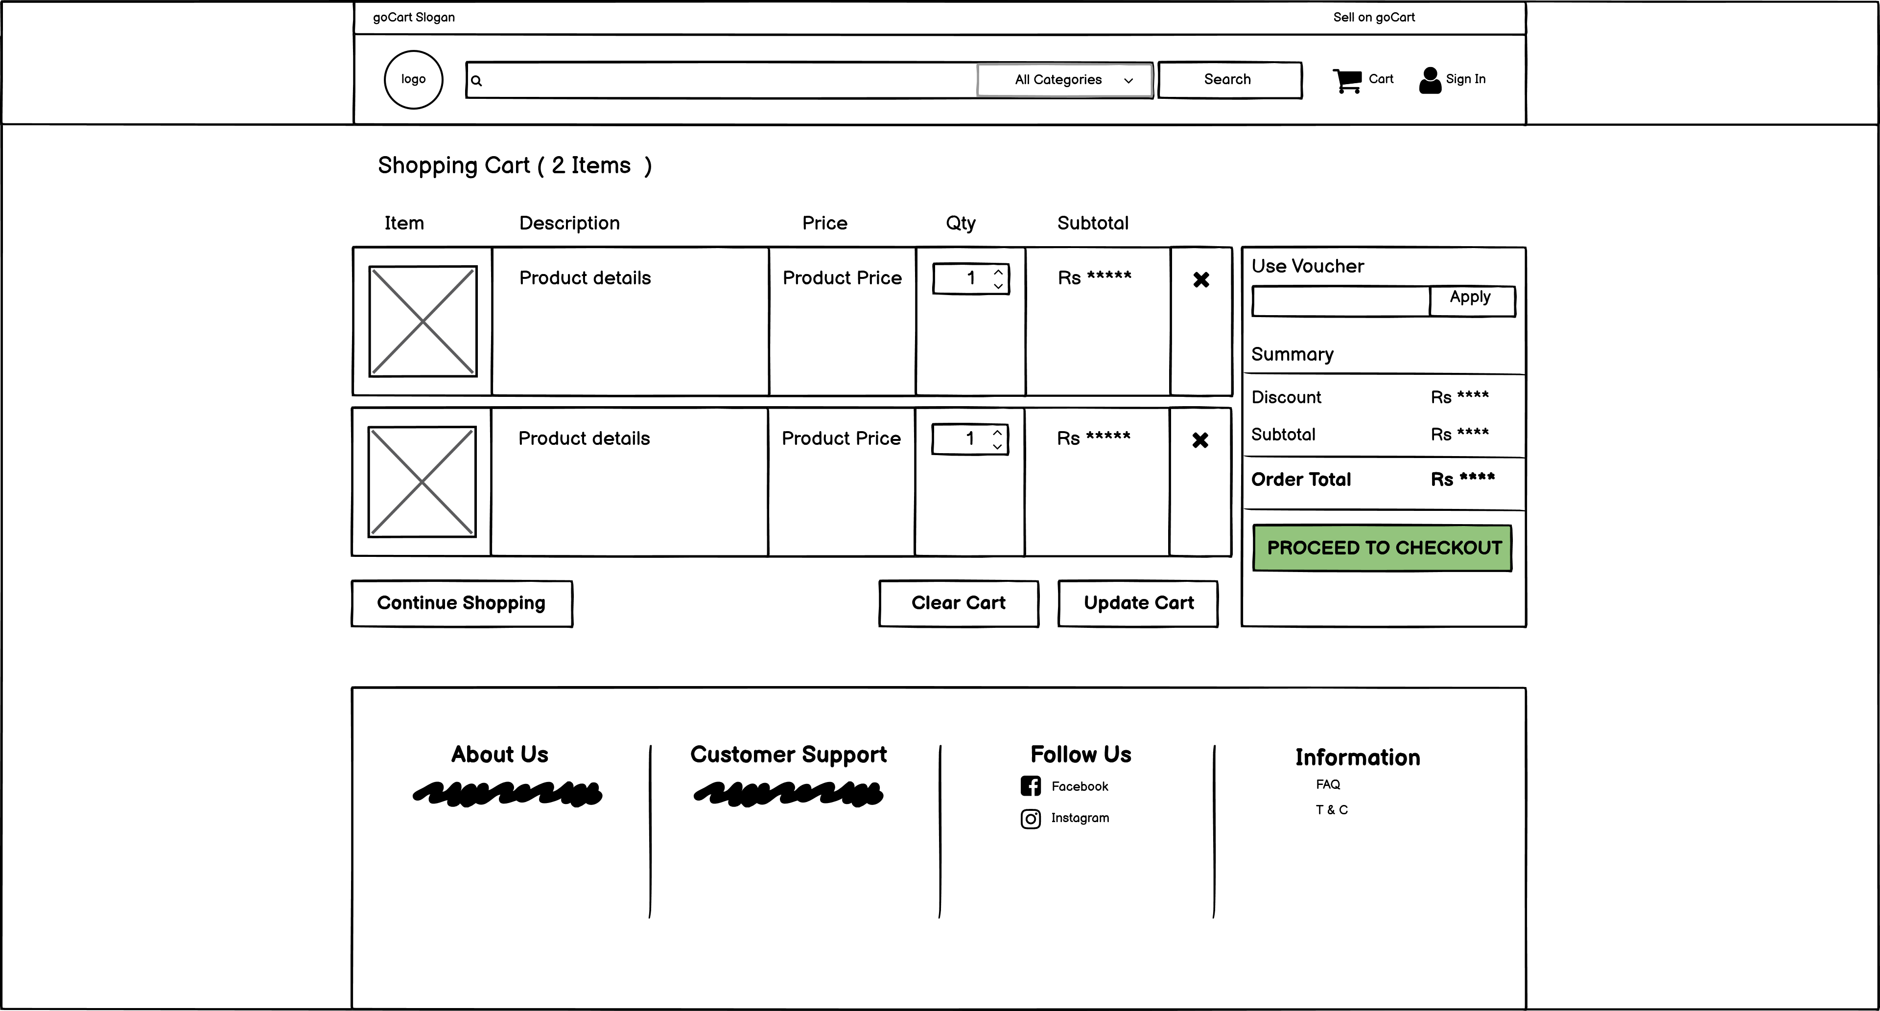
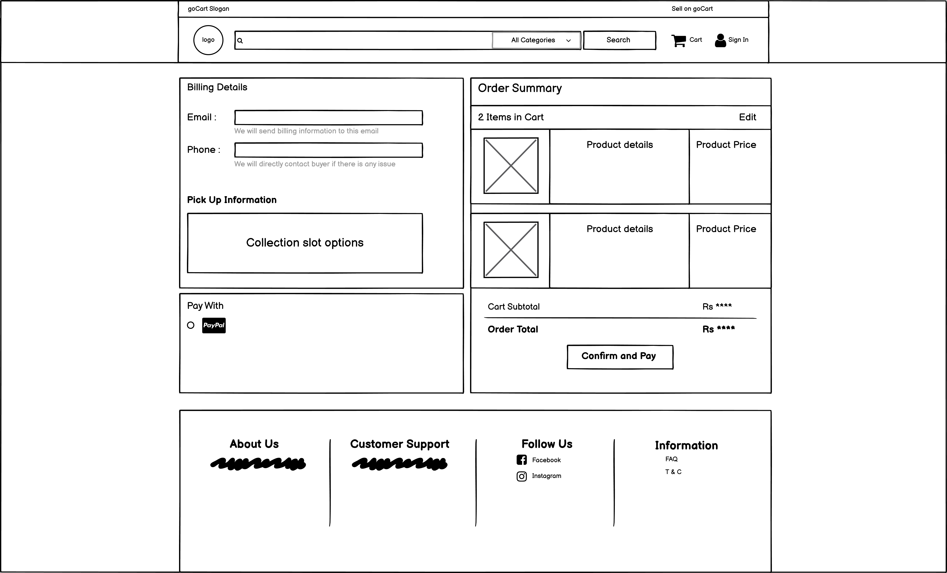
Customer Wireframe
Fig. Cart Fig. Checkout

Slide 34
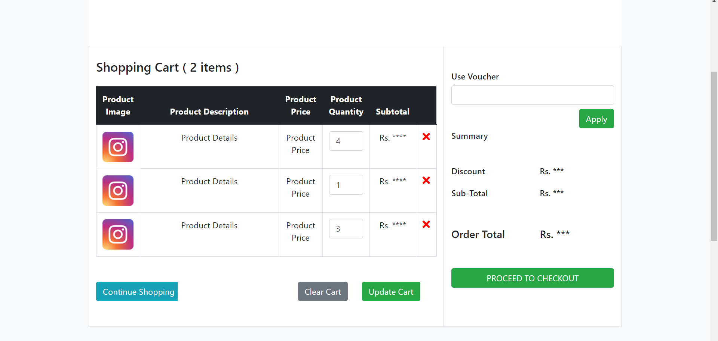
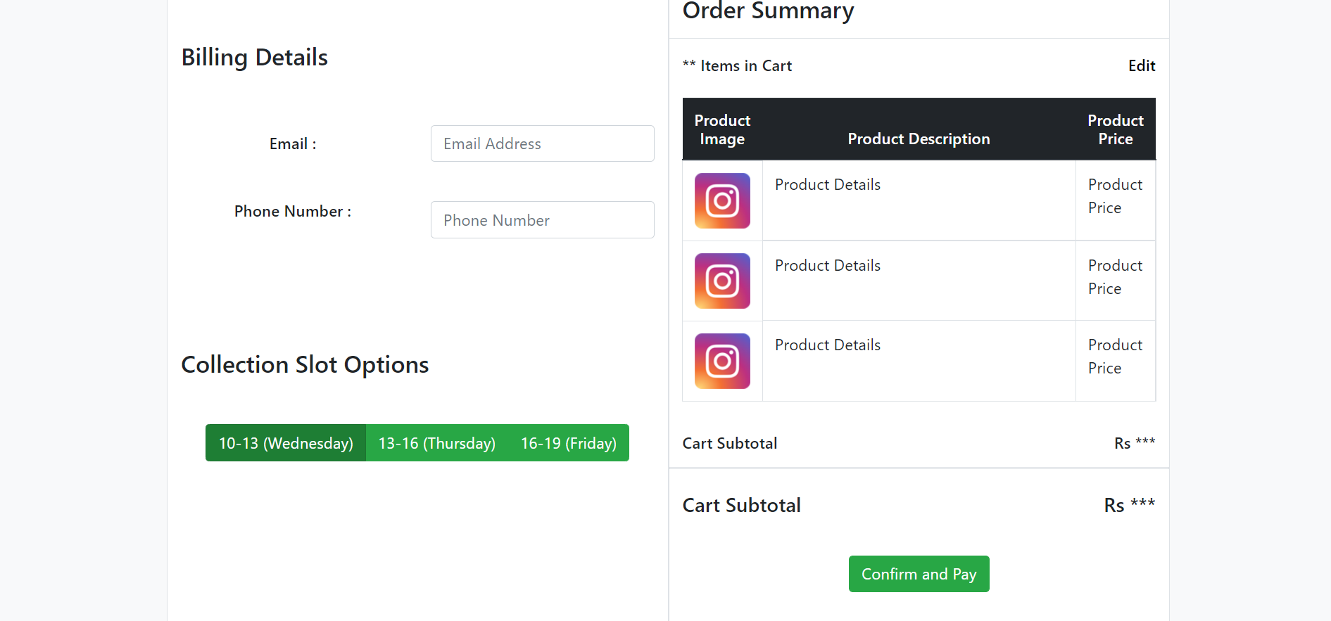
Work in Progress
Fig. Cart Fig. Checkout

Slide 35
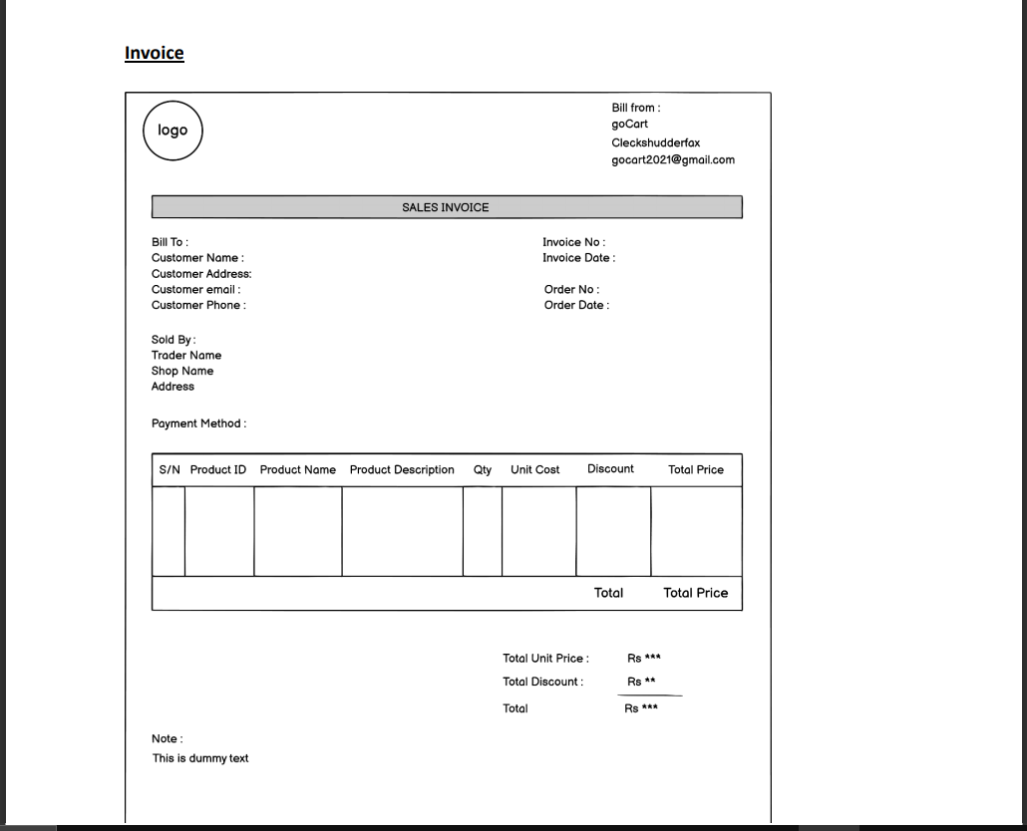
Customer Wireframe
Invoice

Slide 36
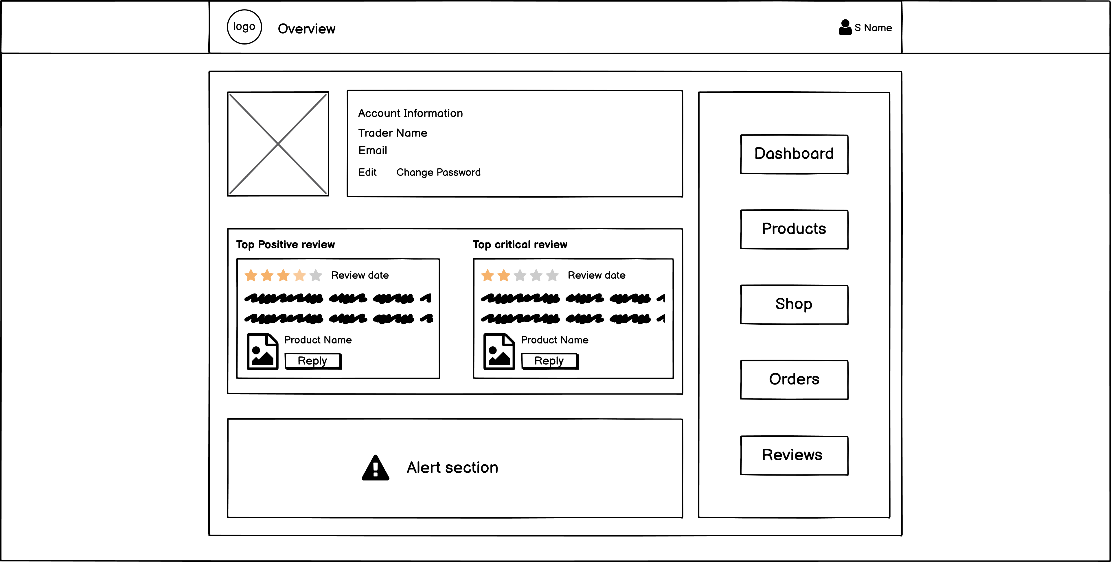
Trader Wireframe
Fig, Trader Home

Slide 37
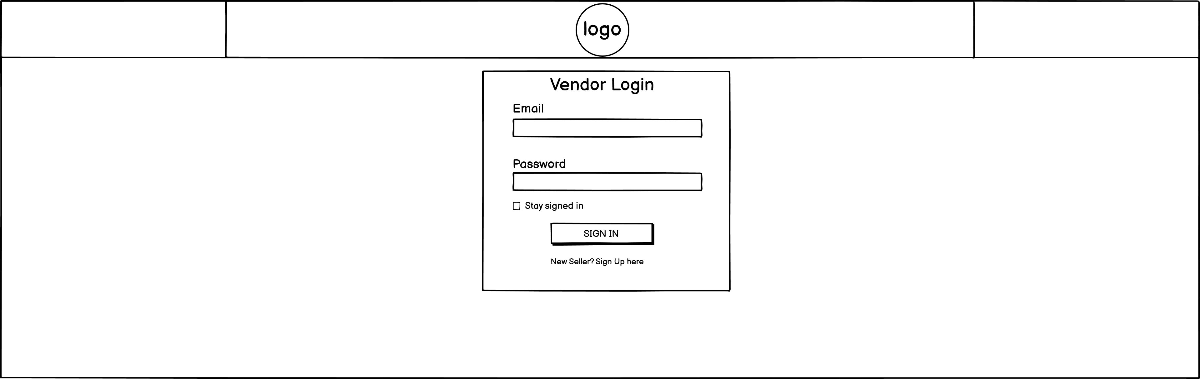
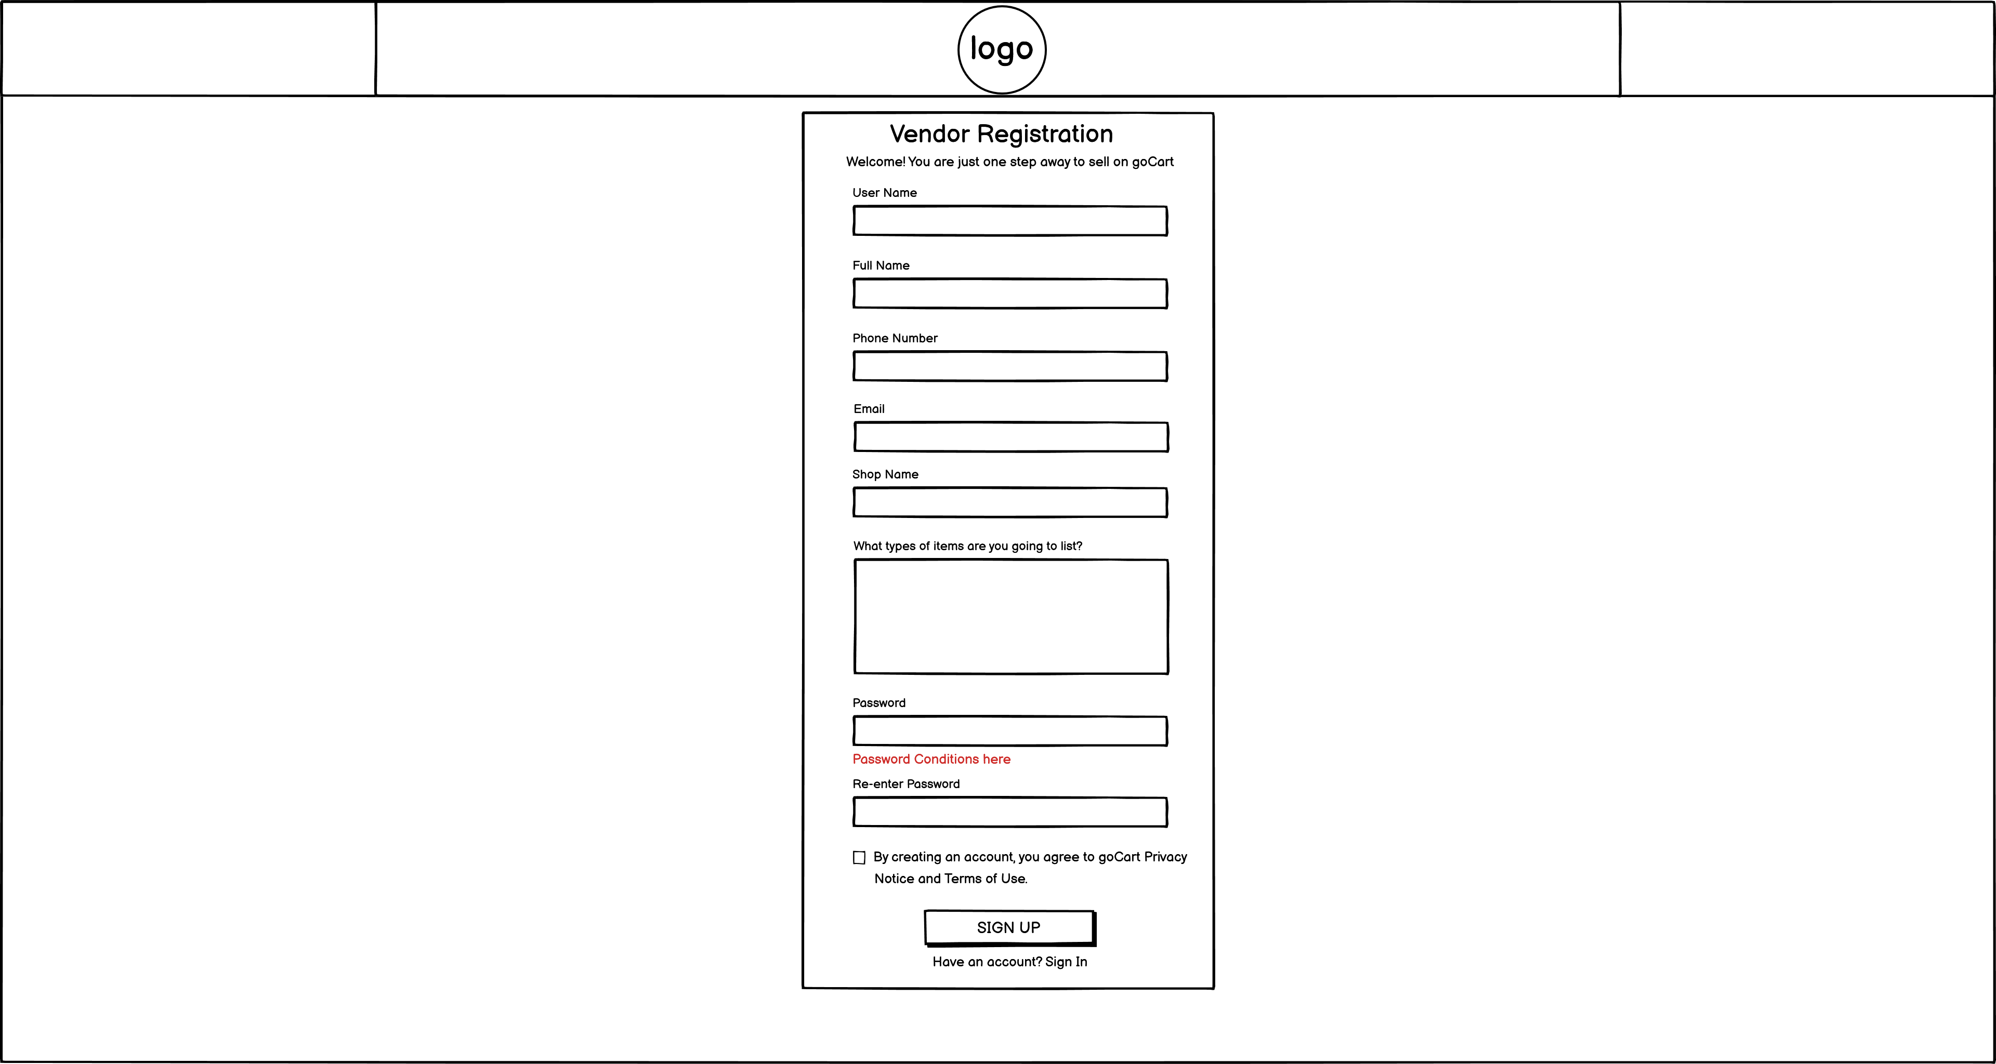
Trader Wireframe
Fig. Sign In Fig. Trader Sign Up

Slide 38
Work in Progress
Fig. Sign In Fig. Sign Up

Slide 39
Requirement catalogue
Moscow rule has been used to derive requirements.
The requirements have been divided into five different categories which are;
Customer Interface, Trader Interface, Admin Interface, Product Interface and Non-Functional Requirements.

Slide 40
Customer Interface
Users should be able to access to products by shop or by product type.
The site should be responsive and should be viewable on mobile as well as desktop devices and viewable on the most popular browsers.
A basket function that keeps goods that spans all traders and requires a single payment for every user.
The system should be able to keep a maximum of 10 shops(traders).
The design of the website should be based on Cleckhuddersfax theme.
The cart and totals reported to the traders should include a breakdown of goods ordered and payment acquired by trader.
There should be a maximum of 20 orders per slot.

Slide 41
Trader Interface
Traders should be able to control their products and data on their shops via a web interface.
Traders should be able to update/delete/add their required products.
Traders will login to the database on a daily basis to view reports on orders and stocks information etc.
Traders should have a trader login that allows them access to their details only.
Traders should be able to view and supervise the details of their separate trader account.
All products will have a unique ID, be associated with a trader, have a short name, a description, an item price, quantity per item, stock available, min order, max order and allergy information.

Slide 42
Management Interface
There should be a separate guidance dashboard for an admin.
An Admin login which can access any of the trader accounts.
Traders will be provided with a monthly data/statistic on their amount of product sales.
The daily report will identify the goods, quantities that have been ordered and the collection time slot.
Traders will be provided with a weekly finance record which will recognize payments to be made to them resulting from the remainders of 7 days orders.
Traders will be able to pass this report ordered in a number of ways: by alphabetically, by total number of orders per product and by total cost per product.
Dashboard will give a range of daily and monthly reports.

Slide 43
Product Interface
Each product will have its own required attributes. I.e., product name, product ID, description, allergy information, price and product image.
Each product will have an add to cart option
Each product will have its own review section.

Slide 44
Non Functional Requirements
HTML/CSS/ JavaScript will be used for building the website.
The sites files and folders will be properly managed, with a guide for Authorized people to access it.
PHP with Oracle Database will be used to build the site.
Template is used to view dashboard

Slide 45
The End

