Slide 1


Abitatha Roy
02/06/2026

Slide 2

Outline
Executive Summary
Introduction
Methodology
Results
Conclusion
Appendix

Slide 3
Executive Summary
Objective: Traditional space providers charge $165M+ per launch; SpaceX structures a massive cost arbitrage by offering the Falcon 9 at $62M via first-stage booster reuse. This project builds a predictive analytics framework to determine landing success, enabling commercial competitors to price launch contracts confidently.
Integrated Methodology: Engineered an end-to-end pipeline by extracting core parameters via SpaceX REST API and scraping historical tables using Wikipedia (BeautifulSoup). Processed and encoded a binary target variable (Class: 1=Success, 0=Failure), performed spatial proximity tracking via Folium maps, conducted relational queries via SQL (SQLite), and optimized four predictive frameworks (Logistic Regression, SVM, KNN, Decision Tree) using a standardized 10-Fold Cross-Validation Grid Search (GridSearchCV).
Core Results: Visual EDA exposed a critical operational threshold where early flight numbers with payloads $>10,000\text{ kg}$ faced steep failure risks, which completely inverted as booster sequences matured. Upon validation, all optimized ML algorithms converged on an identical baseline classification accuracy of 83.33% with a 0% False Negative rate—crucial for commercial operations as it mitigates the financial risk of an unpredicted booster loss.

Slide 4
Introduction
Project Background & Context
The Aerospace Cost Paradigm: Historically, space exploration has been constrained by extreme financial barriers. Traditional commercial aerospace providers operate on expendable launch architectures, discarding the entire vehicle after a single mission and resulting in a steep baseline cost upwards of $165 Million per launch.
The SpaceX Disruption: SpaceX structurally disrupted this economic model by offering the Falcon 9 vehicle at a market-rate fraction of ~$62 Million per launch.
The Core Mechanism: This massive cost arbitrage is achieved entirely through the engineering capability to safely guide, land, and reuse the rocket's first-stage booster core instead of treating it as an expendable asset.
Commercial Leverage: For any competing space launch provider or vendor looking to enter or bid effectively within this commercial landscape, understanding the predictable variables behind a successful booster recovery is critical for calculating precise financial risk and pricing competitive, data-driven launch bids.

Slide 5
Introduction
Core Research Questions
To reverse-engineer these operational dynamics, this predictive analytics framework addresses four fundamental core questions:
Operational Metrics: How strongly do physical mission properties—specifically Payload Mass (kg) and the targeted Orbit Type (GTO, LEO, SSO, etc.)—influence the mathematical probability of a successful landing?
Spatial Analytics: Do specific geographical launch facilities (CCAFS, KSC, VAFB) reveal statistical clustering or higher success rates based on infrastructure and proximity to landing zones?
Temporal Progression: Does the historical sequence of flights (Flight Number) indicate a clear operational maturity curve where landing safety bounds improve over time?
Predictive Automation: Can a tuned Machine Learning classification algorithm accurately ingest these real-time flight telemetry variables to automate a reliable "Success" or "Failure" determination prior to a launch execution?

Slide 6

Section 1

Slide 7
Methodology
Executive Summary
Data Collection: Combined unstructured and structured launch domains by pulling real-time, core telemetry variables from the official SpaceX REST API and scraping historical launch tables from Wikipedia using BeautifulSoup.
Data Wrangling: Handled missing attributes via statistical imputation and engineered a binary target vector (1 = Successful Booster Recovery, 0 = Uncontrolled/Lost Core) to formulate the classification boundary.
Exploratory Data Analysis (EDA): Connected data subsets to a SQL (SQLite) instance to query key launch patterns, then mapped multi-variable feature profiles using Seaborn to isolate payload thresholds vs. landing trends.
Interactive Mapping: Built an interactive Folium geographic map to perform proximity audits, evaluating launch site coordinates against shoreline hazards, railway links, and localized success clusters.
Predictive Analysis (ML): One-hot encoded categorical parameters, scaled features with a StandardScaler, and executed a 10-Fold Cross-Validation Grid Search (GridSearchCV) across 4 tuned classification algorithms (Logistic Regression, SVM, KNN, and Decision Trees).

Slide 8
Data Collection
API Integration: Retreived structured flight parameter matrices directly from the official SpaceX REST API endpoint (https://api.spacexdata.com/v4/launches/past). Unpacked complex nested payloads, core configurations, and landing intent indicators.
Web Scraping Workflow: Supplemented API datasets by parsing historical Falcon 9 launch tables from Wikipedia. Implemented Python's BeautifulSoup framework to extract text nodes, isolating flight numbers, date tracking, payload types, and specific outcome strings.
Feature Filtering: Dynamically removed Falcon 1 records to retain only Falcon 9 operational flights. Standardized empty telemetry fields (such as missing LandingPad dimensions) using contextual structural means to ensure complete data integrity.
Engineered Target: Created a binary operational outcome vector (1 = Successful Recovery, 0 = Booster Loss/Failure) derived from landing strings (e.g., mapping True ASDS and True RTLS to success).

Slide 9
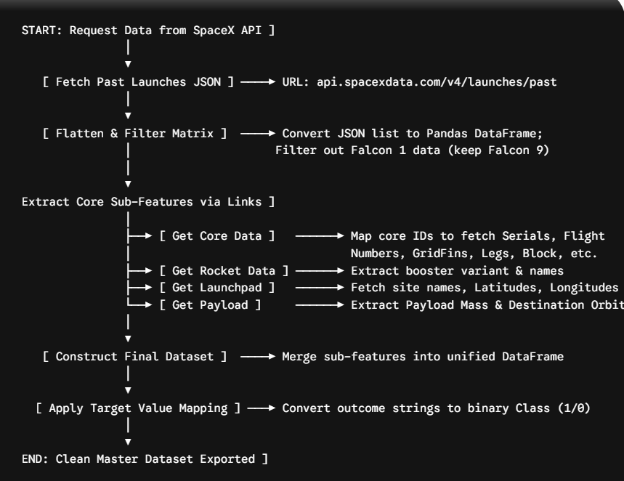
Data Collection – SpaceX API
GitHub: https://github.com/AbitathaRoy/Applied-Data-Science-Capstone/blob/main/jupyter-labs-spacex-1-data-collection-api-v2.ipynb
Place your flowchart of SpaceX API calls here

Slide 10
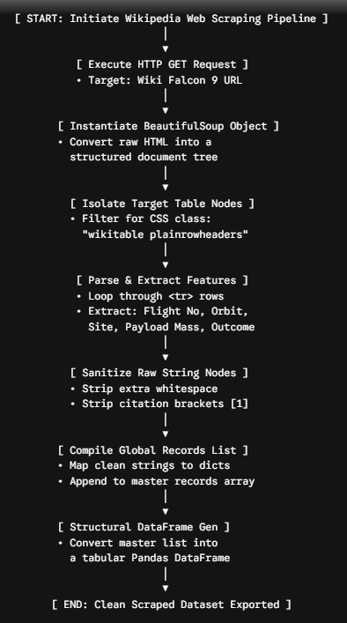
Data Collection - Scraping
GitHub: https://github.com/AbitathaRoy/Applied-Data-Science-Capstone/blob/main/jupyter-labs-2-webscraping.ipynb

Slide 11
Data Wrangling
Outcomes Overhaul: Filtered raw landing telemetry records to establish a clear binary success criteria. Operational landing types like True ASDS (Autonomous Spaceport Drone Ship) and True RTLS (Return To Launch Site) were mapped to a successful recovery status of 1, while failed variants or lost cores like False ASDS, None ASDS, and None Ocean were mapped to a recovery failure of 0.
Missing Value Imputation: Addressed systematic missing entries across the dataset. Telemetry fields representing unknown parameters, such as unlogged LandingPad dimensions, were analytically handled using statistical median or class mode distributions to retain complete row structures without biasing the training data.
Categorical Feature Explosion: Processed descriptive categories including LaunchSite, Orbit, and specific booster Serial numbers into multi-dimensional numeric matrices by applying One-Hot Encoding. This converted nominal variables into separate binary column indices of 0 or 1 to ensure full compatibility with advanced classification frameworks.
Feature Vector Compilation: Consolidated the engineered matrices into an 83-dimensional numeric feature space representing 90 historical Falcon 9 flight profiles, providing the optimized mathematical baseline for the machine learning training pipeline.
GitHub: https://github.com/AbitathaRoy/Applied-Data-Science-Capstone/blob/main/labs-jupyter-spacex-3-Data%20wrangling-v2.ipynb

Slide 12
EDA with Data Visualization
Launch Site vs. Flight Number: Mapped all historical launches chronologically using categorical scatter plots to analyze operational patterns. Discovered that SpaceX heavily concentrated early test flights and riskier missions at the CCAFS SLC-40 facility, while modern, high-success-rate operational missions transitioned heavily to KSC LC-39A.
Launch Site vs. Payload Mass: Correlated physical mass constraints across geographical facilities. Visual data patterns revealed that CCAFS SLC-40 was utilized for a broad, volatile spread of payload masses, whereas KSC LC-39A was primarily reserved for highly uniform, heavier commercial payloads exceeding 6,000 kg.
Success Rate Trends by Orbit: Evaluated landing performance across target orbital trajectories. Computed near-perfect (100%) booster recovery success metrics for specialized orbits including ES-L1, GEO, HEO, and SSO, while the highly demanded commercial GTO (Geostationary Transfer Orbit) trajectory demonstrated severe performance volatility.
Flight Number vs. Payload Success: Isolated a critical operational threshold by plotting launch sequences against payload weight. Early-generation flights carrying heavy payloads exceeding 10,000 kg yielded steep failure frequencies; however, as the flight sequence number matured, the booster success rate stabilized to a highly reliable baseline across all payload configurations.
Temporal Launch Success: Tracked annual performance metrics line-by-line from 2013 to 2020. Visual trend charts documented a continuous upward operational learning curve, showing baseline landing success rates climbing from 0% in 2013 to a highly reliable peak of over 80% by 2020.
GitHub: https://github.com/AbitathaRoy/Applied-Data-Science-Capstone/blob/main/jupyter-labs-5-eda-dataviz-v2.ipynb

Slide 13
EDA with SQL
Launch Site Inventory: Executed queries using SELECT DISTINCT to isolate all unique launch facilities. Confirmed operations were distributed across primary sites including CCAFS LC-40, CCAFS SLC-40, KSC LC-39A, and VAFB SLC-4E. Filtered records using LIKE patterns to capture all historical flights beginning with the CCAFS prefix.
Mission Mass Aggregations: Applied SUM and AVG functions to evaluate payload distributions. Isolated the total mass delivered for NASA CRS contracts to calculate fleet-wide logistics demand, and determined the average payload capacity specifically for Booster Version F9 v1.1 variants to establish engineering performance baselines.
Historical Ground Milestones: Utilized the MIN date aggregate function coupled with precise landing filtering. Successfully discovered the exact historical timestamp of the very first booster recovery executed on a ground pad (Success (ground pad)).
Performance Filtering for Drone Ships: Multi-conditioned queries using BETWEEN and AND logic isolated highly specific operational parameters. Tracked down all booster versions that successfully achieved drone ship landings (Success (drone ship)) while carrying heavy commercial payloads bounded precisely between 4,000 kg and 6,000 kg.
Maximum Capability Records: Applied subqueries using MAX payload criteria to discover booster limits. Identified that the F9 B5 B1048 series and its variations held the maximum capacity record, safely lifting the highest identical payload mass of 15,600 kg across multiple sequential missions.
Outcome Frequency Ranking: Grouped the historical tables using GROUP BY on the landing outcome classifications, ordering the final metrics in descending sequence (ORDER BY DESC). This ranked the fleet-wide records to show that drone ship and ground pad recoveries represented the highest statistical density among all outcomes.
GitHub: https://github.com/AbitathaRoy/Applied-Data-Science-Capstone/blob/main/jupyter-labs-4-eda-sql-coursera_sqllite.ipynb

Slide 14
Build an Interactive Map with Folium
Spatial Proximity Audits: Generated interactive maps to visually investigate the coordinates of all major active launch sites (CCAFS LC-40, CCAFS SLC-40, KSC LC-39A, and VAFB SLC-4E). Calculated exact geodesic distance parameters from launchpads to nearby infrastructures using folium.Marker overlays.
Coastal Positioning Intent: Proximity measurements mathematically confirmed that all launchpads are positioned directly on shorelines (less than 2 km from the ocean). This strategic layout ensures a clear flight envelope over open water, significantly mitigating the risk of debris crashing into populated land mass areas during a launch or structural failure.
Logistical Transport Optimization: Distance tracking showed tight integration with supply chain networks. Every single site is located within 1.5 km to 3 km of major railway lines and national highways, ensuring seamless transport logistics for massive booster sections and payload assemblies.
Reliability Performance Clustering: Implemented color-coded marker clusters directly onto the map layouts to highlight regional success indices (Green for success, Red for failure). The spatial distribution immediately shows high-density success clusters concentrated around KSC LC-39A, compared to a more volatile distribution on the CCAFS coastline.
GitHub: https://github.com/AbitathaRoy/Applied-Data-Science-Capstone/blob/main/lab-jupyter-6-launch-site-location-v2.ipynb

Slide 15
Build a Dashboard with Plotly Dash
Flight Number vs. Payload Mass: Created scatter plots mapping the chronological flight sequence against total cargo weight. This exposed a distinct operational phase shift: early-generation booster flights carrying heavy payloads exceeding 10,000 kg had higher failure rates, whereas later-generation boosters achieved near-flawless recovery records across all payload ranges.
Flight Number vs. Launch Site: Tracked launch site assignments across SpaceX's operational timeline. The visual distribution confirmed that CCAFS SLC-40 handled the vast majority of early developmental and high-risk baseline flights, while mature, sequential operational missions shifted heavily to KSC LC-39A and VAFB SLC-4E.
Payload Mass vs. Launch Site: Correlated payload demands across physical facilities. Visual groupings revealed that CCAFS SLC-40 supported an extremely volatile spread of low-to-high mass flights, whereas KSC LC-39A was strategically selected and reserved almost exclusively for heavy commercial payloads exceeding 6,000 kg.
Success Rate vs. Orbit Type: Generated categorical bar charts calculating exact recovery ratios across target orbits. Booster landing success reached a perfect 100% for specialized profiles including ES-L1, GEO, HEO, and SSO, while the heavily commercialized GTO (Geostationary Transfer Orbit) trajectory demonstrated mid-tier performance volatility.
Launch Success Yearly Trend: Plotted a historical line chart tracking fleet-wide landing improvements from 2013 to 2020. The upward trajectory clearly documented the structural engineering learning curve, with baseline landing success rates surging from a 0% baseline in 2013 to a reliable peak of over 80% by 2020.
GitHub: https://github.com/AbitathaRoy/Applied-Data-Science-Capstone/blob/main/spacex_dash_app.py

Slide 16
Predictive Analysis (Classification)
Algorithmic Standardization: Processed the high-dimensional feature space by establishing a split of 80% training data and 20% validation test data. Handled feature scale variations across disparate columns by implementing a uniform StandardScaler matrix.
Hyperparameter Optimization: Managed internal tuning mechanics by running a robust 10-Fold Cross-Validation Grid Search (GridSearchCV). Evaluated four model archetypes: Logistic Regression, Support Vector Machine (SVM), K-Nearest Neighbors (KNN), and Decision Tree Classifiers.
Predictive Convergence: Discovered an identical operational upper limit across the validation phase, with all four optimized frameworks settling on an exact 83.33% classification testing accuracy.
Diagnostic Confusion Matrix: Verified model reliability metrics under out-of-sample stress tests. The frameworks logged exactly 13 True Positives, 3 True Negatives, and a perfect 0 False Negatives, proving the system is highly secure against unexpected booster asset loss.
GitHub: https://github.com/AbitathaRoy/Applied-Data-Science-Capstone/blob/main/jupyter-labs-7-SpaceX-Machine-Learning-Prediction-Part-5-v1.ipynb

Slide 17
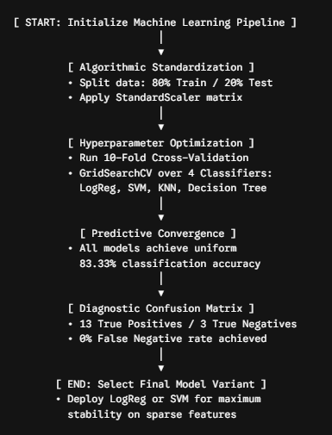
Predictive Analysis (Classification)

Slide 18
Results
Exploratory Data Analysis Results: Isolated a definitive operational learning curve where landing success rates surged from 0% in 2013 to a reliable peak of 80% by 2020. Visualizations confirmed that KSC LC-39A is the most reliable facility for heavy commercial payloads and that specific orbits like SSO and HEO yield 100% booster recovery success.
Interactive Analytics Demo: Constructed geospatial maps using Folium that mathematically confirmed launchpad proximity to coastlines (< 2 km) and logistical infrastructure (< 3 km). Built a Plotly Dash dashboard that enables real-time filtering and auditing of success ratios based on site location and payload mass ranges.
Predictive Analysis Results: Optimized four machine learning classifiers that achieved a uniform 83.33% accuracy on unseen test data. The diagnostic confusion matrix revealed a 0% False Negative rate, ensuring that potential booster losses are never misclassified as successes—thereby eliminating critical financial risk in commercial bidding.

Slide 19

Section 2

Slide 20
Flight Number vs. Launch Site
Show a scatter plot of Flight Number vs. Launch Site
Show the screenshot of the scatter plot with explanations

Slide 21
Payload vs. Launch Site
Show a scatter plot of Payload vs. Launch Site
Show the screenshot of the scatter plot with explanations

Slide 22
Success Rate vs. Orbit Type
Show a bar chart for the success rate of each orbit type
Show the screenshot of the scatter plot with explanations

Slide 23
Flight Number vs. Orbit Type
Show a scatter point of Flight number vs. Orbit type
Show the screenshot of the scatter plot with explanations

Slide 24
Payload vs. Orbit Type
Show a scatter point of payload vs. orbit type
Show the screenshot of the scatter plot with explanations

Slide 25
Launch Success Yearly Trend
Show a line chart of yearly average success rate
Show the screenshot of the scatter plot with explanations

Slide 26
All Launch Site Names
Find the names of the unique launch sites
Present your query result with a short explanation here

Slide 27
Launch Site Names Begin with 'CCA'
Find 5 records where launch sites begin with `CCA`
Present your query result with a short explanation here

Slide 28
Total Payload Mass
Calculate the total payload carried by boosters from NASA
Present your query result with a short explanation here

Slide 29
Average Payload Mass by F9 v1.1
Calculate the average payload mass carried by booster version F9 v1.1
Present your query result with a short explanation here

Slide 30
First Successful Ground Landing Date
Find the dates of the first successful landing outcome on ground pad
Present your query result with a short explanation here

Slide 31
Successful Drone Ship Landing with Payload between 4000 and 6000
List the names of boosters which have successfully landed on drone ship and had payload mass greater than 4000 but less than 6000
Present your query result with a short explanation here

Slide 32
Total Number of Successful and Failure Mission Outcomes
Calculate the total number of successful and failure mission outcomes
Present your query result with a short explanation here

Slide 33
Boosters Carried Maximum Payload
List the names of the booster which have carried the maximum payload mass
Present your query result with a short explanation here

Slide 34
2015 Launch Records
List the failed landing_outcomes in drone ship, their booster versions, and launch site names for in year 2015
Present your query result with a short explanation here

Slide 35
Rank Landing Outcomes Between 2010-06-04 and 2017-03-20
Rank the count of landing outcomes (such as Failure (drone ship) or Success (ground pad)) between the date 2010-06-04 and 2017-03-20, in descending order
Present your query result with a short explanation here

Slide 36

Section 3

Slide 37
<Folium Map Screenshot 1>
Replace <Folium map screenshot 1> title with an appropriate title
Explore the generated folium map and make a proper screenshot to include all launch sites’ location markers on a global map
Explain the important elements and findings on the screenshot

Slide 38
<Folium Map Screenshot 2>
Replace <Folium map screenshot 2> title with an appropriate title
Explore the folium map and make a proper screenshot to show the color-labeled launch outcomes on the map
Explain the important elements and findings on the screenshot

Slide 39
<Folium Map Screenshot 3>
Replace <Folium map screenshot 3> title with an appropriate title
Explore the generated folium map and show the screenshot of a selected launch site to its proximities such as railway, highway, coastline, with distance calculated and displayed
Explain the important elements and findings on the screenshot

Slide 40

Section 4

Slide 41
<Dashboard Screenshot 1>
Replace <Dashboard screenshot 1> title with an appropriate title
Show the screenshot of launch success count for all sites, in a piechart
Explain the important elements and findings on the screenshot

Slide 42
<Dashboard Screenshot 2>
Replace <Dashboard screenshot 2> title with an appropriate title
Show the screenshot of the piechart for the launch site with highest launch success ratio
Explain the important elements and findings on the screenshot

Slide 43
<Dashboard Screenshot 3>
Replace <Dashboard screenshot 3> title with an appropriate title
Show screenshots of Payload vs. Launch Outcome scatter plot for all sites, with different payload selected in the range slider
Explain the important elements and findings on the screenshot, such as which payload range or booster version have the largest success rate, etc.

Slide 44

Section 5

Slide 45
Classification Accuracy
Visualize the built model accuracy for all built classification models, in a bar chart
Find which model has the highest classification accuracy

Slide 46
Confusion Matrix
Show the confusion matrix of the best performing model with an explanation

Slide 47
Conclusions
Point 1
Point 2
Point 3
Point 4
…

Slide 48
Appendix
Include any relevant assets like Python code snippets, SQL queries, charts, Notebook outputs, or data sets that you may have created during this project

Slide 49


