Slide 1
Feature Driven Development (FDD)

Slide 2
FDD:
Feature Driven Development (FDD) is an agile framework that, as its name suggests, organizes software development around making progress on features.
Features in the FDD context, though, are not necessarily product features in the commonly understood sense. They are, rather, more akin to user stories in Scrum.
In other words, “complete the login process” might be considered a feature in the Feature Driven Development (FDD) methodology.

Slide 3
FDD IN AGILE
An Agile methodology for developing software, Feature-Driven Development (FDD) is customer-centric, iterative, and incremental, with the goal of delivering tangible software results often and efficiently. FDD in Agile encourages status reporting at all levels, which helps to track progress and results.
FDD Different from Scrum:
FDD is related to Scrum, but as its name implies, it’s a feature-focused method (as opposed to a delivery-focused method). Features are a foundational piece of FDD; they’re to FDD what user stories are to Scrum: Small functions that are, most importantly, client-valued.

Slide 4
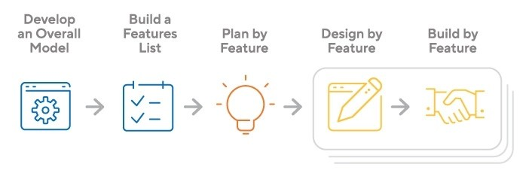
How Does FDD Work:
Typically used in large-scale development projects, five basic activities exist during FDD:
Develop overall model
Build feature list
Plan by feature
Design by feature
Build by feature
An overall model shape is formed during the first two steps, while the final three are repeated for each feature. The majority (roughly 75%) of effort during FDD will be spent on the fourth and fifth steps – Design by Feature and Build by Feature.

Slide 5
Strengths and Weakness of Feature Driven Development:
FDD’s strengths include:
Simple five-step process allows for more rapid development
Allows larger teams to move products forward with continuous success
Leverages pre-defined development standards, so teams are able to move quickly
FDD’s weaknesses include:
Does not work efficiently for smaller projects
Less written documentation, which can lead to confusion
Highly dependent on lead developers or programmers

