Slide 1


IBM Bluemix
by
Abisola Adeniran

Slide 2
WHAT IS BLUEMIX?
cloud offering from IBM

Slide 3
IBM SoftLayer Infrastructure as a Service (IaaS):
Provides self service deployment of virtual and dedicated bare metal servers.
IBM Bluemix Platform as a Service (PaaS):
Built on Cloud Foundry open source technology.
IBM Software as a Service (SaaS):
Provides ready to use business applications.
Notes:
Platform as a Service handles managing middleware, operating systems, and hosting infrastructure automatically.

Slide 4
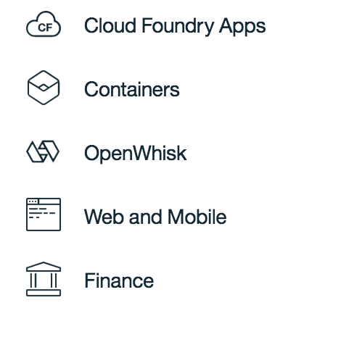
BLUEMIX CAPABILITIES
Platform as a service that makes application development easier by allowing developers to focus on code and data alone
without worrying about infrastructure.
Provides the ability to run docker images on the cloud
Event driven serverless architecture that enables you to execute functions in response to certain events.
Download starter codes for your web or mobile applications with a chosen application pattern and already integrated services.
Build custom financial applications by mixing and matching services.

Slide 5
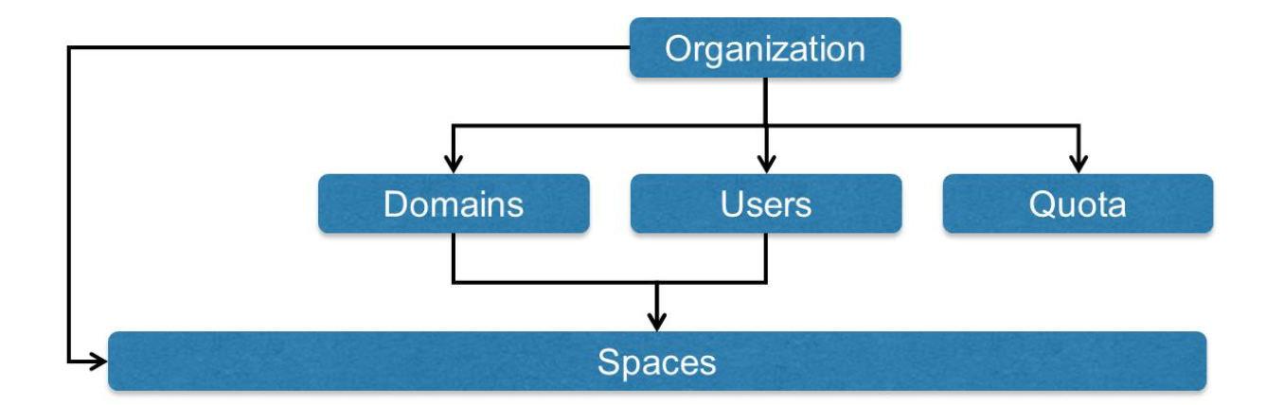
Key grouping component
Route on the internet for the org
Various roles in an org
Resources limit for the org
Collection of related applications, services and users
ORGANIZATION MANAGEMENT COMPONENTS

Slide 6
PaaS COMPONENTS
Runtime
Is a set of resources required to run an application
Boilerplates
Combination of runtime and predefined services.
Services
Ready to use functionality for running applications
Can be managed or user defined services.

Slide 7
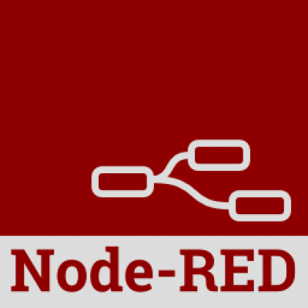
Browser based flow editor that allows you to wire together difference nodes of services.
Built on Node.js
Can be run locally, in the cloud or on a device.

Slide 8
RELEVANT LINKS
https://console.ng.bluemix.net/
https://www.ibm.com/watson/developercloud/personality-insights.html
https://d3js.org/
http://mistic100.github.io/jQCloud/
https://mustache.github.io/
https://github.com/Abiwax/Node-Red

