Slide 1
Employee Data Analysis using Excel
STUDENT NAME: J.Yogeshwari
REGISTER NO: asunm110122200238
DEPARTMENT:B.Com corporate secretaryship
COLLEGE: D R B C C C HINDHU COLLEGE

Slide 2
PROJECT TITLE
Department Analysis using Excel

Slide 3


AGENDA
Problem Statement
Project Overview
End Users
Our Solution and Proposition
Dataset Description
Modelling Approach
Results and Discussion
Conclusion
3/21/2024 Annual Review

Slide 4

PROBLEM STATEMENT
The company needs to analyse inconsistent employee performance across departments. Using Excel, this analysis will consolidate data, apply key metrics, and provide insights to improve productivity and inform management decisions.

Slide 5

PROJECT OVERVIEW
.
This project involves using Excel to analyse employee performance data, identify trends, and provide actionable insights to improve productivity and guide management decisions.

Slide 6

WHO ARE THE END USERS?
HR Managers: To track and evaluate employee performance.
Department Heads: To identify team strengths and areas for improvement.
Senior Management: To make data-driven decisions on workforce development and incentives.
Employees: To receive feedback and understand performance expectations.

Slide 7

OUR SOLUTION AND ITS VALUE PROPOSITION
Our Solution: An Excel tool for consolidating and analyzing employee performance data. Value Proposition: Provides actionable insights to enhance productivity and inform management decisions.

Slide 8
Dataset Description
Employee dataset: kaggle
26features 9 features Employee ID
Name
Gender
Department
Salary
Start date
FTE
Employee type
Work location
Job rating

Slide 9

THE "WOW" IN OUR SOLUTION
Our Excel-based tool transforms scattered performance data into powerful insights with minimal effort. It offers instant, clear visuals and actionable recommendations, making performance management not just efficient, but also strategic and impactful.
3/21/2024 Annual Review
9

Slide 10
MODELLING
1. Data:Organize metrics per employee.
2. Analysis:Use pivot tables and basic stats.
3. Modeling:Apply regression or trend analysis.
4. Visualize: Create charts and dashboards.
5. Report:Summarize insights and actions.
10

Slide 11
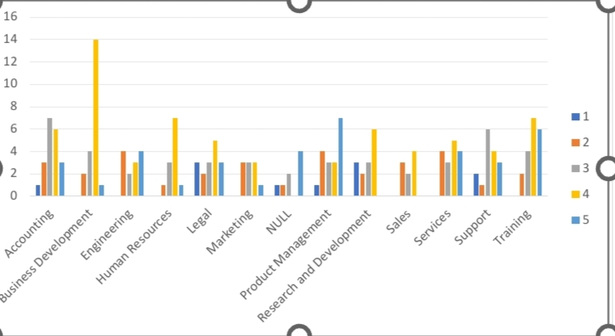
RESULTS
Insights: Performance trends and patterns.Predictions: Future performance forecasts.Visuals: Charts and dashboards.Recommendations: Actionable performance improvements.
11

Slide 12
conclusion
Excel modeling reveals performance trends, forecasts future outcomes, and supports data-driven improvements.

