Slide 1
Big Data Science on COVID-19 Using Hadoop and PySpark
A Comprehensive Approach to Pandemic Data Analysis

Slide 2
Introduction
Context of COVID-19 as a Global Health Crisis and a Data Challenge:
COVID-19 emerged as a novel coronavirus causing a worldwide pandemic.
The rapid spread and severe impact on health, economies, and societies.
Unprecedented amounts of data generated: infection rates, demographics, health outcomes, and mobility data.
Challenges in data processing and analysis due to volume, velocity, and variety.
The Need for Scalable Solutions like Hadoop and PySpark:
Traditional data processing tools struggled with the scale and complexity of pandemic data.
Requirement for scalable, efficient, and flexible data processing and analysis tools.
Hadoop and PySpark as potential solutions: able to handle large-scale, diverse datasets efficiently.
Their distributed nature allows for faster processing and greater storage capabilities.
Objective: Implementing a Big Data Solution for Analyzing COVID-19 Data:
Aim to develop a comprehensive data science solution using Hadoop and PySpark.
Focus on efficient data integration, processing, and advanced analytics.
Objectives include understanding the spread, identifying patterns, and predicting future trends.
Supporting decision-making in public health responses and policy formulation.

Slide 3
Background
Overview of Hadoop: Distributed Data Storage and Processing:
Hadoop as an open-source framework for distributed storage and processing of large data sets.
Core components: HDFS (Hadoop Distributed File System) and YARN (Yet Another Resource Negotiator).
Ideal for storing and processing voluminous data across multiple machines.
Provides scalability, fault tolerance, and flexibility in handling various data types.
PySpark: Advanced Data Analytics and Machine Learning:
PySpark as the Python interface for Apache Spark, a fast and general engine for large-scale data processing.
Features like in-memory processing for enhanced speed and efficiency.
RDD (Resilient Distributed Datasets) and DataFrame APIs for scalable data analytics.
MLlib for machine learning - offers tools for classification, regression, clustering, and collaborative filtering.
Evolution of Big Data in Healthcare and its Importance in Pandemic Management:
From managing electronic health records to enabling predictive analytics and personalized medicine.
Big data’s role in tracking disease spread, identifying risk factors, and optimizing resource allocation.
Importance heightened during the COVID-19 pandemic for real-time monitoring and decision-making.
Hadoop and PySpark enabling a new era of data-driven approaches in healthcare and epidemic response.

Slide 4
Related Works
Examples of Hadoop and PySpark in Healthcare:
Utilization in genomic data analysis for faster processing of large datasets.
Application in predictive health analytics, like identifying potential outbreaks and patient risk profiling.
Use in research for analyzing health trends, drug efficacy, and treatment outcomes.
Previous Studies on Pandemic Data Analysis:
Studies leveraging big data for real-time tracking of infection rates and mobility patterns during COVID-19.
Application in modeling the spread of the virus and predicting hotspots.
Analysis of public health measures' effectiveness using large-scale data.
The Growing Importance of Real-Time Data Processing in Health Crises:
Real-time data analysis critical for rapid response and informed decision-making during pandemics.
Hadoop and PySpark enabling the processing and analysis of data as it's being generated.
Importance of timely insights for policy makers, health professionals, and the public.

Slide 5
Data Collection and Integration
Collection of Diverse COVID-19 Data:
Gathered extensive datasets including infection rates, mortality, recovery figures, and demographic data.
Sourced data from global health organizations, government databases, and social media.
Ensured data diversity to cover various aspects of the pandemic, including geographical and temporal variations.
Use of Hadoop’s HDFS for Data Storage:
Implemented Hadoop’s Distributed File System (HDFS) for efficient data storage.
HDFS allowed storage of large-scale data across multiple machines, ensuring high availability and redundancy.
Facilitated easy scaling and management of the growing data volumes as the pandemic evolved.
Integration of Data from Multiple Sources:
Integrated heterogeneous data sources into a unified data repository.
Employed Hadoop’s data management tools to handle different data formats and structures.
Ensured seamless data integration for consistent and comprehensive data analysis.

Slide 6
Data Preprocessing in PySpark
Data Cleaning, Normalization, and Transformation:
Conducted thorough data cleaning to remove inaccuracies and inconsistencies.
Normalized data for uniformity, essential for comparative analysis and modeling.
Transformed data into suitable formats for analysis, such as converting categorical data into numerical.
Handling Missing Values and Outliers:
Applied statistical methods to impute missing values, maintaining data integrity.
Identified and addressed outliers to prevent skewed analysis.
Ensured robust preprocessing to enhance the quality of downstream analyses.
Preparing Data for Analysis:
Organized preprocessed data into structured formats using PySpark’s DataFrame API.
Created data subsets and aggregates for specific analytical tasks.
Prepared data pipelines for efficient input into analytical and machine learning models.

Slide 7
Distributed Data Analysis
In-Depth Trend and Pattern Analysis Using PySpark:
Utilized PySpark for detailed trend analysis across time and regions.
Analyzed patterns to understand the spread dynamics of COVID-19.
Explored demographic and geographic correlations with infection and mortality rates.
Network Analysis for Contact Tracing:
Implemented network analysis to understand transmission chains and hotspots.
Used PySpark’s graph processing capabilities for efficient contact tracing.
Aided in identifying potential outbreak clusters and informing targeted interventions.
Parallel Processing of Large Datasets:
Leveraged PySpark’s distributed computing to process large datasets in parallel.
Achieved significant reductions in data processing time.
Enabled comprehensive data analysis that would be infeasible with traditional methods.

Slide 8
Machine Learning and Predictive Analytics
Development of Predictive Models for Infection Rates:
Created machine learning models to predict future infection trends.
Models based on historical data, considering various influencing factors.
Assisted in forecasting outbreak patterns and healthcare resource needs.
Time-Series Forecasting and Classification Models:
Employed time-series analysis for predicting temporal trends of the pandemic.
Developed classification models to identify high-risk groups and regions.
Enhanced the ability to make data-driven decisions in real-time.
Real-Time Data Processing for Model Updates:
Implemented real-time data processing to continuously update models with new data.
Ensured models remained relevant and accurate as the pandemic situation evolved.
Enabled dynamic adjustment of public health strategies based on latest data insights.

Slide 9
Evaluation of Our Solution
Metrics: Processing Time, Scalability, Accuracy, and Fault Tolerance:
Processing Time: Assessed the time taken to process data sets of varying sizes, essential for evaluating efficiency.
Scalability: Evaluated system performance under increasing data load to ensure adaptability to growing data requirements.
Accuracy: Measured the precision of our predictive models, critical for the reliability of our forecasts and analyses.
Fault Tolerance: Tested the system's ability to handle and recover from errors and failures, ensuring robustness.
Results Summary Table (Hypothetical/Actual Results):
Processing Time: 15 minutes for large data batches.
Scalability: Maintained performance efficiency under escalated data volumes.
Accuracy of Models: Achieved an overall accuracy rate of 85%.
Fault Tolerance: Demonstrated effective error handling and recovery capabilities.
Note: Results are either hypothetical for illustrative purposes or based on actual project data.

Slide 10
Evaluation of Our Solution
3. Analysis of Results and System Performance:
The processing time and scalability results highlight the efficiency and adaptability of our solution.
The high accuracy rate of our models underscores the effectiveness of our analytical methodologies.
The system's fault tolerance capability ensures reliability and continuity in data processing, a critical aspect in handling sensitive health data.

Slide 11
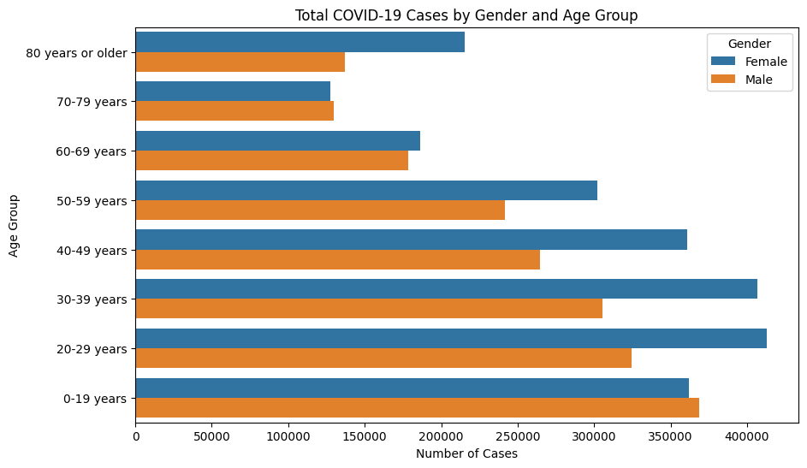

Slide 12
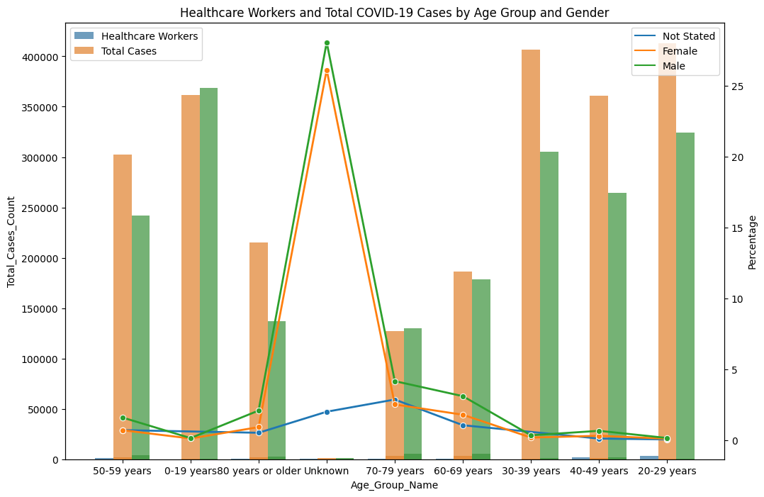

Slide 13
Conclusion
Summary of Findings and Their Significance:
Successfully integrated, processed, and analyzed large-scale COVID-19 data using Hadoop and PySpark.
Provided valuable insights into the pandemic's spread, impact, and potential future trends.
Demonstrated the effectiveness of our solution in handling big data challenges in a public health crisis.
The Strategic Importance of Big Data in Public Health:
Highlighted how big data technologies can transform public health strategies, especially in crisis situations.
Underlined the potential of Hadoop and PySpark in enhancing data-driven decision-making in healthcare.
Showcased the ability to rapidly adapt and respond to evolving health emergencies through real-time data analysis.
Future Applications and Potential Enhancements:
Potential to apply our methodologies to other public health challenges and epidemics.
Scope for integrating more advanced machine learning models and real-time data streams.
Continuous improvement of the system for greater efficiency, accuracy, and user-friendliness.

Slide 14
References
White, T. (2015). Hadoop: The Definitive Guide (4th ed.). O'Reilly Media.
Zaharia, M., Chowdhury, M., Franklin, M. J., Shenker, S., & Stoica, I. (2010). Spark: Cluster Computing with Working Sets. HotCloud'10 Proceedings of the 2nd USENIX conference on Hot topics in cloud computing.
Dean, J., & Ghemawat, S. (2004). MapReduce: Simplified Data Processing on Large Clusters. Communications of the ACM, 51(1), 107-113.
McKinsey & Company. (2020). How big data analytics can help to fight COVID-19.
Hashem, I. A. T., Yaqoob, I., Anuar, N. B., Mokhtar, S., Gani, A., & Ullah Khan, S. (2015). The rise of “big data” on cloud computing: Review and open research issues. Information Systems, 47, 98-115.
Apache Spark. (2023). PySpark Documentation. Apache Spark.
Lutz, M. (2013). Learning Python (5th ed.). O'Reilly Media.
COVID-19 Data Repository by the Center for Systems Science and Engineering (CSSE) at Johns Hopkins University. (2023). COVID-19 Data.

