Slide 1
Lending Club Case Study
Submitted by –
Manikanta Sai Ram Alapati.

Slide 2
End-Goal of the Lending Club Case Study
Classify risky loan applications
Conclude driving factors that are responsible for risky loan applications
Suggest remediation to strengthen their prediction model
Based on which Lending Club can decide whether to reject the loan applications or at flex the interest rates, so that loans repayment doesn't go default !

Slide 3
Our Approach
Data Analysis
Data Analysis
Data Analysis
Data Cleaning
Data Understanding
Univariate Analysis
Segmented Univariate Analysis
Bivariate Analysis
Recommendations
Removing columns having more than 30% of null-values, or with only one data,
Working with the Data Dictionary and getting knowledge of all the columns and their domain speciﬁc uses
Analyzing each column, plotting the distributions of each column.
Analyzing the two variable behavior like term and loan status with respect to loan amount.
Analyzing all plots and recommendations for reducing the loss of business by detecting columns best which contribute to loan defaulters.
Analyzing the continuous data columns with respect to the categorical column

Slide 4
Data Cleaning
We followed a 3 step process-
Following the standard checklist - Fixing Rows
- Fixing Columns
- Fixing missing values
Standardise values
Fixing invalid values
Filtering Data
After following the steps we transformed an entire dataset from a row to column distribution of (39717 x 111)
to (36800 x 31)!

Slide 5
To make our jobs easier, we segmented the variables/ columns into 3 categories -
01
Employment Length
Annual income
Zip Code
Description
Customer Demographics
02
Loan information & characteristics
Loan amount
Funded Amount
Interest rate
Loan Status
Loan Grade
03
Delinquency year
Earliest Credit Lines
Revolving Balance
Recoveries
Application Type Loan Purpose
Customer Behavior variables

Slide 6
Identifying the key contributors
As our analysis is purely based on EDA, while segmenting the data we ignored few of the variables as we are would require advanced techniques to conclude our analysis. Like-
Description- which could be an useful parameter, avoided, as we are yet to learn and apply NLP application
Customer behavior variables - As we are not working on the predictive modeling
Variables of current transaction- Even these variables can’t conclude the risk analysis of the lending club

Slide 7
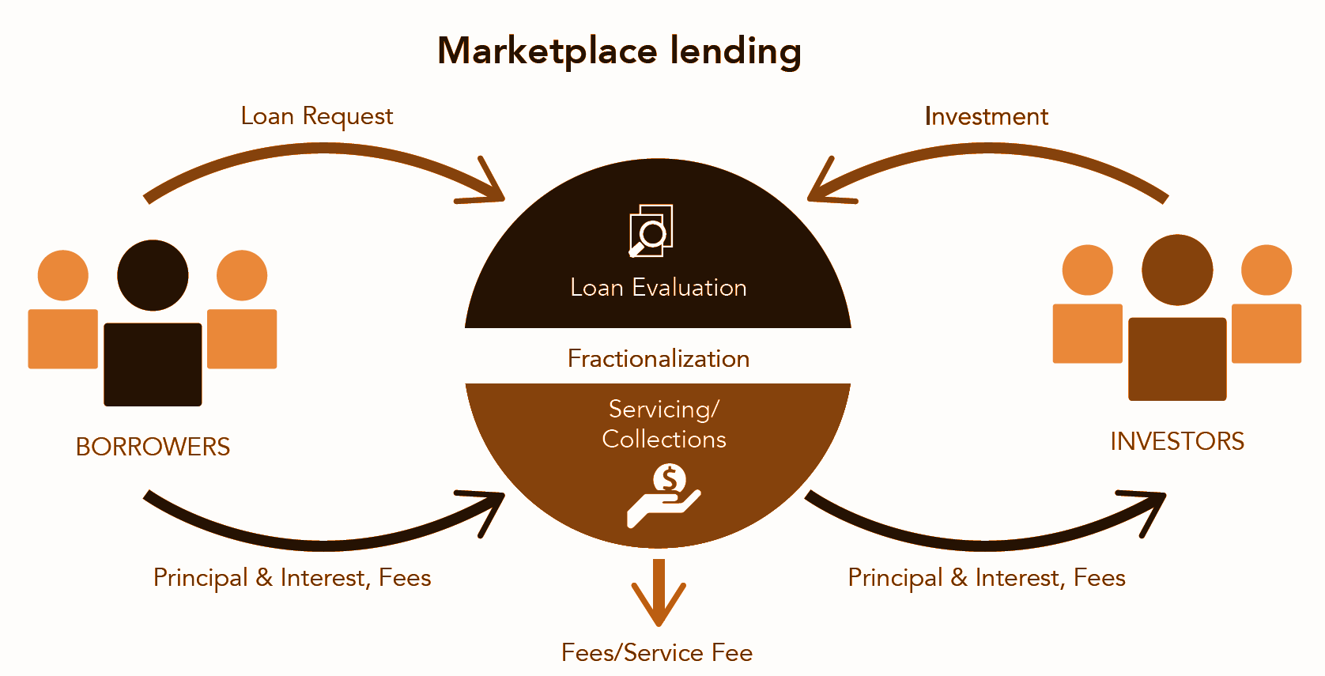
What we understood by risk analysis for the Lending Club
Our target is to derive insights improve this operating system

Slide 8
How we decided which columns in loan data set qualifies our analysis-
DEFAULT !
Loan accepted
Loan dataset
NON-DEFAULTERS
Loan Rejected/ Charged off
not included in the study, as it disqualifies our conditions to be included in the analysis

Slide 9
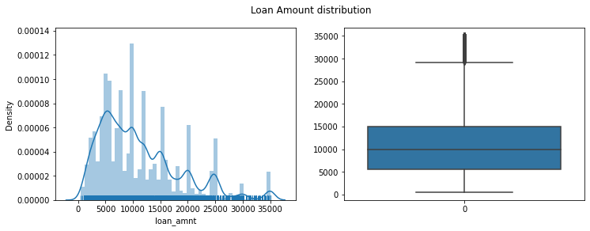
In order to conclude the warning signs that the loan can be
a defaulter, we proceeded with the following steps of analysis -
1. Univariate Analysis- It helped to visualize the density of the occurring values for the selected variables.
For example: we plotted a distribution and a box plot and that more number of people took loan amount of 10000, and also median of distribution is 10000. And very few people took more than 30000 loan amount.

Slide 10
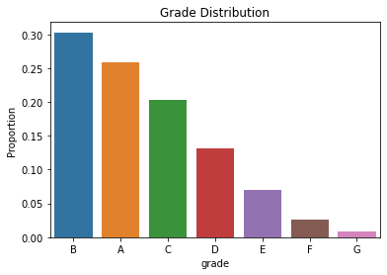
2. Segmented Univariate Analysis- It helped to visualize the frequency of bucketed data points and how it varies across the bucketed segments.
For example: To check the frequency of the graded borrowers of Lending Club (LC) we choose a barplot and we observed that most borrowers fall under A and B grades then other grades (as the risk increases with from categories, D, E, F, G)

Slide 11
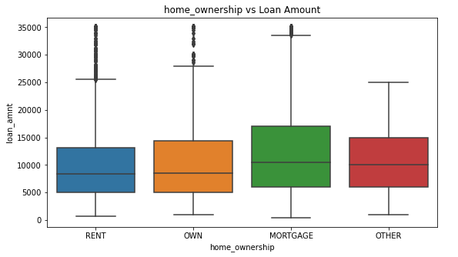
3. Bivariate Analysis- It helps us infer correlation between two variables and concludes simple hypothetical associations.
For example: To check the association between home ownership and loan amount, we used boxplot and concluded that more borrowers are from MORTGAGE and also the median loan amount also high for MORTGAGE owned borrowers.

Slide 12
RESULTS - Prepared a comparative table for ease of understanding
 | OBSERVATIONS
Terms vs Loan Amount | Higher amount loans have high tenure i.e, 60 months
Grade vs Loan Amount | Grade 'F' and 'G' have taken max loan amount. As Grades are decreasing the loan amount is increasing.
home_ownership vs Loan Amount | The median loan amount also high for MORTAGE owned borrowers.
verification_status vs Loan Amount | And most of borrowers are verified for borrowing loan >9k
loan_status vs Loan Amount | Charged Off loans have higher amounts than Fully Paid ones.
purpose vs Loan Amount | More loan amount is from small_business and debt_consolidation.
emp_length vs Loan Amount | More borrowers are from 10+ years and least is <1 year
Issued year vs Loan Amount | #The meadian loan amount in each year did not change much but the distribution is more spread as the years increase, which means people have taken different loan amounts in each year. #Few Loan borrowers took higher loan amount in 2008 and 2011 which are plotted as outliers. #Loan borrowers took almost similar amounts in all the months except in December, people have taken higher amounts as distribution is high above median.

Slide 13
NB: Following are the few of the observation, which were inevitable to decide the defaulter’s fate
 | OBSERVATIONS
Grade vs annual income | Comparatively Annual income is higher for lower grades.
home_ownership vs annual income | The home_ownership status for MORTGAGE has higher income.
verification_status vs annual income | The income source was verfied for most of the borrower's who had higher annual incomes.
loan_status vs annual income | Current status of the loan is Fully paid for most of the borrower's who had higher annual incomes.
purpose vs annual income | A category belonging to renewable_energy, small_business and home_improvement have higher annual income provided by the borrower for the loan request.
dti (Debt to Income Ratio) | OBSERVATIONS
Terms vs dti | dti is bit high for people who got more tenure i.e., 60 months.
Grade vs dti | A' Grade borrowers are having low dti than Other grades. dti should be low for having high repayment percentage.
verification_status vs dti | People in OTHER home_ownership has less dti than others. This is may be bacause other people have mortgage and home loans.
loan_status vs dti | Borrowers with high dti has bit more probability to default
purpose vs dti | People who took loan for credit_card and debt_consolidation purpose has more dti than other purposes.
emp_length vs dti | The dti is pretty much similar for borrowers with all the employment length.

Slide 14
Conclusions
Lending club should reduce the high interest loans for 60 months tenure, they are prone to loan default.
Grades are good metric for detecting defaulters. Lending club should examine more information from borrowers before issuing loans to Low grade (G to A).
Small business loans are defaulted more. Lending club should stop/reduce issuing the loans to them.
Borrowers with mortgage home ownership are taking higher loans and defaulting the approved loans. Lending club should stop giving loans to this category when loan amount requested is more than 12000.
People with more number of public derogatory records are having more chance of filing a bankruptcy. Lending club should make sure there are no public derogatory records for borrower.

