Slide 1
INVESTMENT ASSIGNMENT SUBMISSION
Manikanta Sai Ram Alapati.

Slide 2
Problem Analysis
Spark Funds has two minor constraints for investments:
It wants to invest between 5 to 15 million USD per round of investment.
It wants to invest only in English-speaking countries because of the ease of communication with the companies it would invest in.
On high level following are stages in the workflow.
Gather the data for the analysis.
Clean the data for readability.
Collate data into a model.
Filter model based on investment type, country code and sector.
Identify the best possible investment options
Plot on the option for graphical representation.
Account for missing mappings in the mapping file.
Tools:
Jupyter Note Book.
Downloads:
companies.csv
rounds2.csv
mapping.csv

Slide 3
x
companies
rounds2
mapping
(encoded data)
(encoded data)
(cleaning data)
lowercase permalink
lowercase company_permalink
encoding and clean data filling NaN values
merge companies & rounds2
USA , GBR , IND
(right on master_frame)
(left on master_frame)
(cleaning data)
Pick Top 3 English speaking countries
melt encoded data and rename column variable – mian_sector
(master_frame)
(Yes)
Top9 countries
drop columns
Columns with insufficient data
Group by country_code and Sort by sum investment
merge category_list
left join
(No)
extract
category_list
(final data frame)
Pick One Funding
(No)
(Primary Sector)
raised_amount_usd or country_code or category_list
is null
drop rows
(median)
Create D1 , D2 , D3
data frames and plot graphs
(Yes)
FT raised_amount
btw 5$ to 15$
extract Funding type
Venture , angel , seed , private equity

Slide 4
Data Model Analysis
Data Import – Import data from files.
Data cleaning – Removing or correcting dirty data. Handling of NA values.
Data Merging – Merge companies and investment round data to get fully readable dataset based on unique key.
Data Mapping – Mapping dataset for identifying sectors and investment preferences and also fine the mapping by mapping the primary sectors to nearest logical main sector.
Filtering – To identify preferred investment options for Funds to invest.
Model Objectives:
Investment type analysis : Ability to identify best suited categories for the investment.
Country Analysis: List out countries having most investment in the past.
Sector Analysis: Understanding the investment distribution among sectors.

Slide 5
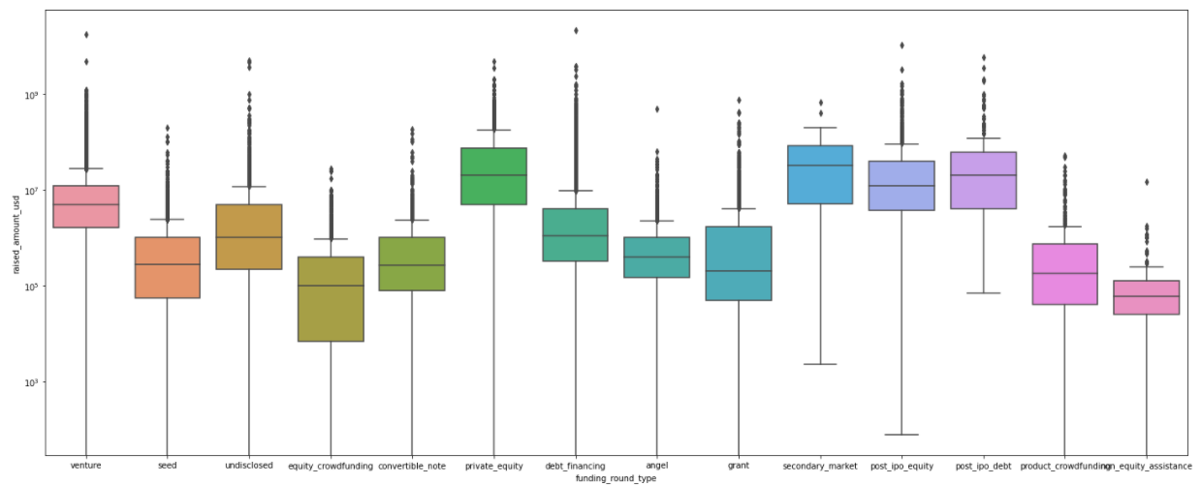
Boxplot of a variable across various funding categories

Slide 6
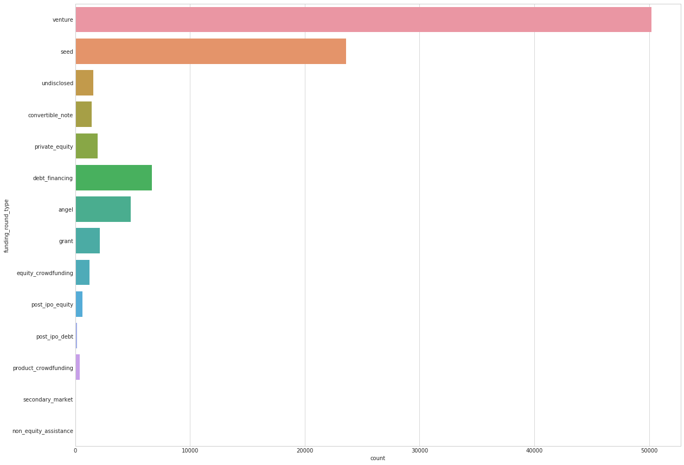
Investment trend shows huge number of persons investing in Venture funding

Slide 7
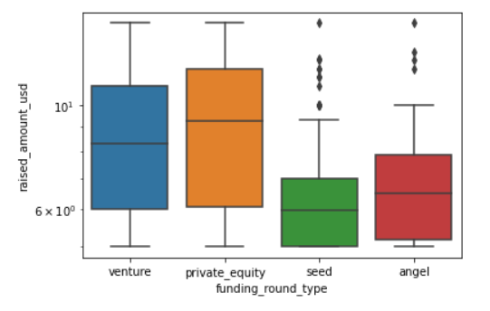
Boxplot of a raised USD amount across various 4 targeted categories

Slide 8
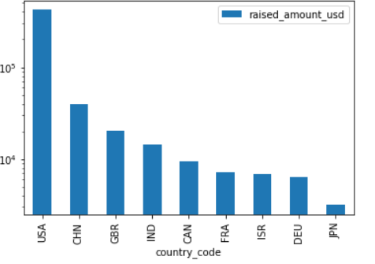
A plot showing the top 9 countries against the total amount of investments of funding type FT.

Slide 9
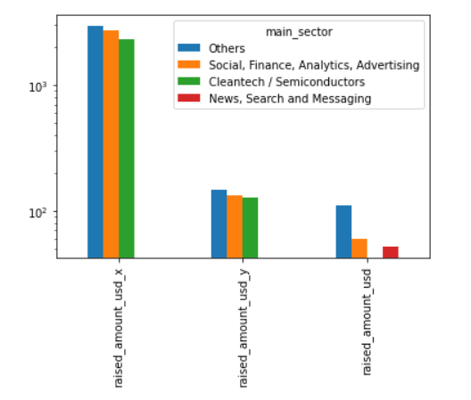
A plot showing the number of investments in the top 3 sectors of the top 3 countries on one chart

Slide 10
Result Analysis
Identify unique companies and handle NA values for raised_amount_usd.
List average funding for each of investment types.
Country-wise funding in sectors for any chosen investment type. List top9 countries for investment type chosen.
List top 3 English speaking courtiers for identifying investment-friendly options.
Sector-wise investment in each country. Total number of investments and Total amount of investment in USD.
Top ,second and third sectors based on count of investments.
Top ,second and third sectors based on amount sum of investments.
Which companies received highest investment in top and second sectors.
Plot Representation of the above.

