Slide 1
COMPLETE SYSTEM GUIDE · 01
WSP Offline System
Case study · user manual · technical map · pitch deck
A private, one-click student applicant workspace
3,000
ACTIVE APPLICANTS
100%
SEMANTIC INDEX
Search, understand, compare, edit, import, protect, and audit the full work-study applicant pool — entirely on the local computer.
Prepared 17 August 2026
Notes:
Opening: the product is installed software with a browser-based local interface, not a cloud portal.
[Sources]
- WSP Offline System live application and repository, reviewed 2026-08-17
- WSP Offline System repository, C:/Users/Salam/Documents/WSP/wsp_offline_app, reviewed 2026-08-17

Slide 2
CASE STUDY · 02
What the system solves
One workspace replaces scattered spreadsheet browsing with an auditable applicant workflow
FIND
SEE
TRUST
Find the right student
See the whole profile
Operate safely
Combine precise database filters with semantic matching over untouched student answers.
Move from cohort patterns to a single student’s academics, skills, preferences, experience, and history.
Transactional imports, automatic backups, diagnostics, index coverage checks, and local-only data handling.
The product turns a workbook into a usable local decision-support system.
Notes:
Feature summary grounded in the local implementation and user-facing pages.
[Sources]
- WSP Offline System source code and generated documentation
- WSP Offline System repository, C:/Users/Salam/Documents/WSP/wsp_offline_app, reviewed 2026-08-17

Slide 3
NAVIGATION · 03
One admin workspace, six connected surfaces
Every page has a clear role in the applicant journey
01
Dashboard
Cohort insight and drilldowns
02
Search & Match
Filters, AI evidence, exports
03
Data Explorer
Sheet views and safe edits
04
Profiles
Directory and holistic record
05
Import Center
Workbook, index, backups
06
System Health
Status and diagnostics
The navigation follows the work: understand → shortlist → inspect → update → protect → verify.
Notes:
This slide summarizes an end-to-end software flow implemented by the documented modules and APIs.
[Sources]
- WSP Offline System source code and generated documentation
- WSP Offline System repository, C:/Users/Salam/Documents/WSP/wsp_offline_app, reviewed 2026-08-17

Slide 4
INSTALLATION · 04
One click installs it like software
The Windows installer verifies prerequisites and creates a desktop launch path
01
Run installer
Launch the signed-style setup batch
02
Preflight
Check Windows, Python, disk, and writable paths
03
Build runtime
Create isolated environment and install locked packages
04
Install app
Create local folders, config, launcher, and desktop shortcut
05
Verify
Run health checks and confirm the local URL
After setup, the user starts WSP Offline System from the desktop icon.
Notes:
This slide summarizes an end-to-end software flow implemented by the documented modules and APIs.
[Sources]
- WSP Offline System source code and generated documentation
- WSP Offline System repository, C:/Users/Salam/Documents/WSP/wsp_offline_app, reviewed 2026-08-17

Slide 5
INSTALLATION · 05
Desktop behavior after setup
A local web application presented with software-like lifecycle controls
START
LOCAL
STOP
Single launcher
Private runtime
Controlled shutdown
Starts the isolated Python runtime, waits for the local server, and opens the workspace.
FastAPI, SQLite, model files, exports, logs, and backups stay on the installed computer.
The UI can stop the local service cleanly; startup and port diagnostics explain failures.
The browser is the interface; the data and processing remain offline on 127.0.0.1.
Notes:
Feature summary grounded in the local implementation and user-facing pages.
[Sources]
- WSP Offline System source code and generated documentation
- WSP Offline System repository, C:/Users/Salam/Documents/WSP/wsp_offline_app, reviewed 2026-08-17

Slide 6
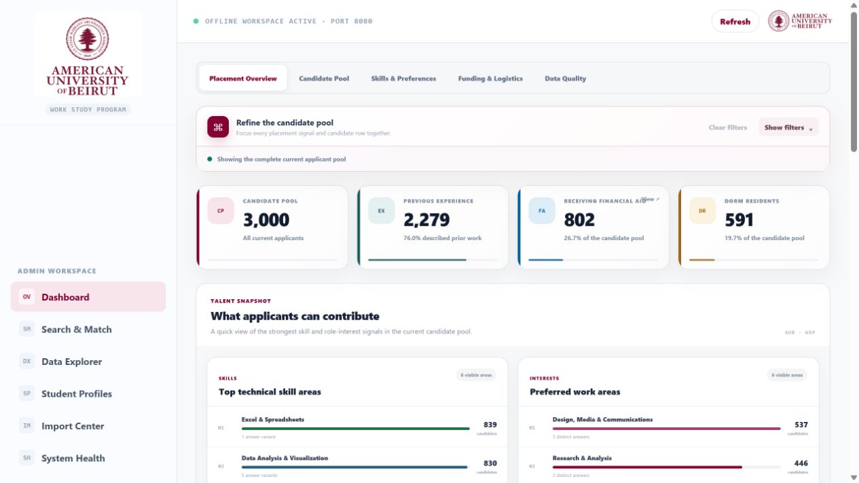
DASHBOARD · 06
Dashboard: cohort intelligence at a glance
A compact opening view with live population, filter context, and analysis tabs
Population and index coverage establish whether insights are complete.
Tabs split the analysis into usable themes instead of one crowded dashboard.
Every KPI and chart follows the current cohort filters.
Notes:
Use the arrows to walk through the visible controls and their operational purpose.
[Sources]
- WSP live UI, http://127.0.0.1:8080/, captured 2026-08-17
- WSP Offline System repository, C:/Users/Salam/Documents/WSP/wsp_offline_app, reviewed 2026-08-17

Slide 7
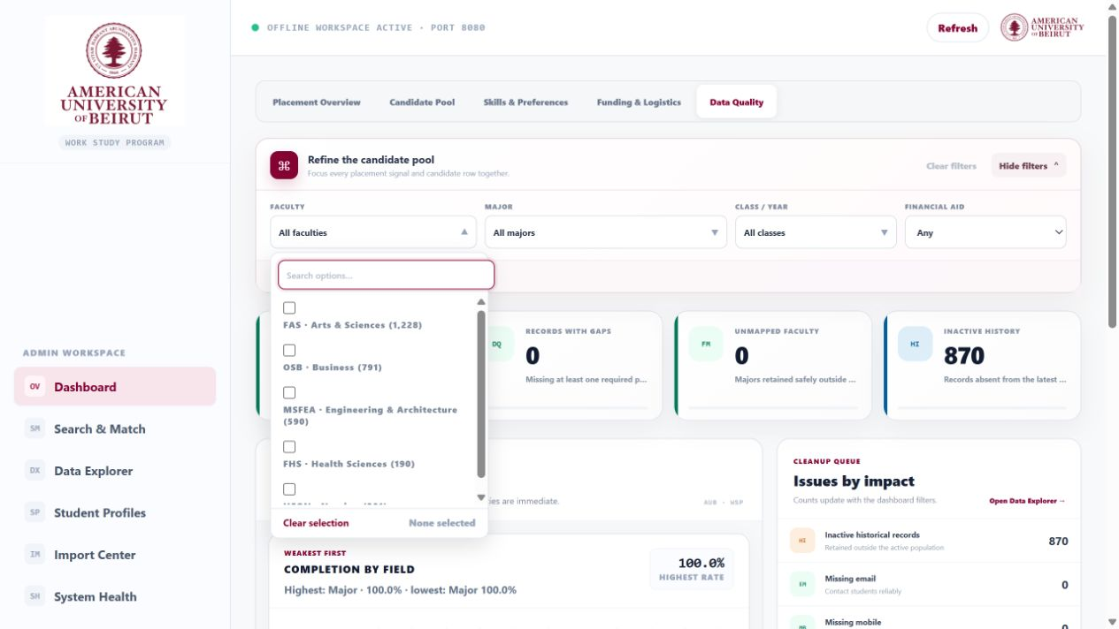
DASHBOARD · 07
Multi-select filters that match real admin work
Faculty, major, class, and status filters support any combination—not only one or all
Searchable multi-select menus allow multiple faculties, majors, or years.
Apply and clear actions make filter state deliberate and reversible.
Selected values become persistent chips and update every dashboard view.
Notes:
Use the arrows to walk through the visible controls and their operational purpose.
[Sources]
- WSP live UI, http://127.0.0.1:8080/?view=quality, captured 2026-08-17
- WSP Offline System repository, C:/Users/Salam/Documents/WSP/wsp_offline_app, reviewed 2026-08-17

Slide 8
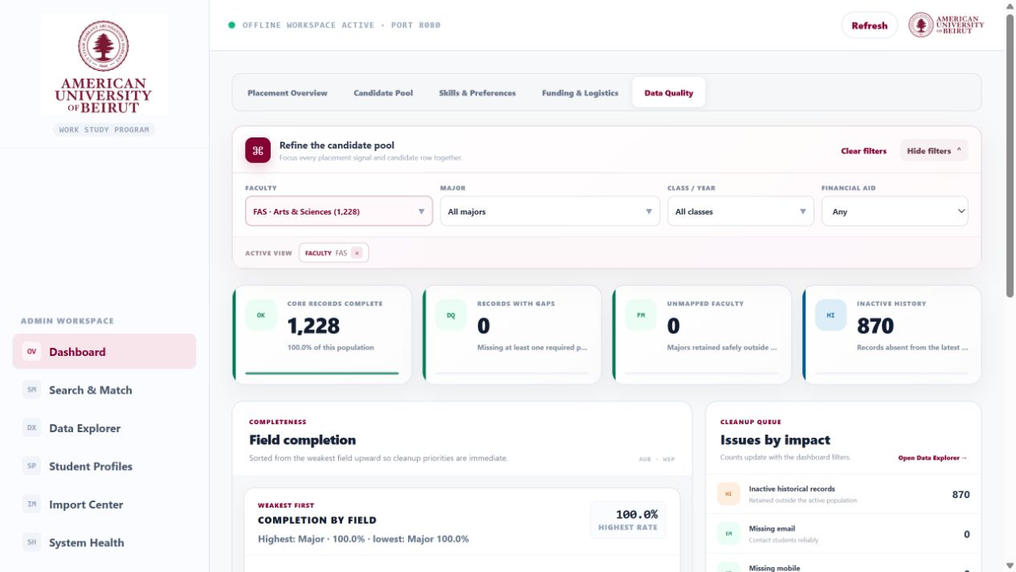
DASHBOARD · 08
Active filter chips keep the cohort definition visible
Applied combinations remain explicit, removable, and consistent across every analysis tab
Each selected faculty, major, class, or status appears as a removable chip.
Clear Filters resets the complete cohort definition in one action.
The population counts and charts recalculate from the same active combination.
Notes:
Use the arrows to walk through the visible controls and their operational purpose.
[Sources]
- WSP live UI, http://127.0.0.1:8080/?faculty=FAS&view=quality, captured 2026-08-17
- WSP Offline System repository, C:/Users/Salam/Documents/WSP/wsp_offline_app, reviewed 2026-08-17

Slide 9
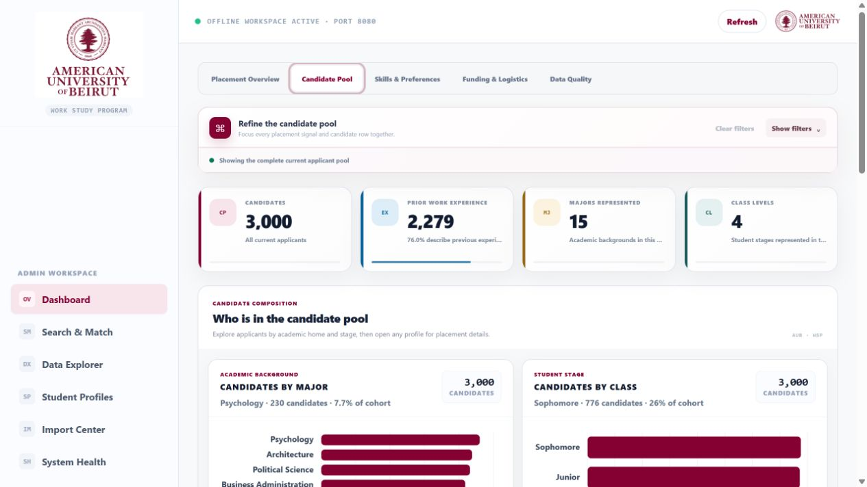
DASHBOARD · 09
Candidate pool: composition before ranking
Understand who applied before making placement decisions
Applicants by major reveal concentration and underrepresented programs.
Class distribution shows the student-stage mix in the selected cohort.
Chart values are clickable filters that cascade across the dashboard.
Notes:
Use the arrows to walk through the visible controls and their operational purpose.
[Sources]
- WSP live UI, http://127.0.0.1:8080/?view=pool, captured 2026-08-17
- WSP Offline System repository, C:/Users/Salam/Documents/WSP/wsp_offline_app, reviewed 2026-08-17

Slide 10
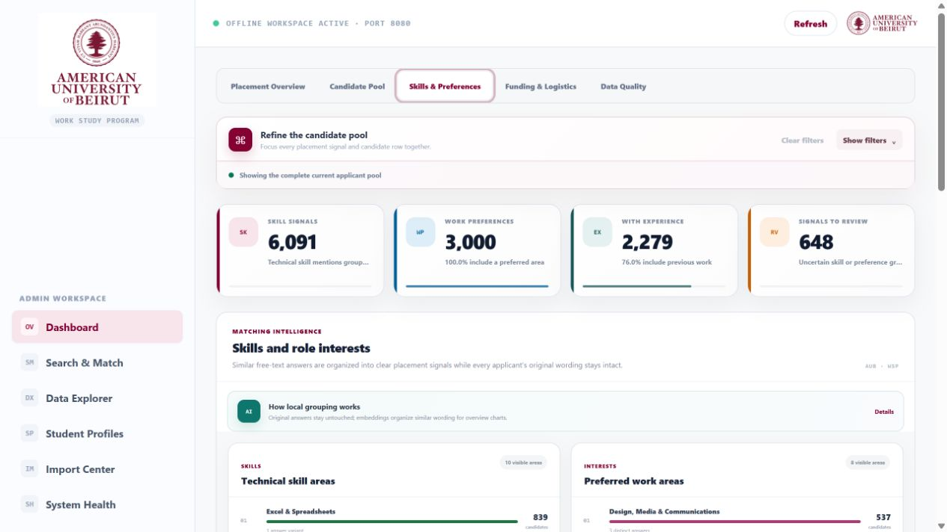
DASHBOARD · 10
Skills and work interests: applicant signal, not rigid labels
The dashboard summarizes messy free text while search retains every original response
Technical skill topics aggregate common capabilities across students.
Preferred-work topics expose demand for role families and activities.
Topic labels are dashboard summaries; they do not replace original text.
Notes:
Use the arrows to walk through the visible controls and their operational purpose.
[Sources]
- WSP live UI, http://127.0.0.1:8080/?view=skills, captured 2026-08-17
- WSP Offline System repository, C:/Users/Salam/Documents/WSP/wsp_offline_app, reviewed 2026-08-17

Slide 11
INTELLIGENCE · 11
Flexible topics emerge from new answers
The system can group rough, misspelled, or novel text without freezing the taxonomy
01
Raw answers
Skills, interests, experience, languages
02
Normalize
Clean punctuation and obvious variants
03
Embed
Convert original phrases into semantic vectors
04
Cluster
Group nearby meanings and surface emerging topics
05
Keep evidence
Store labels separately; preserve original responses
A new unusual answer remains searchable immediately and can influence future topic groups.
Notes:
This slide summarizes an end-to-end software flow implemented by the documented modules and APIs.
[Sources]
- WSP Offline System source code and generated documentation
- WSP Offline System repository, C:/Users/Salam/Documents/WSP/wsp_offline_app, reviewed 2026-08-17

Slide 12
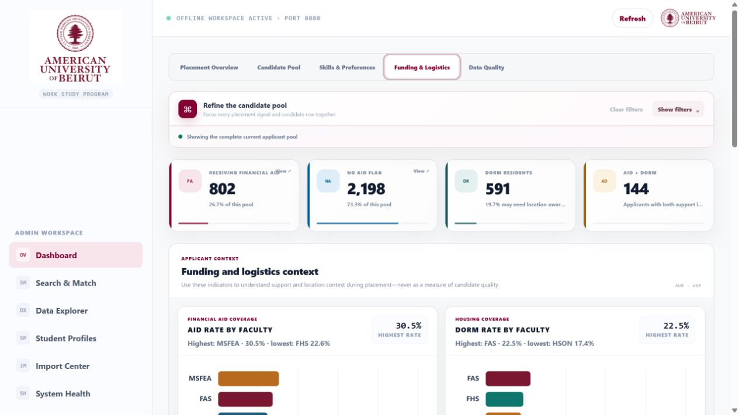
DASHBOARD · 12
Funding and logistics: context for equitable coordination
Operational context is visible without pretending it is a placement score
Financial-aid distribution helps administrators understand cohort context.
Residence indicators support practical scheduling and outreach planning.
These are filters and context—not an automatic judgement of readiness.
Notes:
Use the arrows to walk through the visible controls and their operational purpose.
[Sources]
- WSP live UI, http://127.0.0.1:8080/?view=funding, captured 2026-08-17
- WSP Offline System repository, C:/Users/Salam/Documents/WSP/wsp_offline_app, reviewed 2026-08-17

Slide 13
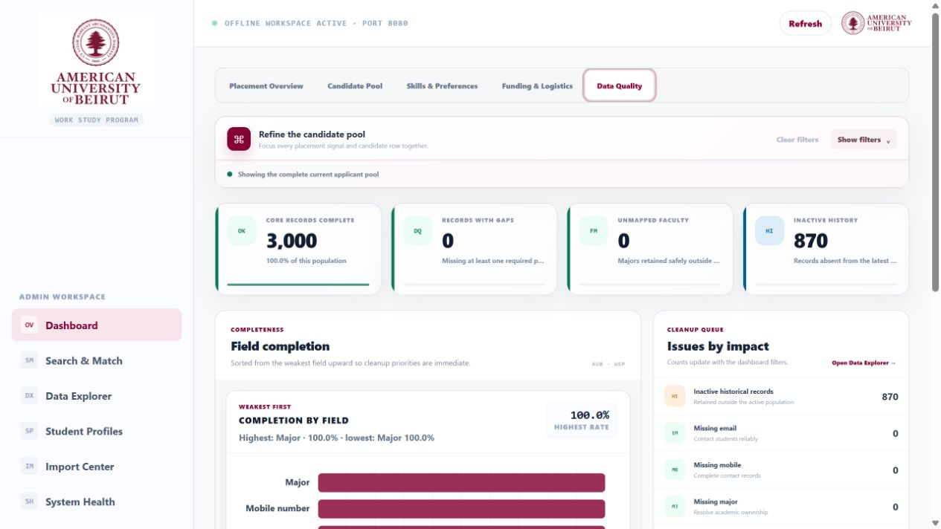
DASHBOARD · 13
Data quality: find records that need attention
Completeness and integrity checks expose missing values before search or placement
Quality KPIs quantify missing identity, contact, academic, or work fields.
Breakdowns show which fields or faculties contribute most to gaps.
Click-through filters turn a warning into a reviewable student list.
Notes:
Use the arrows to walk through the visible controls and their operational purpose.
[Sources]
- WSP live UI, http://127.0.0.1:8080/?view=quality, captured 2026-08-17
- WSP Offline System repository, C:/Users/Salam/Documents/WSP/wsp_offline_app, reviewed 2026-08-17

Slide 14
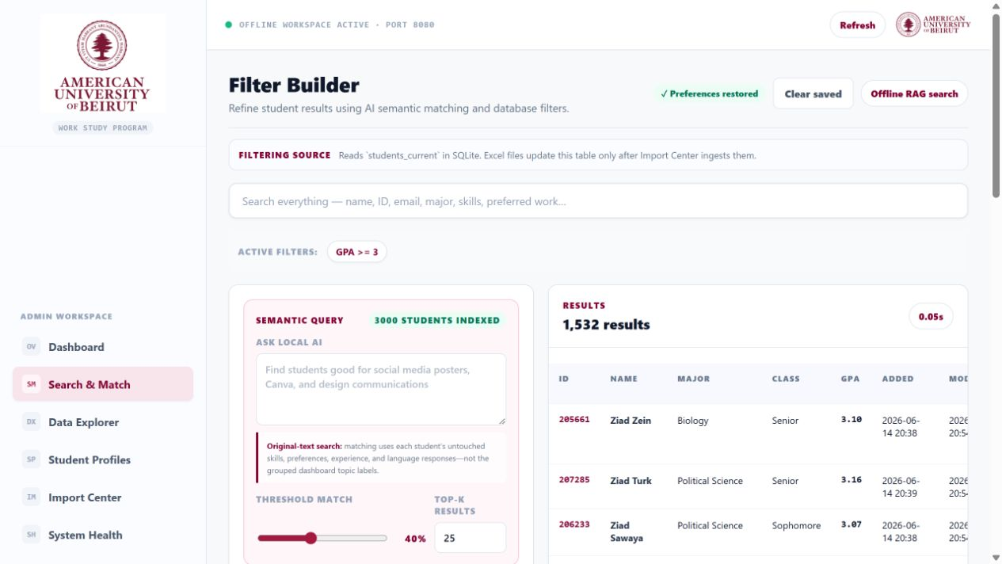
SEARCH & MATCH · 14
Build a shortlist with transparent controls
Structured filters and semantic settings are visible before the query runs
Threshold and Top-K tune precision and list size for the task.
Traditional filters combine GPA, major, class, aid, dorms, and text fields.
Sort, order, missing-record handling, reset, and export remain explicit.
Notes:
Use the arrows to walk through the visible controls and their operational purpose.
[Sources]
- WSP live UI, http://127.0.0.1:8080/filters, captured 2026-08-17
- WSP Offline System repository, C:/Users/Salam/Documents/WSP/wsp_offline_app, reviewed 2026-08-17

Slide 15
SEARCH & MATCH · 15
Preferences remember the administrator’s workflow
Search configuration is auto-saved locally and reused by the Import Center’s Auto Export
SAVE
RESTORE
EXPORT
Automatic local save
Return where you left off
Use the same definition
Input, change, and multi-select events persist the full filter payload in browser storage.
Threshold, Top-K, GPA, majors, classes, sorting, text filters, and missing-row preference restore on load.
Auto Export reads the saved payload so exported rows match the administrator’s working cohort.
Saved preferences stay on the local computer and can be cleared at any time.
Notes:
Feature summary grounded in the local implementation and user-facing pages.
[Sources]
- WSP Offline System source code and generated documentation
- WSP Offline System repository, C:/Users/Salam/Documents/WSP/wsp_offline_app, reviewed 2026-08-17

Slide 16
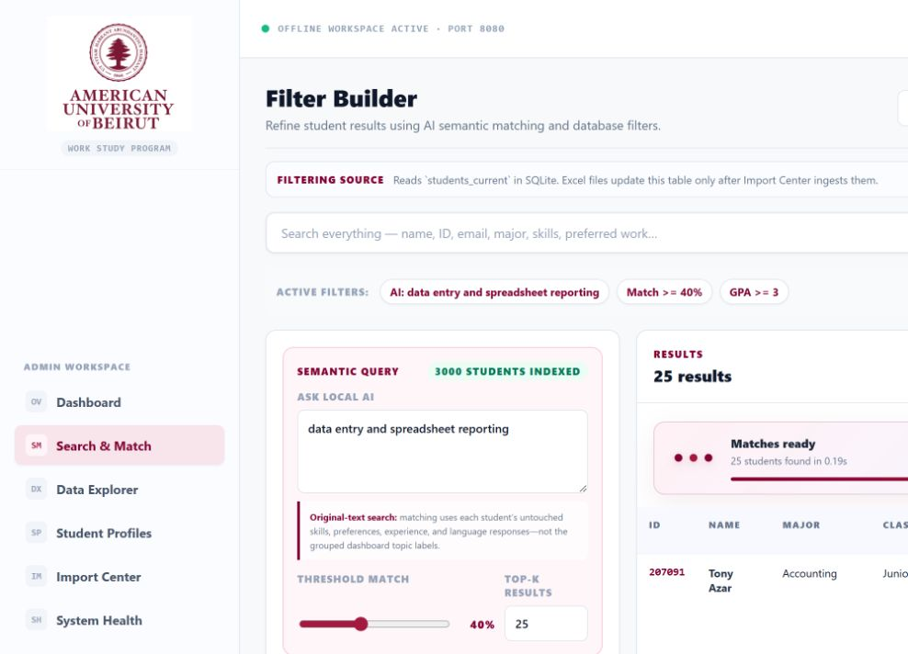
SEARCH & MATCH · 16
Semantic search shows progress without exposing chain-of-thought
The UI reports safe operational stages while the local embedding model works
Three AUB-colored dots and a progress track make the search state visible.
The status copy reports completion time and the number of matches.
The interface reports process status—not hidden model reasoning.
Notes:
Use the arrows to walk through the visible controls and their operational purpose.
[Sources]
- WSP live UI, http://127.0.0.1:8080/filters, captured 2026-08-17
- WSP Offline System repository, C:/Users/Salam/Documents/WSP/wsp_offline_app, reviewed 2026-08-17

Slide 17
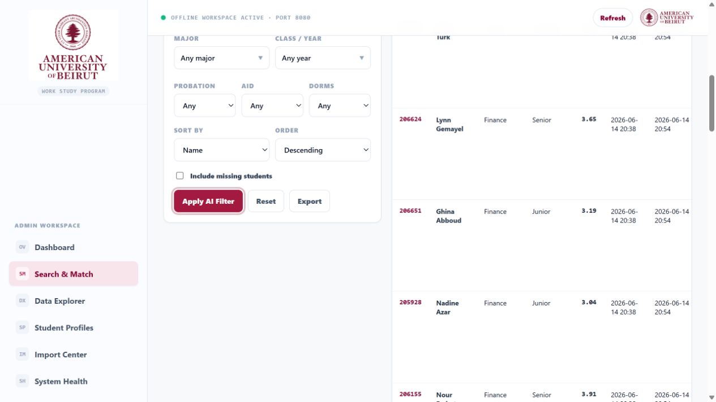
SEARCH & MATCH · 17
Every semantic result explains the match
Evidence comes from the student’s untouched application responses
A similarity score makes ranking comparable across the shortlist.
Closest original fields and phrases show why the student matched.
Identity links open the full student profile for human review.
Notes:
Use the arrows to walk through the visible controls and their operational purpose.
[Sources]
- WSP live UI, http://127.0.0.1:8080/filters, captured 2026-08-17
- WSP Offline System repository, C:/Users/Salam/Documents/WSP/wsp_offline_app, reviewed 2026-08-17

Slide 18
SEARCH & MATCH · 18
Two search modes, one auditable result set
Precise filters narrow the pool; semantic evidence finds meaning inside free text
01
Exact filters
SQL over structured student fields
02
Original text
Skills, preferences, experience, languages
03
Local embeddings
Similarity against precomputed vectors
04
Evidence
Ranked fields and source phrases
05
Export
Current result set to Excel
Grouped dashboard topics never replace the original-text embedding document.
Notes:
This slide summarizes an end-to-end software flow implemented by the documented modules and APIs.
[Sources]
- WSP Offline System source code and generated documentation
- WSP Offline System repository, C:/Users/Salam/Documents/WSP/wsp_offline_app, reviewed 2026-08-17

Slide 19
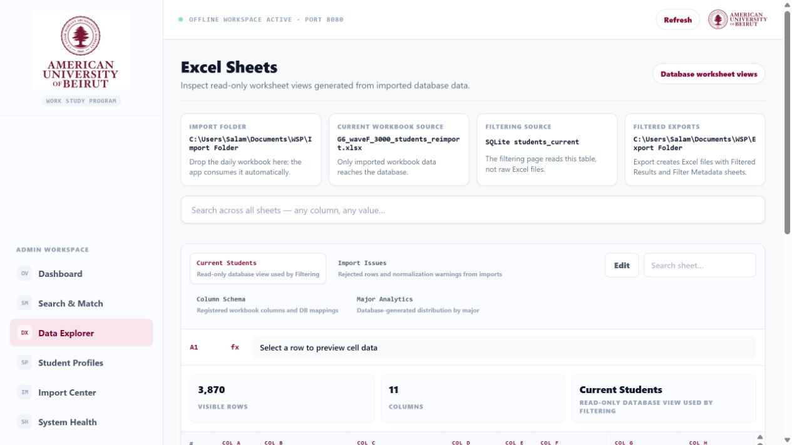
DATA EXPLORER · 19
Explore imported sheets without leaving the workspace
Global search, sheet tabs, row counts, and profile links make the workbook navigable
Sheet tabs preserve the workbook’s source structure.
Global search spans visible fields and returns matching rows quickly.
Row counts and field counts establish the scale of the active sheet.
Notes:
Use the arrows to walk through the visible controls and their operational purpose.
[Sources]
- WSP live UI, http://127.0.0.1:8080/excel-sheets, captured 2026-08-17
- WSP Offline System repository, C:/Users/Salam/Documents/WSP/wsp_offline_app, reviewed 2026-08-17

Slide 20
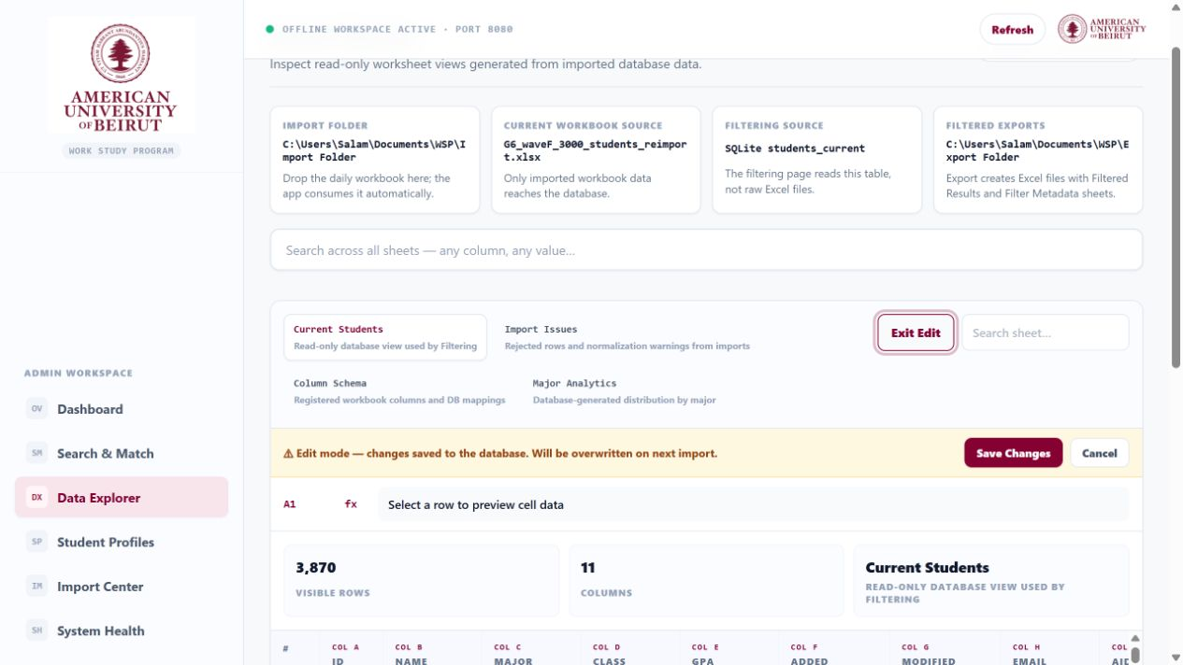
DATA EXPLORER · 20
Controlled editing protects the source of truth
Edit mode exposes only supported changes and keeps cancel/backup behavior visible
Exit Edit makes the current editing state impossible to miss.
Save Changes and Cancel create an explicit commit boundary.
The warning banner explains that direct edits can be replaced by a later import.
Notes:
Use the arrows to walk through the visible controls and their operational purpose.
[Sources]
- WSP live UI, http://127.0.0.1:8080/excel-sheets, captured 2026-08-17
- WSP Offline System repository, C:/Users/Salam/Documents/WSP/wsp_offline_app, reviewed 2026-08-17

Slide 21
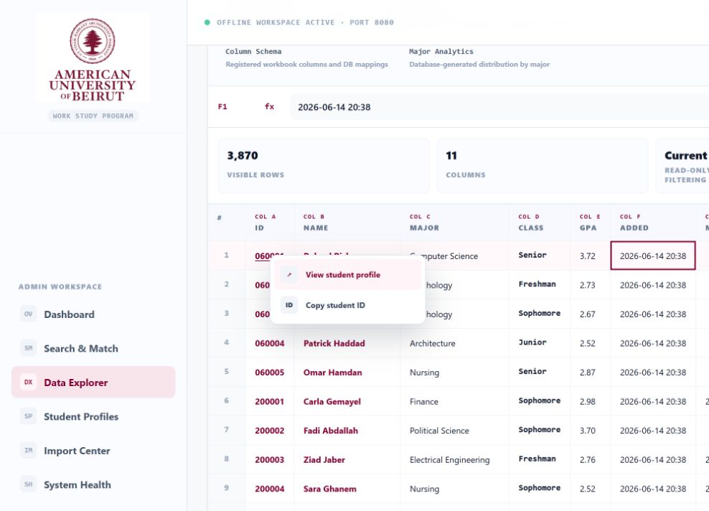
DATA EXPLORER · 21
Right-click turns any row into a profile entry point
Context actions reduce navigation friction while preserving the current table view
Right-click a student row or identity cell to open the action menu.
View student profile opens the universal page for that ID.
Copy student ID supports quick handoff into another workflow.
Notes:
Use the arrows to walk through the visible controls and their operational purpose.
[Sources]
- WSP live UI, http://127.0.0.1:8080/excel-sheets, captured 2026-08-17
- WSP Offline System repository, C:/Users/Salam/Documents/WSP/wsp_offline_app, reviewed 2026-08-17

Slide 22
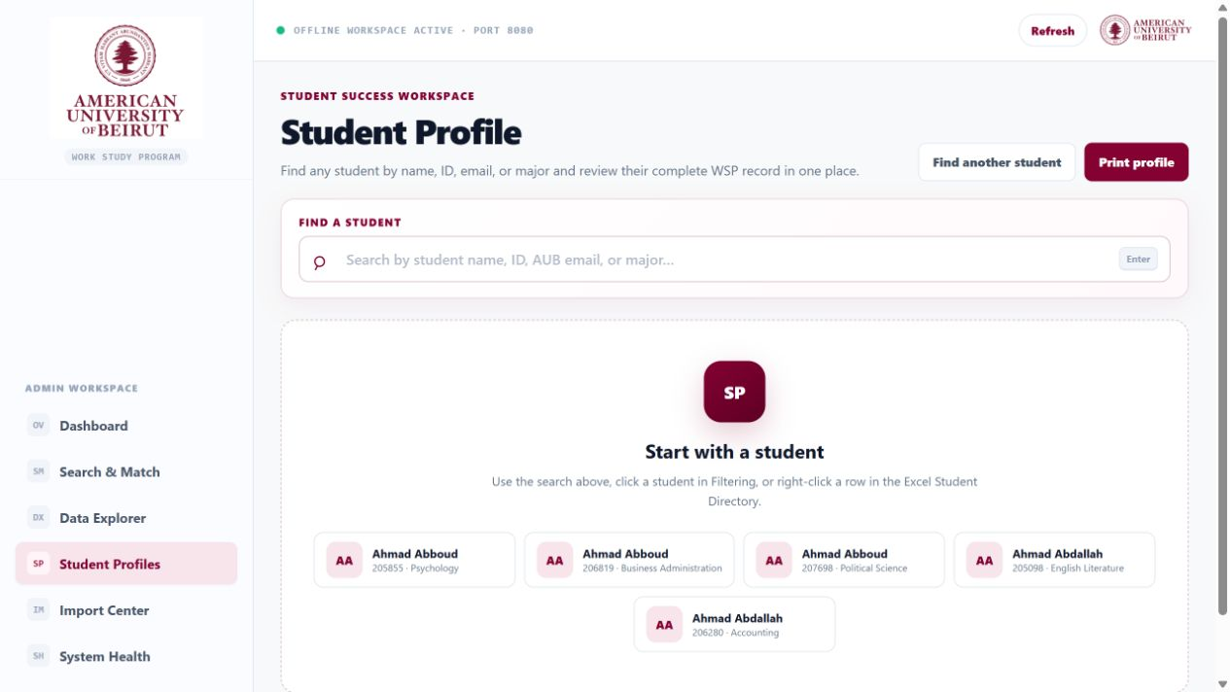
STUDENT PROFILES · 22
A universal directory for every applicant
Search or browse the full applicant population, independent of the current dashboard filter
Search by name or student ID to find one applicant directly.
Directory suggestions summarize identity, major, and student ID.
The same universal profile route is available from every page.
Notes:
Use the arrows to walk through the visible controls and their operational purpose.
[Sources]
- WSP live UI, http://127.0.0.1:8080/student-profile, captured 2026-08-17
- WSP Offline System repository, C:/Users/Salam/Documents/WSP/wsp_offline_app, reviewed 2026-08-17

Slide 23
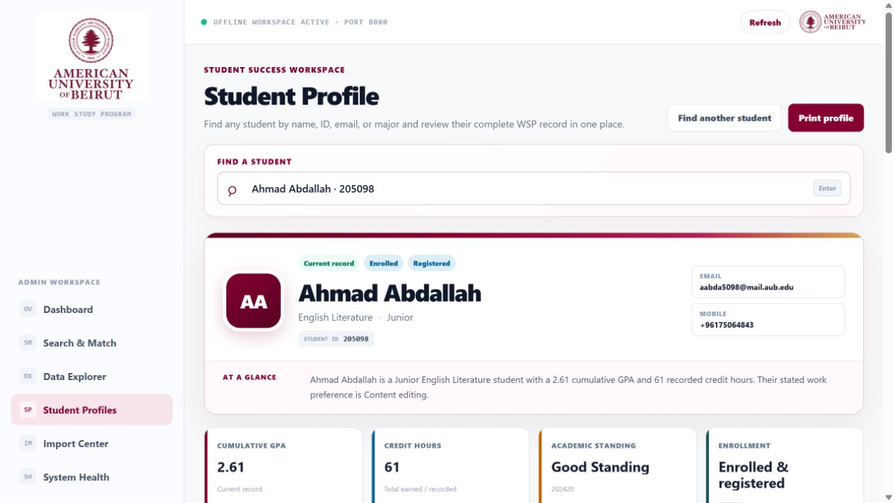
STUDENT PROFILES · 23
Holistic profile: the whole student in one view
A structured narrative replaces horizontal spreadsheet scanning
Identity, academic context, contact, and record metadata anchor the profile.
Skills and preferences keep both concise summaries and source text.
Actions return to search or navigate related records without losing context.
Notes:
Use the arrows to walk through the visible controls and their operational purpose.
[Sources]
- WSP live UI, http://127.0.0.1:8080/student-profile/205098, captured 2026-08-17
- WSP Offline System repository, C:/Users/Salam/Documents/WSP/wsp_offline_app, reviewed 2026-08-17

Slide 24
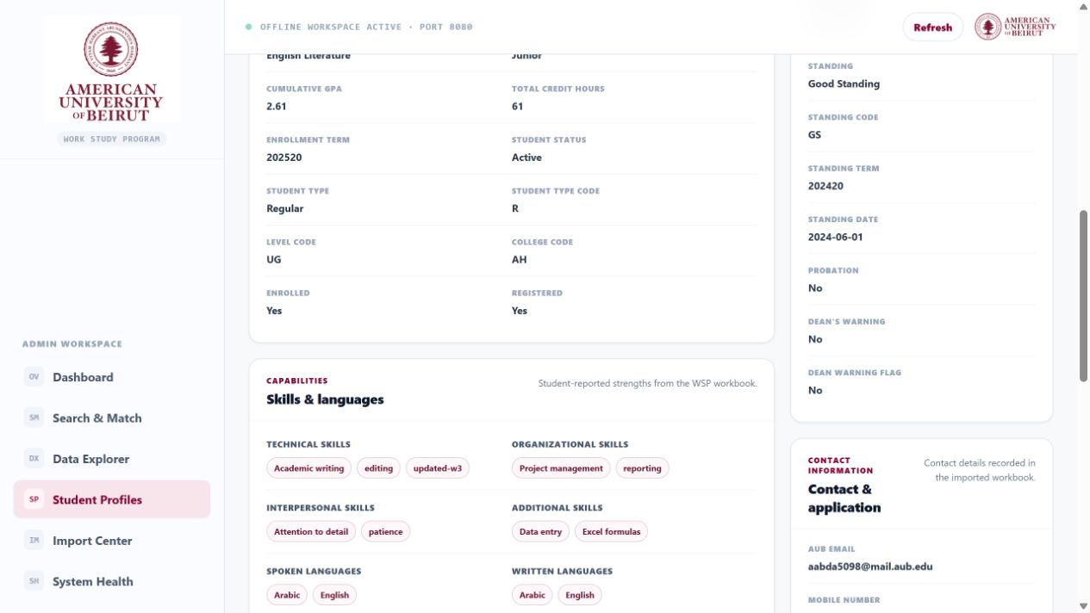
STUDENT PROFILES · 24
Details and history make the record auditable
Experience, language, logistics, and timeline sections explain how the profile evolved
Prior work is displayed when present; missing experience is not treated as failure.
Languages, logistics, and application details remain available for review.
The timeline records import and modification timestamps.
Notes:
Use the arrows to walk through the visible controls and their operational purpose.
[Sources]
- WSP live UI, http://127.0.0.1:8080/student-profile/205098, captured 2026-08-17
- WSP Offline System repository, C:/Users/Salam/Documents/WSP/wsp_offline_app, reviewed 2026-08-17

Slide 25
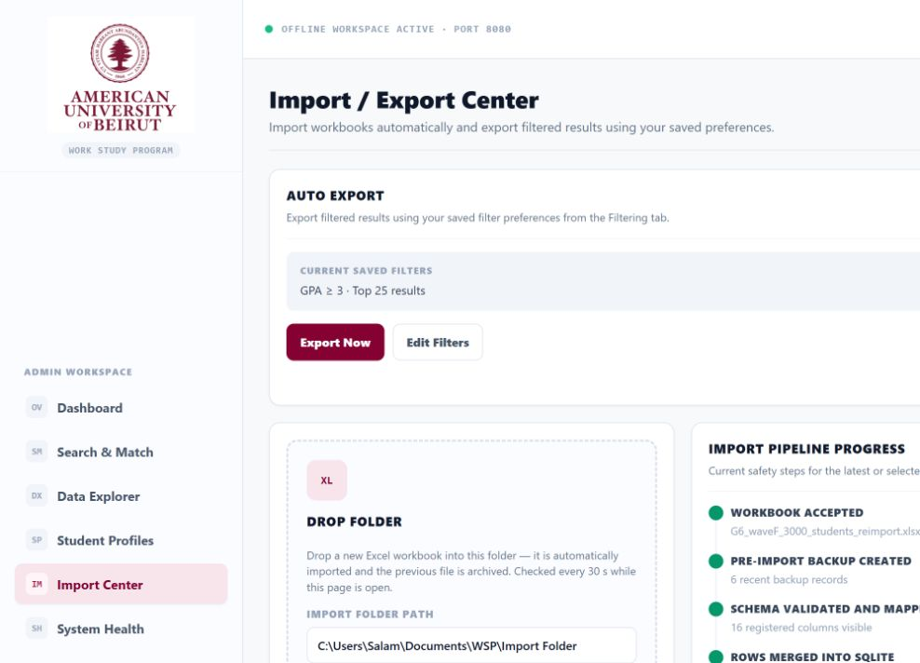
IMPORT CENTER · 25
Import Center: the operational control room
Manual import, watched folders, Auto Export, index coverage, and vault access share one page
Saved filters drive repeatable Auto Export files without rebuilding the query.
The watched Drop Folder imports the newest workbook on a timed check.
Pipeline status reports validation, backup, mapping, merge, and index stages.
Notes:
Use the arrows to walk through the visible controls and their operational purpose.
[Sources]
- WSP live UI, http://127.0.0.1:8080/import, captured 2026-08-17
- WSP Offline System repository, C:/Users/Salam/Documents/WSP/wsp_offline_app, reviewed 2026-08-17

Slide 26
IMPORT CENTER · 26
Workbook import is a transaction, not a file copy
Validation and rollback boundaries keep the live database consistent
01
Select
Manual upload or watched import folder
02
Preview
Read sheets, headers, counts, and schema
03
Validate
Required tables, IDs, types, and duplicates
04
Backup
Snapshot database before mutation
05
Commit
Replace current tables, rebuild views, log result
06
Index
Re-embed changed original text
A failed validation leaves the existing database and vector index untouched.
Notes:
This slide summarizes an end-to-end software flow implemented by the documented modules and APIs.
[Sources]
- WSP Offline System source code and generated documentation
- WSP Offline System repository, C:/Users/Salam/Documents/WSP/wsp_offline_app, reviewed 2026-08-17

Slide 27
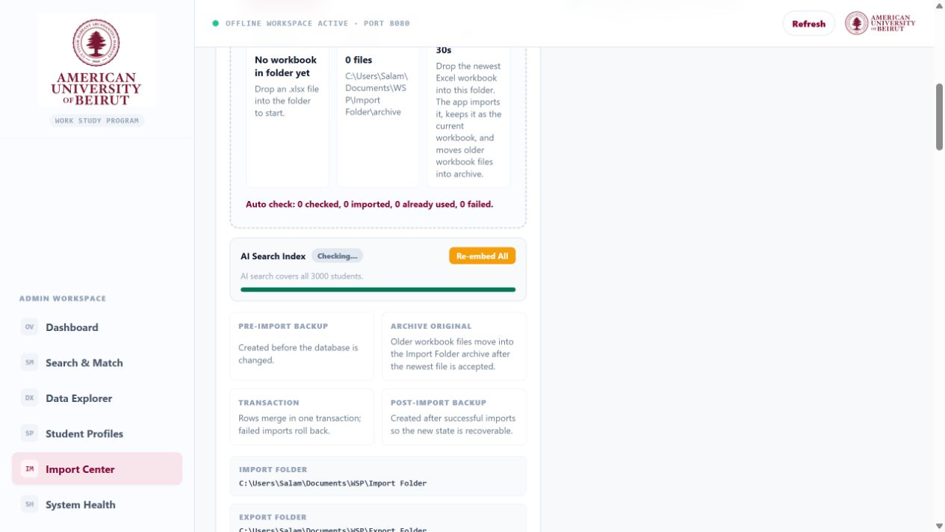
IMPORT CENTER · 27
Index, backup boundaries, and folders explain operations
The lower Import Center documents recovery guarantees and local file handoff paths
AI Search Index exposes coverage and the Re-embed All control.
Pre/post backup, archive, and transaction guarantees sit beside the pipeline.
Import and export folder paths make the local handoff explicit.
Notes:
Use the arrows to walk through the visible controls and their operational purpose.
[Sources]
- WSP live UI, http://127.0.0.1:8080/import, captured 2026-08-17
- WSP Offline System repository, C:/Users/Salam/Documents/WSP/wsp_offline_app, reviewed 2026-08-17

Slide 28
SEMANTIC INDEX · 28
Index coverage is a first-class health signal
The application checks that every current student has an embedding before semantic results are trusted
COUNT
SYNC
FULL
Coverage math
Incremental refresh
Re-embed on demand
Indexed IDs are compared with `students_current`; the UI reports indexed / total and a percentage.
Changed or new documents are embedded; stale IDs are removed; the index is saved atomically.
Administrators can request a full rebuild when the model or document recipe changes.
Current audited state: 3,000 / 3,000 students indexed — 100% coverage.
Notes:
Feature summary grounded in the local implementation and user-facing pages.
[Sources]
- WSP Offline System source code and generated documentation
- WSP Offline System repository, C:/Users/Salam/Documents/WSP/wsp_offline_app, reviewed 2026-08-17

Slide 29
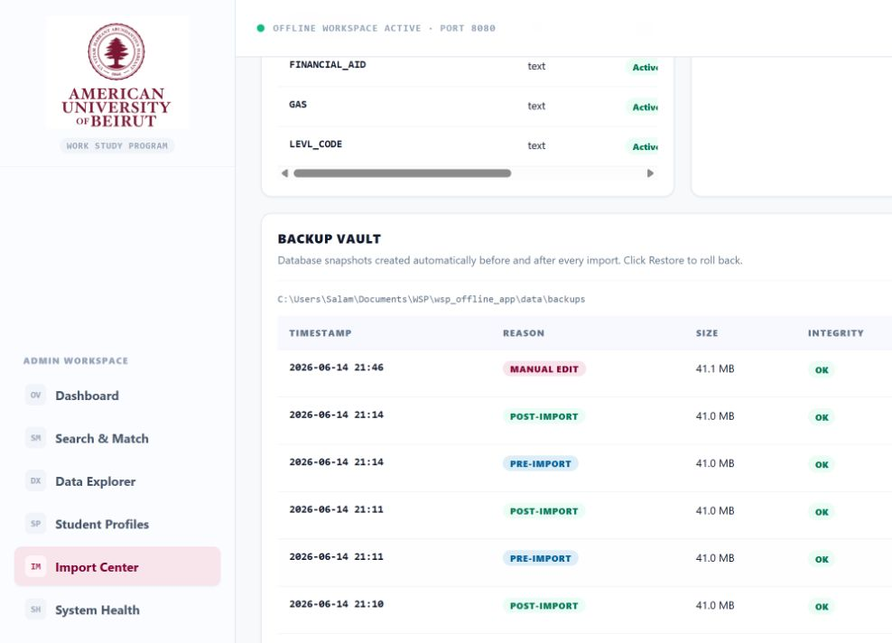
BACKUP VAULT · 29
Backup Vault makes recovery visible
Automatic snapshots can be inspected before a restore is attempted
Every snapshot lists timestamp, reason, size, and integrity status.
Reason badges distinguish pre-import, post-import, manual-edit, and pre-restore backups.
Integrity is checked; Restore is available per snapshot in the full table.
Notes:
Use the arrows to walk through the visible controls and their operational purpose.
[Sources]
- WSP live UI, http://127.0.0.1:8080/import, captured 2026-08-17
- WSP Offline System repository, C:/Users/Salam/Documents/WSP/wsp_offline_app, reviewed 2026-08-17

Slide 30
BACKUP VAULT · 30
Restore is guarded by verification and rollback
A restore never silently overwrites the live workspace
01
Choose backup
Select a known snapshot from the vault
02
Verify
Check file presence and SQLite integrity
03
Safety snapshot
Back up the current live database first
04
Replace
Restore database files through an atomic boundary
05
Reconcile
Reopen database, check schema, refresh index status
06
Confirm
Report restored source and health result
The pre-restore snapshot provides a recovery path if the chosen backup is wrong.
Notes:
This slide summarizes an end-to-end software flow implemented by the documented modules and APIs.
[Sources]
- WSP Offline System source code and generated documentation
- WSP Offline System repository, C:/Users/Salam/Documents/WSP/wsp_offline_app, reviewed 2026-08-17

Slide 31
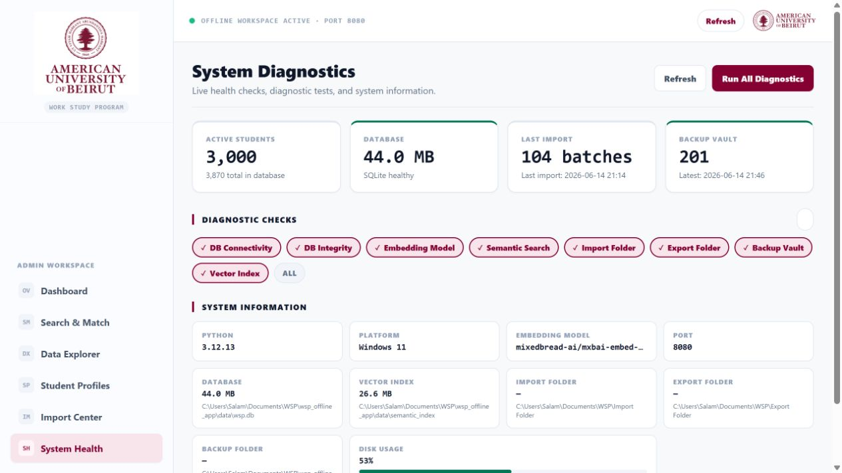
SYSTEM HEALTH · 31
System Health surfaces the runtime state
Database, model, folders, index, version, and environment are visible without opening a terminal
Core service cards make failures and warnings immediately scannable.
Paths and runtime metadata support on-site troubleshooting.
Diagnostics can be launched from the same operational page.
Notes:
Use the arrows to walk through the visible controls and their operational purpose.
[Sources]
- WSP live UI, http://127.0.0.1:8080/system-status, captured 2026-08-17
- WSP Offline System repository, C:/Users/Salam/Documents/WSP/wsp_offline_app, reviewed 2026-08-17

Slide 32
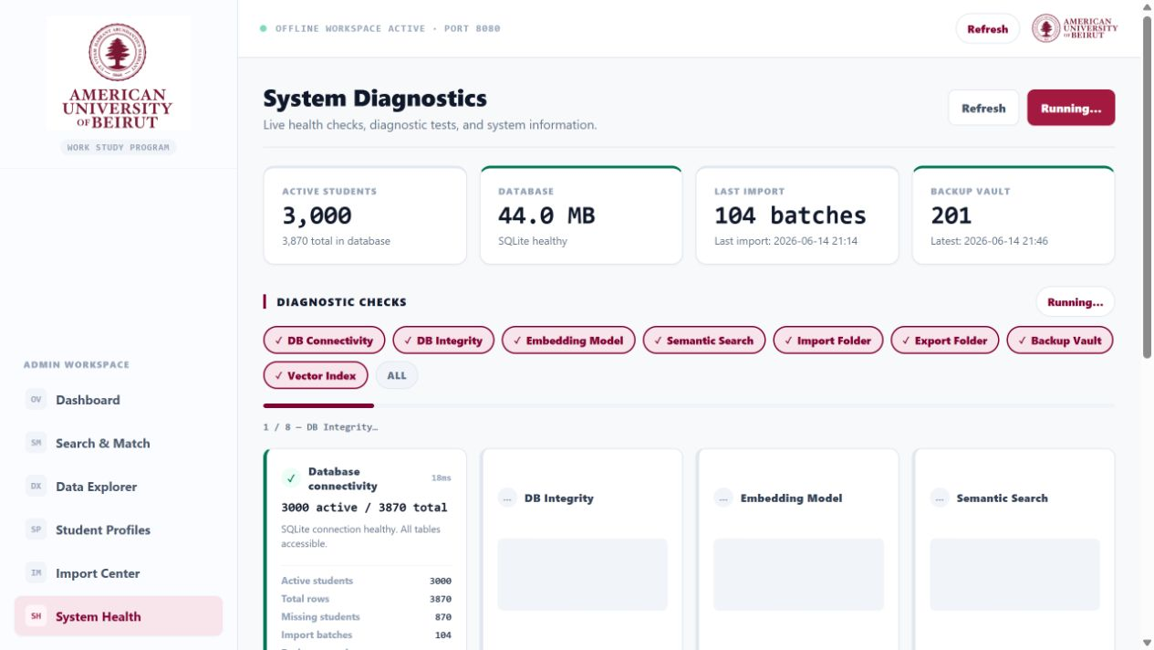
SYSTEM HEALTH · 32
Diagnostics run as a selectable audit
Checks execute independently and report progress so one warning does not hide other results
Administrators can run all checks or select a focused subset.
The progress indicator shows which check is running and how many remain.
Results stay on screen for copying into support or release evidence.
Notes:
Use the arrows to walk through the visible controls and their operational purpose.
[Sources]
- WSP live UI, http://127.0.0.1:8080/system-status, captured 2026-08-17
- WSP Offline System repository, C:/Users/Salam/Documents/WSP/wsp_offline_app, reviewed 2026-08-17

Slide 33
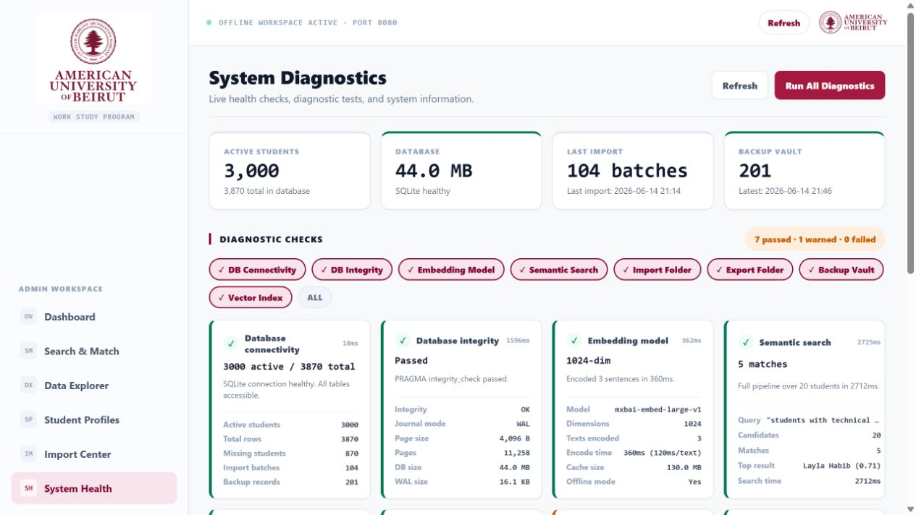
SYSTEM HEALTH · 33
Completed diagnostics separate pass, warning, and failure
The audited system passed core checks; the vault age check correctly raised one warning
Database connectivity and SQLite integrity passed.
Embedding model, semantic search, folders, and 3,000/3,000 index coverage passed.
Backup integrity passed; age was flagged because the newest snapshot was old.
Notes:
Use the arrows to walk through the visible controls and their operational purpose.
[Sources]
- WSP live UI, http://127.0.0.1:8080/system-status, captured 2026-08-17
- WSP Offline System repository, C:/Users/Salam/Documents/WSP/wsp_offline_app, reviewed 2026-08-17

Slide 34
ARCHITECTURE · 34
Local-first architecture keeps student data private
Every core component runs inside the installed workspace
01
Excel input
Source workbook and watched folder
02
Import service
Normalize, validate, transact, log
03
SQLite
Current, missing, imported sheets, metadata
04
FastAPI
Routes for UI, data, search, operations
05
Browser UI
Admin workspace on 127.0.0.1
Semantic model files, vectors, exports, logs, and backups stay beside the local installation.
Notes:
This slide summarizes an end-to-end software flow implemented by the documented modules and APIs.
[Sources]
- WSP Offline System source code and generated documentation
- WSP Offline System repository, C:/Users/Salam/Documents/WSP/wsp_offline_app, reviewed 2026-08-17

Slide 35
OPERATIONS · 35
A practical daily administrator workflow
The product supports exploration and judgement without automating the human decision
01
Import
Load and validate the newest application workbook
02
Verify
Confirm 100% index coverage and system health
03
Understand
Review cohort patterns and data quality
04
Shortlist
Combine filters with semantic evidence
05
Inspect
Open holistic profiles and compare source answers
06
Export
Share the current reviewed result set
Back up before material changes; use diagnostics before a presentation or handoff.
Notes:
This slide summarizes an end-to-end software flow implemented by the documented modules and APIs.
[Sources]
- WSP Offline System source code and generated documentation
- WSP Offline System repository, C:/Users/Salam/Documents/WSP/wsp_offline_app, reviewed 2026-08-17

Slide 36
QUALITY · 36
Verification and release discipline
The package is designed to be installable, repeatable, and supportable on another computer
TEST
CLEAN
AUDIT
Automated test suite
Fresh-environment install
Runtime diagnostics
346 tests cover routes, imports, search, backups, profiles, editing, installer behavior, and regressions.
A clean virtual environment installs locked requirements and starts the application independently of the development machine.
Eight selectable checks verify database, integrity, model, semantic search, folders, vault, and vector coverage.
Documentation and screenshots are generated from the same repository version as this deck.
Notes:
Feature summary grounded in the local implementation and user-facing pages.
[Sources]
- WSP Offline System source code and generated documentation
- WSP Offline System repository, C:/Users/Salam/Documents/WSP/wsp_offline_app, reviewed 2026-08-17

Slide 37
DOCUMENTATION · 37
Documentation follows the same cascade as the code
A reader can move from user action to route, service, storage, and individual source file
USE
FLOW
CODE
User manual
Features & code flow
108 code reference pages
Page-by-page instructions, feature behavior, Excel placement, imports, search, profiles, backups, and health checks.
UI action → API endpoint → service function → SQLite/filesystem side effects → related tests.
One Markdown page per code/config file with symbols, dependencies, routes, runtime role, and source link.
DATA
ARCH
OPS
Data and API reference
Architecture guide
Operations & security
Tables, canonical fields, request/response surfaces, folders, exports, and operational files.
System boundaries, component relationships, lifecycle, semantic pipeline, and backup flow.
Installation, privacy model, backups, diagnostics, troubleshooting, testing, and release checklist.
Start at docs/README.md; every major guide links to the code-reference index.
Notes:
Feature summary grounded in the local implementation and user-facing pages.
[Sources]
- WSP Offline System source code and generated documentation
- WSP Offline System repository, C:/Users/Salam/Documents/WSP/wsp_offline_app, reviewed 2026-08-17

Slide 38
CLOSING · 38
A complete local platform—not just an Excel viewer
WSP Offline System combines usability, explainable intelligence, operational safety, and deployability
Understand the cohort.
Find relevant applicants.
Keep the evidence.
Protect the data.
ONE-CLICK INSTALL
100% LOCAL
3,000 / 3,000 INDEXED
108 CODE GUIDES
Ready for administrator training, technical handoff, case-study presentation, and installation on a new computer.
Notes:
Close on the integrated value: local privacy, explainable matching, safe operations, and documented maintainability.
[Sources]
- WSP Offline System source code and generated documentation
- WSP Offline System repository, C:/Users/Salam/Documents/WSP/wsp_offline_app, reviewed 2026-08-17

