Slide 1
Research Project - QA and Test Tools NUnit
Group No. 1:
Able Varghese Jishnu Sundar Vishavdeep Kaur
Will have Live Demo after this presentation
Notes:
Instructions:
Customize the black text. Be sure to include the names of all team members but not student ID.

Slide 2
What is NUnit
Unit testing framework – Open Source
Widely Used
Performs unit testing in .NET platform
It used for Unit testing
Not a scripting language – Do not create scripts
Outputs XML file(optional)
The need:
Code changes of a code block should not effect functioning of other units or program itself.
All tests are written in .NET supported languages, e.g., C#, VC, VB.NET, J#, etc.
Notes:
Instructions:
On the first page say what the tool is and what it does → high level definition.
What kind of testing does the tool do or what problem does the tool solve?
Who uses the tool. For example, it is for testers, the test managers, project managers, developers …?
You can add other notes such as the following to any page.
These are things you may say while presenting, but do not want to include in body of the slides.
This presentation assumes the reader is familiar with JUnit and Java EE concepts.
The test runner is the driver or the piece of code that launches the test

Slide 3
How NUnit works
NUnit Test Runner
Takes in class library
Perform unit tests
Modes
GUI mode (using separate Nunit tester outside VS)
Test Runner executes set of test suites that are defined manually
Console mode (within Visual Studio)
Test Runner finds test suites in JARs included in target WAR and let you chose which to run
Notes:
Instructions: A slide to capture the nature of the tool
Give a general discussion of what the tool does. This could be:
A list of features
A list of strengths and weaknesses
How it relates to other tools, the runtime environment
Use in the test process more general software development process
…
You can take images from the Web, User’s Guides and similar documents.

Slide 4
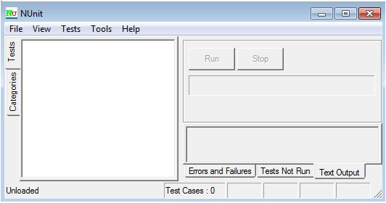
Installation and overview of use
The latest version 3.4 of Nunit.exe can be download from: http://nunit.org
Notes:
Instructions:
If relevant add a page on how to install and use the tool

Slide 5
Input and Output Of NUNit
NUnit
class library or executable file
XML file (Optional)
Processing details on the GUI or Command prompt

Slide 6
Loading & Running Test Cases
Open test runner
In NUnit API, click File > Open project
Nunit test project DLL
Click on Run
Double click on test case to run individually
Notes:
Instructions:
Include as much graphic information, diagrams and the like as possible.
he test assembly is the class library (or executable) that contains the Test Fixtures. The application will then show you a graphical view of each class

Slide 7
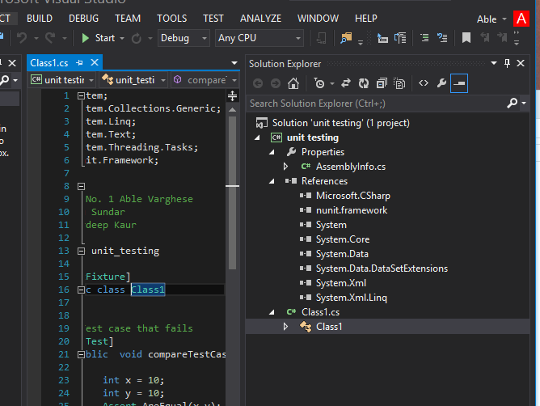
Steps
Add nunit.frameworks.dll to your project references. This dll resides in nunit\bin folder.
Notes:
Instructions:
Include whatever is relevant for your tool. For example, you may list the tests that a static analysis code analyzer does or diagrams of how a source course code control system creates new tracks or streams of versions of files.

Slide 8
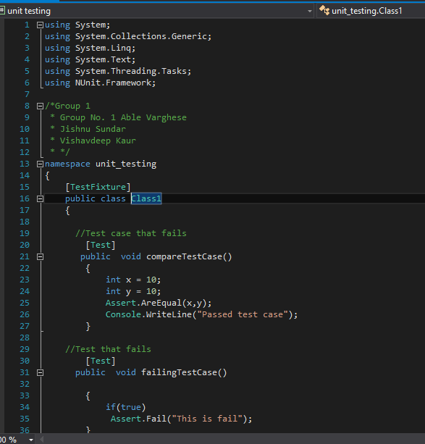
Steps (Create Test Code)
Notes:
Instructions:
Include whatever is relevant for your tool. For example, you may list the tests that a static analysis code analyzer does or diagrams of how a source course code control system creates new tracks or streams of versions of files.

Slide 9
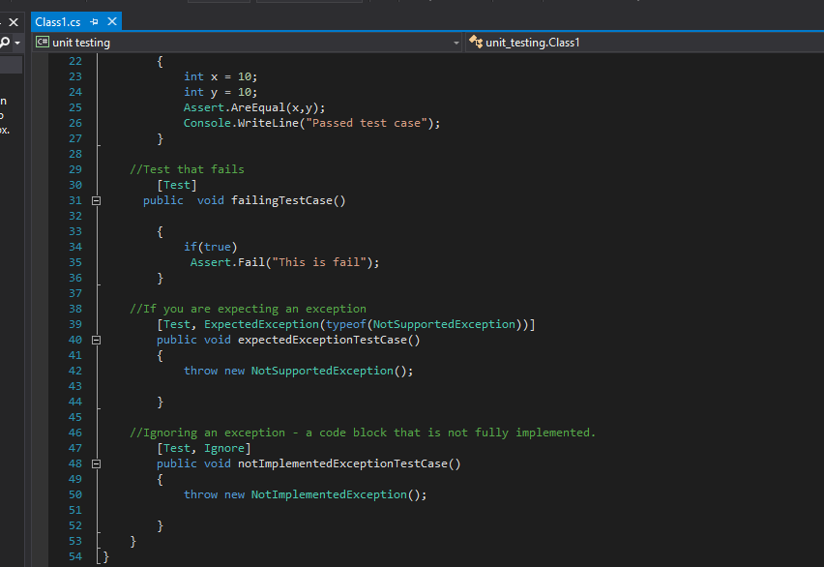
NUnit (Rest of the code)

Slide 10
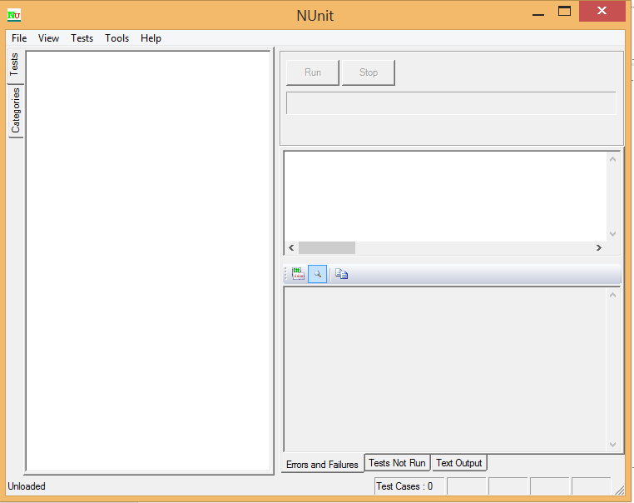
Opening Test Runner GUI

Slide 11
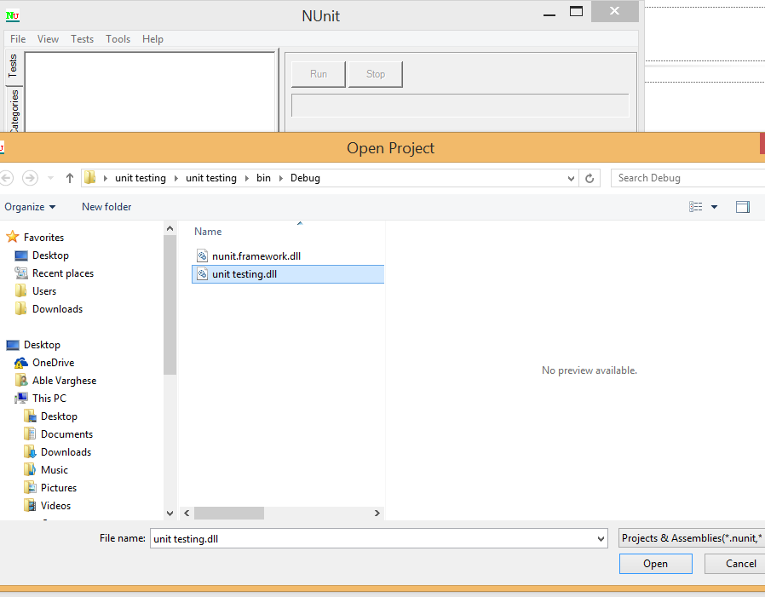
Opening .dll file in the Test Runner

Slide 12
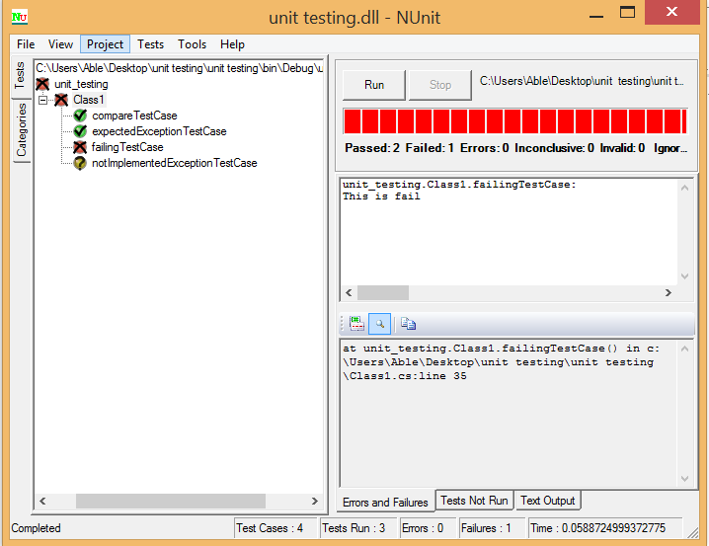
Running all 4 tests

Slide 13
Test Attributes
‘TextFixture’ Attribute
’TestFixture’ attribute - indication for class contains test methods
Test Runner application will scan it for test methods
‘Test’ Attribute
Indicates that a method within a test fixture should be run by the Test Runner application
‘Ignore’ Attribute
Indicates that a test should not be run on a particular method.

Slide 14
Reference and sources
http://www.codeproject.com/Articles/178635/Unit-Testing-Using-NUnit
http://www.nunit.org/
https://github.com/nunit/docs/wiki

Slide 15
Questions Please…
Thank you.

