Slide 1
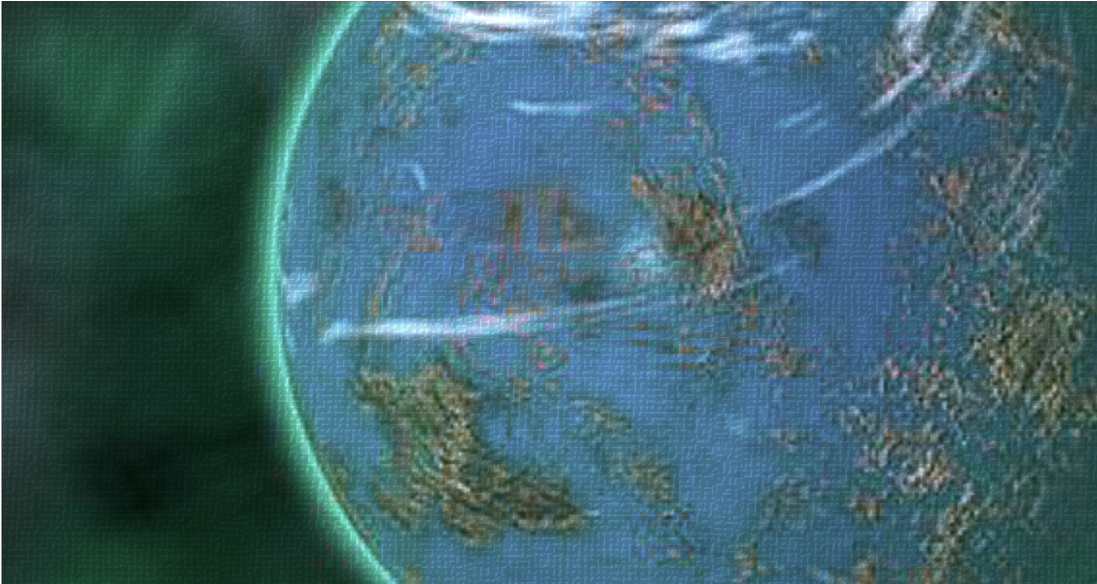

The Journey With the Gray Death Legion

