Slide 1
Decision Tree Regression and Random Forest
Min Chen

Slide 2
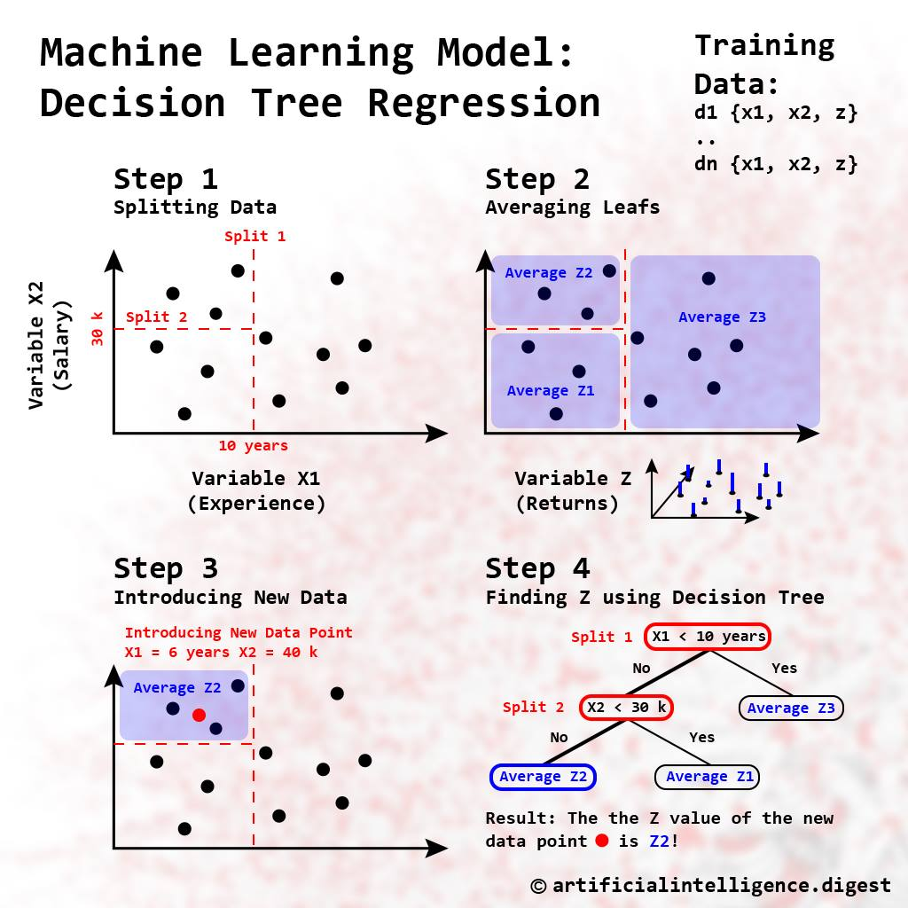
Decision Tree Regression
Once the tree is built, it can be used to make predictions. To predict the value of the target variable for a new observation, the decision tree "routes" the observation through the tree, following the splits until it reaches a leaf. The predicted value for the observation is the mean (or median) of the target variable for the training observations in the leaf.

Slide 3
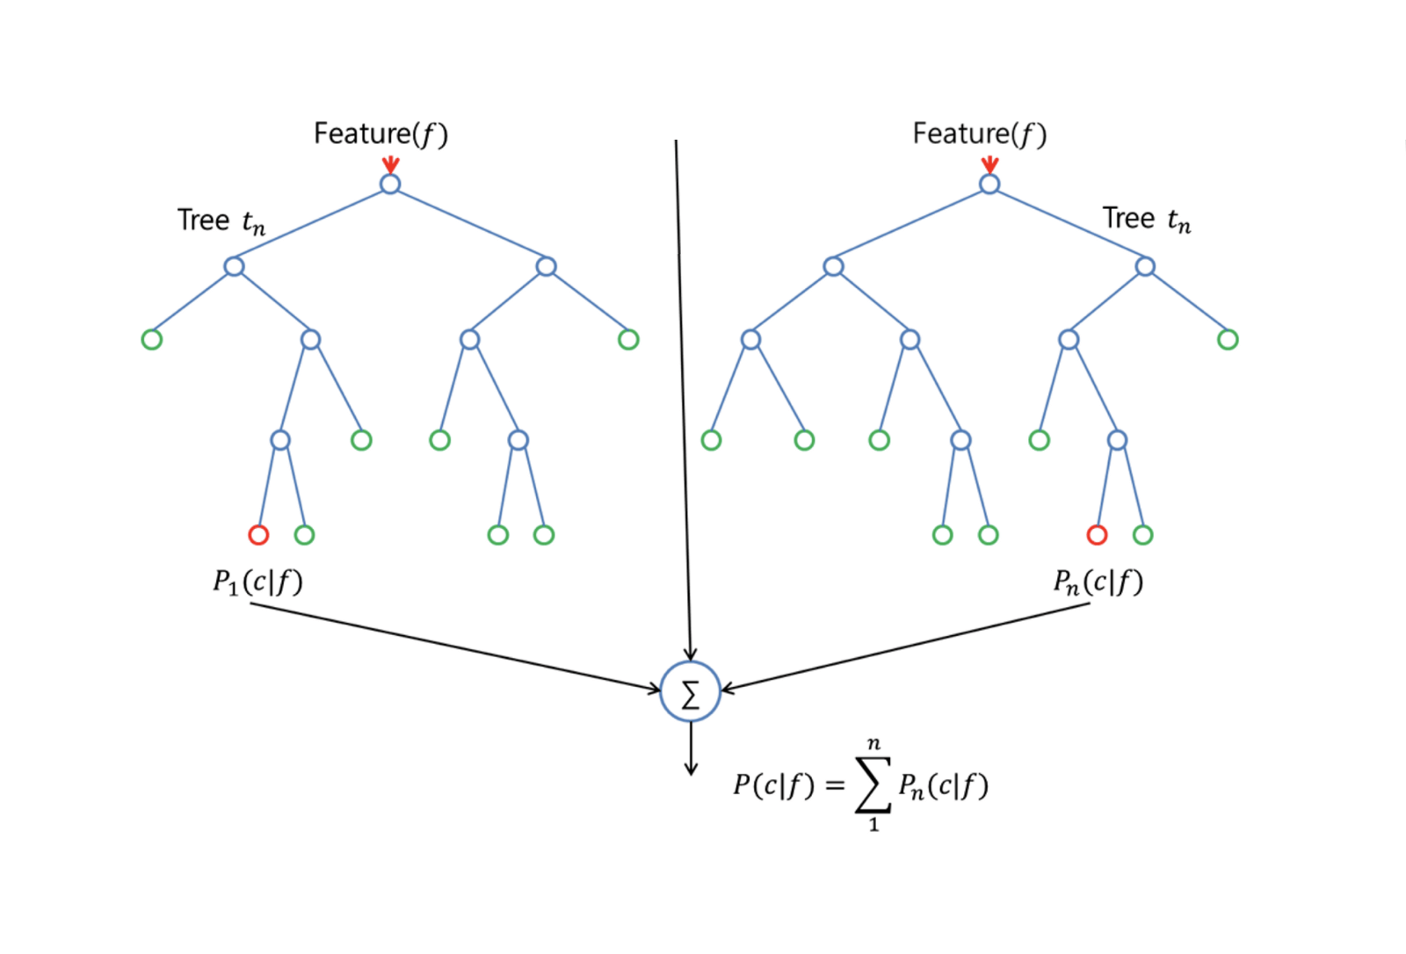
Random forest

Slide 4
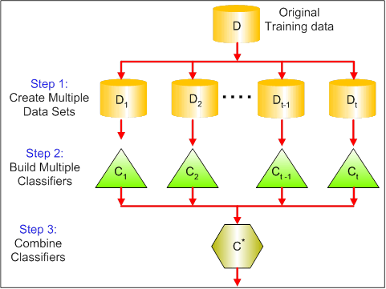
Random Forest: Enhancing Stability and Accuracy
Random Forest is an ensemble method that creates a 'forest' of decision trees, typically hundreds or thousands, to improve prediction accuracy. Each tree in the forest is built from a random sample of the training data, and at each split in the tree, a random subset of features is considered.
Bootstrap Aggregating (Bagging): Each tree in a Random Forest is trained on a random subset of the data obtained with replacement (bootstrap sample), which helps in reducing variance without increasing bias.
Feature Randomness: When building a decision tree within the forest, the algorithm selects a random subset of features at each split, increasing the diversity among the trees. This feature randomness helps in making the model more robust against overfitting and leverages the strength of multiple features that might be predictive in different ways.
Aggregation of Results:
Classification: For a classification problem, the Random Forest takes a majority vote of its trees. The class that gets the most votes by the trees in the forest is chosen as the final output.
Regression: For regression, it averages the predictions of all the trees.

