Slide 1

HTS: A Multithreaded Direct Sparse Triangular Solver Combining Level Scheduling and Recursive Blocking
Andrew M. Bradley
Thanks: E. Boman, J. Booth, C. Dohrmann, S. Hammond, W. Held, M. Heroux, R. Hoekstra, K. Kim, S. Olivier, A. Prokopenko, S. Rajamanickam
Trilinos User Group Meeting 2015
SAND2015-9187 C

Slide 2

Problem Statement
Solve R P T Q x = b
Upper or lower sparse triangular matrix T
Row scaling R
Permutations P, Q
Solution and RHS x, b
(Everything that is needed for LDL, LU, incomplete factorizations, etc.)
Efficient to absorb user data
For many sequential RHS with
Same T or
Same nonzero pattern pat(T)
On a multi/many-core node

Slide 3
Solution Approach
Symbolic phase
Find parallelism in pat(T), the graph of T
Numeric phase
Load data structures with numbers
Solve phase

Slide 4
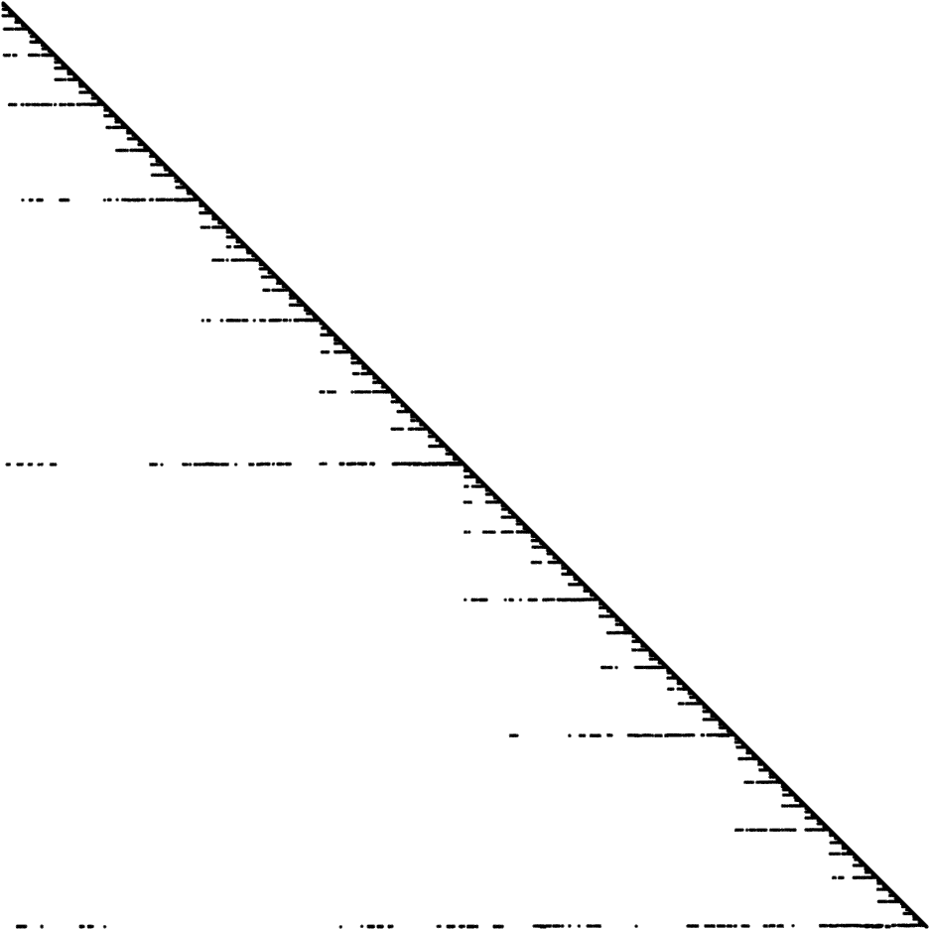
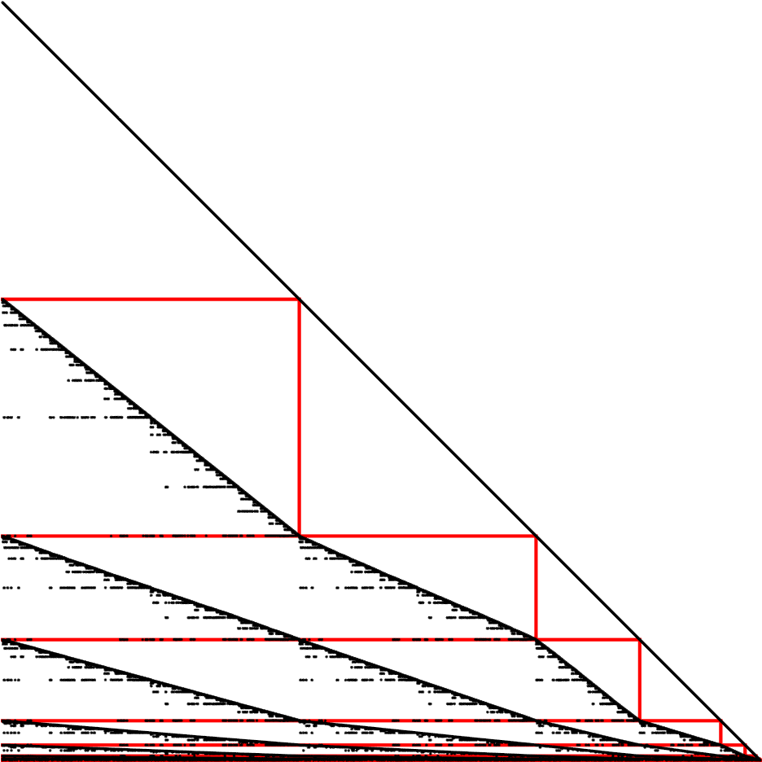
Algorithms: Level Scheduling
Reorder

Slide 5
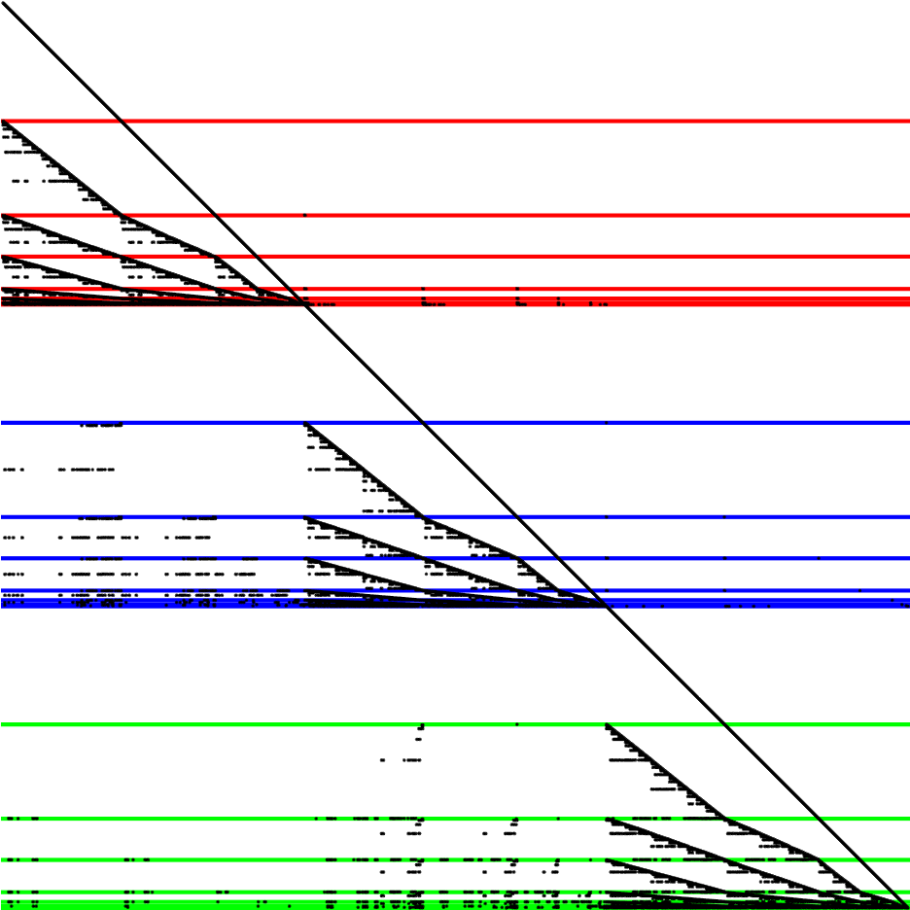
Algorithms: Level Scheduling
Reorder

Slide 6
Algorithms: Pruned Point-to-Point
Park, J., M. Smelyanskiy, N. Sundaram, and P. Dubey., "Sparsifying synchronization for high-performance shared-memory sparse triangular solver." In Supercomputing, pp. 124-140. Springer International Publishing, 2014.

Slide 7

Algorithms: Recursive Blocking

Slide 8
Algorithms: Hybrid

Slide 9
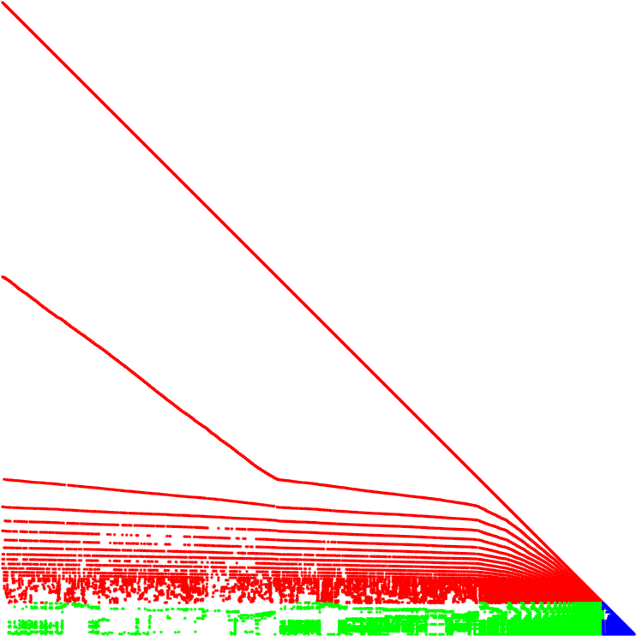
Algorithms: Hybrid
Reorder

Slide 10
HTS
Level schedule solve: Park et al.’s method
Recursive blocking
Also with point-to-point
Switching method
Currently: smoothed level size with threshold
Currently: OpenMP and C++98

Slide 11
Algorithms: Hybrid
Reorder

Slide 14
UMFPACK LU on IB and KNC

Slide 15
Ordering

Slide 16
IC-0 (NodeND) on IB and KNC

Slide 18
Future Work
Point-to-point level scheduling
Group rows into tasks to minimize #dependencies
Size tasks to reflect level of synchronization
Hybrid
Switching method(s)
Does not have to be 3 blocks; alternate
HTS
Kokkos interface
Support a variety of input formats
Direct sparse methods on GPU?

