Slide 1

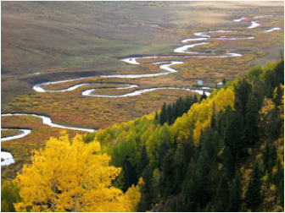

IDEAS xSDK: Providing Software Interoperability
Alicia Klinvex

Slide 2
What is IDEAS xSDK?
IDEAS is a collaborative project between several DOE labs and universities
Focus: improving scientific productivity
xSDK is our extreme-scale scientific software development kit
Composed of high-quality reusable CSE software components and libraries
Goal: interoperability of IDEAS libraries
Trilinos
PETSc
Hypre
SuperLU

Slide 3

Sample use case: Amanzi (LANL)
A parallel flow and reactive transport simulator
Used to analyze multiple DOE waste disposal sites
Example application: modeling hydrological and biogeochemical cycling in the Colorodo River System
Carbon cycling is especially important because of its role in regulating atmospheric CO₂
Needs to use both Trilinos and PETSc

Slide 4
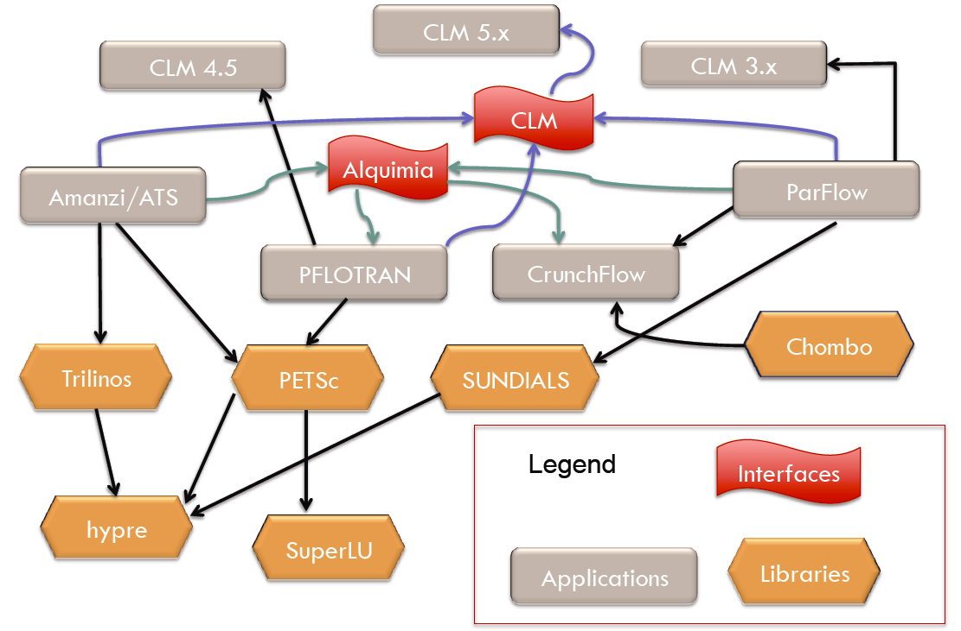
Goals of xSDK (1/3)
Packages must be able to build together
Less trivial than it sounds due to
Namespace conflicts
Dependencies on different versions of the same TPL
Circular dependencies

Slide 5
Goals of xSDK (2/3)
User must be able to
Use PETSc datatypes (Mat, Vec) with Trilinos linear and nonlinear solvers
Use Trilinos datatypes with PETSc linear and nonlinear solvers
Use Hypre preconditioners with Trilinos linear solvers
Use SuperLu as an Amesos(2) solver
Amanzi
Trilinos
PETSc
hypre
SuperLU

Slide 6
Goals of xSDK (3/3)
Interfaces must
Be regularly tested
Have documentation and examples
Be easy to use
Have long-term support

Slide 7
Common configuration and build script
PETSc has a simple-to-use installation process
Automatically looks for everything it needs and displays a helpful error message if it fails to find something
Will automatically download and install desired external packages (including xSDK packages such as Trilinos or hypre)
If the download fails due to a firewall, PETSc will output the URL it tried to reach so you can download the package yourself
Great for interoperability; everything is the correct version
What it looks like: configure --with-mpi-dir=/usr/lib64/openmpi/ --prefix=/home/amklinv/petsc-install --download-hypre --download-superlu

Slide 8
Using PETSc data structures with Trilinos (1/3)
Have PETSc Mat and want to use Trilinos linear solvers, eigensolvers, preconditioners, etc.
Patched the existing Epetra-based interface
PETSc’s Mat is wrapped in a subclass of Epetra_RowMatrix
Created a new Tpetra-based interface
Epetra_RowMatrix
Tpetra::RowMatrix
Epetra_
PETScAIJMatrix
Tpetra::
PETScAIJMatrix
PETSc Mat
PETSc Mat

Slide 9
Using PETSc data structures with Trilinos (2/3)
Tpetra::PETScAIJMatrix wrapper allows us to use PETSc matrices anywhere a Tpetra::RowMatrix would have been appropriate
Anasazi, Belos, Ifpack2, etc.
Raw data is wrapped, not copied

Slide 10
Using PETSc data structures with Trilinos (3/3)
Example: computing the eigenpairs of a PETSc matrix Mat petscA; ... Tpetra::PETScAIJMatrix tpA(petscA); Tpetra::MultiVector X; ... Anasazi::BasicEigenproblem problem(tpA,X); ParameterList pl; ... Anasazi::BlockKrylovSchurSolMgr solver(problem, pl); solver.solve();
End of PETSc code

Slide 11
Using Trilinos data structures with PETSc linear solvers (1/2)
Have Tpetra::Operator and want to use PETSc KSP linear solvers
We created a new Belos::SolverManager subclass that wraps PETSc’s linear solvers (KSP)
Belos::SolverManager
Belos::
PETScSolMgr
PETSc KSP

Slide 12
Using Trilinos data structures with PETSc linear solvers (2/2)
What calling a PETSc linear solver with Tpetra objects looks like to the user: Tpetra::Operator A; Tpetra::MultiVector X, B; ParameterList pl; … Belos::LinearProblem problem(A,X,B); Belos::PETScSolMgr solver(problem,pl); solver.solve();
The user never sees a single line of PETSc code

Slide 13
How does this interface benefit PETSc and Trilinos users in general?
Gives Trilinos users access to more linear solvers
Gives PETSc users access to Kokkos for in-node parallelism
Can use Kokkos for OpenMP, CUDA, etc
Matrix-vector multiplication currently use Trilinos code
Vector operations currently use PETSc code (but we’re working on it)

Slide 14
Using Trilinos data structures with hypre
There were two existing Epetra->hypre interfaces
Ifpack
EpetraExt
They were recently patched by Trilinos user Denis Davydov
New Ifpack2/Tpetra interface
Hypre is wrapped in a subclass of Ifpack2::Preconditioner
User never sees hypre
Ifpack2::Preconditioner
Ifpack2:: Ifpack2_Hypre
hypre

Slide 15
Using Trilinos data structures with SuperLU
We have an Amesos (Epetra) interface and an Amesos2 (Tpetra) interface
Separate interfaces for SuperLU and SuperLU_Dist
Amesos_BaseSolver
Amesos2::Solver
Amesos_Superlu
Amesos2:: Superlu
SuperLU
SuperLU

Slide 16
Issues
Trilinos has multiple vector abstractions
Anasazi
Belos
Thyra
Belos doesn’t allow the user to specify a status test (convergence test)
There is no automated testing for the PETSc and hypre interfaces

Slide 17
Future work
Automated tests
Hypre interface
PETSc solver interface
SuperLU interface?
Interoperability of PETSc and Trilinos nonlinear solves
Documentation on Trilinos abstraction layers
More examples demonstrating interoperability of packages

Slide 18
Summary
xSDK will allow application developers to use IDEAS libraries together
This effort has positive unintended consequences for Trilinos users in general (even if you don’t think you care about interoperability)
Better support and documentation for Trilinos abstraction layers
Makes additional solvers and preconditioners available

