Slide 1
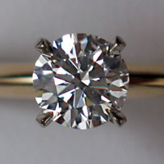
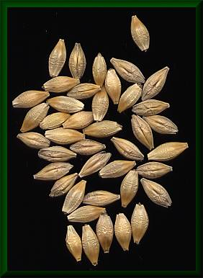

Threaded Construction and Fill of Tpetra Sparse Linear System using Kokkos
Mark Hoemmen and Carter Edwards
Trilinos Users’ Group meeting
October 28, 2014
SAND# 2014-19125 C
Notes:
Source for upper left image: http://en.wikipedia.org/wiki/File:Diamond.jpg
This file is licensed under the Creative Commons Attribution 1.0 Generic license.
Source for upper right image: http://en.wikipedia.org/wiki/File:Gerstenkoerner.jpg
“This work has been released into the public domain by its author, Leo Michels. This applies worldwide. In some countries this may not be legally possible; if so: Leo Michels grants anyone the right to use this work for any purpose, without any conditions, unless such conditions are required by law.”
Source for lower image:
http://commons.wikimedia.org/wiki/File:Petra_,_Al-Khazneh_2.jpg
“This file is licensed under the Creative Commons Attribution-Share Alike 3.0 Unported license.”
The lower image depicts Al Khazneh (the “Treasury”) at Petra (an ancient city in Jordan).

Slide 2
Tpetra: Parallel sparse linear algebra
Advantages of Tpetra
User can choose data type: float, dd_real, complex, AD, UQ, …
Can solve problems with over 2 billion unknowns
MPI+X parallel (X: any shared-memory parallel programming model)
Performance-portable to different node hardware
What IS thread-parallel now (& was in Tpetra since ~2008):
Sparse matrix-vector multiply
(Multi)Vector dot, norm, & update (axpy)
Any preconditioner apply that uses these things
What’s NOT thread-parallel now:
Some kernels: e.g., sparse {triangular solve, matrix-matrix multiply}
Fill: Creating or modifying the entries of a graph, matrix, or vector
We’re fixing this using Kokkos programming model & data structures

Slide 3
Tpetra fill was not thread-scalable
Dynamic memory allocation (“dynamic profile”)
Impossible in some parallel models; slow on others
Allocation implies synchronization (must agree on pointer)
Better: Count, Allocate (thread collective), Fill, Compute
Throw C++ exceptions when out of space
Either doesn’t work (CUDA) or hinders compiler optimization
Prevents fruitful retry in (count, allocate, fill, compute)
Better: Return success / failed count; user reduces over counts
Unscalable reference counting implementation
Teuchos::RCP: like std::shared_ptr but not thread safe
Not hard to make thread safe, but updating the ref count serializes!
Better: Use Kokkos’ thread-scalable reference counting

Slide 4
How will Tpetra make fill MPI+X?
Tpetra will use Kokkos data structures & kernels
Kokkos objects are natively thread-safe & scalable
You’ll be able to extract & work with the Kokkos objects
Tpetra objects will behave like Kokkos::DualView
Simplify port to use GPUs or multiple memory spaces
No overhead (& can ignore) if you only have 1 memory space
Tpetra objects will have view semantics
Copy constructor and operator= will do shallow copy
Deep copy is explicit, just like Kokkos
Tpetra::deep_copy (nonmember function)
2-argument copy constructor with Teuchos::Copy
Will make thread-scalable operations w/ Tpetra objects easier
You may still handle Tpetra objects by RCP or shared_ptr if you like

Slide 5
Initially, use Kokkos directly for fill
Initially, only Kokkos interface is thread-safe & scalable
Simplifies backwards compatibility & gradual porting
Ensures low overhead
Create a Tpetra object by passing in a Kokkos object
Create & fill local Kokkos data structure in thread-parallel way
Pass it into Tpetra object’s constructor
Tpetra object will wrap & own the Kokkos object
Modify existing Tpetra object through Kokkos interface
Ask Tpetra for its Kokkos local data structure, & modify that
Tpetra’s interface for modifying data will evolve
Only serial (no threads) at first; this will change gradually
Will always work on host (not CUDA device) version of data

Slide 6
Tpetra DualView semantics
If you only have one memory space, you can ignore all of this; it turns to no-ops.
Preferred use with two memory spaces:
Assume unsync’d
Sync to memory space where you want to modify it (free if in sync)
Get & modify view in that memory space
Leave the Tpetra object unsync’d
Tpetra objects will act just like Kokkos::DualView.
Tpetra’s evolution of legacy fill interface is host only.
To fill on (CUDA) device, must use Kokkos interface.

Slide 7
Example of DualView use
Tpetra::Vector<…, Cuda> X (map);
{ // Some code that works on CUDA
X.sync<Cuda> (); // copy changes to CUDA device only if needed
X.modify<Cuda> (); // we’re changing in CUDA space
auto X_lcl = X.getLocalView<Cuda> ();
parallel_for (X.getLocalLength (), [=] (const LO i) {X_lcl(i) = …});
} // done w/ CUDA. Don’t sync unless will change on host.
{ // Some code that works (only) on host
X.sync<Host> (); // copy changes to host memory only if needed
X.modify<Host> (); // we’re changing in host space
auto X_lcl = X.getLocalView<Host> ();
parallel_for (X.getLocalLength (), [=] (const LO i) {X_lcl(i) = …});
} // done changing on host. Skip sync & modify if only 1 space.

Slide 8
Timeline
Done
Crs{Graph, Matrix} & MultiVector use Kokkos objects & kernels
Their constructors take Kokkos objects; see TrilinosCouplings FENL
MultiVector implements DualView semantics
Map implements view semantics; new Map works on CPUs
Interface changes left: MUST finish by Trilinos 12.0 in April
Make Crs{Graph, Matrix} & Map implement DualView semantics
Firm up Kokkos objects’ interfaces & typedefs in Tpetra
Critical thread-parallel kernels to implement
Not needed for Trilinos 12.0, but we want them soon!
Sparse triangular solve (prototypes exist) & relaxations
Multigrid setup: Sparse matrix-matrix multiply, aggregation

Slide 9
How did we do it?
2 Tpetra versions now coexist: “Classic” & “Kokkos Refactor”
Both build & pass all Tpetra & downstream solver tests
We maintained backwards compatibility if possible (mostly was)
You can test both versions in the same code!
Partial specialization on the Node template parameter
Classic Tpetra uses Nodes in KokkosClassic subpackage
Kokkos Refactor Tpetra uses Nodes in KokkosCompat subpackage
Look in packages/tpetra/src/kokkos_refactor for implementations
How do I enable Kokkos Refactor RIGHT NOW?
Look in packages/tpetra/ReleaseNotes.txt
Enable KokkosCore & 5 other subpackages explicitly
Set CMake option (Tpetra_ENABLE_Kokkos_Refactor:BOOL=ON)
Set default Node type via CMake, or specify it explicitly

Slide 10
Schedule for releasing new Tpetra
Will deprecate Classic at 11.14 release in January
11.14: Kokkos will build in Trilinos by default (Primary Tested)
Using old Node types will emit deprecate warnings
Plan to remove Classic at 12.0 release in April
Don’t worry, MPI only will remain default (Kokkos::Serial device)
Best practice: Do NOT specify Node template parameter explicitly
Rely on default Node type unless you really care
Prefer to change default Node type via CMake option
Find default from typedefs: e.g., Tpetra::Map<>::node_type
Early adopters: Get in touch with us!

Slide 11
Create & fill Kokkos data structures

Slide 12
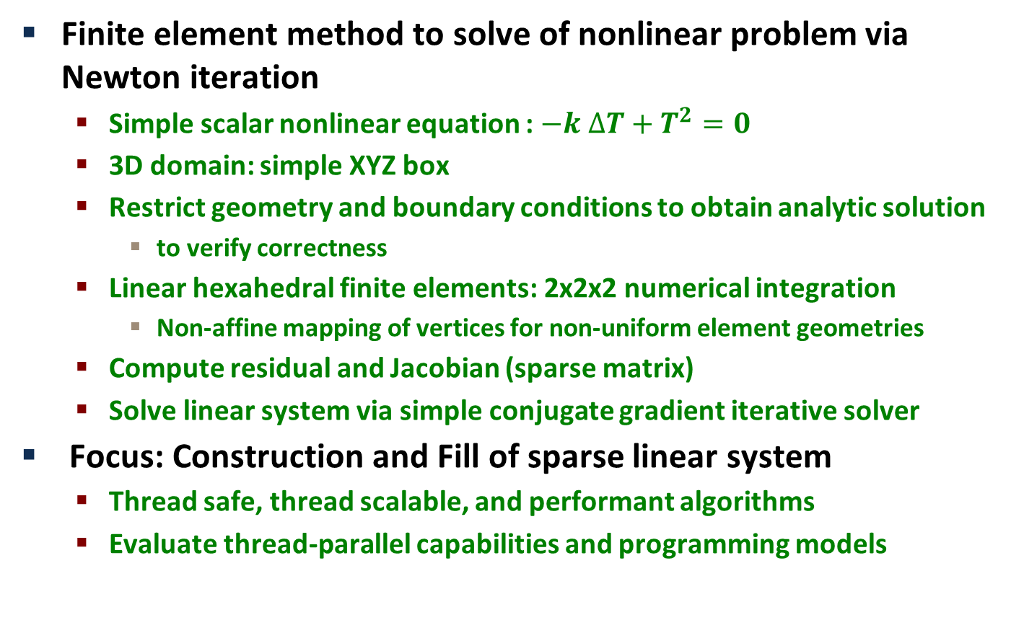
MiniFENL: Mini (proxy) Application
Finite element method to solve of nonlinear problem via Newton iteration
Simple scalar nonlinear equation : $−k ∆T+T^{2}=0$
3D domain: simple XYZ box
Restrict geometry and boundary conditions to obtain analytic solution
to verify correctness
Linear hexahedral finite elements: 2x2x2 numerical integration
Non-affine mapping of vertices for non-uniform element geometries
Compute residual and Jacobian (sparse matrix)
Solve linear system via simple conjugate gradient iterative solver
Focus: Construction and Fill of sparse linear system
Thread safe, thread scalable, and performant algorithms
Evaluate thread-parallel capabilities and programming models

Slide 13
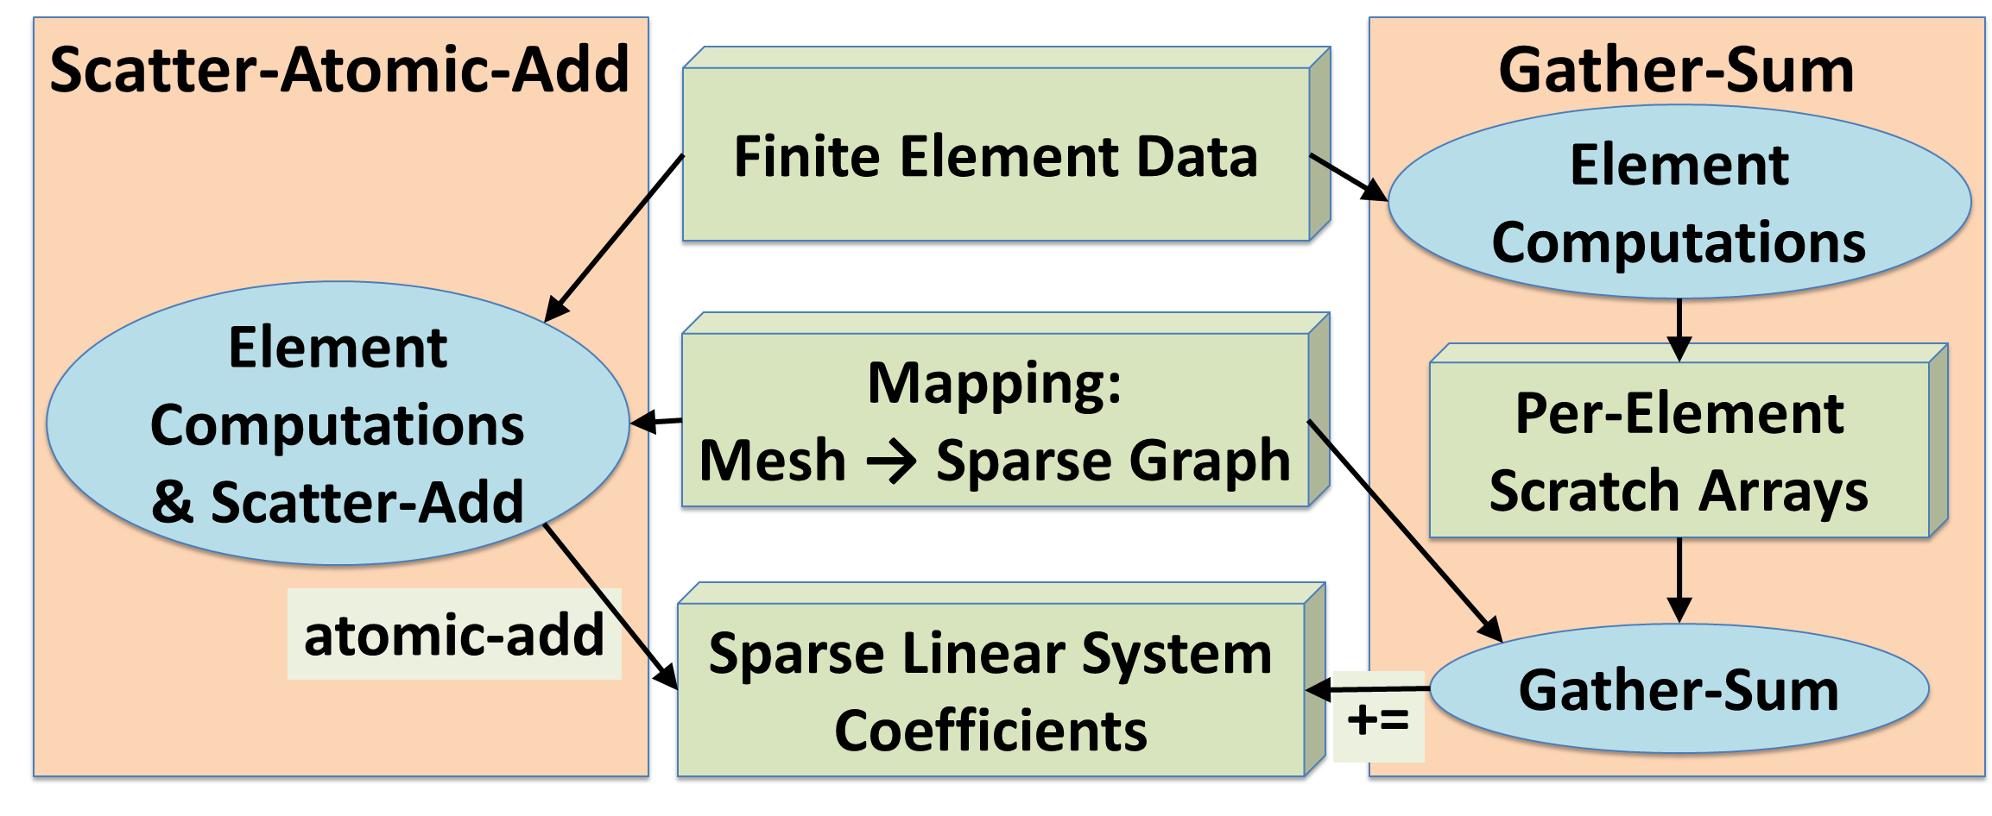
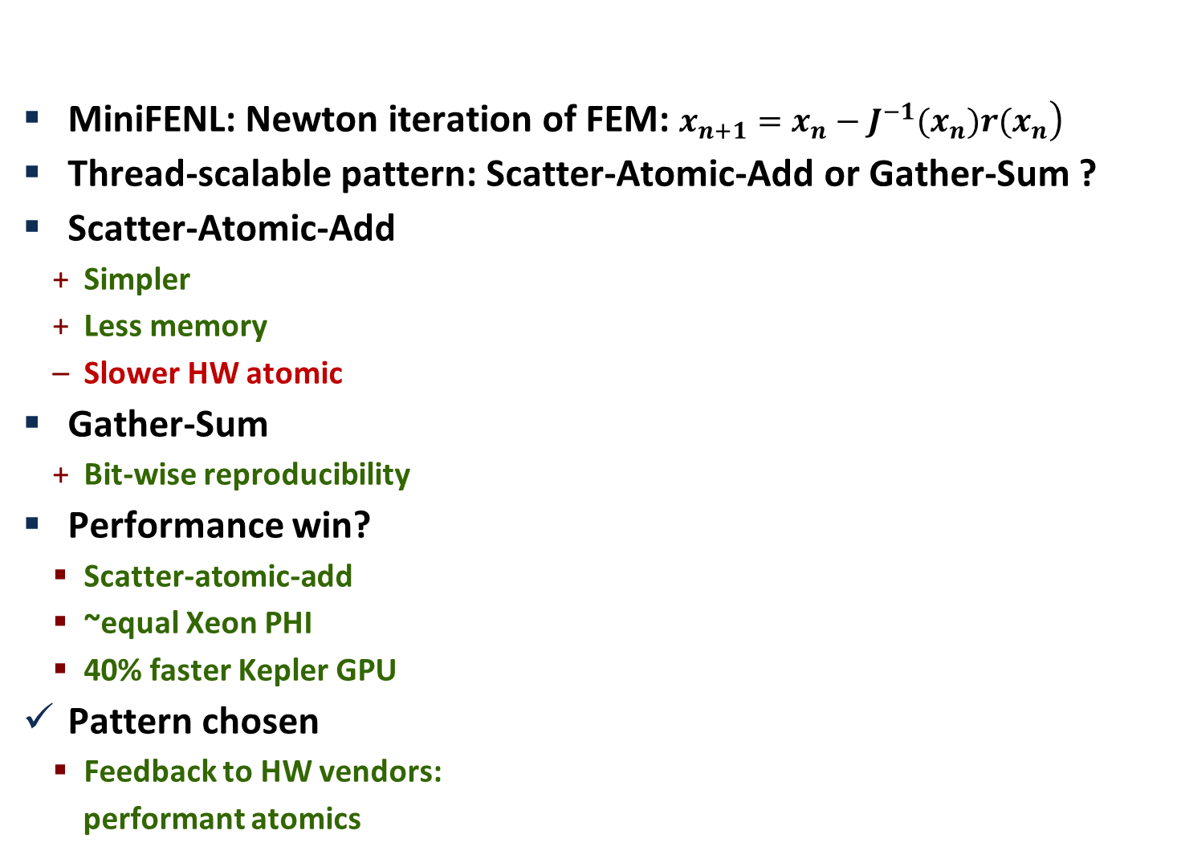
Thread-Scalable Fill of Sparse Linear System
MiniFENL: Newton iteration of FEM: $\left.x_{n+1}=x_{n}−J^{−1}(x_{n})r(x_{n}\right)$
Thread-scalable pattern: Scatter-Atomic-Add or Gather-Sum ?
Scatter-Atomic-Add
Simpler
Less memory
Slower HW atomic
Gather-Sum
Bit-wise reproducibility
Performance win?
Scatter-atomic-add
~equal Xeon PHI
40% faster Kepler GPU
Pattern chosen
Feedback to HW vendors:
performant atomics

Slide 14
Using Kokkos atomic-add interface
Kokkos::View<double*> residual ; // global
Kokkos::CrsMatrix<...> jacobian ; // global
// parallel compute of element[ielem] residual and jacobian
double elem_res[NN];
double elem_jac[NN][NN];
for ( int i = 0 ; i < NN ; ++i ) {
const int row = elem_node_index( ielem , i );
if ( row < residual.dimension_0() ) { // locally owned row
Kokkos::atomic_fetch_add( & residual(row), elem_res[i] );
for ( int j = 0 ; j < NN ; ++j ) {
const int entry = elem_graph_map( ielem , i , j );
Kokkos::atomic_fetch_add( & jacobian.values(entry)
, elem_jac[i][j] );
}
}
}

Slide 15
Performance Overhead of Atomic Add
Performance analysis: replace atomic-add with “ y += x ; ”
Numerical errors due to thread unsafe race condition
Approximate performance of “perfect” atomics or coloring algorithm
Kepler: Large overhead for double precision “CAS loop” atomic
Phi: Small overhead versus element computation

Slide 16
Thread Scalable CRS Graph Construction
Thread scalable construction (reconstruction) pattern
Count in parallel
Allocate (resize)
Fill in parallel
Compute in parallel
Construction of CRS Graph from Element-Node connectivity
Generate elements’ unique node-node pairs (graph edges)
Count non-zeros per row (graph vertices’ degree)
Prefix-sum non-zeros per row for CRS row offset array
Allocate CRS column index array
Fill CRS column index array
Sort each row of CRS column index array
Following pseudo-code is simplified to illustrate algorithm

Slide 17
CRS Graph Edges (non-zero entries)
Generate elements’ unique node-node pairs
Kokkos::UnorderedMap< pair<int,int> > nodenode(“nn”,capacity);
Kokkos::parallel_for( num_elem , [=]( int ielem ) {
for ( int i = 0 ; i < NN ; ++i ) {
const int row = elem_node_id( ielem , i );
for ( j = i ; j < NN ; ++j ) {
const int col = elem_node_id( ielem , j );
const pair<int,int> key( min(row,col), max(row,col));
auto result = nodenode.insert( key );
if ( result.success() ) { // First time inserted
if ( row < row_count.dimension_0() )
Kokkos::atomic_fetch_add( & row_count(row) , 1 );
if (col != row && col < row_count.dimension_0() )
Kokkos::atomic_fetch_add( & row_count(col) , 1 );
}
}
} );

Slide 18
CRS Graph Row Offset Array
Parallel prefix-sum row counts and allocate column index array
Kokkos::parallel_scan( num_rows ,
[=]( int irow , int & update , bool final ) {
// parallel scan is a multi-pass parallel pattern
// In the ‘final’ pass ‘update’ has the prefix value
if ( final ) graph.row_map( irow ) = update ;
update += row_count( irow );
if ( final && num_rows == irow + 1 )
graph.row_map(irow+1) = update ; // total non-zeros
} );
graph.columns =
View<int*>(“columns”, graph.row_map(num_rows) );

Slide 19
CRS Graph: Fill Column Index Array
Fill column index array with rows in non-deterministic order
Kokkos::fill( row_count , 0 );
Kokkos::parallel_for( nodenode.capacity() ,
[=]( int ientry ) {
if ( nodenode.valid_at(ientry) ) {
const pair<int,int> key = nodenode.key_at(ientry);
const int i = key.first ;
const int j = key.second ;
if ( i < num_rows )
graph.columns( graph.row_map(i) +
atomic_fetch_add(&row_count(i),1) );
if ( j != i && j < num_rows )
graph.columns( graph.row_map(j) +
atomic_fetch_add(&row_count(j),1) );
}
});
Sort each row of column index array

