Slide 1
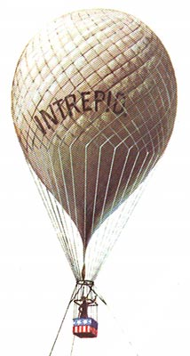


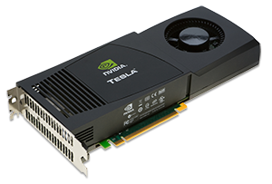

Intrepid
Intrepid to Kokkos refactoring
Adam Delora, H. Carter Edwards, Irina Demeshko
SAND NO SAND2014-19287 PE

Slide 2
Intrepid
Intrepid package is a library of tools for compatible discretizations of Partial Differential Equations (PDEs).
Used in: Drekar, Albany and other codes.
Kokkos
Intrepid needs to be refactored for manycore architecture,
where Kokkos is Trilinos' path-forward for manycore performance portability

Slide 3
Intrepid to Kokkos refactoring
Goals:
support for Kokkos::View multidimensional arrays
create functors for Intrepid functions to run thread-parallel
optimize functors
Adam Delora
Irina Demeshko
Harvey Mudd math / computer science clinic
(SNL liaison: H. Carter Edwards)

Slide 4
Issue: Intrepid does not work with Kokkos::View today
template<class Scalar, class ArrayOutData, class ArrayInDataLeft, class ArrayInDataRight>
void ArrayTools::scalarMultiplyDataData(ArrayOutData & outputData,
ArrayInDataLeft & inputDataLeft,
ArrayInDataRight & inputDataRight,
const bool reciprocal){
switch(invalRank) {
case 2:{
for(int cl = 0; cl < numCells; cl++) {
for(int pt = 0; pt < numPoints; pt++) {
outputData(cl, pt) = inputDataRight(cl, pt)/inputDataLeft(cl, pt);
} // P-loop
} // C-loop
}
break;
case 3:{
for(int cl = 0; cl < numCells; cl++) {
for(int pt = 0; pt < numPoints; pt++) {
for( int iVec = 0; iVec < dim1Tens; iVec++) {
outputData(cl, pt, iVec) = inputDataRight(cl, pt, iVec)/inputDataLeft(cl, pt);
} // D1-loop
} // P-loop
} // C-loop
}
break;
}
!Kokkos::View has a compile-time rank
Assumes run-time rank of the Arrays

Slide 5
Our Solution Partial Template Specialization
template<class A>
struct Rank{static const int value = -1;};
template<class arg1, class arg2, class arg3, class arg4, class arg5>
struct Rank<Kokkos::View<arg1,arg2,arg3,arg4,arg5> >{
static const int value=Kokkos::View<arg1,arg2,arg3,arg4, arg5>::rank;
};
template<class ArrayOutData, class ArrayInDataLeft, class ArrayInDataRight, class Layout, class MemorySpace>
struct ArrayTools::scalarMultiplyDataData2<ArrayOutData, ArrayInDataLeft, ArrayInDataRight, Layout, MemorySpace,2,2>{
scalarMultiplyDataData2(ArrayOutData outputData,
ArrayInDataLeft inputDataLeft,
ArrayInDataRight inputDataRight,
const bool reciprocal){
Kokkos::parallel_for(outputData.dimension_0(), ComputeFunctor<Kokkos::View<double***> >(outputview2,
inputview1, inputview2));
}
template<class ArrayOutData, class ArrayInDataLeft, class ArrayInDataRight>
void ArrayTools::scalarMultiplyDataData( ArrayOutData& outputData,
const ArrayInDataLeft& inputDataLeft,
const ArrayInDataRight& inputDataRight,
const bool reciprocal){
ArrayTools::scalarMultiplyDataData2<ArrayOutData,ArrayInDataLeft,ArrayInDataRight, void, void,
Rank<ArrayInDataRight>::value,Rank<ArrayOutData>::value>(outputData, inputDataLeft, inputDataRight,reciprocal);
}

Slide 6
Kokkos Functor Example
template<class ViewType>
struct ComputeFunctor{
ViewType outputData;
const ViewType inputData1;
const ViewType inputData2;
ComputeFunctor (ViewType outputData_,
const ViewType1 inputData1_,
const ViewType2 inputData2_)
:outputData(outputData_),inputData1(inputData1_), inputData2(inputData2_) {}
KOKKOS_INLINE_FUNCTION
void operator() (int i) const {
for(int j = 0; j < outputData.dimension_1(); j++)
for(int k = 0; k < outputData.dimension_2(); k++)
outputData(i,j,k) = inputData1(i,j,k)*inputData2(i,j,k)+inputData2(i,j,k);
}
};

Slide 7
Nested Parallelism
template<class A>
struct Rank{static const int value = -1;};
template<class arg1, class arg2, class arg3, class arg4, class arg5>
struct Rank<Kokkos::View<arg1,arg2,arg3,arg4,arg5> >{
static const int value=Kokkos::View<arg1,arg2,arg3,arg4, arg5>::rank;
};
template<class ArrayOutData, class ArrayInDataLeft, class ArrayInDataRight, class Layout, class MemorySpace>
struct ArrayTools::scalarMultiplyDataData2<ArrayOutData, ArrayInDataLeft, ArrayInDataRight, Layout, MemorySpace,2,2>{
scalarMultiplyDataData2(ArrayOutData outputData,
ArrayInDataLeft inputDataLeft,
ArrayInDataRight inputDataRight,
const bool reciprocal){
const team_policy policy( outputData.dimension_0(), hyperthreads);
Kokkos::parallel_for(policy,NestedComputeFunctor<Kokkos::View<double***> >(outputview2,
inputview1, inputview2));
}
template<class ArrayOutData, class ArrayInDataLeft, class ArrayInDataRight>
void ArrayTools::scalarMultiplyDataData( ArrayOutData& outputData,
const ArrayInDataLeft& inputDataLeft,
const ArrayInDataRight& inputDataRight,
const bool reciprocal){
ArrayTools::scalarMultiplyDataData2<ArrayOutData,ArrayInDataLeft,ArrayInDataRight, void, void,
Rank<ArrayInDataRight>::value,Rank<ArrayOutData>::value>(outputData, inputDataLeft, inputDataRight,reciprocal);
}

Slide 8
Hierarchical Parallelism Example
typedef Kokkos::TeamVectorPolicy<32> team_policy;
typedef team_policy::member_type team_member ;
template<class ViewType>
struct NestedComputeFunctor {
ViewType outputData;
const ViewType inputData1;
const ViewType inputData2;
NestedComputeFunctor (ViewType outputData_,
const ViewType inputData1_,
const ViewType inputData2_)
:outputData(outputData_),inputData1(inputData1_) ,inputData2(inputData2_) {}
KOKKOS_INLINE_FUNCTION
void operator() (const team_member & thread) const {
int i = thread.league_rank();
thread.team_par_for(outputData.dimension_1(),[&] (const int& j){
thread.vector_par_for(outputData.dimension_2(),[&] (const int& k){
outputData(i,j,k) = inputData1(i,j,k)*inputData2(i,j,k)+inputData2(i,j,k);
});
});
}
};

Slide 9
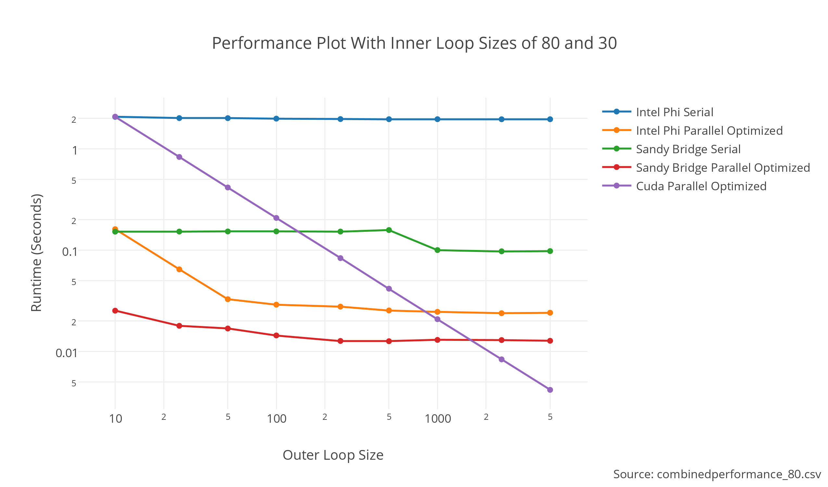
Combined Performance Results with 80 and
30 Inner Loop Sizes

Slide 10
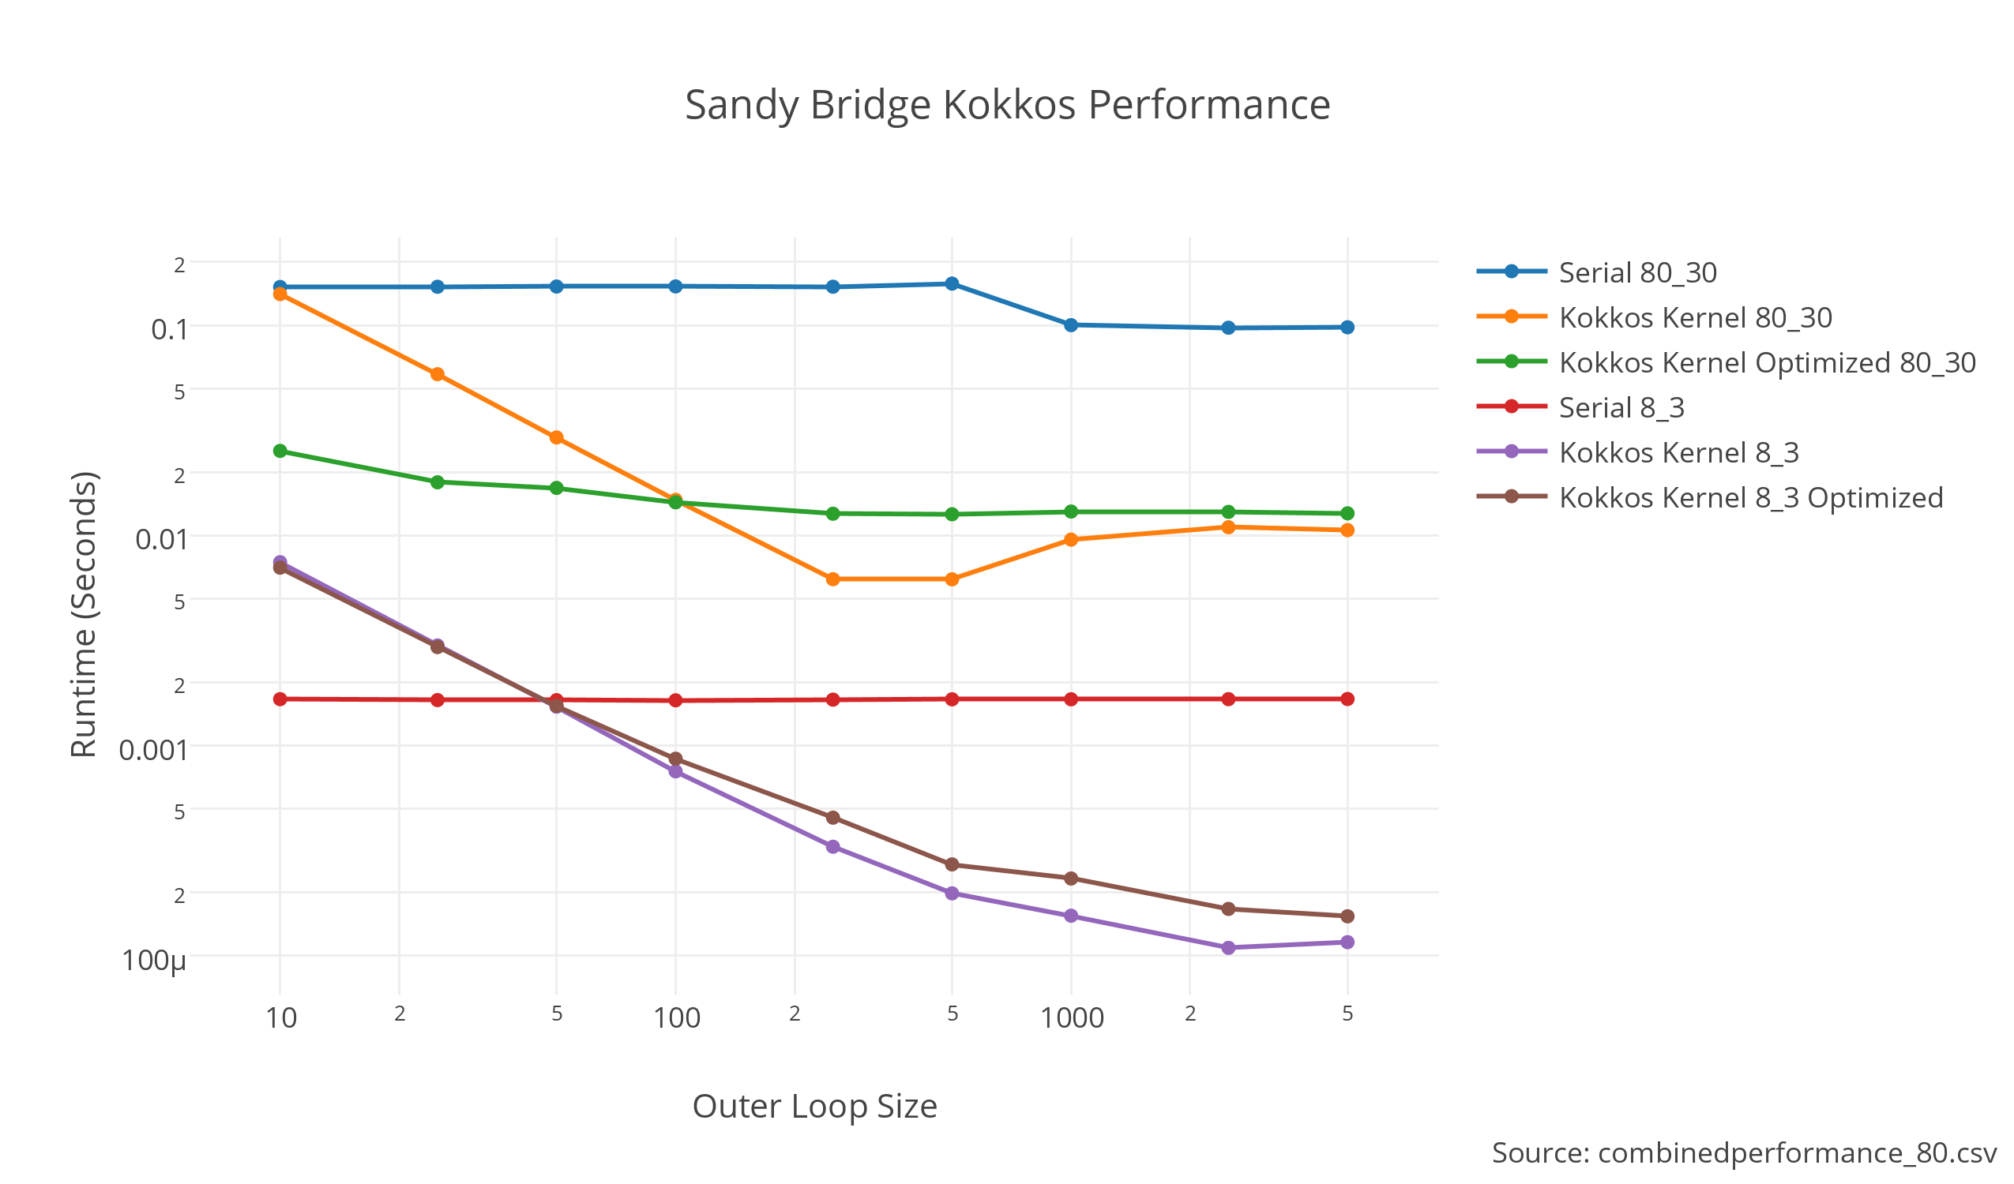
Sandy Bridge Performance Results

Slide 11
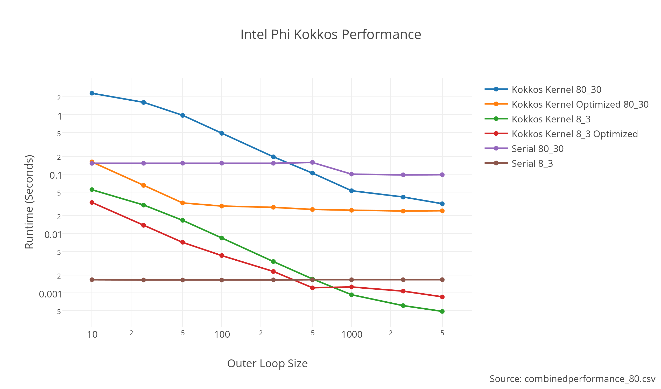
Intel Phi Performance Results

Slide 12
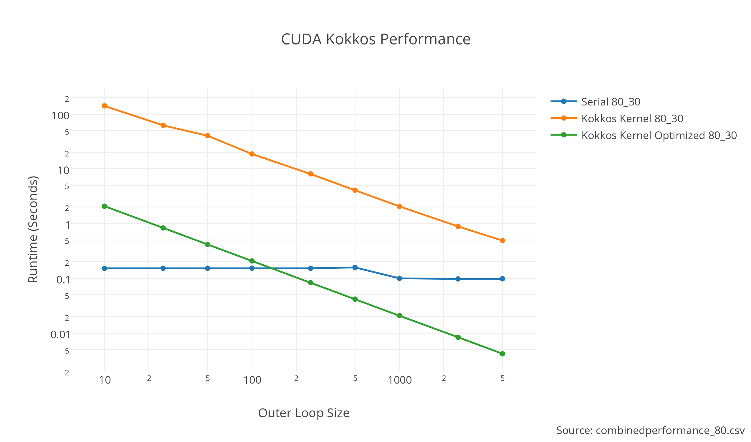
CUDA Performance Results

Slide 13
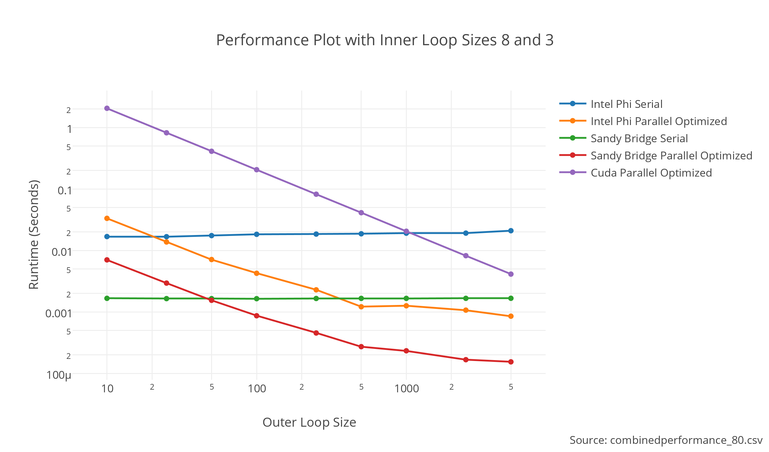
Combined Performance Results 8 and 3 inner
Loop Sizes

Slide 14
Harvey Mudd math / computer science clinic
(SNL liaison: H. Carter Edwards)
Interdisciplinary team of four undergraduate senior year students
learn to use Kokkos, re-engineer selected HPC kernels
for thread-scalability using Kokkos, and assess performance
and portability of those computational kernels.
Schedule:
By December 2014 re-engineer and assess Intrepid array-tools kernels.
By May 2014 re-engineer a second to-be-selected set of kernels.

