Slide 1
STK (Sierra Toolkit) Update
Trilinos User Group meetings, 2014
R&A: SAND2014-19233 PE
Sandia National Laboratories is a multi-program laboratory operated by Sandia Corporation, a wholly owned subsidiary of Lockheed Martin company, for the U.S. Department of Energy’s National Nuclear Security Administration under contract DE-AC04-94AL85000.

Slide 2
Outline
What is STK
STK vs STK_classic
API differences
Performance differences
STK plans for the coming year

Slide 3
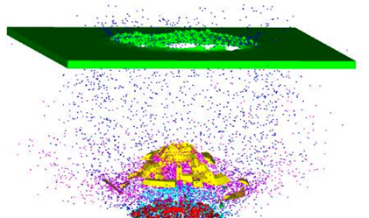
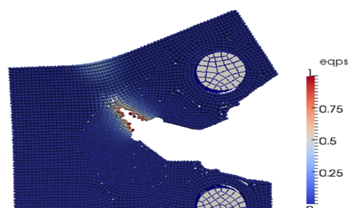
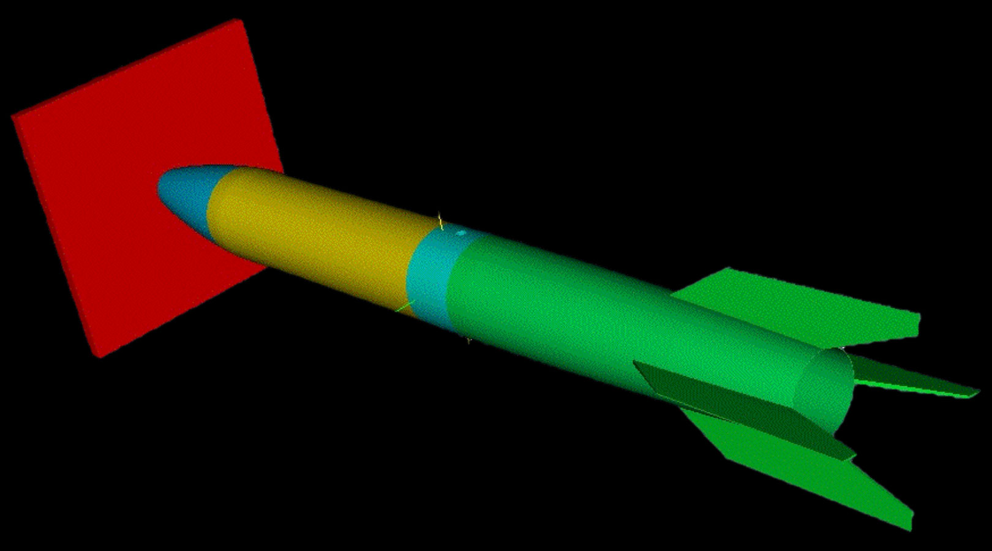
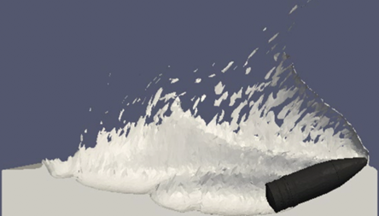
What is STK
STK is a collection of infrastructure modules supporting unstructured-mesh analysis applications.
Developed in the SIERRA project
Finite Element/Finite Volume Analysis Applications
Solid Mechanics
Structural Dynamics
Thermal/Fluid Mechanics

Slide 4
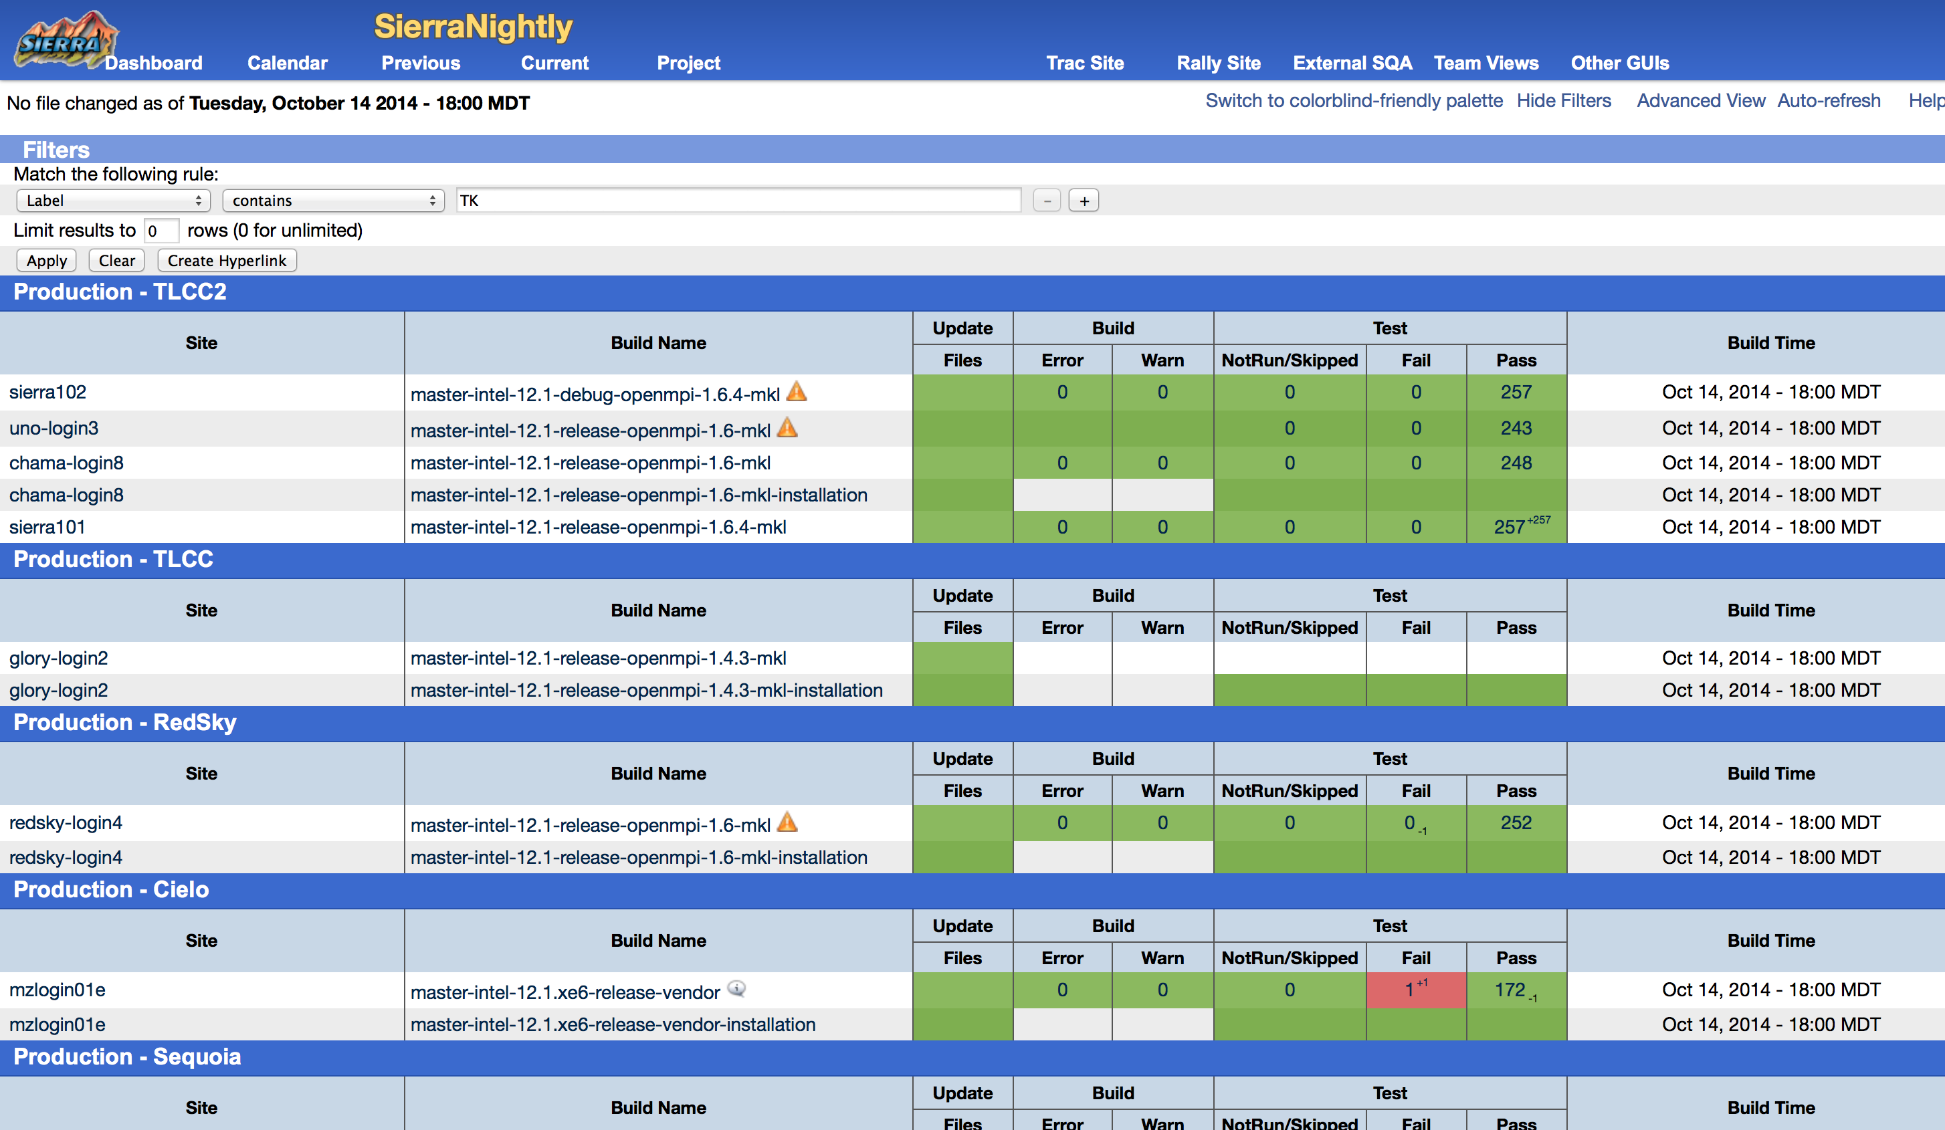
SIERRA / STK development environment
The SIERRA project uses a build system based on “bjam” (of boost lineage).
We monitor nightly and continuous builds/tests and valgrind reports on cdash dashboards.
STK modules are updated into Trilinos periodically (thanks Brent!) and at that point the sources are built/tested using cmake/ctest support.

Slide 5
Sierra ToolKit (STK) modules overview
Dependency diagram:
Arrows point towards a module that is used (depended on) by another module.
Parallel-consistent Mesh database
Heterogeneous element types
Unstructured
Search
Proximity, mesh independent
IO
Bridge from mesh-data to external capability
Built optionally
Topology
Entity-local definitions for node orderings, etc
Util
Nearly everything depends on util directly or indirectly
Transfer
Inter-mesh solution-field transfers
Stk_transfer
Stk_io
Stk_mesh
Stk_topology
Stk_search
Stk_util

Slide 6
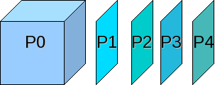

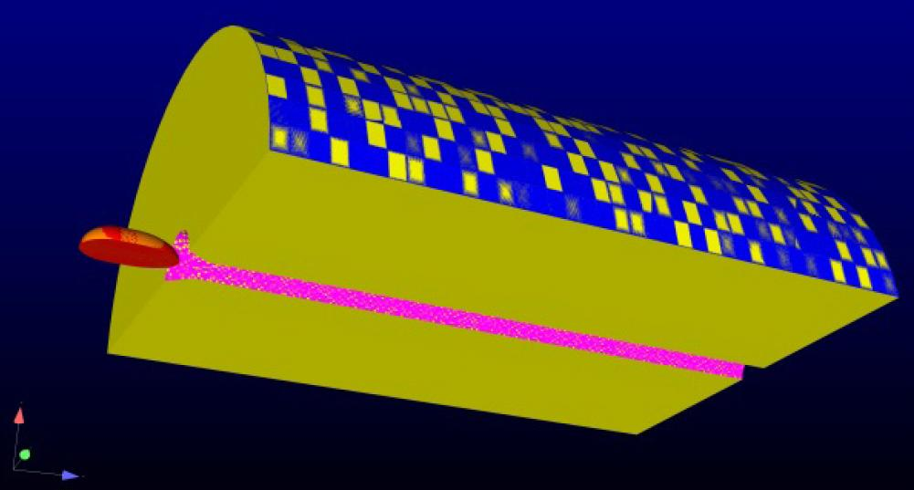
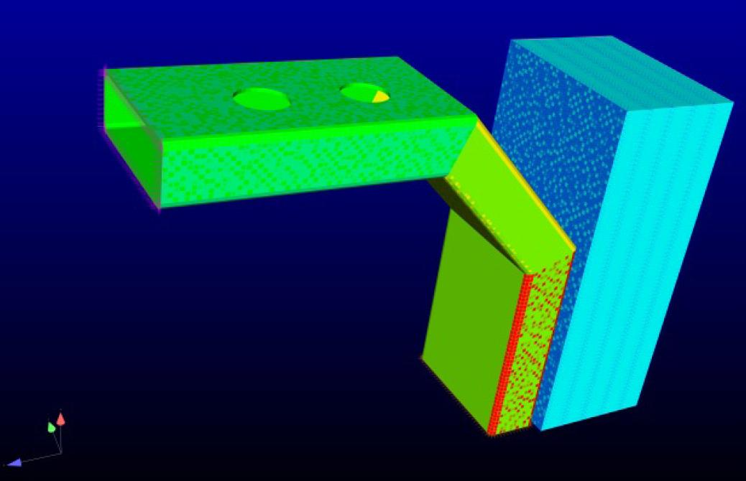
STK Mesh
Parallel distributed, parallel consistent
Heterogeneous element types and field types
Unstructured grid

Slide 7
STK vs STK_classic
Starting a couple years ago, we made major changes to the STK package, changing APIs and data-structures, etc.
Almost all changes are in stk_mesh…
We froze the STK package in Trilinos, performed development in the SIERRA repository, and have now brought the new code back into Trilinos.
Old
New
STK
stk_util
stk_mesh
stk_search
…
STK
stk_classic
stk_util
stk_mesh
stk_search
…
Old sub-packages

Slide 8
STK vs STK_classic: API changes
Entity
Entity changed from an object with methods, to an index.
To do anything with an Entity now, you need a stk::mesh::BulkData instance.
Example
Old
EntityId id = node.identifier();
New
EntityId id = bulkdata.identifier(node);

Slide 9
STK vs STK_classic: API changes (continued)
Relations / Connectivity: Entities are connected…
Previously, Entity held arrays of Relations.
Relation class held connected entity, ordinal (local-id) and other data
These items are now held in separate ‘raw’ arrays.
Example: connected nodes of an element
Old
PairIterRelation node_relations = element.relations(NODE_RANK);
Loop { Entity node = node_relations[i].entity();
New
unsigned num_nodes = bulkdata.num_nodes(element);
const Entity* nodes = bulkdata.begin_nodes(element);
Loop { Entity node = nodes[i];

Slide 10
STK vs STK_classic: API changes (continued)
Fields can only be associated with 1 entity rank
improved performance, reduced complexity
IO: MeshReadWriteUtils replaced by StkMeshIoBroker
several API differences, see example materials
Shards (topology definitions) is being replaced by stk_topology
we will maintain mappings back and forth for users who continue to use Shards.

Slide 11
STK vs STK_classic: API changes (continued)
More detail is covered in a conversion guide written by Jim Foucar (thanks Jim!)
Also see documentation tests which illustrate usage of a lot of the new STK code-base. See stk/stk_doc_tests

Slide 12
STK vs STK_classic: Performance improvements
Entity changes and connectivity storage changes improved cache efficiency of connectivity traversal
Restricting fields to a single entity-rank improved speed of field-data access (removed pointer hop(s))
Selector caching improved speed of bucket access
Scalable entity creation
stk::mesh::create_edges(mesh)…
…was reported as a scalability bottleneck for runs using large numbers of MPI ranks

Slide 13
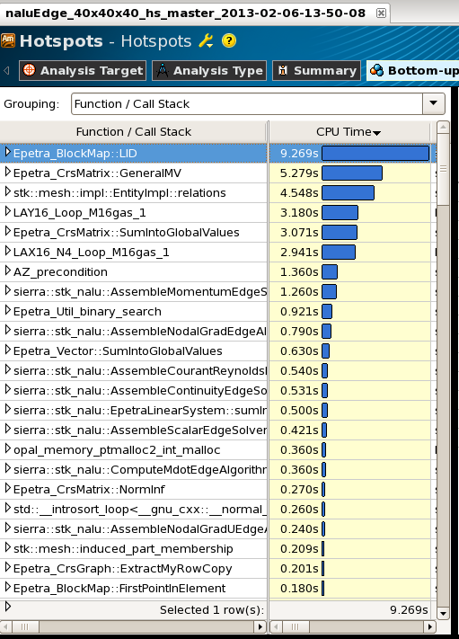
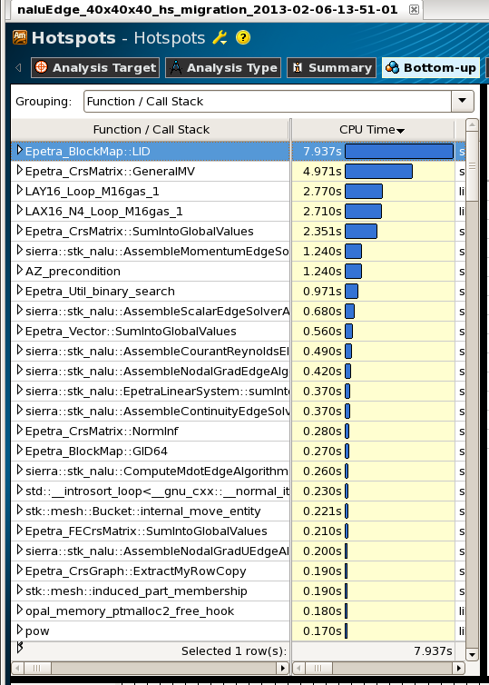
STK vs STK_classic: Performance Improvements (continued)

Slide 14
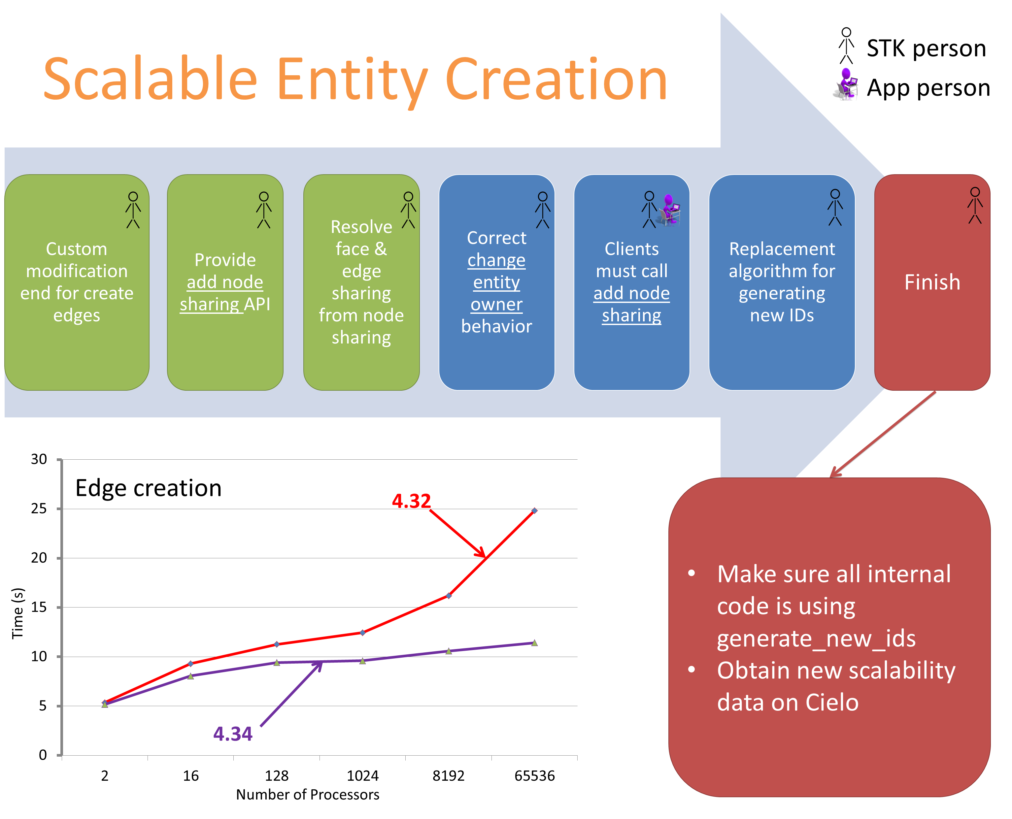
Scalable Entity Creation
unit test generation of IDs
scope out separation of global IDs from internal IDs to STK Mesh

Slide 15
STK plans for the coming year
IO
Ghosting
Arbitrary Relations
Balance/Rebalance
IO Auto Decomp
Batch Mesh Modification
Scalable Entity Creation
Feature Development, enhancements
Research
Next generation platforms
Threading, GPUs, Kokkos?
Data Structures
Hierarchical Decomposition

