Slide 1


An Overview of Trilinos Mark Hoemmen Sandia National Laboratories 27 Oct 2014 SAND# 2014-18749 PE
Sandia is a multiprogram laboratory managed and operated by Sandia Corporation, a wholly
owned subsidiary of Lockheed Martin Corporation, for the U. S. Department of Energy’s
National Nuclear Security Administration under contract DE-AC04-94AL85000.

Slide 2
Schedule
Session 1: Trilinos overview (~ 90 minutes)
Short break
Session 2: Trilinos tutorial & hands-on session
Epetra & Tpetra sparse linear algebra
Linear solvers, preconditioners, & eigensolvers
Kokkos overview & tutorial
Hands-on, audience-directed topics

Slide 3
Outline
What can Trilinos do for you?
Trilinos’ software organization
Whirlwind tour of Trilinos packages
Getting started: “How do I…?”
Preparation for hands-on tutorial

Slide 4

What can Trilinos do for you?

Slide 5
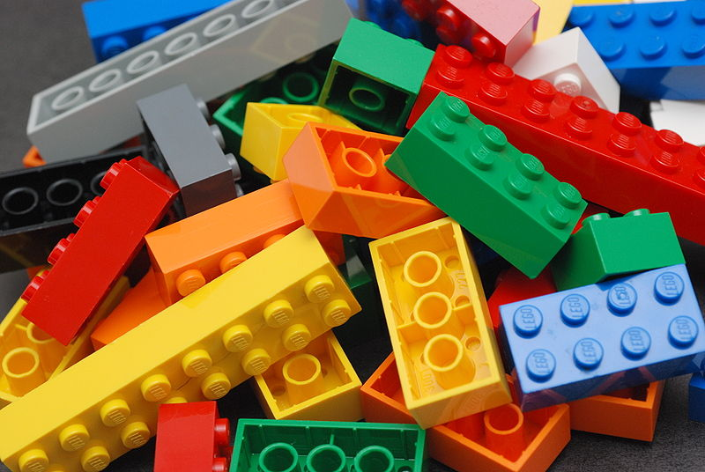
What is Trilinos?
Object-oriented software framework for…
Solving big complex science & engineering problems
More like LEGO™ bricks than Matlab™
Notes:
Original of LEGO™ bricks picture:
https://secure.wikimedia.org/wikipedia/en/wiki/File:Lego_Color_Bricks.jpg
Accessed 12 Aug 2011. Author: Alan Chia. Licensed under a Creative Commons Attribution-Share Alike 2.0 Generic License.

Slide 6
Applications
All kinds of physical simulations:
Structural mechanics (statics & dynamics)
Circuit simulations (physical models)
Electromagnetics, plasmas, & superconductors
Combustion & fluid flow (at macro- & nanoscales)
Coupled / multiphysics models
Data and graph analysis
Even gaming!

Slide 7


Target platforms: Any and all, current and future
Laptops & workstations
Clusters & supercomputers
Multicore CPU nodes
Hybrid CPU / GPU nodes
Parallel programming environments
MPI, OpenMP, Pthreads, …
CUDA (for NVIDIA GPUs)
Combinations of the above
User “skins”
C++ (primary language)
Python (PyTrilinos)
Web (Hands-on demo)
Notes:
You can build and run Trilinos on laptops, workstations, clusters, and supercomputers.
I’ve heard that someone even got Trilinos to build and run on a cell phone!
I am a Trilinos developer and have had success building Trilinos on many different machines, some of which belong to Sandia, some to NERSC (the National Energy Research Supercomputing Center associated with LBNL), and some academic (UC Berkeley).

Slide 8
Unique features of Trilinos
Huge library of algorithms
Linear & nonlinear solvers, preconditioners, …
Optimization, transients, sensitivities, uncertainty, …
Discretizations, mesh tools, automatic differentiation, …
Package-based architecture
Support for huge (> 2B unknowns) problems
Support for mixed & arbitrary precisions
Growing support for hybrid (MPI+X) parallelism
X: Threads (CPU, Intel Xeon Phi, CUDA on GPU)
Built on a unified shared-memory parallel programming model: Kokkos (see Session 2 & later this week)
Support currently limited, but growing
Notes:
Explain “limited but growing” support for MPI+X.
Parallelism is not a “magic go faster” button.
It requires algorithmic choices, and sometimes trade-offs.
For example, many preconditioners and smoothers use incomplete factorizations.
Applying an incomplete factorization preconditioner requires sparse triangular solve.
This parallelizes, but not well.
The typical pattern of the last decade was to rely on domain decomposition, to keep the triangular solves sequential.
However, domain decomposition gets less and less effective in both strong and weak scaling regimes as the number of MPI processes increases.
Thread parallelization of sparse triangular solve within an MPI process has similar issues.
Our preference is to solve issues algorithmically, so that they scale better, rather than try to brute-force parallelism whether it really makes things faster.
ShyLU is a good example: it could be used as a more parallel replacement for incomplete factorizations.

Slide 9

How Trilinos evolved
physics
Started as linear solvers & distributed objects
Capabilities grew to satisfy application & research needs
L(u)=f
Math. model
discretizations
methods
Numerical math
Convert to models that can be solved on digital computers
Time domain
Space domain
Automatic diff.
Domain dec.
Mortar methods
L_{h}(u_{h})=f_{h}
Numerical model
solvers
core
Algorithms
Find faster & more efficient ways to solve numerical models
Linear
Nonlinear
Eigenvalues
Optimization
Petra
Utilities
Interfaces
Load Balancing
u_{h}=L_{h}⁻¹ f_{h}
Algorithms
Discretizations in space & time
Optimization & sensitivities
Uncertainty quantification
computation

Slide 10
From Forward Analysis, to Support for High-Consequence Decisions
Systems of systems
Optimization under Uncertainty
Quantify Uncertainties/Systems Margins
Simulation Capability
Library Demands
Optimization of Design/System
Robust Analysis with Parameter Sensitivities
Accurate & Efficient Forward Analysis
Forward Analysis
Each stage requires greater performance and error control of prior stages: Always will need: more accurate and scalable methods.
more sophisticated tools.

Slide 11
Trilinos strategic goals
Algorithmic goals
Scalable computations (at all levels of parallelism)
Hardened computations
Fail only if problem intractable
Diagnose failures & inform the user
Full vertical coverage
Problem construction, solution, analysis, & optimization
Software goals
Universal interoperability (within & outside Trilinos)
Universal accessibility
Any hardware & operating system with a C++ compiler
Including programming languages besides C++
“Self-sustaining” software
Legible design & implementation
Sufficient testing & documentation for confident refactoring

Slide 12
Trilinos is made of packages

Slide 13
Trilinos is made of packages
Not monolithic; ~60 separate packages
Each package
Has its own development team & management
May or may not depend on other Trilinos packages
May even have a different license or release status
Most BSD; some LGPL
Some not publicly released yet (e.g., “pre-copyright”)
Benefits from Trilinos’ build, test, & release infrastructure
Common build & test framework: TriBITS
Lets packages express their dependencies on
Other packages
Third-party libraries (e.g., HDF5, BLAS, SuperLU, …)
Runs packages’ tests nightly, & on every check-in
Useful: spun off from Trilinos into a separate project
Notes:
Why packages?
Multifrontal development
Reflects history of Trilinos: Aztec, ML, and Zoltan were (and are) separate packages
Naturally reflects organization of research or software development teams
What does that mean for you?
If you only care about Zoltan, you don’t have to use anything else.
It’s your choice whether to plug into bigger multiple-package systems.

Slide 14
Interoperability vs. Dependence (“Can Use”) (“Depends On”)
Packages have minimal required dependencies…
But interoperability makes them useful:
NOX (nonlinear solver) needs linear solvers
Can use any of {AztecOO, Belos, LAPACK, …}
Belos (linear solver) needs preconditioners, matrices, & vectors
Matrices and vectors: any of {Epetra, Tpetra, Thyra, …, PETSc}
Preconditioners: any of {IFPACK, ML, Ifpack2, MueLu, Teko, …}
We express interoperability as “optional dependency”
Interoperability is enabled at configure time
Each package declares its list of interoperable packages
Trilinos’ build system automatically hooks them together
You tell Trilinos what packages you want to build…
…it automatically enables any packages on which it depends

Slide 15
Packages benefit users
You decide how much of Trilinos you want
Only use & build the packages you need (not all ~60)
Can distribute any subset of packages
Mix & match Trilinos components with your own, e.g.,
Trilinos’ sparse matrices with your own linear solvers
Your sparse matrices with Trilinos’ linear solvers
Trilinos’ sparse matrices & linear solvers w/ your nonlinear solvers
Easier to find specialized help for problems of your interest
Package developers know their packages’ algorithms
Notes:
Why packages?
Multifrontal development
Reflects history of Trilinos: Aztec, ML, and Zoltan were (and are) separate packages
Naturally reflects organization of research or software development teams
What does that mean for you?
If you only care about Zoltan, you don’t have to use anything else.
It’s your choice whether to plug into bigger multiple-package systems.

Slide 16
Packages benefit developers
Popular packages (e.g., ML & Zoltan) keep their “brand”
Reflects organization of research / development teams
Easy to turn a research code into a new package
Small teams with minimal interference between teams
Teams can define their own standards & schedule
Team X doesn’t have to suffer if Team Y falls behind
TriBITS build system supports external packages!
e.g., Data Transfer Kit: https://github.com/CNERG/DataTransferKit
Need not live in Trilinos’ repository or have Trilinos’ license
Please participate in discussion later this week about evolving policies to handle more external packages
Notes:
Why packages?
Multifrontal development
Reflects history of Trilinos: Aztec, ML, and Zoltan were (and are) separate packages
Naturally reflects organization of research or software development teams
What does that mean for you?
If you only care about Zoltan, you don’t have to use anything else.
It’s your choice whether to plug into bigger multiple-package systems.

Slide 17
Capability areas and leaders
Capability areas:
Framework, Tools, & Interfaces (Jim Willenbring)
Software Engineering Technologies & Integration (Ross Bartlett)
Discretizations (Pavel Bochev)
Geometry, Meshing, & Load Balancing (Karen Devine)
Scalable Linear Algebra (Mike Heroux)
Linear & Eigen Solvers (Jonathan Hu)
Nonlinear, Transient, & Optimization Solvers (Andy Salinger)
Scalable I/O (Ron Oldfield)
User Experience (Bill Spotz)
Each area includes one or more Trilinos packages
Each leader provides strategic direction within area

Slide 18
Whirlwind Tour of Packages

Slide 19

Full Vertical Solver Coverage
Optimization
Unconstrained:
MOOCHO
Constrained:
Bifurcation Analysis
LOCA
Transient Problems
Sensitivities
(Automatic Differentiation: Sacado)
DAEs/ODEs:
Rythmos
Nonlinear Problems
NOX
AztecOO
Linear Problems
Belos
Linear Equations:
Ifpack, ML, etc...
Eigen Problems:
Anasazi
Distributed Linear Algebra
Epetra
Matrix/Graph Equations:
Tpetra
Vector Problems:
Kokkos

Slide 20
Trilinos Package Summary
 | Objective | Package(s)
Discretizations | Meshing & Discretizations | Intrepid, Pamgen, Sundance, Mesquite, STKMesh
 | Time Integration | Rythmos
Methods | Automatic Differentiation | Sacado
 | Mortar Methods | Moertel
Services | Linear algebra objects | Epetra, Tpetra
 | Interfaces | Xpetra, Thyra, Stratimikos, Piro, …
 | Load Balancing | Zoltan, Isorropia, Zoltan2
 | “Skins” | PyTrilinos, WebTrilinos, ForTrilinos, CTrilinos
 | Utilities, I/O, thread API | Teuchos, EpetraExt, Kokkos, Phalanx, Trios, …
Solvers | Iterative linear solvers | AztecOO, Belos, Komplex
 | Direct sparse linear solvers | Amesos, Amesos2, ShyLU
 | Direct dense linear solvers | Epetra, Teuchos, Pliris
 | Iterative eigenvalue solvers | Anasazi
 | Incomplete factorizations | AztecOO, Ifpack, Ifpack2
 | Multilevel preconditioners | ML, CLAPS, MueLu
 | Block preconditioners | Meros, Teko
 | Nonlinear solvers | NOX, LOCA
 | Optimization | MOOCHO, Aristos, TriKota, GlobiPack, OptiPack
 | Stochastic PDEs | Stokhos

Slide 21

Whirlwind Tour of Packages Discretizations Methods Core Solvers

Slide 22

Trilinos’ Common Language: Petra
“Common language” for distributed sparse linear algebra
Petra¹ provides parallel…
Sparse graphs & matrices
Dense vectors & multivectors
Data distributions & redistribution
“Petra Object Model”:
Describes objects & their relationships abstractly, independent of language or implementation
Explains how to construct, use, & redistribute parallel graphs, matrices, & vectors
We maintain 2 implementations
Al Khazneh (“The Treasury”), in the ancient city of Petra, in modern Jordan.
¹Petra (πέτρα) is Greek for “foundation.”

Slide 23
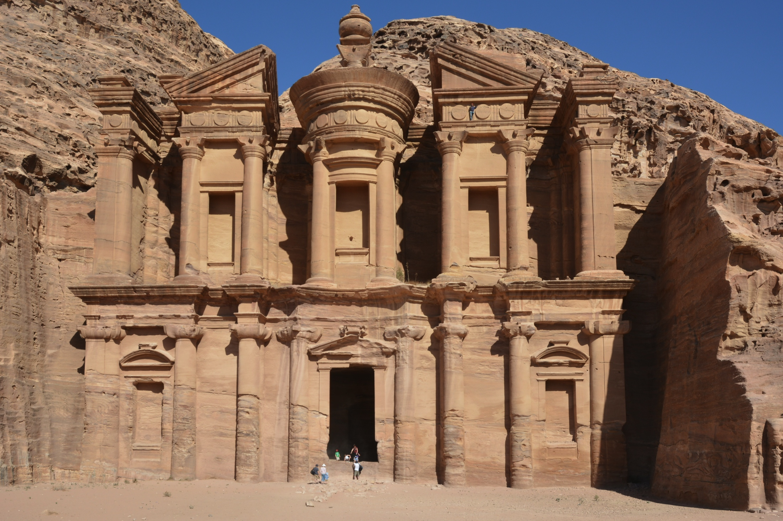
Petra Implementations
Epetra (Essential Petra):
Earliest & most heavily used
C++ <= 1998 (“C+/- compilers” OK)
Real, double-precision arithmetic
C & Fortran interfaces
MPI only (very little OpenMP support)
Some support for problems with over two billion unknowns (“Epetra64”)
Tpetra (Templated Petra):
Supports C++11 (don’t currently need it)
Real, complex, extended-precision, automatic differentiation, etc. types
Can solve problems with > 2B unknowns
“MPI+X” (shared-memory parallel)
Al Deir (“The Monastery”) at Petra.
Package leads: Mike Heroux, Mark Hoemmen (many developers)
Notes:
http://en.wikipedia.org/wiki/File:Al_Deir_Petra.JPG
This file is licensed under the Creative Commons Attribution-Share Alike 3.0 Unported license.

Slide 24
Two “software stacks”: Epetra & Tpetra
Many packages were built on Epetra’s interface
Users want features that break interfaces
Support for solving huge problems (> 2B entities)
Arbitrary & mixed precision
Hybrid (MPI+X) parallelism (← most radical interface changes)
Users also value backwards compatibility
We decided to build a (partly) new stack using Tpetra
Some packages can work with either Epetra or Tpetra
Iterative linear solvers & eigensolvers (Belos, Anasazi)
Multilevel preconditioners (MueLu), sparse direct (Amesos2)
Which do I use?
Epetra is more stable; Tpetra is more forward-looking
For MPI only, their performance is comparable
For MPI+X, Tpetra will be the only path forward
Just don’t expect MPI+X to work with everything NOW

Slide 25
Kokkos: Thread-parallel programming model & more
See Section 2 for an overview & brief tutorial
Performance-portable abstraction over many different thread-parallel programming models: OpenMP, CUDA, Pthreads, …
Avoid risk of committing code to hardware or programming model
C++ library: Widely used, portable language with good compilers
Abstract away physical data layout & target it to the hardware
Solve “array of structs” vs. “struct of arrays” problem
Expose different memory & execution spaces
Data structures & idioms for thread-scalable parallel code
Multi-dimensional arrays, hash table, sparse graph & matrix
Automatic memory management, atomic updates, vectorization, ...
Stand-alone; does not require other Trilinos packages
Used in LAMMPS molecular dynamics code; growing use in Trilinos
Talks this week: Tue 10:30, Thu 09:00
Developers: Carter Edwards, Christian Trott, Dan Sunderland, Mark Hoemmen

Slide 26
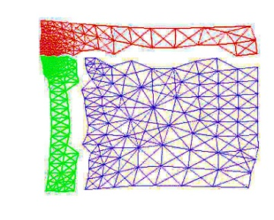
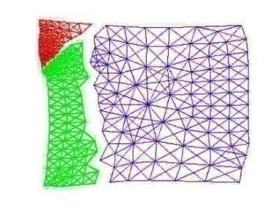
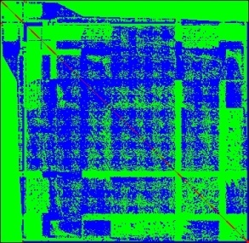
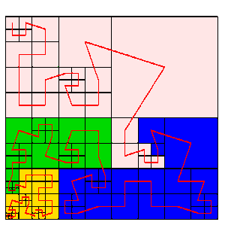
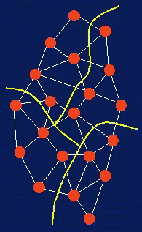
Zoltan(2)
Data Services for Dynamic Applications
Dynamic load balancing
Graph coloring
Data migration
Matrix ordering
Partitioners:
Geometric (coordinate-based) methods:
Recursive Coordinate Bisection
Recursive Inertial Bisection
Space Filling Curves
Refinement-tree Partitioning
Hypergraph & graph (connectivity-based) methods
Isorropia package: interface to Epetra objects
Zoltan2: interface to Tpetra objects
Developers: Karen Devine, Erik Boman, Siva Rajamanickam, Michael Wolf

Slide 27
“Skins”
PyTrilinos provides Python access to Trilinos packages
Uses SWIG to generate bindings.
Support for many packages
CTrilinos: C wrapper (mostly to support ForTrilinos).
ForTrilinos: OO Fortran interfaces.
WebTrilinos: Web interface to Trilinos
Generate test problems or read from file.
Generate C++ or Python code fragments and click-run.
Hand modify code fragments and re-run.
Developer: Bill Spotz
Developers: Nicole Lemaster, Damian Rouson
Developers: Ray Tuminaro, Jonathan Hu, Marzio Sala, Jim Willenbring

Slide 28
Whirlwind Tour of Packages Discretizations Methods Core Solvers

Slide 29
Amesos(2)
Interface to sparse direct solvers
Challenges:
Many different third-party sparse direct solvers
No clear winner for all problems
Different, changing interfaces & data formats, serial & parallel
Amesos(2) features:
Accepts Epetra & Tpetra sparse matrices & dense vectors
Consistent interface to many third-party sparse factorizations
e.g., MUMPS, Paradiso, SuperLU, Taucs, UMFPACK
Can use factorizations as solvers in other Trilinos packages
Automatic efficient data redistribution (if solver not MPI parallel)
Built-in default solver: KLU(2)
Interface to new direct / iterative hybrid-parallel solver ShyLU
Developers: Ken Stanley, Marzio Sala, Tim Davis; Eric Bavier, Erik Boman, Siva Rajamanickam

Slide 30
AztecOO
Iterative linear solvers: CG, GMRES, BiCGSTAB,…
Incomplete factorization preconditioners
Aztec was Sandia’s workhorse solver:
Extracted from the MPSalsa reacting flow code
Installed in dozens of Sandia apps
1900+ external licenses
AztecOO improves on Aztec by:
Using Epetra objects for defining matrix and vectors
Providing more preconditioners & scalings
Using C++ class design to enable more sophisticated use
AztecOO interface allows:
Continued use of Aztec for functionality
Introduction of new solver capabilities outside of Aztec
Developers: Mike Heroux, Alan Williams, Ray Tuminaro

Slide 31
Belos
Next-generation linear iterative solvers
Decouples algorithms from linear algebra objects
Linear algebra library has full control over data layout and kernels
Improvement over AztecOO, which controlled vector & matrix layout
Essential for hybrid (MPI+X) parallelism
Solves problems that apps really want to solve, faster:
Multiple right-hand sides: AX=B
Sequences of related systems: (A + ΔA_{k}) X_{k} = B + ΔB_{k}
Many advanced methods for these types of systems
Block & pseudoblock solvers: GMRES & CG
Recycling solvers: GCRODR (GMRES) & CG
“Seed” solvers (hybrid GMRES)
Block orthogonalizations (TSQR)
Supports arbitrary & mixed precision, complex, …
If you have a choice, pick Belos over AztecOO
Developers: Heidi Thornquist, Mike Heroux, Chris Baker, Mark Hoemmen

Slide 32
Ifpack(2): Algebraic preconditioners
Preconditioners:
Overlapping domain decomposition
Incomplete factorizations (within an MPI process)
(Block) relaxations & Chebyshev
Accepts user matrix via abstract matrix interface
Use {E,T}petra for basic matrix / vector calculations
Perturbation stabilizations & condition estimation
Can be used by all other Trilinos solver packages
Ifpack2: Tpetra version of Ifpack
Supports arbitrary precision & complex arithmetic
Path forward to hybrid-parallel factorizations
Developers: Mike Heroux, Mark Hoemmen, Siva Rajamanickam,
Marzio Sala, Alan Williams, etc.

Slide 33
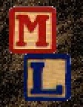
: Multi-level Preconditioners
Smoothed aggregation, multigrid, & domain decomposition
Critical technology for scalable performance of many apps
ML compatible with other Trilinos packages:
Accepts Epetra sparse matrices & dense vectors
ML preconditioners can be used by AztecOO, Belos, & Anasazi
Can also be used independent of other Trilinos packages
Next-generation version of ML: MueLu
Works with Epetra or Tpetra objects (via Xpetra interface)
Developers: Ray Tuminaro, Jeremie Gaidamour, Jonathan Hu, Marzio Sala, Chris Siefert

Slide 34
MueLu: Next-gen algebraic multigrid
Motivation for replacing ML
Improve maintainability & ease development of new algorithms
Decouple computational kernels from algorithms
Rely more on other Trilinos packages for linear algebra, smoothers, etc.
Exploit Tpetra features
MPI+X (Kokkos programming model mitigates risk)
64-bit global indices (to solve problems with >2B unknowns)
Arbitrary Scalar types (Tramonto runs MueLu w/ double-double)
Works with Epetra or Tpetra (via Xpetra common interface)
Facilitate algorithm development
Energy minimization methods
Geometric or classic algebraic multigrid; mix methods together
Better preconditioner reuse (for nonlinear solve iterations)
Amazing new tutorial and users’ guide (Tobias Wiesner)!
Developers: Andrey Prokopenko, Jonathan Hu, Chris Siefert, Ray Tuminaro, Tobias Wiesner

Slide 35
Anasazi
Next-generation iterative eigensolvers
Decouples algorithms from linear algebra objects
Block eigensolvers for accurate cluster resolution
Can solve
Standard (AX = ΛX) or generalized (AX = BXΛ)
Hermitian or not, real or complex
Algorithms available
Block Krylov-Schur (most like ARPACK’s IR Arnoldi) & Block Davidson
Implicit Riemannian Trust Region solvers
Locally Optimal Block-Preconditioned CG (LOBPCG)
Scalable orthogonalizations (e.g., TSQR, SVQB)
New solvers! TraceMin and friends
See talk Wed 13:50 by Alicia Klinvex (Purdue)
Developers: Heidi Thornquist, Mike Heroux, Chris Baker,
Rich Lehoucq, Ulrich Hetmaniuk, Mark Hoemmen

Slide 36
NOX: Nonlinear Solvers
Suite of nonlinear solution methods
Broyden’s Method
Newton’s Method
Tensor Method
Jacobian Estimation
Graph Coloring
Finite Difference
Jacobian-Free Newton-Krylov
Globalizations
Implementation
Parallel
Object-oriented C++
Independent of the linear algebra implementation!
Line Search
Interval Halving Quadratic
Cubic
More-Thuente
Trust Region
Dogleg
Inexact Dogleg
Developers: Tammy Kolda, Roger Pawlowski

Slide 37
LOCA: Continuation problems
Solve parameterized nonlinear systems F(x, λ) = 0
Identify “interesting” nonlinear behavior, like
Turning points
Buckling of a shallow arch under symmetric load
Breaking away of a drop from a tube
Bursting of a balloon at a critical volume
Bifurcations, e.g., Hopf or pitchfork
Vortex shedding (e.g., turbulence near mountains)
Flutter in airplane wings; electrical circuit oscillations
LOCA uses Trilinos components
NOX to solve nonlinear systems
Anasazi to solve eigenvalue problems
AztecOO or Belos to solve linear systems
Developers: Andy Salinger, Eric Phipps

Slide 38
MOOCHO & Aristos
MOOCHO: Multifunctional Object-Oriented arCHitecture for Optimization
Solve non-convex optimization problems with nonlinear constraints, using reduced-space successive quadratic programming (SQP) methods
Large-scale embedded simultaneous analysis & design
Aristos: Optimization of large-scale design spaces
Embedded optimization approach
Based on full-space SQP methods
Efficiently manages inexactness in the inner linear solves
Developer: Roscoe Bartlett
Developer: Denis Ridzal

Slide 39
Whirlwind Tour of Packages Core Utilities
Discretizations Methods Solvers

Slide 40
Intrepid
Interoperable Tools for Rapid Development of Compatible Discretizations
Intrepid offers an innovative software design for compatible discretizations:
Access to finite {element, volume, difference} methods using a common API
Supports hybrid discretizations (FEM, FV and FD) on unstructured grids
Supports a variety of cell shapes:
Standard shapes (e.g., tets, hexes): high-order finite element methods
Arbitrary (polyhedral) shapes: low-order mimetic finite difference methods
Enables optimization, error estimation, V&V, & UQ using fast embedded techniques (direct support for cell-based derivative computations or via automatic differentiation)
Λ^{k}
Forms
Reduction
{C⁰,C¹,C²,C³}
Discrete forms
d,d*,⬆,^,(,)
Operations
Cell Data
D,D*,W,M
Discrete ops.
Reconstruction
Higher order
General cells
Pullback: FEM
Direct: FV/D
Developers: Pavel Bochev & Denis Ridzal
Notes:
Reduce text at the top
Remove the red line from slide

Slide 41
Rythmos
Numerical time integration methods
“Time integration” == “ODE solver”
Supported methods include
Backward & Forward Euler
Explicit Runge-Kutta
Implicit BDF
Operator splitting methods & sensitivities
Developers: Glen Hansen, Roscoe Bartlett, Todd Coffey

Slide 42
Whirlwind Tour of Packages Discretizations Methods Core Solvers

Slide 43
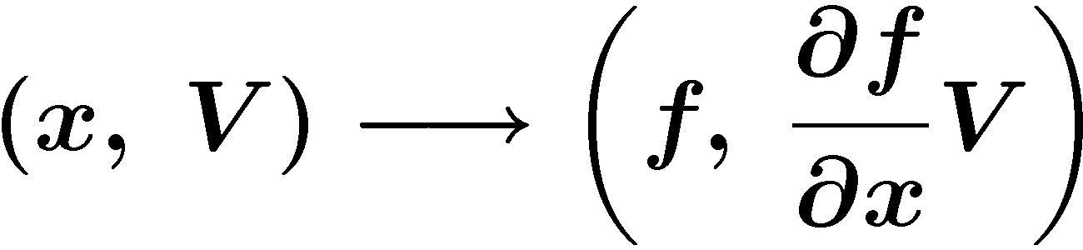
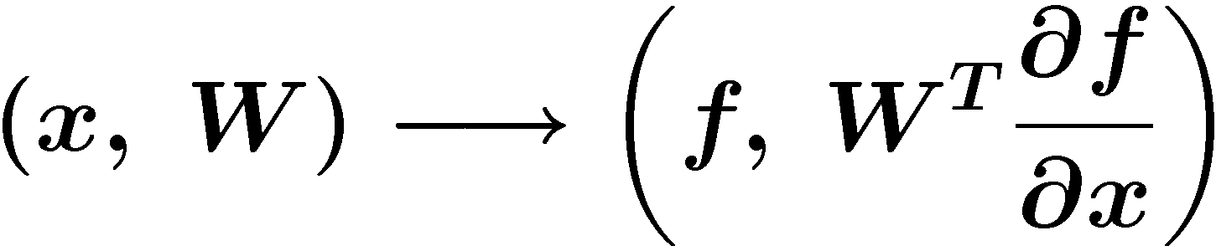
Sacado: Automatic Differentiation
Automatic differentiation tools optimized for element-level computation
Applications of AD: Jacobians, sensitivity and uncertainty analysis, …
Uses C++ templates to compute derivatives
You maintain one templated code base; derivatives don’t appear explicitly
Provides three forms of AD
Forward Mode:
Propagate derivatives of intermediate variables w.r.t. independent variables forward
Directional derivatives, tangent vectors, square Jacobians, ∂f / ∂x when m ≥ n
Reverse Mode:
Propagate derivatives of dependent variables w.r.t. intermediate variables backwards
Gradients, Jacobian-transpose products (adjoints), ∂f / ∂x when n > m.
Taylor polynomial mode:
Basic modes combined for higher derivatives
Developers: Eric Phipps, David Gay
Notes:
The Sandia AD project called Sacado roughly means “I have derived” in Spanish.
Many Sandia application codes are element-based, whereas the global computation is a linear combination of small element-level computations.
Element can mean an element in a finite element code, a cell in a finite volume code, a device in a network simulation, etc…
We can use AD to compute element-level derivatives that are manually summed into the global derivative.
These element computations are well suited for AD since they involve many fewer independent and dependent variables, I.e., up to a few hundred as opposed to millions for the global computation, and also don’t typically involve any parallel communication.
Because of simplicity of element-level computation, we can use simple but fast OO AD tools
We’ve been using this package Tfad for forward mode, but are rewriting it since it is no longer a supported library
We’re using a package called Rad developed by David Gay for reverse mode, which is a less general but much more efficient implementation of reverse-mode AD than other packages like ADOL-C
To apply these tools, you have to change the types in the code from floats/doubles to the AD types for Tfad and Rad
We can make that process more efficient by templating the application code using C++ templates
By instantiating the templates classes on floats/doubles, you get the original computation and by instantiating them on the AD types you get the AD computation
Means developers only need to develop and maintain one templated code base
Makes it easy to add new AD types since you only need to add new instantiations
We’ve been developing these ideas in Charon, a large-scale finite element semiconductor device and reacting fluid flow simulation code.
We’ve templated both the finite-element residual computation in Charon and the electric current calculation
Having AD just in Charon is allowing us to directly impact important projects such as QASPR
I just presented this work at an AD workshop at ICCS a week ago, which made me realize just how different this approach is than what people are typically doing in the AD community
This is a much more lower-level, intrusive approach designed to be used by code developers who are experts on the structure of their codes instead of a black-box, all or nothing approach for people who may not know anything about the internals of the code
Difference is the approach:
By applying AD at element-level , eliminate all of the difficulties of applying AD to a large-scale code (cross-country accumulation, MPI, etc…)
By templating app, we can use simple, highly specialized tools that are fast (ADOL-C tries to do everything with one type)

Slide 44
Abstract solver interfaces & applications

Slide 45
Parts of an application
Linear algebra library (LAL)
Anything that cares about graph, matrix, or vector data structures
Preconditioners, sparse factorizations, sparse mat-vec, etc.
Abstract numerical algorithms (ANA)
Only interact with LAL through abstract, coarse-grained interface
e.g., sparse mat-vec, inner products, norms, apply preconditioner
Iterative linear (Belos) & nonlinear (NOX) solvers
Stability analysis (LOCA) & optimization (MOOCHO, …)
Time integration (Rythmos); black-box parameter studies & uncertainty quantification (UQ) (TriKota, …)
“Everything else”: Depends on both LAL & ANA
Discretization & fill into sparse matrix data structure (many packages)
Embedded automatic differentiation (Sacado) or UQ (Stokhos)
Hand off discretized problem (LAL) to solver (ANA)
Read input decks; write out checkpoints & results

Slide 46
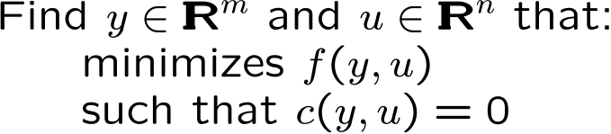
Problems & abstract numerical algorithms
Trilinos Packages
Linear Problems:
Linear equations:
Eigen problems:
Belos
Anasazi
Nonlinear Problems:
Nonlinear equations:
Stability analysis:
NOX
LOCA
Transient Nonlinear Problems:
DAEs/ODEs:
Rythmos
Optimization Problems:
Unconstrained:
Constrained:
MOOCHO
Aristos

Slide 47
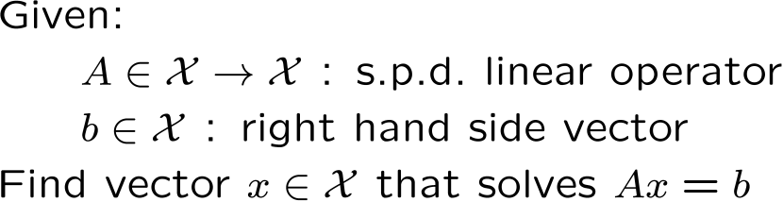
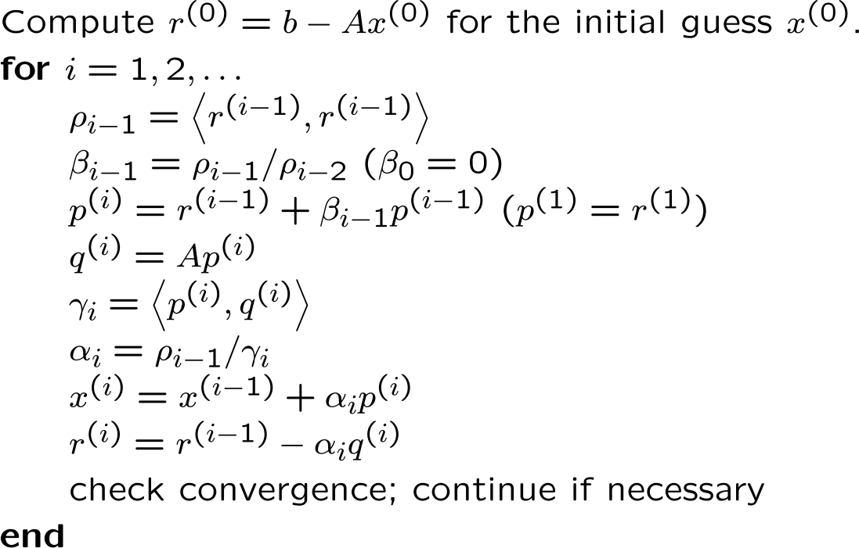
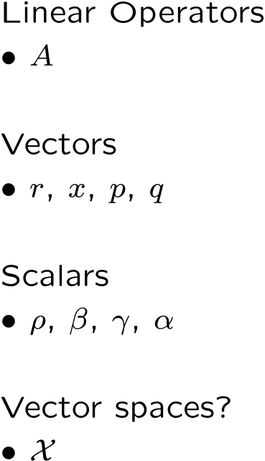
Abstract Numerical Algorithms
An abstract numerical algorithm (ANA) is a numerical algorithm that can be expressed solely in terms of vectors, vector spaces, and linear operators
Example Linear ANA (LANA) : Linear Conjugate Gradients
ANAs can be very mathematically sophisticated!
ANAs can be extremely reusable!
Linear Conjugate Gradient Algorithm
Types of operations
Types of objects
linear operator applications
vector-vector operations
scalar operations
scalar product
<x,y> defined by vector space
Notes:
So we looked at some different categories of numerical algorithms and some of the different computing environments these algorithms are run in but what is an abstract numerical algorithm?

Slide 48
Thyra: Linear algebra library wrapper
Abstract interface that wraps any linear algebra library
Interfaces to linear solvers (Direct, Iterative, Preconditioners)
Use abstraction of basic matrix & vector operations
Can use any concrete linear algebra library (Epetra, Tpetra, …)
Nonlinear solvers (Newton, etc.)
Use abstraction of linear solve
Can use any concrete linear solver library & preconditioners
Transient/DAE solvers (implicit)
Use abstraction of nonlinear solve
Thyra is how Stratimikos talks to data structures & solvers
Developers: Roscoe Bartlett, Kevin Long
Notes:
Many different kinds of numerical problems and algorithms for solving those problems are used in scientific computing
Just some of the categories of problems and algorithms are:

Slide 49
Stratimikos package
Greek στρατηγική (strategy) + γραμμικός (linear)
Uniform run-time interface to many different packages’
Linear solvers: Amesos, AztecOO, Belos, …
Preconditioners: Ifpack, ML, …
Defines common interface to create and use linear solvers
Reads in options through a Teuchos::ParameterList
Can change solver and its options at run time
Can validate options, & read them from a string or XML file
Accepts any linear system objects that provide
Epetra_Operator / Epetra_RowMatrix view of the matrix
Vector views (e.g., Epetra_MultiVector) for right-hand side and initial guess
Increasing support for Tpetra objects
Developers: Ross Bartlett, Andy Salinger, Eric Phipps

Slide 50
Stratimikos Parameter List and Sublists
<ParameterList name=“Stratimikos”>
<Parameter name="Linear Solver Type" type="string" value=“AztecOO"/>
<Parameter name="Preconditioner Type" type="string" value="Ifpack"/>
<ParameterList name="Linear Solver Types">
<ParameterList name="Amesos">
<Parameter name="Solver Type" type="string" value="Klu"/>
<ParameterList name="Amesos Settings">
<Parameter name="MatrixProperty" type="string" value="general"/>
...
<ParameterList name="Mumps"> ... </ParameterList>
<ParameterList name="Superludist"> ... </ParameterList>
</ParameterList>
</ParameterList>
<ParameterList name="AztecOO">
<ParameterList name="Forward Solve">
<Parameter name="Max Iterations" type="int" value="400"/>
<Parameter name="Tolerance" type="double" value="1e-06"/>
<ParameterList name="AztecOO Settings">
<Parameter name="Aztec Solver" type="string" value="GMRES"/>
...
</ParameterList>
</ParameterList>
...
</ParameterList>
<ParameterList name="Belos"> ... </ParameterList>
</ParameterList>
<ParameterList name="Preconditioner Types">
<ParameterList name="Ifpack">
<Parameter name="Prec Type" type="string" value="ILU"/>
<Parameter name="Overlap" type="int" value="0"/>
<ParameterList name="Ifpack Settings">
<Parameter name="fact: level-of-fill" type="int" value="0"/>
...
</ParameterList>
</ParameterList>
<ParameterList name="ML"> ... </ParameterList>
</ParameterList>
</ParameterList>
Top level parameters
Sublists passed on to package code!
Linear Solvers
Every parameter and sublist is handled by Thyra code and is fully validated!
Preconditioners

Slide 51
Piro package
“Strategy package for embedded analysis capabilities”
Piro stands for “Parameters In, Responses Out”
Describes the abstraction for a solved forward problem
Like Stratimikos, but for nonlinear analysis
Nonlinear solves (NOX)
Continuation & bifurcation analysis (LOCA)
Time integration / transient solves (Rythmos)
Embedded uncertainty quantification (Stokhos)
Optimization (MOOCHO)
Goal: More run-time control, fewer lines of code in main application
Motivating application: Albany (prototype finite-element application)
Not a Trilinos package, but demonstrates heavy Trilinos use
Developer: Andy Salinger

Slide 52
Albany: rapid code development with transformational algorithms
4-line Main()
“input.xml”
Piro Analysis
Cubit
Hand-Coded:
Dakota
Exodus
Pamgen
OptiPack
Piro Solver
MOOCHO
STK_IO
NOX
Cubit
Rythmos
Abstract
Discretization
LOCA
MOOCHO
Model
Evaluator
STK Mesh
Stokhos
Albany
“Application”
Abstract
Problem
Problem Factory
Stratimikos
Aztec
Phalanx Field Manager
Sacado AD
Stokhos UQ
Belos
Anasazi
Abstract Node
Phalanx Evaluators
ML
Kokkos
Amesos
Multicore
Intrepid
Ifpack
Accelerators
Notes:
Transformational capabailities – how to get code to spit them out. More research end.

Slide 53
Trilinos’ package management

Slide 54
TriBITS: Trilinos/Tribal Build, Integrate, Test System
Based on CMake, CTest, & CDash (Kitware open-source toolset)
Developed during Trilinos’ move to CMake
Later extended for use in CASL projects (e.g., VERA) & SCALE
Partitions a project into packages
Common CMake build & test infrastructure across packages
Handles dependencies between packages
Integrated support for MPI, CUDA, & third-party libraries (TPLs)
Multi-repository development
Can depend on packages in external repositories
Handy for mixing open-source & closed-source packages
Test driver (tied into CDash)
Runs nightly & continuous integration
Helps target which package caused errors
Pre-push synchronous continuous integration testing
Developers must use Python checkin-test.py script to push
The script enables dependent packages, & builds & runs tests
Also automates asynchronous continuous integration tests
Lots of other features!

Slide 55
TriBITS: Meta Project, Repository, Packages
RepoA / ProjectA
Package1
Package2
RepoB
Package3
Package4
Package7
Package8
RepoC
Package5
Package6
Package9
Package10
ProjectD
ProjectC
Current TriBITS features:
Flexibly aggregate packages from different repositories into big projects
Can use TriBITS in stand-alone projects (independent of Trilinos)
In use by CASL VERA software, and several other CASL-related software packages
Tool to manage multiple git repositories
Future changes/additions to TriBITS
Combine concepts of TPLs & packages to allow flexible configuration & building
TribitsExampleProject
Trilinos-independent TriBITS documentation
Provide open access to TribitsExampleProject and therefore TriBITS

Slide 56
Software interface idioms

Slide 57
Idioms: Common “look and feel”
Petra distributed object model
Provided by Epetra & Tpetra
Common “language” shared by many packages
Kokkos shared-memory parallel programming model
Multidimensional arrays (with device-optimal layout)
Parallel operations (for, reduce, scan): user specifies kernel
Thread-parallel hash table, sparse graph, & sparse matrix
Teuchos utilities package
Hierarchical “input deck” (ParameterList)
Memory management classes (RCP, ArrayRCP)
Safety: Manage data ownership & sharing
Performance: Avoid deep copies
Performance counters (e.g., TimeMonitor)

Slide 58
Petra distributed object model

Slide 59
Solving Ax = b: Typical Petra Object Construction Sequence
Comm: Assigns ranks to processes
Any number of Comm objects can exist
Comms can be nested (e.g., serial within MPI)
Construct Comm
Maps describe a parallel layout
Multiple objects can share the same Map
Two Maps (source & target) define a communication pattern (Export or Import)
Construct Map
Construct x
Construct b
Construct A
Computational objects
Compatibility assured via common Map

Slide 60
A Simple Epetra/AztecOO Program
// Header files omitted…
int main(int argc, char *argv[]) {
MPI_Init(&argc,&argv); // Initialize MPI, MpiComm
Epetra_MpiComm Comm( MPI_COMM_WORLD );
// Header files omitted…
int main(int argc, char *argv[]) {
Epetra_SerialComm Comm();
// ***** Create x and b vectors *****
Epetra_Vector x(Map);
Epetra_Vector b(Map);
b.Random(); // Fill RHS with random #s
// ***** Map puts same number of equations on each pe *****
int NumMyElements = 1000 ;
Epetra_Map Map(-1, NumMyElements, 0, Comm);
int NumGlobalElements = Map.NumGlobalElements();
// ***** Create Linear Problem *****
Epetra_LinearProblem problem(&A, &x, &b);
// ***** Create/define AztecOO instance, solve *****
AztecOO solver(problem);
solver.SetAztecOption(AZ_precond, AZ_Jacobi);
solver.Iterate(1000, 1.0E-8);
// ***** Create an Epetra_Matrix tridiag(-1,2,-1) *****
Epetra_CrsMatrix A(Copy, Map, 3);
double negOne = -1.0; double posTwo = 2.0;
for (int i=0; i<NumMyElements; i++) {
int GlobalRow = A.GRID(i);
int RowLess1 = GlobalRow - 1;
int RowPlus1 = GlobalRow + 1;
if (RowLess1!=-1)
A.InsertGlobalValues(GlobalRow, 1, &negOne, &RowLess1);
if (RowPlus1!=NumGlobalElements)
A.InsertGlobalValues(GlobalRow, 1, &negOne, &RowPlus1);
A.InsertGlobalValues(GlobalRow, 1, &posTwo, &GlobalRow);
}
A.FillComplete(); // Transform from GIDs to LIDs
// ***** Report results, finish ***********************
cout << "Solver performed " << solver.NumIters()
<< " iterations." << endl
<< "Norm of true residual = "
<< solver.TrueResidual()
<< endl;
MPI_Finalize() ;
return 0;
}

Slide 61
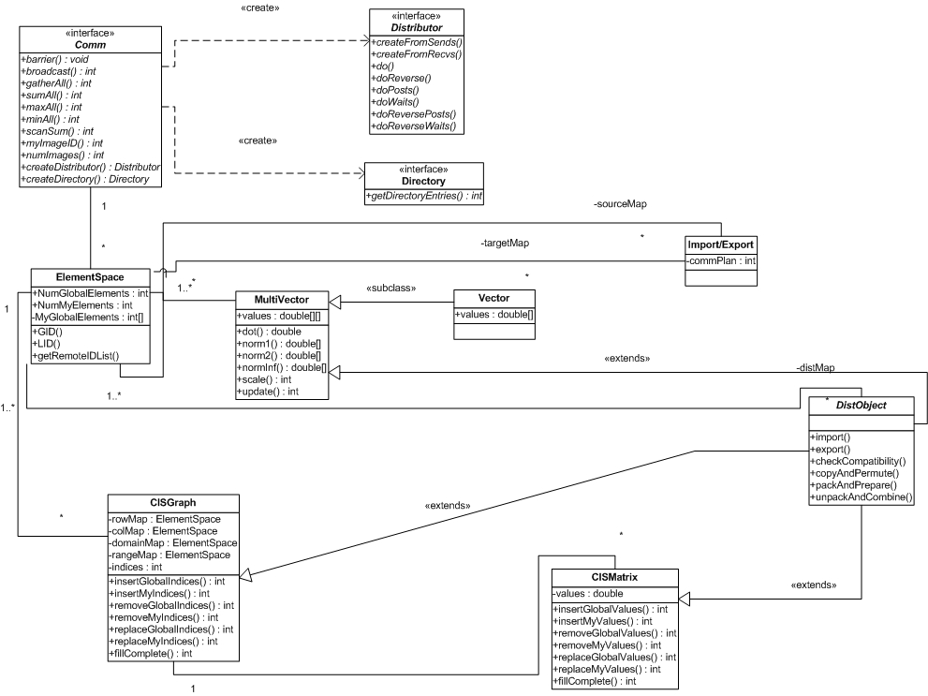
Petra Object Model
Perform redistribution of distributed objects:
Parallel permutations.
“Ghosting” of values for local computations.
Collection of partial results from remote processors.
Base Class for All Distributed Objects:
Performs all communication.
Requires Check, Pack, Unpack methods from derived class.
Abstract Interface for Sparse All-to-All Communication
Supports construction of pre-recorded “plan” for data-driven communications.
Examples:
Supports gathering/scatter of off-processor x/y values when computing y = Ax.
Gathering overlap rows for Overlapping Schwarz.
Redistribution of matrices, vectors, etc…
Graph class for structure-only computations:
Reusable matrix structure.
Pattern-based preconditioners.
Pattern-based load balancing tools.
Abstract Interface to Parallel Machine
Shameless mimic of MPI interface.
Keeps MPI dependence to a single class (through all of Trilinos!).
Allow trivial serial implementation.
Opens door to novel parallel libraries (shmem, UPC, etc…)
Basic sparse matrix class:
Flexible construction process.
Arbitrary entry placement on parallel machine.
Describes layout of distributed objects:
Vectors: Number of vector entries on each processor and global ID
Matrices/graphs: Rows/Columns managed by a processor.
Called “Maps” in Epetra.
Dense Distributed Vector and Matrices:
Simple local data structure.
BLAS-able, LAPACK-able.
Ghostable, redistributable.
RTOp-able.

Slide 62
A Map describes a data distribution
A Map…
has a Comm(unicator)
is like a vector space
assigns entries of a data structure to (MPI) processes
Global vs. local indices
You care about global indices (independent of # processes)
Computational kernels care about local indices
A Map “maps” between them
Parallel data redistribution = function betw. 2 Maps
That function is a “communication pattern”
{E,T}petra let you precompute (expensive) & apply (cheaper) that pattern repeatedly to different vectors, matrices, etc.
All Epetra concepts here carry over to Tpetra

Slide 63
1-to-1 Maps
A Map is 1-to-1 if…
Each global index appears only once in the Map
(and is thus associated with only a single process)
For data redistribution, {E,T}petra cares whether source or target Map is 1-to-1
“Import”: source is 1-to-1
“Export”: target is 1-to-1
This (slightly) constraints Maps of a matrix:
Domain Map must be 1-to-1
Range Map must be 1-to-1

Slide 64
2D Objects: Four Maps
Epetra 2D objects: graphs and matrices
Have four maps:
Row Map: On each process, the global IDs of the rows that process will “manage.”
Column Map: On each processor, the global IDs of the columns that process will “manage.”
Domain Map: The layout of domain objects (the x (multi)vector in y = Ax).
Range Map: The layout of range objects (the y (multi)vector in y = Ax).
Typically a 1-to-1 map
Typically NOT a 1-to-1 map
Must be 1-to-1
maps!!!

Slide 65
Sample Problem
y
A
x
=

Slide 66
Case 1: Standard Approach
First 2 rows of A, elements of y and elements of x, kept on PE 0.
Last row of A, element of y and element of x, kept on PE 1.
PE 0 Contents
PE 1 Contents
RowMap = {0, 1}
ColMap = {0, 1, 2}
DomainMap = {0, 1}
RangeMap = {0, 1}
RowMap = {2}
ColMap = {1, 2}
DomainMap = {2}
RangeMap = {2}
Original Problem
Notes:
Rows are wholly owned.
RowMap=DomainMap=RangeMap (all 1-to-1).
ColMap is NOT 1-to-1.
Call to FillComplete: A.FillComplete(); // Assumes
y
A
x
=

Slide 67
Case 2: Twist 1
First 2 rows of A, first element of y and last 2 elements of x, kept on PE 0.
Last row of A, last 2 element of y and first element of x, kept on PE 1.
PE 0 Contents
PE 1 Contents
RowMap = {0, 1}
ColMap = {0, 1, 2}
DomainMap = {1, 2}
RangeMap = {0}
RowMap = {2}
ColMap = {1, 2}
DomainMap = {0}
RangeMap = {1, 2}
Notes:
Rows are wholly owned.
RowMap is NOT = DomainMap is NOT = RangeMap (all 1-to-1).
ColMap is NOT 1-to-1.
Call to FillComplete: A.FillComplete(DomainMap, RangeMap);
Original Problem
y
A
x
=

Slide 68
Case 2: Twist 2
First row of A, part of second row of A, first element of y and last 2 elements of x, kept on PE 0.
Last row, part of second row of A, last 2 element of y and first element of x, kept on PE 1.
PE 0 Contents
PE 1 Contents
RowMap = {0, 1}
ColMap = {0, 1}
DomainMap = {1, 2}
RangeMap = {0}
RowMap = {1, 2}
ColMap = {1, 2}
DomainMap = {0}
RangeMap = {1, 2}
Notes:
Rows are NOT wholly owned.
RowMap is NOT = DomainMap is NOT = RangeMap (all 1-to-1).
RowMap and ColMap are NOT 1-to-1.
Call to FillComplete: A.FillComplete(DomainMap, RangeMap);
Original Problem
y
A
x
=

Slide 69
What does FillComplete do?
Signals you’re done defining matrix structure
Does a bunch of stuff
Creates communication patterns for distributed sparse matrix-vector multiply:
If ColMap ≠ DomainMap, create Import object
If RowMap ≠ RangeMap, create Export object
A few rules:
Non-square matrices will always require:
A.FillComplete(DomainMap,RangeMap);
DomainMap & RangeMap must be 1-to-1

Slide 70
Data Classes Stacks
Xpetra
Epetra
Tpetra
Manycore BLAS
Kokkos sparse graph & matrix data structures & kernels
Native C & C++ array types
Kokkos multi-D arrays & parallel patterns
Teuchos & user
array types
Classic Stack
New Stack

Slide 71
Teuchos
Portable utility package of commonly useful tools
ParameterList: nested (key, value) database (more later)
Generic LAPACK and BLAS wrappers
Local dense matrix and vector classes
Memory management classes (more later)
Scalable parallel timers and statistics
Support for generic algorithms (traits classes)
Help make Trilinos work on as many platforms as possible
Protect algorithm developers from platform differences
Not all compilers could build Boost in the mid-2000s
BLAS and LAPACK Fortran vs. C calling conventions
Different sizes of integers on different platforms
You’ll see this package a lot
Package lead: Roscoe Barlett (many developers)

Slide 72
ParameterList: Trilinos’ “input deck”
Simple key/value pair database, but nest-able
Naturally hierarchical, just like numerical algorithms or software
Communication protocol between application layers
Reproducible runs: save to XML, restore configuration
Can express constraints and dependencies
Optional GUI (Optika): lets novice users run your app
Teuchos::ParameterList p;
p.set(“Solver”, “GMRES”);
p.set(“Tolerance”, 1.0e-4);
p.set(“Max Iterations”, 100);
Teuchos::ParameterList& lsParams = p.sublist(“Solver Options”);
lsParams.set(“Fill Factor”, 1);
double tol = p.get<double>(“Tolerance”);
int fill = p.sublist(“Solver Options”).get<int>(“Fill Factor”);

Slide 73
TimeMonitor
Track run time & call count of any chunk of code
Time object associates a string name to the timer:
RCP<Time> t = TimeMonitor::getNewCounter (“My function”);
Use TimeMonitor to activate timer:
{
TimeMonitor tm (*t); // starts timer t
doStuff (); // if this throws an exception, timer t stops
// Stops timer t
}
Automatically takes care of recursive / nested calls
Scalable (O(log P)), safe parallel timer statistics summary
TimeMonitor::summarize ();
Can pass in a communicator or parameters
Can handle if some timers don’t exist on some processes

Slide 74
Memory management classes
Scientific computation: Lots of data, big objects
Avoid copying and share data whenever possible
Who “owns” (deallocates) the data?
Manual memory management (void*) not an option
Results in buggy and / or conservative code
Reference-counted pointers (RCPs) and arrays
You don’t have to deallocate memory explicitly
Objects deallocated when nothing points to them anymore
Almost no performance cost for large objects
Interface acts syntactically like pointers / raw arrays

Slide 75
Technical report on Teuchos’ memory management classes
http://trilinos.sandia.gov/RefCountPtrBeginnersGuideSAND.pdf

Slide 76
Why memory management classes?
Disadvantages:
More characters to type
RCP<Matrix> vs. Matrix*
ArrayRCP<double> vs. double[]
Not thread-safe (but don’t belong in tight loops anyway)
Advantages:
Little or no run-time cost for most use cases
Automated performance tests
Behave syntactically like pointers: *, ->
Useful error checking in debug build
RCPs part of interface between packages
Trilinos like LEGO™ blocks
Packages don’t have to worry about memory management
Easier for them to share objects in interesting ways

Slide 77
Building your application with Trilinos

Slide 78


Building your application with Trilinos
If you are using Makefiles:
If you are using CMake:
Makefile.export system
CMake FIND_PACKAGE
Notes:
Original location of CMake logo:
http://www.cmake.org/opensourcelogos/cmake100.png
Downloaded 12 Aug 2011. This work is owned by Kitware and licensed under a Creative Commons Attribution-NoDerivs 3.0 Unported License. For details, see
http://www.kitware.com/company/cclicense.html
Original location of GNU head logo:
https://www.gnu.org/graphics/gnu-head-sm.jpg
Downloaded 12 Aug 2011. Licensing information available here: https://www.gnu.org/graphics/agnuhead.html

Slide 79
Don’t write Makefiles that use Trilinos by hand!
Which libraries? Link order matters!
-lnoxepetra -lnox –lepetra –lteuchos –lblas –llapack
Optional package dependencies affect required libraries
Using the same compilers that Trilinos used
g++ or icc or icpc or …?
mpiCC or mpCC or mpicxx or … ?
Using the same libraries that Trilinos used
Using Intel’s MKL requires a web tool to get the link line right
Trilinos remembers this so you don’t have to
Consistent build options and package defines:
g++ -g –O3 –D HAVE_MPI –D _STL_CHECKED
You don’t have to figure any of this out! Trilinos does it for you!
Please don’t try to guess and write a Makefile by hand!
This leads to trouble later on, which I’ve helped debug.

Slide 80
Why is this hard? Why doesn’t “-ltrilinos” work?
Trilinos has LOTS of packages
Top-level packages might get new package dependencies indirectly, without knowing it:
NOX
ML
Amesos
SuperLU
Ifpack
New Library
New Library
Epetra
EpetraExt
Direct Dependencies
Indirect Dependencies
Better to let Trilinos tell you what libraries you need!
It already does the work for you.

Slide 81
Using the Makefile.export system
#
# A Makefile that your application can use if you want to build with Epetra.
#
# You must first set the TRILINOS_INSTALL_DIR variable.
# Include the Trilinos export Makefile for the Epetra package.
# You may do this per package or for all of Trilinos.
include $(TRILINOS_INSTALL_DIR)/include/Makefile.export.Epetra
# Add the Trilinos installation directory to the library and header search paths.
LIB_PATH = $(TRILINOS_INSTALL_DIR)/lib
INCLUDE_PATH = $(TRILINOS_INSTALL_DIR)/include $(CLIENT_EXTRA_INCLUDES)
# Set the C++ compiler and flags to those specified in the export Makefile.
# This ensures your application is built with the same compiler and flags
# with which Trilinos was built.
CXX = $(EPETRA_CXX_COMPILER)
CXXFLAGS = $(EPETRA_CXX_FLAGS)
# Add the Trilinos libraries, search path, and rpath to the
# linker command line arguments
LIBS = $(CLIENT_EXTRA_LIBS) $(SHARED_LIB_RPATH_COMMAND) \
$(EPETRA_LIBRARIES) \
$(EPETRA_TPL_LIBRARIES) \
$(EPETRA_EXTRA_LD_FLAGS)
#
# Rules for building executables and objects.
#
%.exe : %.o $(EXTRA_OBJS)
$(CXX) -o $@ $(LDFLAGS) $(CXXFLAGS) $< $(EXTRA_OBJS) -L$(LIB_PATH) $(LIBS)
%.o : %.cpp
$(CXX) -c -o $@ $(CXXFLAGS) -I$(INCLUDE_PATH) $(EPETRA_TPL_INCLUDES) $<

Slide 82

Using CMake to build with Trilinos
CMake: Cross-platform build system
Similar function as the GNU Autotools
Building Trilinos requires CMake
You don’t have to use CMake to use Trilinos
But if you do: FIND_PACKAGE(Trilinos …)
Example: https://code.google.com/p/trilinos/wiki/CMakeFindPackageTrilinosExample
I find this much easier than writing Makefiles

Slide 83
Documentation, downloading, & building Trilinos

Slide 84
How do I learn more?
Documentation:
Per-package documentation: http://trilinos.org/packages/
Other material on Trilinos website: http://trilinos.org/
Trilinos Wiki with many runnable examples: https://code.google.com/p/trilinos/wiki/
E-mail lists: http://trilinos.org/mail_lists.html
Annual user meetings and other tutorials:
Trilinos User Group (TUG) meeting and tutorial
Here we are! Last week of October at SNL / NM
European TUG meetings (once yearly)
Next: Paris, France, 02-04 March 2014
Talks available for download (slides &/or video):
http://trilinos.org/community/events/

Slide 85
How do I get Trilinos?
Current release (11.12.1) available for download
http://trilinos.org/download/
Source tarball with sample build scripts
Public read-only git repository
http://trilinos.org/publicRepo/
Development version, updated ~ nightly
Cray packages recent releases of Trilinos
http://www.nersc.gov/users/software/programming-libraries/math-libraries/trilinos/
$ module load trilinos
Recommended for best performance on Cray machines
Most packages BSD license; a few are LGPL

Slide 86
How do I build Trilinos?
Need C and C++ compiler and the following tools:
CMake (version >= 2.8.11), BLAS, & LAPACK
Optional software:
MPI (for distributed-memory parallel computation)
Many other third-party libraries
You may need to write a short configure script
Sample configure scripts in sampleScripts/
Find one closest to your software setup, & tweak it
Build sequence looks like GNU Autotools
Invoke your configure script, that invokes CMake
make –j<N> && make –j<N> install
Documentation:
TrilinosBuildQuickRef.* in Trilinos source directory
http://trilinos.sandia.gov/Trilinos11CMakeQuickstart.txt
https://code.google.com/p/trilinos/wiki/BuildScript
I will cover this, given audience interest

Slide 87
Hands-on tutorial
Two ways to use Trilinos
Student shell accounts
WebTrilinos
Student shell accounts
Pre-built Trilinos with Trilinos_tutorial (Github repository)
Github: branch, send pull requests, save commits / patches!
Steps (we may do some for you in advance):
Log in to student account on paratools07.rrt.net
git clone https://github.com/jwillenbring/Trilinos_tutorial.git
cd Trilinos_tutorial && source ./setup.sh (load modules)
cd cmake_build && ./live-cmake (build all examples)
Change into build subdirectories to run examples by hand
WebTrilinos
Build & run Trilinos examples in your web browser!
Need username & password (will give these out later)
https://code.google.com/p/trilinos/wiki/TrilinosHandsOnTutorial
Example codes: https://code.google.com/p/trilinos/w/list

Slide 88
Other options to use Trilinos
Virtual machine
Install VirtualBox, download VM file, and run it
Same environment as student shell accounts
We won’t cover this today, but feel free to try it
Build Trilinos yourself on your computer
We may cover this later, depending on your interest
Prerequisites:
C++ compiler, CMake version >= 2.8.11, BLAS & LAPACK, (MPI)
Download Trilinos: trilinos.org -> Download
Find a configuration script suitable for your computer
https://code.google.com/p/trilinos/wiki/BuildScript
Trilinos/sampleScripts/
Modify the script if necessary, & use it to run CMake
make –jN, make –jN install
Build your programs against Trilinos
Use CMake with FIND_PACKAGE(Trilinos …), or
Use Make with Trilinos Makefile.export system

Slide 89
U. Oregon student accounts
Thanks to Sameer Shende & Robert Yelle (U Oregon)!
$ ssh chymera.nic.uoregon.edu -l livetau
Learn password later (don’t broadcast it)
$ ssh nuc{12,13,14,15} (no password)
$ cd student<N> (01 – 20)
$ cd Trilinos_tutorial
$ ./cleanit.sh
$ . ./setup.sh
$ module load cmake
$ make
(or change into a specific example directory & make it)
“beginner” & “advanced” subdirectories
Either run directly, or use “mpiexec”

Slide 90
Questions?

