Slide 1
Uncertainty Quantification for Next-Generation Architectures
Eric Phipps (etphipp@sandia.gov), H. Carter Edwards, Jonathan Hu
Sandia National Laboratories
Trilinos Users Group
October 28-29, 2014
SAND2014-16397PE
Sandia National Laboratories is a multi-program laboratory managed and operated by Sandia Corporation, a wholly owned subsidiary of Lockheed Martin Corporation, for the U.S. Department of Energy's National Nuclear Security Administration under contract DE-AC04-94AL85000.
Notes:
The ideas I am going to present today are ideas that several of us at Sandia and Oak Ridge have been thinking about for a while now on how to most effectively implement uncertainty calculations on likely exascale architectures.

Slide 2
Can Exascale Solve the UQ Challenge?
UQ means many things
Best estimate + uncertainty, model validation, model calibration, …
A key to many UQ tasks is forward uncertainty propagation
Given uncertainty model of input data (aleatory, epistemic, …)
Propagate uncertainty to output quantities of interest
There are many forward uncertainty propagation approaches
Monte Carlo, stochastic collocation, polynomial chaos, stochastic Galerkin, …
Key challenge:
Accurately quantifying rare events and localized behavior in high-dimensional uncertain input spaces
Can easily require O(10⁴-10⁶) expensive forward simulations
Often can only afford O(10²) on today’s petascale machines

Slide 3
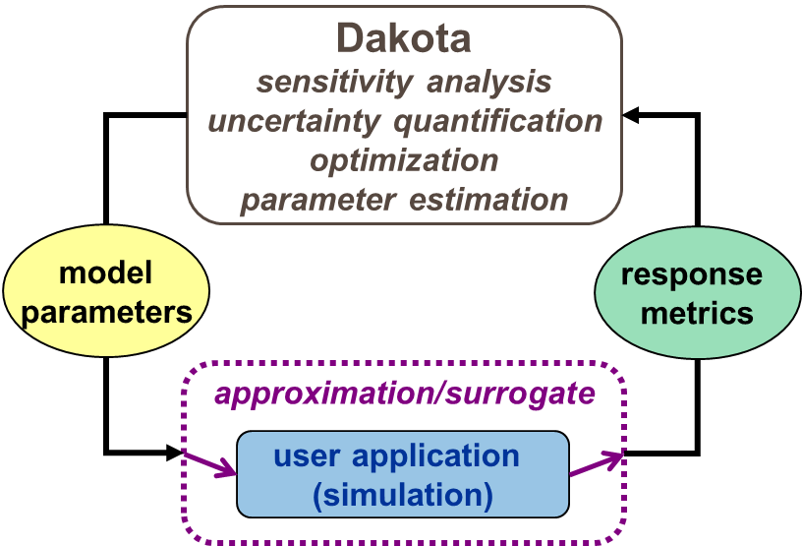

Emerging Architectures Motivate New Approaches to Predictive Simulation
UQ approaches traditionally implemented as an outer loop:
Aggregate UQ performance limited to that of underlying deterministic simulation
Existing application codes may be substantially slower on upcoming architectures
Irregular memory access patterns (e.g., indirect accesses resulting in long latencies)
Inconsistent vectorization (e.g., complex loop structures with variable trip-count)
Poor scalability to high thread-counts (e.g., poor cache reuse results in ineffective hardware threading)
Investigate improving performance and scalability through embedded UQ approaches that propagate UQ information at lowest levels of simulation
Improve memory access patterns and cache reuse
Expose new dimensions of structured fine-grained parallelism
Reduce aggregate communication
http://dakota.sandia.gov

Slide 4
Polynomial Chaos Expansions (PCE)
Steady-state finite dimensional model problem:
(Global) Polynomial Chaos approximation:
Multivariate orthogonal polynomials
Typically constructed as tensor products with total order at most N
Can be adapted (anisotropic, local support)
Non-intrusive polynomial chaos (NIPC, NISP):
Sparse-grid quadrature methods for scalability to moderate stochastic dimensions

Slide 5
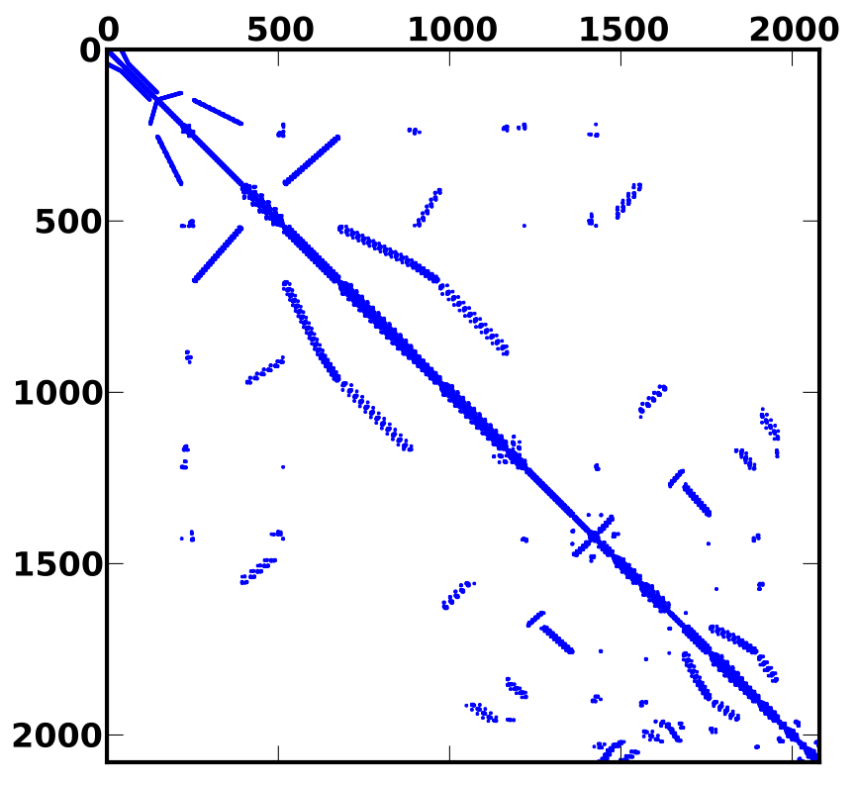

Simultaneous ensemble propagation
PDE:
Propagating m samples – block diagonal (nonlinear) system:

Slide 6
Simultaneous ensemble propagation
Commute Kronecker products (just a reordering of DoFs):
Each sample-dependent scalar replaced by length-m array
Automatically reuse non-sample dependent data
Sparse accesses amortized across ensemble
Math on ensemble naturally maps to vector arithmetic

Slide 7
Potential Speed-up for PDE Assembly
Halo exchange
Amortize MPI latency across ensemble
Gather
Reuse node-index map (mesh)
Replace sparse with contiguous loads
Local residual/Jacobian
Vectorized math
Scatter
Reuse node-index map and element graph (mesh)
Replace sparse with contiguous stores

Slide 8
Potential Speed-up for Sparse Solvers
Ingredients to sparse linear system solvers (CG, GMRES, …)
Sparse matrix-vector products
Dot-products
Preconditioners
Relaxation-based (Jacobi, Gauss-Seidel, …)
Incomplete factorizations (ILU, IC, …)
Polynomial (Chebyshev, …)
Multilevel (Algebraic/Geometric multigrid)
Sparse matrix-vector products
Amortize MPI latency in halo exchange
Reuse matrix graph
Replace sparse with contiguous loads
Vector arithmetic
Dot-products
Amortize MPI latency
Preconditioners
Sparse mat-vecs
Sparse factorizations/triangular-solves
Smaller, more unstructured matrices

Slide 9

Stokhos: Trilinos Tools for Embedded UQ Methods
Provides “ensemble scalar type”
C++ class containing an array with length fixed at compile-time
Overloads all math operations by mapping operation across array
Uses expression templates to fuse loops
Enabled in simulation codes through template-based generic programming
Template C++ code on scalar type
Instantiate template code on ensemble scalar type
Integrated with Kokkos (Edwards, Sunderland, Trott) for many-core parallelism
Specializes Kokkos data-structures, execution policies to map vectorization parallelism across ensemble
For CUDA, currently requires manual modification of parallel launch to use customized execution policies
Integrated with Tpetra-based solvers for hybrid (MPI+X) parallel linear algebra
Exploits templating on scalar type
Optimized linear algebra kernels for ensemble scalar type
Krylov solvers (Belos), Incomplete factorization preconditioners (Ifpack2), algebraic multigrid preconditioners (MueLu)
http://trilinos.sandia.gov

Slide 10
Ensemble Scalar Type
namespace Sacado {
namespace UQ {
// The ensemble scalar type. Ensemble values contained in statically allocated
// array with fixed size Num
template <typename Value, int Num> class Ensemble {
// ...
Value values[Num];
};
}
}
// Overloaded math with expression templates
typedef Sacado::UQ::Ensemble<double,16> Scalar;
Scalar a; a[0] = 0.0; a[1] = 1.0; ...
double b = 2.0;
Scalar c = 3.0;
Scalar d = sin(a)*b + c;
// Generates code equivalent to (compiler can easily unroll, auto-vectorize loop)
for (int i=0; i<16; ++i)
d[i] = sin(a[i])*b + c[i];

Slide 11

Kokkos Integration
Views of ensemble scalar type internally stored as views of 1-higher rank
Ensemble dimension is always contiguous, regardless of layout
Requires specialized kernel launch for CUDA to map warp to ensemble dimension to achieve performance
Kokkos::View< Ensemble<double,4>*, LayoutRight, Device > view(“v”, 10);
Kokkos::View< Ensemble<double,4>*, LayoutLeft, Device > view(“v”, 10);

Slide 12
Techniques Prototyped in FENL Mini-App
Simple nonlinear diffusion equation
3-D, linear FEM discretization
1x1x1 cube, unstructured mesh
KL-like random field model for diffusion coefficient
Trilinos-couplings Trilinos package
Hybrid MPI+X parallelism
Traditional MPI domain decomposition using threads within each domain
Employs Kokkos for thread-scalable
Graph construction
PDE assembly
Employs Tpetra for distributed linear algebra
CG iterative solver (Belos package)
Smoothed Aggregation AMG preconditioning (MueLu)
Supports embedded ensemble propagation via Stokhos through entire assembly and solve
Samples generated via tensor product & Smolyak sparse grid quadrature
http://trilinos.sandia.gov

Slide 13
Ensemble Assembly Speed-Up
Notes:
Single node performance, thread parallel_for over cells
Speed-up here is coming from contiguous loads/stores, mesh reuse for larger problem sizes. For smaller problem sizes, more work per thread

Slide 14
Ensemble MPI Halo-Exchange Speed-Up
Notes:
Speed-up here is coming from MPI latency amortized over ensemble

Slide 15
Ensemble Matrix-Vector Product Speed-Up
Notes:
Single node performance, thread-parallel_for over matrix rows
Speed-up here is coming from contiguous loads, reuse of matrix graph for larger problem sizes. For smaller sizes, more work per thread

Slide 16
Ensemble AMG-Preconditioned CG Speed-Up
Several ensemble AMG setup, solve kernels have not yet been optimized for GPU!
Notes:
Smoothed-aggregation algebraic multigrid via MueLu package, chebyshev smoothers, superlu coarse-grid solve (not thread parallel)
Speed-up comes from speed-up of mat-vecs, halo exchange. Greater speed-up due to more unstructured matrices, smaller matrices
Take the Xeon Phi results with a grain-of-salt. Got wide variation in timings, but always following the same general pattern

Slide 17
Concluding Remarks
Similar approach possible for embedded stochastic Galerkin UQ methods
Introduces coupling across UQ dimension, thus more FLOPs and cache reuse
Similar performance improvements
Stokhos tools available today to implement these ideas in application codes
Integrated with Kokkos for multicore programming
Integrated with Tpetra for distributed linear algebra
Demonstrated with several common solver packages (Belos, Ifpack2, MueLu)
Future work (expected this year)
Integration with “analysis” layer (Piro, Thyra, …)
Simplify/eliminate Kokkos kernel launch modifications
Incorporate into robust uncertainty propagation methods

Slide 18
Auxiliary Slides

Slide 19
Ensemble CG Speed-Up

