Slide 1


Data Services and Trilinos A Brief Introduction to Trios Data Services Approved for Public Release: SAND2011-8379P
2011 Trilinos User Group Meeting
Nov, 2011
Ron Oldfield
Sandia National Laboratories

Slide 2
I/O Challenges for Exascale
Storage systems are the slowest, most fragile, part of an HPC system
Current usage models not appropriate for Petascale, much less Exascale
Checkpoints are a HUGE concern for I/O…currently primary focus of FS
App workflow uses storage as a communication conduit
Simulate, store, analyze, store, refine, store, … most of the data is transient
High-level I/O libraries (e.g., HDF5, netCDF) have high overheads
Trios Data Services to the rescue!
Reduce the “effective” I/O cost through data staging
Reduce amount of data written to storage (integrated analysis, data services)
Nothing comes for free…
We use additional compute and memory resources
Data services introduce issues with resilience (we’re addressing this)

Slide 3
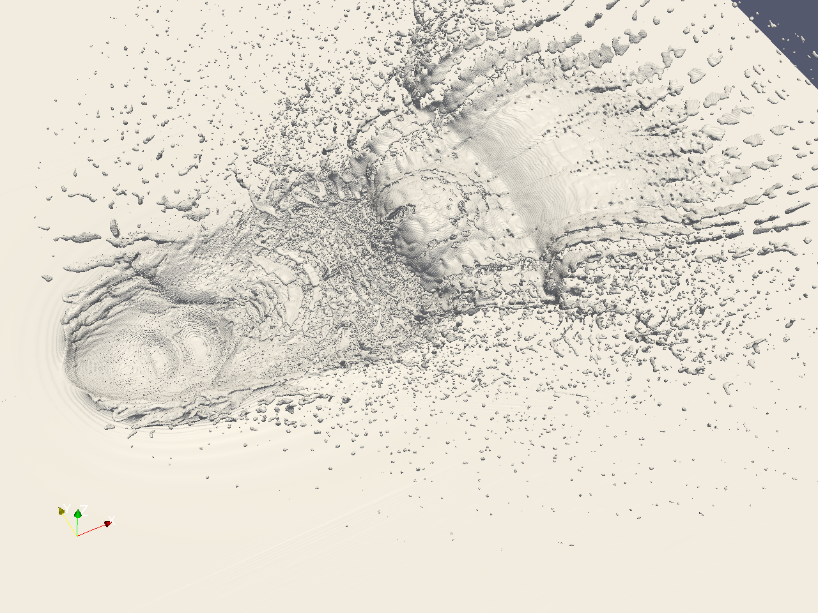

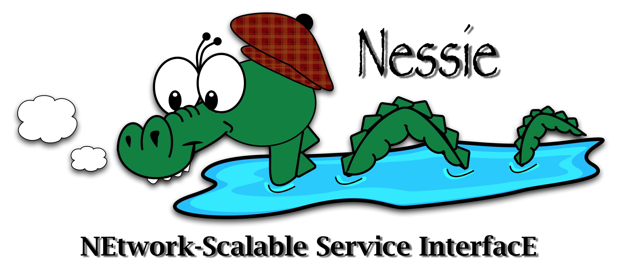
Trios Data Services I/O Software to Reduce I/O
Approach
Leverage available compute/service node resources for I/O caching and data processing
Application-Level I/O Services
First used for seismic imaging (mid 90s)
PnetCDF staging service
CTH real-time analysis
SQL Proxy (for NGC)
Interactive sparse-matrix visualization (for NGC)
Nessie (NEtwork Scalable Service InterfacE)
Framework for developing data services
Client and server libs, cmake macros, utilities
Originally developed for lightweight file systems
Client Application
(compute nodes)
I/O Service
(compute/service nodes)
Lustre File System
Raw Data
Processed Data
Visualization Client
Cache/aggregate/process

Slide 4
Some Details on Nessie
Designed for Bulk Data Movement on HPC Platforms
Goals of data-movement protocol
Low stress on servers (assume order of magnitude more clients than servers)
Efficient use of network (avoid copies, dropped messages, retransmissions, …
Features of Nessie
Asynchronous, RPC-like API
User low-level RDMA transports
Portals, InfiniBand, Gemini
Small requests
Server-directed for bulk data
Writes: pull from client
Reads: push to client
server-initiated
client-initiated
Client
Server
write
request
request
ok
A
request
queue
B
C
pinned
A
C
D
B
D
data
buffers
data

Slide 5
Example: A Simple Transfer Service Trilinos/packages/trios/examples/xfer-service
Used to test Nessie API
xfer_write_encode: client transfers data to server through RPC args
xfer_write_rdma: server pulls raw data using RDMA get
xfer_read_encode: server transfers data to client through RPC result
xfer_read_rdma: server transfers data to client using RDMA put
Used for performance evaluation
Test low-level network protocols
Test overhead of XDR encoding
Tests async and sync performance
Creating the Transfer Service
Define the XDR data structs and API arguments
Implement the client stubs
Implement the server
Client Application
Xfer-Service

Slide 6
Transfer Service Implementing the Client Stubs
Interface between scientific app and service
Steps for client stub
Initialize the remote method arguments, in this case, it’s just the length of the array
Call the rpc function. The RPC function includes method arguments (args), and a pointer to the data available for RDMA (buf)
The RPC is asynchronous
The client checks for completion by calling nssi_wait(&req);

Slide 7
Transfer Service Implementing the Server
Implement server stubs
Using standard stub args
For xfer_write_rdma_srvr, the server pulls data from client
Implement server executable
Initialize Nessie
Register server stubs/callbacks
Start the server thread(s)

Slide 8
Evaluating the Transfer Service
Performance of xfer_write_rdma on Red Storm

Slide 9
Summary and Staff
Trios Data Services reduce the impact of I/O on applications
Reduce the “effective” I/O cost through data staging
Reduce amount of data written to storage (integrated analysis, data services)
Nessie provides an effective framework for developing services
Client and server API, macros for XDR processing, utils for managing svcs
Supports most HPC interconnects (Seastar, Gemini, InfiniBand)
Trilinos provides a great research vehicle
Common repository, testing support, broad distribution
Trios Data Services Development Team (and current assignment)
Ron Oldfield: PI, CTH data service, Nessie development
Todd Kordenbrock: Nessie development, performance analysis
Gerald Lofstead: PnetCDF/Exodus service, transaction-based resilience
Craig Ulmer: Data-service APIs for accelerators (GPU, FPGA)
Ron Minnich: Protocol performance evaluations, Nessie BG/P support

Slide 10
Data Services and Trilinos A Brief Introduction to Trios Data Services
2011 Trilinos User Group Meeting
Nov, 2011
Ron Oldfield
Sandia National Laboratories

