Slide 1
Implementation of Relational Operations: Joins
Notes:
1

Slide 2
Schema for Examples
Sailors (sid: integer, sname: string, rating: integer, age: real)
Reserves (sid: integer, bid: integer, day: dates, rname: string)
Similar to old schema; rname added for variations.
Reserves:
  Each tuple is 40 bytes long, 100 tuples per page, 1000 pages.
Sailors:
  Each tuple is 50 bytes long, 80 tuples per page, 500 pages.
Notes:
4

Slide 3


Equality Joins With One Join Column
SELECT *
FROM Reserves R1, Sailors S1
WHERE R1.sid=S1.sid
In algebra: R S. Common! Must be carefully optimized. R S is large; so, R S followed by a selection is inefficient.
Assume: M tuples in R, p_{R} tuples per page, N tuples in S, p_{S} tuples per page.
  In our examples, R is Reserves and S is Sailors.
Cost metric: # of I/Os. We will ignore output costs.
Notes:
5

Slide 4
Simple Nested Loops Join
foreach tuple r in R do
foreach tuple s in S do
if r_{i} == s_{j} then add <r, s> to result
For each tuple in the outer relation R, we scan the entire inner relation S.
  Cost: M + p_{R} * M * N = 1000 + 100*1000*500 I/Os.
Page-oriented Nested Loops join: For each page of R, get each page of S, and write out matching pairs of tuples <r, s>, where r is in R-page and S is in S-page.
  Cost: M + M*N = 1000 + 1000*500
  If smaller relation (S) is outer, cost = 500 + 500*1000
Notes:
6

Slide 5
Block Nested Loops Join
Use one page as an input buffer for scanning the inner S, one page as the output buffer, and use all remaining pages to hold ``block’’ of outer R.
  For each matching tuple r in R-block, s in S-page, add <r, s> to result. Then read next R-block, scan S, etc.
R & S
Join Result
Hash table for block of R
(k < B-1 pages)
. . .
. . .
. . .
Input buffer for S
Output buffer
Notes:
9

Slide 6
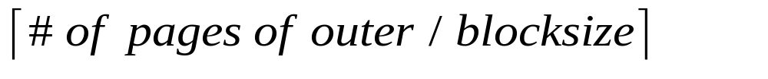
Examples of Block Nested Loops
Cost: Scan of outer + #outer blocks * scan of inner
  #outer blocks =
With Reserves (R) as outer, and 100 pages of R:
  Cost of scanning R is 1000 I/Os; a total of 10 blocks.
  Per block of R, we scan Sailors (S); 10*500 I/Os.
  If space for just 90 pages of R, we would scan S 12 times.
With 100-page block of Sailors as outer:
  Cost of scanning S is 500 I/Os; a total of 5 blocks.
  Per block of S, we scan Reserves; 5*1000 I/Os.
With sequential reads considered, analysis changes: may be best to divide buffers evenly between R and S.

Slide 7
Index Nested Loops Join
foreach tuple r in R do
foreach tuple s in S where r_{i} == s_{j} do
add <r, s> to result
If there is an index on the join column of one relation (say S), can make it the inner and exploit the index.
  Cost: M + ( (M*p_{R}) * cost of finding matching S tuples)
For each R tuple, cost of probing S index is about 1.2 for hash index, 2-4 for B+ tree. Cost of then finding S tuples (assuming Alt. (2) or (3) for data entries) depends on clustering.
  Clustered index: 1 I/O (typical), unclustered: up to 1 I/O per matching S tuple.

Slide 8
Examples of Index Nested Loops
Hash-index (Alt. 2) on sid of Sailors (as inner):
  Scan Reserves: 1000 page I/Os, 100*1000 tuples.
  For each Reserves tuple: 1.2 I/Os to get data entry in index, plus 1 I/O to get (the exactly one) matching Sailors tuple. Total: 220,000 I/Os.
Hash-index (Alt. 2) on sid of Reserves (as inner):
  Scan Sailors: 500 page I/Os, 80*500 tuples.
  For each Sailors tuple: 1.2 I/Os to find index page with data entries, plus cost of retrieving matching Reserves tuples. Assuming uniform distribution, 2.5 reservations per sailor (100,000 / 40,000). Cost of retrieving them is 1 or 2.5 I/Os depending on whether the index is clustered.
Notes:
8

Slide 9
Sort-Merge Join (R S)
i=j
Sort R and S on the join column, then scan them to do a ``merge’’ (on join column), and output result tuples.
  Advance scan of R until current R-tuple >= current S tuple, then advance scan of S until current S-tuple >= current R tuple; do this until current R tuple = current S tuple.
  At this point, all R tuples with same value in R.i (current R group) and all S tuples with same value in S.j (current S group) match; output <r, s> for all pairs of such tuples.
  Then resume scanning R and S.
R is scanned once; each S group is scanned once per matching R tuple. (Multiple scans of an S group are likely to find needed pages in buffer.)
Notes:
11

Slide 10
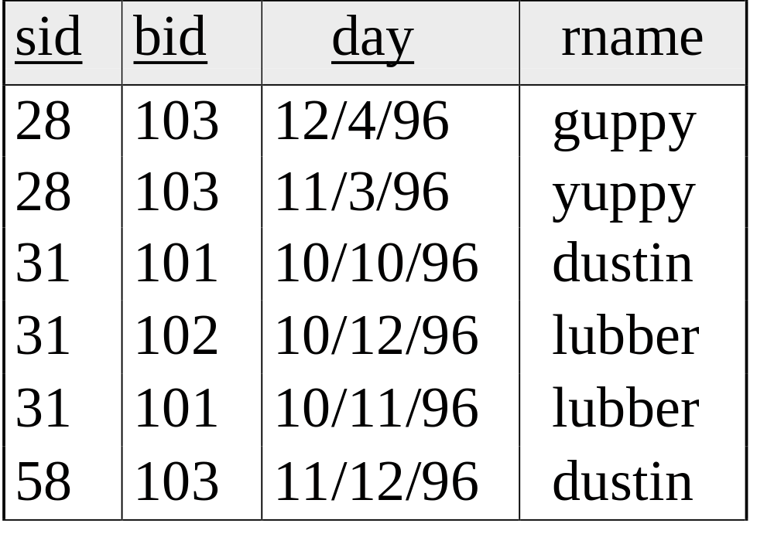
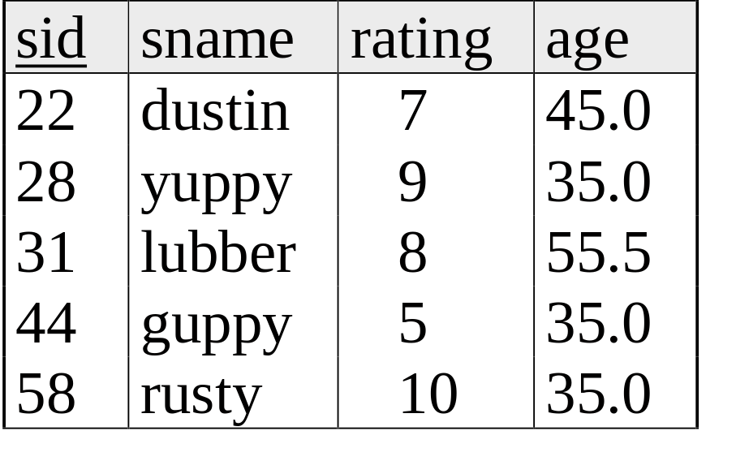
Example of Sort-Merge Join
Cost: M log M + N log N + (M+N)
  The cost of scanning, M+N, could be M*N (very unlikely!)
With 35, 100, or 300 buffer pages, both Reserves and Sailors can be sorted in 2 passes; total join cost: 7500.
(BNL cost: 2500 to 15000 I/Os)
Notes:
12

Slide 11
Impact of Buffering
If several operations are executing concurrently, estimating the number of available buffer pages is guesswork.
Repeated access patterns interact with buffer replacement policy.
  e.g., Inner relation is scanned repeatedly in Simple Nested Loop Join. With enough buffer pages to hold inner, replacement policy does not matter. Otherwise, MRU is best, LRU is worst (sequential flooding).
  Does replacement policy matter for Block Nested Loops?
  What about Index Nested Loops? Sort-Merge Join?
Notes:
21

Slide 12
Summary
Many join algorithms exist, with tradeoffs:
  Simple NL: Brainless. We read in pages, not tuples.
  Page-oriented NL: Block-oriented NL with block size = 1 for both relations
  Block-oriented NL: Read in multiple pages of outer relation
  Index NL: Like Page-oriented NL, but use index to “probe” inner relation for each outer tuple
  Sort-Merge join: great if things already sorted (or need to be later on….)
Must consider available alternatives for each operation in a query and choose best one based on system statistics (relation sizes, distributions, buffer pool size, etc.)
Notes:
22

