Slide 1
CS 168 The End of Architecture and the Beginning of Design
Fall 2016
Scott Shenker
CS168.io
http://inst.eecs.berkeley.edu/~cs168/fa16/

Slide 2

Ssssshhhhhhhhhhhhhhh

Slide 3
What You Should Understand So Far
Layers merely applying modularity to networks
Key to longevity of Internet architecture
Limits the scope of changes to (usually) a single layer
Three networking principles:
Layering: how to arrange modules
End-to-End principle: where to put functionality
No reliability in network
Fate-sharing: where to put state
No per-flow state in network
Lesson: think big picture before designing details
If the architecture is wrong, engineering can’t save it

Slide 4
Questions I Did Not Answer
Why is there only one IP layer?
Why was the Internet invented?

Slide 5
Agenda for Today
Finish up last lecture
End of “architecture”
Fundamentals of Routing
Beginning of “engineering” or “design”

Slide 6
If the Internet is the answer, what were the questions?

Slide 7
Internet Prehistory (late 50’s)
Telephone network is largest comm’n system
Uses circuit switching
Need to build networks for other tasks
Defense
Computers
…
But people knew that circuit switching was:
Inefficient (for bursty loads)
Not very resilient (complicated story)
Which is why AT&T worked hard to make components reliable

Slide 8
Three crucial questions arose
Paul Baran (RAND) asked:
“How can we design a more resilient network?”
And invented the notion of packet switching
Len Kleinrock (UCLA) asked:
“How can we design a more efficient network?”
And invented the notion of packet switching
A few years later Bob Kahn (DARPA) asked:
“How can we connect these networks together?”
And invented the notion of the Internet

Slide 9
Questions vs Answers
Asking the right questions is hard
Questions that capture the most essential challenge
The challenge that, if met, will change the world
Answering questions is much easier
Once a question is properly posed, researchers are pretty good about answering them
Too many researchers focus on questions they can easily justify and answer quantitatively
These are not the questions that are truly important
These three previous questions led to Internet!

Slide 10
History of the Internet

Slide 11
Internet Timeline
1961 Baran, Kleinrock advocate packet switching
1962 Licklider’s vision of Galactic Network
1965 Roberts connects two computers via phone
1967 Roberts publishes vision of ARPANET
1969 BBN installs first IMP at UCLA
IMP: Interface Message Processor
1971 Network Control Program (protocol)
1972 Public demonstration of ARPANET

Slide 12
The opening of the Internet revolution
Kleinrock’s group at UCLA tried to log on to Stanford computer: His recollection of the event…
We typed the L…
“Do you see the L?”
“Yes, we see the L.”
We typed the O…
“Do you see the O?”
“Yes, we see the O.”
Then we typed the G…
…and the system crashed!
Notes:
Perfect demo

Slide 13
Timeline continued…
1972 Email invented
1972 Telnet introduced
1972 Kahn advocates Open Architecture networking

Slide 14
The Problem
Many different packet-switching networks
Only nodes on the same network could communicate

Slide 15
Kahn’s Rules for Interconnection
Each network is independent and must not be required to change (why?)
Best-effort communication (why?)
Best effort = no guarantees about delays or delivery
Boxes (routers) connect networks
No global control at operations level (why?)

Slide 16
Solution
Gateways

Slide 17
Kahn’s vision
Kahn imagined there would be only a few networks (~20) and thus only a few routers
He was wrong (why?)
Proposed gateways to “translate” btwn networks
Via a universal protocol that they all understood
N translations rather than N²
Search for “universal” protocol is birth of Internet
The actual design of IP came later (Cerf and Kahn)
The reason we have only one L3 protocol
This vision requires a universal protocol!

Slide 18
Timeline continued….
1973 FTP introduced
1973 Ethernet invented (Xerox PARC)
1974 Cerf and Kahn paper on TCP/IP
1980 TCP/IP adopted as defense standard
1983 Global NCP to TCP/IP flag day
198x XNS, DECbit, and other protocols
1984 Janet (British research network)
1985 NSFnet (picks TCP/IP) [thank you Al Gore!]
198x Internet meltdowns due to congestion
1986 Van Jacobson saves the Internet (BSD TCP)
1988 Dave Clark steps down from IAB

Slide 19
Unsung hero of Internet: David Clark
Chief Architect 1981-1988
Great consistency of vision
Kept the Internet true to its basic design principles
Authored End-to-End Principle
Conceives and articulates architectural concepts
Read “Active Networking and End-To-End Arguments”
Perhaps the only “irreplaceable” Internet pioneer

Slide 20
Timeline continued…
1988 Deering and Cheriton propose multicast
1989 Birth of the web….Tim Berners-Lee (CERN)
He invented HTTP
The web quickly took over the Internet….

Slide 21
Why did it take a physicist to invent web?
Physicists are the smartest people in the world?
Computer scientists were trying to invent nirvana
Well, actually Xanadu (Ted Nelson)
More generally, CS researchers focused on hyptertext
Users didn’t need what we wanted to invent
Think about it: a paper on HTTP would have been rejected by every CS conference and journal
In general, the CS research community is great at solving well-defined problems, but terrible at guessing what users will actually use
“Academics get paid for being clever, not for being right.”
…Don Norman

Slide 22
Timeline continued…..
1993 Search engines invented (Excite)
1994 Internet goes commercial
199x ATM rises and falls (as internetworking layer)
Telcos try to kill the Internet
199x QoS rises and falls
I try to kill the Internet
1998 IPv6 specification (led by Deering)
1998 Google reinvents search (ranking algorithm)
200x The Internet boom and bust
201x CS enrollments suggest boom is back!
CS 168: ~80 in 2010 to >600 in 2016

Slide 23
Questions I Can’t Answer
When was layering invented?
When will IPv6 finally happen?
What are the biggest recent developments?
From desktops to laptops to phones…(to IoT)?
From data applications to video?
From ad hoc deployment to carefully managed infrastructure
The rise of large datacenters
The failure of security efforts
SDN, NFV, and all that....
....

Slide 24
Internet Design Goals

Slide 25
David Clark
Wrote a paper in 1988 that tried to capture why the Internet turned out as it did
In particular, it described an ordered list of priorities that informed the design

Slide 26
Internet Design Goals (Clark ‘88)
Connect existing networks (Kahn’s stated goal)
Robust in face of failures
Support multiple types of delivery services
Accommodate a variety of networks
Allow distributed management
Easy host attachment
Cost effective
Allow resource accountability
Notes:
Important that his is an ORDERED list.

Slide 27
#1 Connect Existing Networks
Wanted single protocol that could be used to connect any pair of (existing) networks
The Internet Protocol (IP) is that unifying protocol
All (existing) networks must be able to implement it
This is where the need for best effort arose….
And this is where circuit switching died
Why?

Slide 28
#2 Robust
Def’n A: As long as network is not partitioned, two hosts should be able to communicate (eventually)
Must eventually recover from failures
Def’n B: Failures should not interfere with endpoint semantics
Must always isolate endpoints from failures
A: Very successful, not clear how relevant now
Availability more important than recovering from disaster
B: This notion of robustness is underappreciated
Key to modularity of Internet

Slide 29
#3 Types of Delivery Services
Use of the term “delivery services” already implied an application-neutral network
Built lowest common denominator service
Allow end-based protocols to provide better service
For instance, turn unreliable service into reliable service
Example: recognition that TCP wasn’t needed (or wanted) by some applications
Separated TCP from IP, and introduced UDP

Slide 30
The paradox of the Internet’s design
The goal is to support many applications
These applications have different requirements
Shouldn’t the Internet support them all?
That is, provide a service the satisfies all of them
By meeting the most stringent requirements

Slide 31
What service should Internet support?
Strict delay bounds?
Some applications require them
Guaranteed delivery?
Some applications are sensitive to packet drops
No applications mind getting good service
Why not require Internet support all these guarantees?

Slide 32
Important life lessons
(1) People (or applications)
Don’t always need what they think they need
Almost never need what we think they need
(2) Flexibility often more important than performance
But typically only in hindsight!
Example: cell phones vs landlines
(3) Architect for flexibility, engineer for performance
Flexibility ensures longevity
Performance requirements are ephemeral

Slide 33
Applying lessons to Internet
Requiring performance guarantees would limit variety of networks that could attach to Internet
Many applications don’t need these guarantees
And those that do?
Well, they don’t either (usually) (Why?)
Tremendous ability to mask drops, delays
And ISPs can work hard to deliver good service without changing the architecture
Through good engineering and provisioning

Slide 34
Bottom Line
The choice of best effort packet switching service is not as obvious as it might seem today
Guaranteed service was the more obvious choice
Great vision on the part of the Internet designers
To see past so-called “requirements”…
...and envision a future where application agility minimizes the need for intricate infrastructure
And we were very lucky that they were focused on applications that did not need great service

Slide 35
#4 Variety of Networks
Incredibly successful!
Minimal requirements on networks
No need for reliability, in-order, fixed size packets, etc.
A result of aiming for lowest common denominator
IP over everything
Then: ARPANET, X.25, DARPA satellite network..
Now: Wifi, Cellular, ATM, SONET, WDM…

Slide 36
#5 Decentralized Management
Both a curse and a blessing
Important for easy deployment
Makes management hard today
Recent efforts have improved management of individual networks
But no attempt to manage the Internet as a whole….

Slide 37
#6 Host Attachment
Clark observes that cost of host attachment may be higher because hosts have to be smart
But the administrative cost of adding hosts is very low, which is probably more important
Plug-and-play kind of behavior….
And most hosts have to be smart for other reasons
So the cost is actually minimal….

Slide 38
#7 Cost Effective
Cheaper than circuit switching at low end
More expensive than circuit switching at high end
Why?
Not a bad compromise:
Cheap where it counts (low-end)
More expensive for those who can pay….

Slide 39
#8 Resource Accountability
Failure!

Slide 40
Internet Motto
We reject kings, presidents, and voting. We believe in rough consensus and running code.”
David Clark

Slide 41
Real Goals
Build something that works!
Connect existing networks
Robust in face of failures
Support multiple types of delivery services
Accommodate a variety of networks
Allow distributed management
Easy host attachment
Cost effective
Allow resource accountability

Slide 42
Questions to think about….
What priorities would a commercial design have?
Probably focus on high-revenue applications
What would the resulting design look like?
Probably bake some of the application into the network
As in the phone network
What goals are missing from this list?
Suggestions?

Slide 43
Some of the missing issues
Security
Resilience to attacks (denial-of-service)
Endpoint security
Tracking down misbehaving users
Privacy
Availability
Resource sharing (fairness, etc.)
ISP-level concerns
Technical issues of interconnection and internal management
Economic issues of interconnection
Value flow (who should get paid for these bits?)

Slide 44
From Architecture to Design

Slide 45
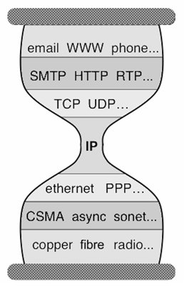
Five Layers
Applications
…built on…
Reliable (or unreliable) transport
…built on…
Best-effort global packet delivery
…built on…
Best-effort local packet delivery
…built on…
Physical transfer of bits

Slide 46
Traditional Courses
Cover each layer in order (as in our textbook)
Philosophies differ as to top-down vs bottom-up
I prefer to focus on the distinction between
General architecture considerations
Fundamental intellectual challenges
Design/implementation choices in today’s Internet
We will next address fundamental challenges
Later will discuss current designs in each layer

Slide 47
Which of these tasks are hard?
Application: not a fundamental challenge
Not general, and not necessarily hard
Reliable transport: a fundamental challenge
General, and difficult
Global and local packet delivery:
Local and global packet delivery both require routing
This is a general and difficult challenge
Physical transfer: not a fundamental challenge
Not general, and not conceptually difficult

Slide 48
Two Fundamental Challenges
Routing: guiding packets from source to destination
Reliable delivery: building a reliable transport service on top of best-effort delivery
Other pieces required to build operational networks
Naming, addressing, congestion control,….
We will get to those later in the course
But these two are inherent and hard
Routing: next few lectures
Reliable transport: lecture after that

Slide 49
A Few Preliminaries
Network Topologies
Forwarding

Slide 50
Example of Network Graph
Router with 6 attached links
Router with 4 attached links

Slide 51
A Variety of Networks
ISPs: carriers
Backbone
Edge (connecting to customers)
Border (to other ISPs)
Enterprises: companies, universities
Core
Edge (connecting to hosts)
Border (to outside)
Datacenters: massive collections of machines
Aggregation and Core
Top-of-Rack (connecting to hosts)
Border (to outside)

Slide 52
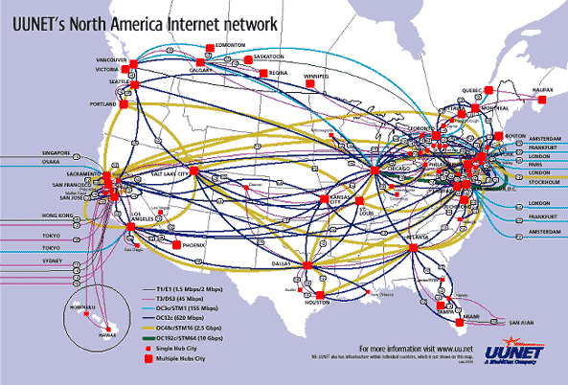
UUNET’s North American Network
Notes:
Very irregular

Slide 53
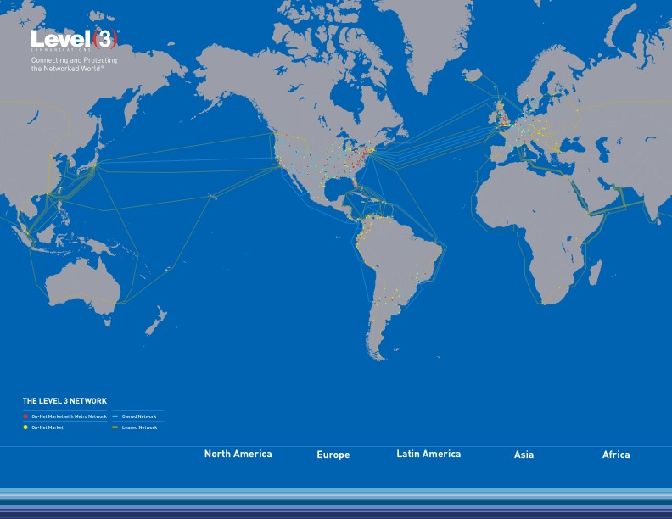
Level3’s Global Network

Slide 54
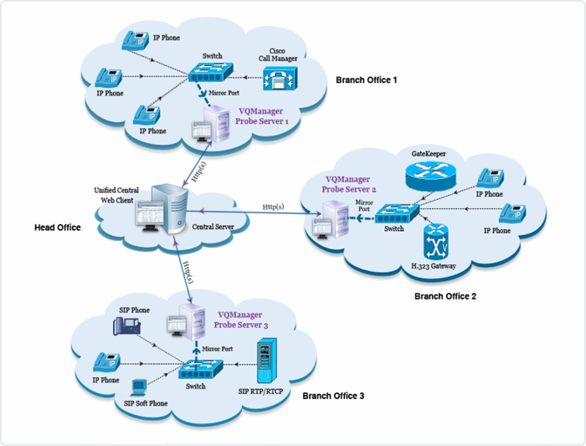
Enterprise Network
Notes:
Not very detailed, couldn’t get a better one….

Slide 55
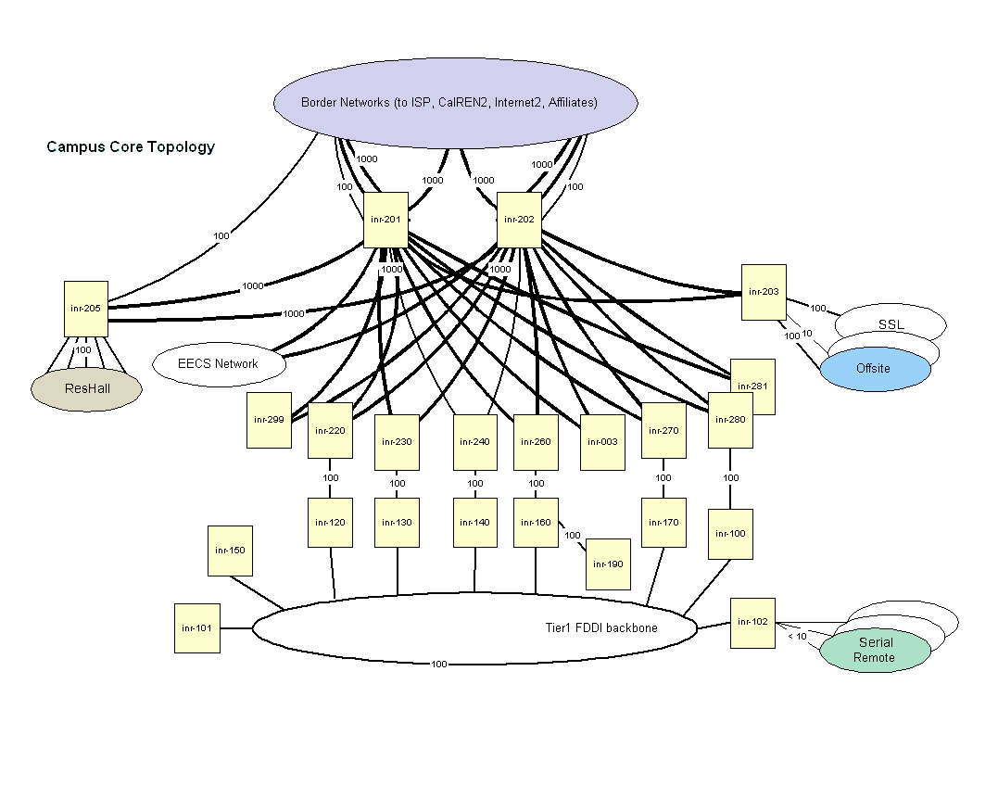
Berkeley’s Campus Network

Slide 56
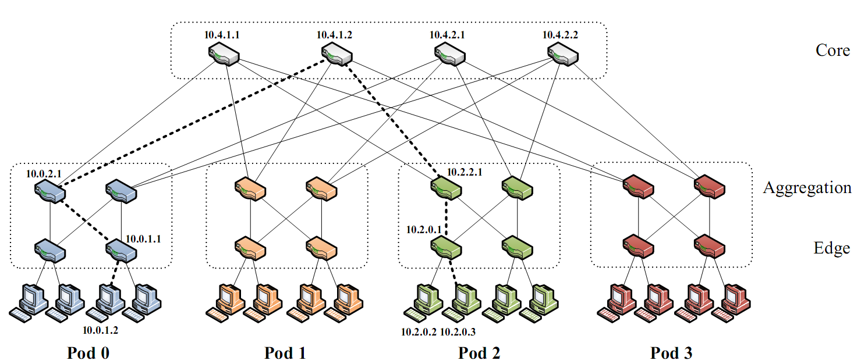
Partial Datacenter Network
Notes:
Only a part of the network, but the takeaway is that the network is very regular, involving levels of hierarchy.

Slide 57
Forwarding Decisions
Switches and routers make the following mapping:
Header + Routing Table ➔ OutgoingPort
Most do so in single transmission time
Forwarding decisions must be simple
Assume forwarding decisions are deterministic
Packets with same state always routed to same port
Decisions based on packet header:
Destination Address, Source Address, etc.

Slide 58
Forwarding Decision Dependencies
Must depend on destination
Could also depend on :
Source: requires n² state
Input port: not clear what this buys you
Other header information: ignore for now
We will focus only on destination-based routing
But first consider the alternative

Slide 59
Source/Destination-Based Routing
Paths from two different sources (to same destination) can be very different

Slide 60
Destination-Based Routing
Paths from two different sources (to same destination) must coincide once they overlap
Notes:
Why coincide?

Slide 61
Destination-Based Routing
Paths to same destination never cross
Once paths to destination meet, they never split
Set of paths to destination create a “delivery tree”
Must cover every node exactly once
Only one outgoing arrow at each node
All nodes have path to destination
Produces Spanning Tree rooted at destination
Notes:
You all know what a spanning tree is?

Slide 62
A “Delivery Tree” for a Destination

Slide 63
Assume Destination-Based Routing
For rest of lecture (and course)…..

Slide 64
The Crucial Routing Question
How do you create these directed delivery trees?
One for each destination
Describes the paths from all sources to that destination
Each tree must
Span all hosts (because each can send a packet)
And converge on the destination
There are many approaches to routing….
They differ in fundamental ways
We will discuss some of them on Thursday
But today....

Slide 65
We Will Learn By Doing!
I need 40 volunteers
If you haven’t participated, this is your chance!

Slide 66
The Task
Do not look at sheet of paper until I say so
You will have five minutes to complete this task
Each sheet says:
You are node X You are connected to nodes Y,Z
Your job: find route from source (node 1) to destination (node 40) in five minutes

Slide 67
Ground Rules
You may not:
Leave your seat (but you can stand)
Pass your sheet of paper
Let anyone copy your sheet of paper
You may:
Ask nearby friends for advice
Shout to other participants (anything you want)
Curse your instructor (sotto voce)
You must: Try

Slide 68
Go!

Slide 69
Ssssshhhhhhhhhhhhhhh

Slide 70
Postmortem
What went right?
What went wrong?

