Slide 1
CS 168 TCP, DNS, Web
Fall 2016
Scott Shenker
CS168.io
http://inst.eecs.berkeley.edu/~cs168/fa16/

Slide 2

Ssssshhhhhhhhhhhhhhh

Slide 3
Announcements
Homework #3: coming soon
Treat it like a worksheet
Will explain when posted
Project #2: due 10/10
Midterm: A week from today
Only one person rescheduled….
Special office hours to be announced
Sections on Wednesday devoted to review

Slide 4
Agenda For Today
Finishing up TCP
DNS
The Web (will only get started)

Slide 5
Timing Diagram: 3-Way Handshaking
Passive Open
Active Open
Server
Client (initiator)
listen()
connect()
SYN, SeqNum = x
SYN + ACK, SeqNum = y, Ack = x + 1
ACK, Ack = y + 1
accept()

Slide 6
Tearing Down the Connection

Slide 7
Normal Termination, One Side At A Time
B
ACK
SYN
SYN ACK
Data
ACK
FIN
ACK
FIN
ACK
A
time
Finish (FIN) to close connections
FIN occupies one byte in the sequence space
Other host ack’s the byte to confirm
Closes A’s side of the connection, but not B’s
Until B likewise sends a FIN
Which A then acks
Connection now closed
Connection now half-closed
Timeout:
Avoid reincarnation
B will retransmit FIN if ACK is lost
Notes:
Why timer? Will get packet with no state!!

Slide 8
Normal Termination, Both Together
Same as before, but B sets FIN with their ack of A’s FIN
B
ACK
ACK
SYN
SYN ACK
Data
ACK
FIN
FIN + ACK
A
time
Timeout:
Avoid reincarnation
Can retransmit FIN ACK if ACK lost
Connection now closed

Slide 9
Abrupt Termination
B
ACK
SYN
SYN ACK
ACK
RST
RST
Data
Data
A
time
A sends a RESET (RST) to B
E.g., because app. process on A crashed
That’s it
B does not ack the RST
Thus, RST is not delivered reliably
And: any data in flight is lost
But: if B sends anything more, will elicit another RST

Slide 10
TCP State Transitions
Data, ACK exchanges are in here

Slide 11
An Simpler View of the Client Side
CLOSED
SYN (Send)
TIME_WAIT
SYN_SENT
Rcv. FIN, Send ACK
Rcv. SYN+ACK, Send ACK
ESTABLISHED
FIN_WAIT2
FIN_WAIT1
Rcv. ACK, Send Nothing
Send FIN

Slide 12
TCP Retransmission

Slide 13
Timeouts and Retransmissions
Reliability requires retransmitting lost data
Involves setting timers and retransmitting on timeouts
TCP only has a single timer
TCP resets timer whenever new data is ACKed
Retx packet containing “next byte” when timer expires
RTO (Retransmit Time Out) is basic timeout value

Slide 14
Setting the Timeout Value (RTO)
1
1
Timeout
RTT
RTT
1
Timeout
1
Timeout too long → inefficient
Timeout too short →
duplicate packets

Slide 15
Base RTO on RTT Estimation
Use exponential averaging of RTT samples
SampleRTT
EstimatedRTT
Time

Slide 16
Exponential Averaging Example
EstimatedRTT = α*EstimatedRTT + (1 – α)*SampleRTT
Assume RTT is constant → SampleRTT = RTT
EstimatedRTT (α = 0.5)
RTT
EstimatedRTT (α = 0.8)
0
1
2
3
4
5
6
7
8
9
time

Slide 17
Problem: Ambiguous Measurements
How do we differentiate between the real ACK, and ACK of the retransmitted packet?
Sender
Receiver
Sender
Receiver
Original Transmission
Original Transmission
SampleRTT
ACK
SampleRTT
Retransmission
Retransmission
ACK

Slide 18
Karn/Partridge Algorithm
Measure SampleRTT only for original transmissions
Once a segment has been retransmitted, do not use it for any further measurements
Computes EstimatedRTT using α = 0.875
Timeout estimate (ETO) = 2 × EstimatedRTT
Use exponential backoff for repeated retransmissions
Every time RTO timer expires, set RTO ← 2·RTO
(Up to maximum ≥ 60 sec)
Every time new measurement comes in (= successful original transmission), collapse RTO back to ETO

Slide 19
Example
First arriving ACK expects 100 (adv. window=500)
Timer reset to ETO (new data ACKed)
Sender sends packets 100, 200, 300, 400, 500
Arriving ACK expects 300
Timer reset to ETO (= RTO)
Packets 600, 700 sent
Arriving ACK expects 300 (what happens next?)
Timer goes off
Packet 300 is resent
Timeout is doubled to 2RTO
Arriving ACK expects 600
Timer reset to ETO
Packets 800, 900, 1000 are sent
If this timer expires before new data is ACKed, what should sender do?

Slide 20
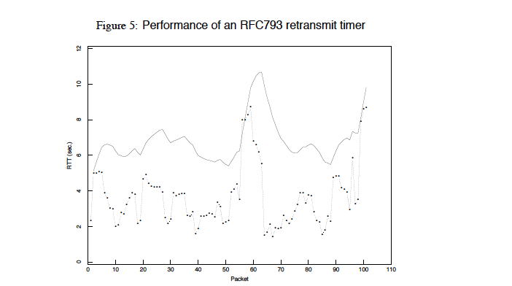
Karn/Partridge in action
from Jacobson and Karels, SIGCOMM 1988

Slide 21
Jacobson/Karels Algorithm
Problem: need to better capture variability in RTT
Directly measure deviation
Deviation = | SampleRTT – EstimatedRTT |
EstimatedDeviation: exponential average of Deviation
RTO = EstimatedRTT + 4 x EstimatedDeviation

Slide 22
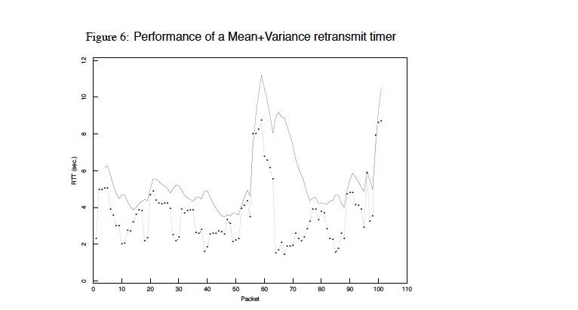
With Jacobson/Karels

Slide 23
This is all very interesting, but…..
Implementations often use a coarse-grained timer
500 msec is typical
So what?
Above algorithms are largely irrelevant
Incurring a timeout is expensive
So we rely on duplicate ACKs

Slide 24
Loss with cumulative ACKs
Sender sends packets with 100B and seqnos.:
100, 200, 300, 400, 500, 600, 700, 800, 900
Assume 5th packet (seqno 500) is lost, but no others
Stream of ACKs will be:
200, 300, 400, 500, 500, 500, 500, 500

Slide 25
Loss with cumulative ACKs
“Duplicate ACKs” are a sign of an isolated loss
The lack of ACK progress means 500 hasn’t been delivered
Stream of ACKs means some packets are being delivered
Therefore, could trigger resend upon receiving k duplicate ACKs
TCP uses k=3
We will revisit this in congestion control

Slide 26
Any Questions?

Slide 27
DNS

Slide 28
Naming
Internet has one global system of addressing: IP
By explicit design
And one global system of naming: DNS
Almost by accident, naming was an afterthought
At the time, only items worth naming were hosts
A mistake that causes many painful workarounds
Everything is now named relative to a host
Content is most notable example (URL structure)

Slide 29
Logical Steps in Using Internet
Person has name of entity she wants to access
Content, host, etc.
Invokes an application to perform relevant task
Using that name (e.g., www.cnn.com)
App invokes DNS to translate name to address
E.g. 157.166.255.18
App invokes transport protocol to contact host
Using address as destination

Slide 30
Relationship Btwn Names/Addresses
Addresses can change underneath
Move www.cnn.com to 4.125.91.21
Humans/Apps should be unaffected
Name could map to multiple IP addresses
www.cnn.com to multiple replicas of the Web site
Enables
Load-balancing
Reducing latency by picking nearby servers
Multiple names for the same address
E.g., aliases like www.cnn.com and cnn.com

Slide 31
Mapping from Names to Addresses
Originally: per-host file hosts.txt in /etc/hosts
SRI (Menlo Park) kept master copy
Downloaded regularly
Flat namespace
As the Internet grew this system broke down
SRI couldn’t handle the load
Conflicts in selecting names
Hosts had inaccurate copies of hosts.txt
Domain Name System (DNS) invented to fix this
First server implementation done by 4 UCB students!
Notes:
Could have one without the other…

Slide 32
Goals and Approach
Goals:
Scaling (names, users, updates, etc.)
Ease of management (uniqueness of names, etc.)
Availability and consistency
Fast lookups
Approach: Three intertwined hierarchies:
Naming structure: www.cnn.com
Management: hierarchy of authority over names
Infrastructure: hierarchy of DNS servers

Slide 33
Hierarchical Namespace
root
edu
com
gov
mil
org
net
uk
fr
…
“Top Level Domains” (TLDs) are at the top
Domains are subtrees
E.g: .edu, berkeley.edu, eecs.berkeley.edu
Name is leaf-to-root path
instr.eecs.berkeley.edu
berkeley
ucla
eecs
sims
instr
Notes:
gTLDs and ccTLDs

Slide 34
Hierarchical Administration
ICANN/IANA
root
root
edu
edu
gov
gov
mil
mil
net
net
uk
uk
fr
com
fr
com
org
org
berkeley
ucla
berkeley
A zone corresponds to an administrative authority responsible for contiguous portion of hierarchy
UCB controls *.berkeley.edu and *sims.berkeley.edu
EECS controls *.eecs.berkeley.edu
Name collisions trivially avoided!
Each domain can ensure this locally
eecs
eecs
sims
sims
instr

Slide 35
Infrastructure Hierarchy
Top of hierarchy: Root
Location hardwired into other servers
Next Level: Top-level domain (TLD) servers
.com, .edu, etc.
Managed professionally
Bottom Level: Authoritative DNS servers
Actually do the mapping
Can be maintained locally or by a service provider

Slide 36
Per-domain availability
DNS servers are replicated
Primary and secondary name servers required
Name service available if at least one replica is up
Queries can be load-balanced between replicas
Try alternate servers on timeout
Exponential backoff when retrying same server

Slide 37
Who Knows What?
Every server knows address of root name server
Root servers know the address of all TLD servers
Every node knows the address of children
An authoritative DNS server stores name-to-address mappings (“resource records”) for all DNS names in the domain that it has authority for
Therefore, each server:
Stores only a subset of the total DNS database (scalable!)
Can discover server(s) for any portion of the hierarchy

Slide 38
Benefits of This Approach
Scalable in names, updates, lookups, users
Highly available: domains replicate independently
Extensible: can add TLDs just by changing root db
Autonomous administration:
Each domain manages own names and servers
And can further delegate
Easily ensures uniqueness of names
And consistency of databases

Slide 39
Was Hierarchy Necessary?
Two aspects of logical hierarchy:
Name resolution: walk up/down hierarchy
Name allocation: control over namespace partitioned
How to handle both without hierarchy?
Any ideas?
Resolution: Google
Scalable key-value store
Allocation:
Statistically unique names (random)

Slide 40
DNS Records
DNS servers store resource records (RRs)
RR is (name, value, type, TTL)
Type = A: (→ Address)
name = hostname
value = IP address
Type = NS: (→ Name Server)
name = domain
value = name of dns server for domain

Slide 41
DNS Records (cont’d)
Type = MX: (→ Mail eXchanger)
name = domain in email address
value = name(s) of mail server(s)
Type = CNAME: (→ Canonical NAME)
Name = alias
Value is “canonical” name
Type = PTR: (→ Pointer)
name is reversed IP
value is corresponding hostname

Slide 42
Inserting Resource Records into DNS
Example: you just created company “FooBar”
You get a block of IP addresses from your ISP
E.g., 212.44.9.128/25
Register foobar.com at registrar (e.g., GoDaddy)
Provide registrar with names and IP addresses of your authoritative name server(s)
Registrar inserts RR pairs into the .com TLD server:
(foobar.com, dns1.foobar.com, NS)
(dns1.foobar.com, 212.44.9.129, A)
Store resource records in your server dns1.foobar.com
e.g., type A record for www.foobar.com
e.g., type MX record for foobar.com

Slide 43
Distributed Hierarchical Database
Everything scales but the root!
root
com
edu
org
ac
uk
zw
arpa
generic domains
country domains
bar
Top-Level Domains (TLDs)
ac
in-
addr
west
east
cam
foo
my
usr
my.east.bar.edu
usr.cam.ac.uk

Slide 44
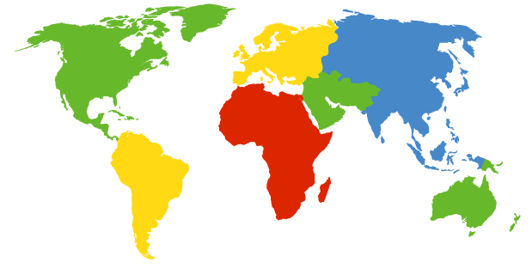
DNS Root
Located in Virginia, USA
How do we make the root scale?
Verisign, Dulles, VA

Slide 45
DNS Root Servers
13 root servers (see http://www.root-servers.org/)
Labeled A through M
How can we seamlessly scale this further?
A Verisign, Dulles, VA
C Cogent, Herndon, VA
D U Maryland College Park, MD
G US DoD Vienna, VA
H ARL Aberdeen, MD
J Verisign
K RIPE London
I Autonomica, Stockholm
E NASA Mt View, CA
F Internet Software
Consortium
Palo Alto, CA
M WIDE Tokyo
B USC-ISI Marina del Rey, CA
L ICANN Los Angeles, CA

Slide 46
Anycast
Routing finds shortest paths to destination
If several locations are given the same address, then the network will deliver the packet to the closest location with that address
This is called “anycast”
No modification of routing is needed for this….
Allows for seamless replication of resources
Any problems with this approach?

Slide 47
DNS Root Servers
13 root servers (see http://www.root-servers.org/)
Labeled A through M
Replication via any-casting (localized routing for addresses)
A Verisign, Dulles, VA
C Cogent, Herndon, VA (also Los Angeles, NY, Chicago)
D U Maryland College Park, MD
G US DoD Vienna, VA
H ARL Aberdeen, MD
J Verisign (21 locations)
K RIPE London (plus 16 other locations)
I Autonomica, Stockholm (plus 29 other locations)
E NASA Mt View, CA
F Internet Software
Consortium,
Palo Alto, CA
(and 37 other locations)
M WIDE Tokyo
plus Seoul, Paris, San Francisco
B USC-ISI Marina del Rey, CA
L ICANN Los Angeles, CA

Slide 48
Using DNS
Two components
Local DNS servers
Resolver software on hosts
Local DNS server (“default name server”)
Usually near the endhosts that use it
Local hosts configured with local server (e.g., /etc/resolv.conf) or learn server via DHCP
Client application
Obtain DNS name (e.g., from the URL)
Do gethostbyname() to trigger resolver code
Which then sends request to local DNS server

Slide 49
How Resolution Happens
root servers
local
DNS server
(mydns.berkeley.edu)
.edu servers
nyu.edu servers
DNS client (me.cs.berkeley.edu)

Slide 50
root servers
local
DNS server
(mydns.berkeley.edu)
.edu servers
nyu.edu servers
www.nyu.edu?
DNS client (me.cs.berkeley.edu)

Slide 51
root
DNS server
DNS server
(mydns.berkeley.edu)
.edu servers
nyu.edu servers
www.nyu.edu?
DNS client (me.cs.berkeley.edu)

Slide 52
root
DNS server
DNS server
(mydns.berkeley.edu)
.edu servers
nyu.edu servers
www.nyu.edu?
DNS client (me.cs.berkeley.edu)

Slide 53
recursive DNS query
root
DNS server
DNS server
(mydns.berkeley.edu)
.edu servers
www.nyu.edu?
nyu.edu servers
DNS client (me.cs.berkeley.edu)

Slide 54
root
DNS server
DNS server
(mydns.berkeley.edu)
.edu servers
nyu.edu servers
DNS client (me.cs.berkeley.edu)

Slide 55
iterative DNS query
root
DNS server
Where is .edu?
DNS server
(mydns.berkeley.edu)
Where is nyu.edu?
.edu servers
Where is www.nyu.edu?
nyu.edu servers
DNS client (me.cs.berkeley.edu)

Slide 56
DNS Protocol
Query and Reply messages
Both with the same message format
see text for details
Client-Server interaction on UDP Port 53
Spec supports TCP too, but not always implemented
Reliability via repeating requests on timeout

Slide 57
Goals
Scaling (names, users, updates, etc.)
Yes
Ease of management (uniqueness of names, etc.)
Yes
Availability and consistency
Yes
Fast lookups
??

Slide 58
This is not fast!
root
DNS server
.edu TLD
DNS server
local
DNS server
nyu.edu
DNS server
DNS client
Notes:
How can we improve performance?

Slide 59
DNS Caching
How DNS caching works
DNS servers cache responses to queries
Responses include a “time to live” (TTL) field
Server deletes cached entry after TTL expires
Why caching is effective
The top-level servers very rarely change
Popular sites visited often → local DNS server often has the information cached

Slide 60
DNS Measurements (MIT data from 2000)
What is being looked up?
~60% requests for A records
~25% for PTR records
~5% for MX records
~6% for ANY records
How long does it take?
Median ~100msec (but 90th percentile ~500msec)
80% have no referrals; 99.9% have fewer than four
Query packets per lookup: ~2.4
But this is misleading….

Slide 61
DNS Measurements (MIT data from 2000)
Does DNS give answers?
~23% of lookups fail to elicit an answer!
~13% of lookups result in NXDOMAIN (or similar)
Mostly reverse lookups
Only ~64% of queries are successful!
How come the web seems to work so well?
~ 63% of DNS packets in unanswered queries!
Failing queries are frequently retransmitted
99.9% successful queries have ≤2 requests
Notes:
Nxdomain = nonexistent domain

Slide 62
Moral of the Story
The Internet was designed to be highly resilient.
No matter what goes wrong, it tries to recover
In a highly resilient system, many things can be going wrong without you noticing it!

Slide 63
DNS Measurements (MIT data from 2000)
Top 10% of names accounted for ~70% of lookups
Caching should really help!
9% of lookups are unique
Cache hit rate can never exceed 91%
Cache hit rates ~ 75%
But caching for more than 10 hosts doesn’t add much

Slide 64
A Common Pattern…..
Distributions of various metrics (file lengths, access patterns, etc.) often have two properties:
Large fraction of total metric in the top 10%
Sizable fraction (~10%) of total fraction in low values
In an exponential distribution
Large fraction is in top 10%
But low values have very little of overall total
Lesson: in networking, have to pay attention to both ends of distribution (high peak and long tail)
Here, caching helps, but not a panacea
Notes:
Draw!!!!

Slide 65
Any Questions?

Slide 66
The Web

Slide 67

The Web – Precursor
1967, Ted Nelson, Xanadu:
A world-wide publishing network that would allow information to be stored not as separate files but as connected literature
Owners of documents would be automatically paid via electronic means for the virtual copying of their documents
Coined the term “Hypertext”
Influenced research community
Who then missed the web…..
Ted Nelson

Slide 68

The Web – History
Physicist trying to solve real problem
Distributed access to data
World Wide Web (WWW): a distributed database of “pages” linked through Hypertext Transport Protocol (HTTP)
First HTTP implementation - 1990
Tim Berners-Lee at CERN
HTTP/0.9 – 1991
Simple GET command for the Web
HTTP/1.0 –1992
Client/Server information, simple caching
HTTP/1.1 - 1996
Tim Berners-Lee

Slide 69
Why Didn’t CS Research Invent Web?
HTML is precisely what we were trying to PREVENT— ever-breaking links, links going outward only, quotes you can't follow to their origins, no version management, no rights management.
– Ted Nelson
Academics get paid for being clever,
not for being right.
–Don Norman

Slide 70
Why So Successful?
What do the web, youtube, fb have in common?
The ability to self-publish
Self-publishing that is easy, independent, free
No interest in collaborative and idealistic endeavor
People aren’t looking for Nirvana (or even Xanadu)
People also aren’t looking for technical perfection
Want to make their mark, and find something neat
Two sides of the same coin, creates synergy
“Performance” more important than dialogue….

Slide 71
Web Components
Infrastructure:
Clients
Servers
Proxies
Content:
Individual objects (files, etc.)
Web sites (coherent collection of objects)
Implementation
URL: naming content
HTTP: protocol for exchanging content

Slide 72
URL Syntax
protocol://hostname[:port]/directorypath/resource
protocol | http, ftp, https, smtp, rtsp, etc.
hostname | DNS name, IP address
port | Defaults to protocol’s standard port e.g. http: 80 https: 443
directory path | Hierarchical, reflecting file system
resource | Identifies the desired resource Can also extend to program executions: http://us.f413.mail.yahoo.com/ym/ShowLetter?box=%40B%40Bulk&MsgId=2604_1744106_29699_1123_1261_0_28917_3552_1289957100&Search=&Nhead=f&YY=31454&order=down&sort=date&pos=0&view=a&head=b

Slide 73
Web and DNS
URLs use hostnames
Thus, content names are tied to specific hosts
Why is this a problem?
Makes persistence of names problematic…

