Slide 1
Packets in Flight
CS 168 – Fall 2016 – Section 2

Slide 2
Packets in Flight
When we send packets…
... some of them get to the destination
... some don’t
... some get there fast
... some take longer
Why does this happen?

Slide 3
Packets in Flight- Delays
How long does it take for your data to reach its destination?
It depends on…
... how much data you’re sending and the link speed → transmission delay
... your distance from the destination → propagation delay
… the traffic pattern → queuing delay
… how fast routers process the packet header → processing delay
Notes:
Transmission – how long it takes computer to actually put bits onto the wire. Depends on how much data you’re sending and the link speed
Propagation – normally speed of light.
Queueing – the traffic pattern. Routers are usually receiving/sending many packets on many different connections simultaneously, and this can slow down the network.

Slide 4
Packets in Flight- Delays
How long does it take for your data to reach its destination?
It depends on…
... how much data you’re sending and the link speed → transmission delay
... your distance from the destination → propagation delay
… the traffic pattern → queuing delay
… how fast routers process the packet header → processing delay
We will ignore processing delay
Notes:
Processing – not really gonna talk about them

Slide 5
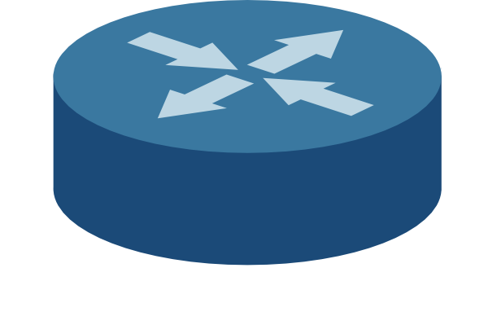

Transmission Delay
How long it takes for the all bits in the packet to get on the wire
The time between the first and last bits enter the link
Notes:
test

Slide 6
Transmission Delay
How long it takes for the all bits in the packet to get on the wire
The time between the first and last bits enter the link
Limited by the bandwidth
Longer time between first and last bits getting on the wire
Notes:
Bandwidth – how many bits you can send through a wire per second

Slide 7
Transmission Delay
How long it takes for the all bits in the packet to get on the wire
The time between the first and last bits enter the link
Limited by the bandwidth
Depends on packet size
Notes:
Transmission delay depends on packet size: the more data you have to send, the longer it’s gonna take to put that data onto the wire. You can only put so many bits onto the wire per second

Slide 8
Transmission Delay
How long it takes for the all bits in the packet to get on the wire
The time between the first and last bits enter the link
Limited by the bandwidth
Depends on packet size
Transmission delay
=
packet size (bytes)
/ bandwidth (bits/sec)
Notes:
Packet size = bytes
Bandwidth = bytes per second

Slide 9
Transmission Delay: Example
Transmission delay =
(packet size) / bandwidth
1 Mbps = 10^6 bits per second
1 ms = 10^3 seconds
Bandwidth = 4 Mbps
Packet size = 500B

Slide 10
Transmission Delay: Example
Transmission delay =
(packet size) / bandwidth
1 Mbps = 10^6 bits per second
1 ms = 10^3 seconds
Bandwidth = 4 Mbps
Packet size = 500B

Slide 11
Propagation Delay (latency)
How long it takes to transmit one bit from one end to the other
Depends on the length of the link
Limited by the speed of light (propagation speed of link)
Does NOT depend on the size of the packet
Propagation Delay
=
length of link (m)
/ speed of light (m / sec)

Slide 12
Propagation Delay: Example
Propagation Delay
=
(link length) / (link speed)
Link speed = speed of light
≈ 3 * 10^5 km/s
Link length = 6000 km

Slide 13
Propagation Delay: Example
Propagation Delay
=
(link length) / (link speed)
Link speed = speed of light
≈ 3 * 10^5 km/s
Link length = 6000 km

Slide 14
Bandwidth Delay Product (BDP)
Now that we know the propagation delay, we can tell how many bits are “in flight” (on the link) at any time
??
??
BDP = ?? * ??

Slide 15
Bandwidth Delay Product (BDP)
Now that we know the propagation delay, we can tell how many bits are “in flight” (on the link) at any time
Bandwidth
Propagation delay
BDP = Bandwidth * Propagation delay

Slide 16
Packets might have to wait before they can be transmitted…

Slide 17
Queuing Delay
How long the packet waits to get on the wire
Happens when arrival rate is greater than transmission rate
Depends on arrival rate, transmission rate, burstiness

Slide 18
Queues
http://www.ccs-labs.org/teaching/rn/animations/queue/index.htm
(emission rate is our “arrival rate”)
What happens when emission rate > transmission rate?
How does burstiness affect queuing delays?
What happens when the queue is full?

Slide 19
Queues
http://www.ccs-labs.org/teaching/rn/animations/queue/index.htm
(emission rate is our “arrival rate”)
What happens when emission rate > transmission rate?
How does burstiness affect queuing delays?
Bursty flows tend to increase queuing delay
What happens when the queue is full?
Packets are dropped

Slide 20


End-to-end Delay
Sum of all nodal delays on the path

Slide 21
Round Trip Time (RTT)
The time it for the packet to reach its destination…
… and receive a response

Slide 22
Visualizing packet delay…
Time
Transmission delay
Propagation delay

Slide 23
Visualizing end-to-end delay…
R
B
A
Time
Transmission delay
Propagation delay
Transmission delay
Propagation delay

Slide 24
Visualizing end-to-end delay…
Two packets, back-to-back
Time
Transmission delay
Propagation delay
What is this??
End-to-end delay of brown packet
Transmission delay
Propagation delay

Slide 25
Visualizing end-to-end delay…
Two packets, back-to-back
Time
Transmission delay
Propagation delay
Queuing delay
End-to-end delay of brown packet
Transmission delay
Propagation delay

