Slide 1
Distance-Vector Routing
CS 168 – Fall 2016 – Section 4

Slide 2
Agenda
Application
Transport
Network (L3)
Distance-Vector Routing
Network
Datalink
Physical

Slide 3
Distance-Vector Key Points
Scalable
Unlike link-state, routers don’t need global network topology
Distributed
Routers communicate with neighbors to compute routes
Avoids Loops
Minimizing metric is distance (or “cost,” so not necessarily physical distance)

Slide 4
Distance-Vector Routing
Each router…
Has a “vector” of distances to each dest
Also keeps track of next-hop router for each dest
Uses outgoing links to compute its initial vector
Initial State
A | B | C
0, A | 2, B | 9, C
A | B | C | D
9, A | 1, B | 0, C | 16, D
9
A
C
2
1
16
B
D
7
A | B | C | D
2, A | 0, B | 1, C | 7,D
B | C | D
7, B | 16, C | 0, D

Slide 5
Two Components of Distance-Vector
Protocol
Each router floods its vector to neighbors when helpful
Algorithm
- Upon receiving a vector from a neighbor, each router uses Bellman-Ford to update its own vector

Slide 6
Protocol
Each router advertises (floods) its vector to its neighbors…
Whenever any distance to a dest changes in its vector
- Including when it builds its initial vector
2. Periodically
- Helps with consistency among neighbors

Slide 7
Protocol Example
Since each router just built its initial vector, each of them floods its vector
Only A is shown here, but B,C,D do the same
A | B | C | D
9, A | 1, B | 0, C | 16, D
A | B | C
0, A | 2, B | 9, C
9
A
C
2
1
16
B
D
7
B | C | D
7, A | 16, B | 0, C
A | B | C | D
2, A | 0, B | 1, C | 7,D

Slide 8
Algorithm
Upon receiving a vector from its neighbor, a router…
Learns about new destinations
Uses Bellman-Ford to update its vector
for d in destinations:
minCost, nextHop = ∞, None
for n in neighbors:
c = cost of link to n
a = advertised distance from n to d
if a + c < minCost:
minCost = a + c
nextHop = n
vector[d] = (minCost, nextHop)
Flood vector if any entry changed! (part of protocol, not algorithm)

Slide 9
Distance-Vector Walkthrough
Continuing the example from earlier
Let’s consider just router A for now
All routers initially flood their vectors
A | B | C
0, A | 2, B | 9, C
A | B | C | D
9, A | 1, B | 0, C | 16, D
9
A
C
2
1
16
B
D
7
B | C | D
7, A | 16, B | 0, C
A | B | C | D
2, A | 0, B | 1, C | 7,D

Slide 10
Walkthrough
9
A
C
2
1
16
B
D
Initially, A doesn’t know either of its neighbors’
vectors
7
A’s Perspective
B’s vector
?
C’s vector
?
A’s vector
A | B | C
0, A | 2, B | 9, C
A

Slide 11
Walkthrough
9
A
C
2
1
16
B
D
A receives B’s vector
- Learns about D
Using Bellman-Ford, updates its entries for dests C and D
- Floods new vector to neighbors
7
B’s vector
A | B | C | D
2, A | 0, B | 1, C | 7,D
B’s vector
A | B | C | D
2, A | 0, B | 1, C | 7,D
C’s vector
?
C’s vector
?
A | B | C
0, A | 2, B | 9, C
A | B | C | D
0, A | 2, B | 3, B | 9, B
A’s vector
A’s vector
A
A

Slide 12
Walkthrough
9
A
C
2
1
16
B
D
7
A receives C’s vector
Using Bellman-Ford, realizes it has no updated distances
- Does not flood vector to neighbors
B’s vector
A | B | C | D
2, A | 0, B | 1, C | 7,D
B’s vector
A | B | C | D
2, A | 0, B | 1, C | 7,D
C’s vector
A | B | C | D
9, A | 1, B | 0, C | 16, D
C’s vector
A | B | C | D
9, A | 1, B | 0, C | 16, D
A | B | C | D
0, A | 2, B | 3, B | 9, B
A | B | C | D
0, A | 2, B | 3, B | 9, B
A’s vector
A’s vector
A
A

Slide 13
Walkthrough
Eventually all vectors will converge
Routers still send periodic updates to deal with network changes
A | B | C | D
0, A | 2, B | 3, B | 9,B
A | B | C | D
3, B | 1, B | 0, C | 8, B
9
A
C
2
1
16
B
D
7
A | B | C | D
9, B | 7, B | 8, B | 0,D
A | B | C | D
2, B | 0, B | 1, B | 7,B

Slide 14
Special Case 1: Poison Reverse
A realizes C is its first hop router to D, as well as to C…
A changes its distance to D and C to infinity
Sends this modified vector to C
A also realizes B is its first hop router to B
A changes its distance to B to infinity
Sends this modified vector to B
A | B | C | D
0, A | 2,B | ∞ | ∞
2
A | B | C | D
0, A | ∞ | 2,C | 4, C
A
C
2
2
B
D
D

Slide 15
Special Case 2: Split Horizon
Split horizon is the same as poison reverse, except…
In split horizon, A does not advertise its distance to D and C at all when sending its vector to C
Similarly, A does not advertise its distance to B when sending its vector to B
A | B
0,A | 2,B
A | C | D
0,A | 2,C | 4,C
2
A
C
2
2
B
D

Slide 16
Special Case 3: Route Poisoning
When a link between A and C goes down and they can no longer reach each other…
A advertises infinity for dest C, and vice versa
A also advertises infinity to D because A uses C to get to D (same with C to B)
A | B | C | D
∞ | ∞ | 0, C | 2, D
A | B | C | D
0, A | 2,B | ∞ | ∞
A
C
2
2
B
D
D

Slide 17
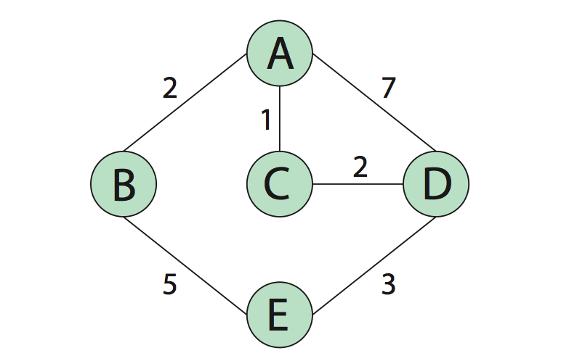
Diagram for Q1

