Slide 1
CS 168 How the Internet Works
Fall 2016
Scott Shenker
CS168.io
http://inst.eecs.berkeley.edu/~cs168/fa16/

Slide 2

Ssssshhhhhhhhhhhhhhh

Slide 3
Administrivia
Discussion sections start tomorrow
Bring your laptop!
First project out: Alice Sheng lead TA
Project OH: every weekday 4-6 (Soda 415/420)
Due in a week+. First part in section tomorrow.
Next lecture: philosophy, principles,…
Next week: routing!

Slide 4
Today’s Lecture
Overview of how the Internet works
Why packets?
Packet dynamics
Delays, queues, and all that….
This stuff is boring, ask questions earlier

Slide 5

Networks Deliver Packets
link
end-system
switch
path
packet

Slide 6
The Core Task of Internet
Delivers packets between processes (applications) on different hosts
This involves both the network and network stack
Network: Routers/switches and links
Network stack: networking SW on host
Stack replicates some router/switch functionality
Then adds some additional networking functionality…
...before handing body of packet to application
Will discuss this in next lecture

Slide 7
Packets
Packets are bags of bits with:
Header: meaningful to network (and network stack)
Can be more than one header!
Body: meaningful only to application
Body can be bits in a file, image, whatever
What information goes in a header?
Header
Body
Used By Network
Used By App

Slide 8
Packets Must Be Sent Along Path
link
end-system
switch
path
packet

Slide 9
What Must Header Contain For This?
Packet must describe where it should be sent
Requires an address for the destination host
That’s the only way a router/switch can know what to do with the packet

Slide 10
Names vs Addresses
Network address: where host is located
Network name: which host it is
When you move server to new building
Name doesn’t change
But address does
Same thing with your own name and address!
Let’s get back to packet delivery….

Slide 11
Packets Must Be Sent Along Path
link
end-system
switch
path
packet

Slide 12
Fundamental Challenge #1
Route packets through network to destination
Given destination address, how does each switch/router forward packets so that packet reaches destination?
When a packet arrives at a router, the routing table determines which outgoing link the packet is sent on
Outgoing link is often referred to as a port
The word port has two meanings in this lecture

Slide 13
Two Meanings of “Port”
Switches/routers have physical ports:
Places where links connect to switches
Network stacks have logical ports:
Logical places where applications connect to stack
More about this later in lecture, and in section
Back to routing tables…
Where do they come from?

Slide 14
Routing Protocols (Conceptually)
Distributed algorithm run between routers
Gather information about the network topology
Compute paths through that topology
Store forwarding information in each router:
If packet is destined for X, send out this port
If packet is destined for Y, send out that port
…
We call this a routing table

Slide 15
Control Plane vs Data Plane
Control plane: mechanisms used to compute routing tables (and other forwarding information)
Inherently global: must know topology to compute
Routing algorithm is part of the control plane
Time scale: per network event
Data plane: using those tables to actually forward packets
Inherently local: depends only on arriving packet and local routing table
Forwarding mechanism is part of data plane
Time scale: per packet arrival

Slide 16
Fundamental Challenge #2
How do you deliver packets reliably?
Packets can be dropped along the way
Buffers in router can overflow
Routers can crash while buffering packets
Links can garble packets
How do you make sure packets arrive safely on an unreliable network?
Or at least know if they are not delivered….
Want no false positives, and high chance of success

Slide 17
Two Questions about Reliability
Who is responsible for this? (architecture)
Network?
Host?
How is it implemented? (engineering)
We will consider both perspectives….

Slide 18
Other Important Challenges
Routing with autonomous control
Internet is comprised of many different ISPs
More generally called Autonomous Systems (ASes)
They each get to make their own decisions about how to do routing
How can you make sure that these independent decisions result in usable end-to-end routes?
Congestion control
Hosts on the Internet independently decide at what rate they will send packets
How can you make sure that these independent decisions don’t overload various links?

Slide 19
What Have We Missed?
Consider when you access a web page
Insert URL into browser (e.g., cnn.com)
Packets sent to web site (reliably)
Packets reach application on destination host
How do you get to the web site?
URL is user-level name (e.g., cnn.com)
Network needs address (e.g., where is cnn.com?)
Must map names to addresses….

Slide 20
Mapping Names to Addresses
On the Internet, we only name hosts (sort of)
URLs are based on the name of the host containing the content (i.e., cnn.com names a host)
Before you can send packets to cnn.com, you must resolve names into the host’s address
Done by the Domain Name System (DNS)

Slide 21
Finishing Our Story
We now have the address of the web site
So we can send packets to host
Are we done?
When a packet arrives at a host, what does the host do with it?
To which process (app) should the packet be sent?
If the packet header only has the destination address, how does the host know where to deliver packet?

Slide 22
Of Sockets and Ports
When a process wants access to the network, it opens a socket, which is associated with a port
This is not a physical port, just a logical one
Socket: an OS mechanism that connects processes to the networking stack
Port: number that identifies that particular socket
The port number is used by the OS to direct incoming packets

Slide 23
Implications for Packet Header
Packer header includes:
Destination address and port
Source address and port
When a packet arrives, packet is delivered to socket associated with the destination port
Why include the source port/address?
Details about sockets in section (tomorrow!)

Slide 24
Separation of Concerns
Network
Deliver packets from host to host (based on address)
Network Stack (OS)
Deliver packets to appropriate socket (based on port)
Applications
Send and receive packets
Understand content of packet bodies
Secret of the Internet’s success is getting these and other abstractions right…

Slide 25
Review of Important Issues
Routing
Reliable transport
Routing with autonomous control
Congestion control
Mapping names to addresses

Slide 26
What Else Are We Missing?
How do hosts get their addresses?
DHCP
What else happens to packets on path?
Middleboxes
What about security?
Names play a central role. Why?
What about specialized networks?
Wireless, Datacenters, Ethernets (L2)
Notes:
This completes the list of topics we will cover…

Slide 27
Why Packets?

Slide 28
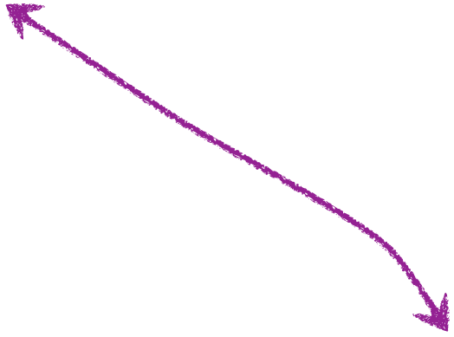
Links/Switches are Shared
shared link and switch resources

Slide 29
Two approaches to sharing
Reservations:
“Flows” reserve bandwidth needed in advance
Must reserve their peak bandwidth
On demand: (also known as “best effort”)
Send packets when you have them
Hope for the best….

Slide 30
Example of Statistical Multiplexing
Statistical multiplexing: Combining demands to share resources efficiently
Long history in computer science
Processes on an OS
Cloud computing
Based on the premise that:
Peak of aggregate load is << aggregate of peak loads
In fact peak of agg. approaches sum of average loads
Therefore, it is better to share resources than to strictly partition them….

Slide 31
Two Design Choices
Both embody statistical multiplexing
Reservation: sharing at flow level
Resources shared between flows currently in system
On-demand: sharing at packet level
Resources shared between packets currently in system

Slide 32
Two approaches to sharing
Reservations
On demand
How are these implemented?

Slide 33
Two approaches to sharing
Reservations → circuit switching
Set up a “circuit”, no need to look at individual packet headers in detail
On demand → packet switching
Service each packet independently by inspecting its packet header
How are these implemented?

Slide 34
Circuit Switching
dst
10Mb/s?
src
✔
10Mb/s?
✔
10Mb/s?
✔
(1) src sends a reservation request for 10Mbps to dst
(2) Switches “establish a circuit”
(3) src starts sending data
(4) src sends a “teardown circuit” message

Slide 35
Circuit Switching
switch
src
dst
Reservation also establishes a “circuit” within a switch

Slide 36
Many kinds of “circuits”
Time division multiplexing
divide time in time slots
separate time slot per circuit
Frequency division multiplexing
divide frequency spectrum in frequency bands
separate frequency band per circuit
time
frequency
time

Slide 37

Circuit Switching and Failures
Circuit is established
Link Fails along path
Must establish new circuit
A
B
Circuit switching doesn’t “route around trouble”

Slide 38
Packet switching
switch
dst
Each packet contains destination (dst)
Each packet treated independently

Slide 39
Packet switching
switch
dst
Each packet contains destination (dst)
Each packet treated independently
With buffers to absorb transient overloads

Slide 40
Packet Switching and Failures
Link Fails along path
Route recomputed on the fly
A
B
Packet switching “routes around trouble”

Slide 41
Which is better: Circuits or Packets?
What are the tradeoffs?
Which is better for the Internet?

Slide 42
Example: three constant sources
Total bandwidth 30Mbps
Mbps = megabits per second
Demands: Each source needs a constant rate of 10Mbps
Reservation and on-demand give same result
Every source gets what they need
No wasted bandwidth
….

Slide 43
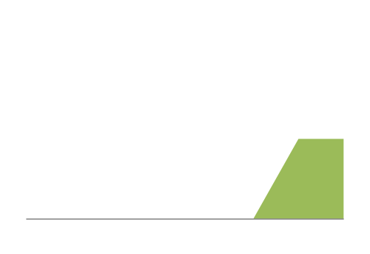
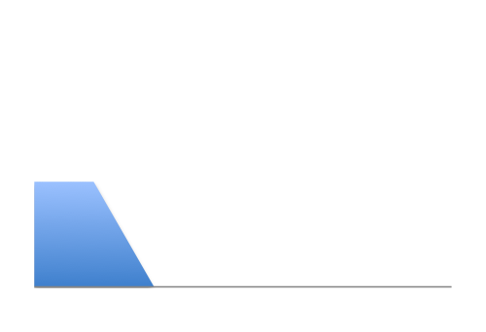
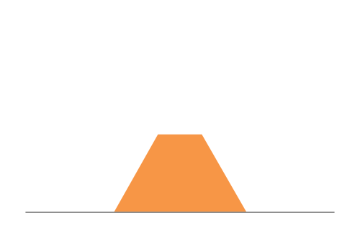
Example: Three “bursty” sources
12Mbps
Link capacity = 30Mbps
11Mbps
13Mbps
Time

Slide 44
What happens with reservations?
Option #1: allow two flows to reserve peak rate
Must turn away third flow!
12Mbps
Link capacity = 30Mbps
11Mbps
13Mbps
Time

Slide 45
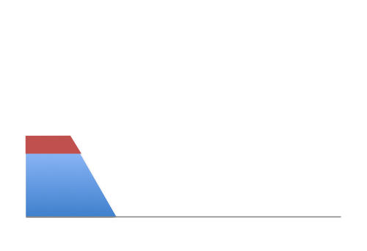
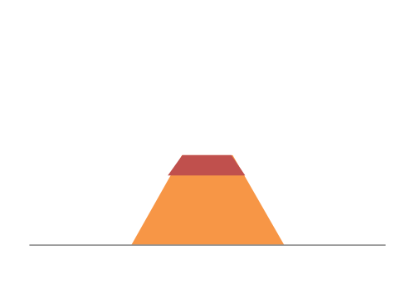
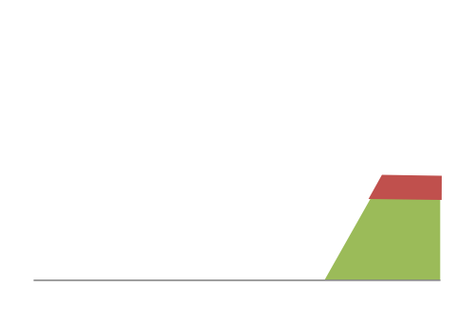
What happens with reservations?
Option #2: allow flows to reserve equal rates
Frequent overloading!
12Mbps
Link capacity = 30Mbps
11Mbps
Each source gets 10Mbps
13Mbps
Time

Slide 46
What happens with on-demand?
No overloading
Link capacity = 30Mbps
Time

Slide 47
Peak vs Average Rates
For each flow, define:
P = peak rate
A = average rate
Reservations must reserve P:
But flows only use A (on average)
Level of utilization is A/P
On-demand:
Can achieve higher utilizations
Depends on degree of sharing, burstiness of flows
Peak of aggregate approaches sum of averages

Slide 48
Smooth vs Bursty Applications
Some apps have relatively small P/A ratios
Voice might have a ratio of 3:1 or so
Data applications tend to be rather bursty
Ratios of 100 or greater are common
That’s why the phone network used reservations
And the Internet does not….
More in next lecture (not as obvious as it may seem)

Slide 49
Packet Delays

Slide 50
Performance Metrics
Delay
Loss
Throughput

Slide 51
Delay
How long does it take to send a packet from its source to destination?

Slide 52
Loss
What fraction of the packets sent to a destination are dropped?

Slide 53
Throughput
At what rate is the destination receiving data from the source?

Slide 54
Today
Focus on delay
Loss and throughput will become relevant in later lectures….

Slide 55
A network link
Link bandwidth
Number of bits sent per unit time (bits/sec or bps)
Propagation delay (sometimes called latency)
Time for one bit to move through the link (seconds)
Bandwidth-Delay Product (BDP)
Number of bits “in flight” at any time (sent, not recvd)
BDP = bandwidth × propagation delay
bandwidth
delay x bandwidth
Propagation delay

Slide 56
Examples of BDP
Same city over a slow link:
bandwidth: ~100Mbps
propagation delay: ~0.1msec
BDP: 10,000bits (1.25KBytes)
Between cities over fast link:
bandwidth: ~10Gbps
propagation delay: ~10msec
BDP: 10⁸bits (12.5MBytes)

Slide 57
Delay
Consists of four components
Transmission delay
Propagation delay
Processing delay
Queueing delay
First consider transmission, propagation delays
Then queueing delays
Ignore processing delays (tiny in most cases)
due to link properties
due to traffic mix and
switch internals

Slide 58
End-to-end delay
transmission
propagation
queuing
processing
transmission
propagation
queuing
processing
transmission
propagation

Slide 59
Transmission Delay
Q: How long does it take to push all the bits of a packet into a link?
A: Packet size / Transmission rate of the link
Example: Packet = 1kb, Rate = 100Mbps
1000 bits / 100 Mbits per sec = 10⁻⁵ sec = 10μsec

Slide 60
Propagation Delay
Q: How long does it take to move one bit from one end of a link to the other?
A: Link length / Propagation speed of link
Propagation speed ~ some fraction of speed of light
Example: Length = 30 kilometers
30 kilometers/3x10⁸ meters per sec = 10⁻⁴ sec = 100μsec

Slide 61
Now ask a more practical question
Q: How long does it take for a packet to travel from A to B?
A: The delay combines both transmission and propagation delays
Perhaps also queueing, but ignore those for now

Slide 62
Example: 100B packet from A to B
A
B
1Mbps, 1ms
100Byte packet
time=0
Time to transmit one bit = 1/10⁶s
Time when that bit reaches B = 1/10⁶+1/10³s
Time to transmit 800 bits=800x1/10⁶s
The last bit reaches B at
(800x1/10⁶)+1/10³s
= 1.8ms
This is exactly
transmission
plus propogation
delays!
Time

Slide 63
Example: 100B packet from A to B
1GB file in 100B packets
1Gbps, 1ms?
A
B
1Mbps, 1ms
100Byte packet
10⁷ x 100B packets
The last bit in the file reaches B at
(10⁷x800x1/10⁹)+1/10³s
= 8001ms
The last bit reaches B at
(800x1/10⁹)+1/10³s
= 1.0008ms
The last bit reaches B at
(800x1/10⁶)+1/10³s
= 1.8ms
Time

Slide 64
Three cases with 1msec prop. delay
1GB file, 1Gbps link: transmission time dominant
100B packet, 1Gbps link: propagation delay dominant
100B packet, 1Mbps link: transmission ~ propagation
Network design might differ based on which dominates
But in the Internet, can’t know in advance!

Slide 65
Technology Trends
Propagation delay?
No change
Transmission delay?
Getting smaller!
Queueing delay?
Usually smaller
How does this affect applications?
CDNs work very hard to move data near clients
Reduces backbone bandwidth requirements
But also decreases latency
Google: time is money!

Slide 66
What Trend Did I Leave Out?
The dominance of video
Very high fraction of traffic is video
Files getting larger
But also many, many small flows…
Crucial aspect of Internet traffic:
Most flows are tiny
Most bytes in large flows
Can’t only design for either end of the spectrum

Slide 67
Another way of visualizing packets and their delays

Slide 68
The “pipe” view
A
B
100Byte packet
1Mbps, 10ms
pkt tx time
100Byte packet
100Byte packet
BW →
time →
Time

Slide 69
The “pipe” view
1Mbps, 10ms (BDP=10,000)
BW →
time →
1Mbps, 5ms (BDP=5,000)
10Mbps, 1ms (BDP=10,000)
BW →
BW →
time →
time →

Slide 70
The “pipe” view
1Mbps, 10ms (BDP=10,000)
BW →
100b packets
time →
1Mbps, 10ms (BDP=10,000)
250b packets
BW →
time →

Slide 71
Queueing and Packet Dynamics

Slide 72
Queueing delay: “pipe” view

Slide 73
Queueing delay: “pipe” view
No overload!

Slide 74
Queueing delay: “pipe” view
Queue
Transient Overload
Not a rare event!

Slide 75
Queueing delay: “pipe” view
Queue
Transient Overload
Not a rare event!

Slide 76
Queueing delay: “pipe” view
Queue
Transient Overload
Not a rare event!

Slide 77
Queueing delay: “pipe” view
Queue
Transient Overload
Not a rare event!

Slide 78
Queueing delay: “pipe” view
Queue
Transient Overload
Not a rare event!

Slide 79
Queueing delay: “pipe” view
Queue
Transient Overload
Queues absorb transient bursts but introduce queueing delay
Not a rare event!

Slide 80
Queueing delay: “pipe” view
What about persistent overload?
Will eventually drop packets (“loss”)

Slide 81
More packet animations….

Slide 82
The Lifecycle of Packets
Packet Currently
Being Transmitted
Link
Packet Buffer
Packet Arriving
at Switch
Packet
Being
Transmitted
Excess Packets
Stored in Buffer

Slide 83
The Delays of Their Lives
Transmission
Delay
Queueing
Delay
Round-Trip Time (RTT) is the time it takes
a packet to reach the destination and
the response to return to the sender
Propagation Delay is how long it takes
to reach the next switch after transmission

Slide 84
Smooth Arrivals = No Queueing Delays

Slide 85
Bursty Arrivals = Queueing Delays
There is substantial queueing delay even though link is underutilized

Slide 86
Packet Losses: Buffers Full

Slide 87
Packet Losses: Corruption

Slide 88
Queueing Delay
How long does a packet have to sit in a buffer before it is processed?
Depends on traffic pattern
Arrival rate at the queue
Nature of arriving traffic (bursty or not?)
Transmission rate of outgoing link

Slide 89
Average queuing delay
arrival rate / departure rate
1
Notes:
This plot shows the average queuing delay experienced by a packet arriving at a buffer,
as a function of this entity here, which is the arrival rate divided by the departure rate.
As this entity approaches 1 (the arrival rate approaches the departure rate),
the average delay goes to infinity.
The important thing to note about this curve is the shape.
When we approach close to this area here, the curve goes up very fast.
This means that small changes in arrival rate can have a dramatic impact on delay.
This is what happens when you are driving in a congested highway.
The smallest disturbance (like one car braking) can significantly increase your delay.
When you design a queuing system, you want it to operate far from that point.

Slide 90
Basic Queueing Terminology
Arrival process: how packets arrive
Average rate A
Peak rate P
W: average time packets wait in the queue
W for “waiting time”
L: average number of packets waiting in the queue
L for “length of queue”

Slide 91
Little’s Law (1961)
L = A x W
Compute L: count packets in queue every second
How often does a single packet get counted? W times
Why do you care?
Easy to compute L and A, harder to compute W
Congratulations, you now know all the queueing theory you ever need to know!

Slide 92
Thursday’s lecture….
Layering, principles, the “good stuff”
Read K&R 1.4-1.8 (mostly for context)

