Slide 1
CS 168 More Congestion Control
Fall 2016
Scott Shenker
CS168.io
http://inst.eecs.berkeley.edu/~cs168/fa16/

Slide 2

Ssssshhhhhhhhhhhhhhh

Slide 3
Announcements
Only 126 students have recorded participation
If you don’t participate, you will fail
Project 3 out
Homework 4 next week

Slide 4
And Now, Kay Ousterhout!

Slide 5
Why AIMD?
In what follows refer to cwnd in units of MSS

Slide 6
Reality Of Congestion Control
1Gbps
1Gbps
600Mbps
Congestion control is a resource allocation problem involving many flows, many links, and complicated global dynamics

Slide 7
Problem is too complicated….
Goal:
Avoid overloading links, but don’t waste bandwidth
Must do so in the presence of
Many competing flows
Dynamic conditions (flows arriving, leaving)
Complicated topology
Limited visibility
How do you think about such a problem?

Slide 8
Modularity is not just for design….
It is a lesson in how to think!
Break problems into subproblems
Gain insight into the subproblems,
And hope that union solves real problem

Slide 9
Three Congestion Control Challenges
Single flow adjusting to bottleneck bandwidth
Without any a priori knowledge
Could be a Gbps link; could be a modem
Single flow adjusting to variations in bandwidth
When bandwidth decreases, must lower sending rate
When bandwidth increases, must increase sending rate
Multiple flows sharing the bandwidth
Must avoid overloading network
And share bandwidth “fairly” among the flows

Slide 10
Problem #1: Single Flow, Fixed BW
Slow start is pretty good at this….
Identifies fixed BW within factor of two
And does so in logarithmic time
...no need to discuss further

Slide 11
Problem #2: Single Flow, Varying BW
Want to track available bandwidth
Oscillate around its current value
If you never send more than your current rate, you won’t know if more bandwidth is available
Possible variations: (in terms of change per RTT)
Multiplicative increase or decrease:
cwnd → cwnd * / a
Additive increase or decrease:
cwnd → cwnd +- b

Slide 12
Four alternatives
AIAD: gentle increase, gentle decrease
AIMD: gentle increase, drastic decrease
MIAD: drastic increase, gentle decrease
too many losses: eliminate
MIMD: drastic increase and decrease
Notes:
What do you think about these options?
Which one is obviously bad?
What do you think about the other ones?

Slide 13
Problem #3: Multiple Flows
Want steady state to be “fair”
Many notions of fairness, but here just require two identical flows to end up with the same bandwidth
This eliminates MIMD and AIAD
As we shall see…
AIMD is the only remaining solution!
Not really, but close enough….

Slide 14
Buffer and Window Dynamics
A
B
x
C = 50 pkts/RTT
No congestion → x increases
Congestion → x decreases

Slide 15
Simple Model of Congestion Control
Two users
rates x₁ and x₂
Congestion when x₁+x₂ > 1
Unused capacity when x₁+x₂ < 1
Fair when x₁ =x₂
1
Efficiency line (x₁+x₂ = 1)
Fairness line (x₁ =x₂)
User 2’s rate (x₂)
congested →
← inefficient
User 1’s rate (x₁)
1

Slide 16
Example
1
fairness
line
Efficient: x₁+x₂=1
Fair
Congested: x₁+x₂=1.2
(0.7, 0.5)
User 2: x₂
(0.2, 0.5)
(0.5, 0.5)
congested →
Inefficient: x₁+x₂=0.7
(0.7, 0.3)
← inefficient
Efficient: x₁+x₂=1
Not fair
efficiency
line
User 1: x₁
1

Slide 17
AIAD
Increase: x + a_{I}
Decrease: x - a_{D}
Does not converge to fairness
fairness
line
(x₁-a_{D}+a_{I}), x₂-a_{D}+a_{I}))
(x₁,x₂)
User 2: x₂
(x₁-a_{D},x₂-a_{D})
congested →
← inefficient
efficiency
line
User 1: x₁

Slide 18
AIAD Sharing Dynamics
x₁
A
B
x₂
D
E

Slide 19
AIAD Sequence of Values
X1 = 1, X2 = 3, capacity can handle total = 5
Increase: add 2 Decrease: subtract 1
First window successful:
X1 → 3, X2 → 5
Second window has drops:
X1 → 2, X2 → 4
Third window has drops:
X1 → 1, X2 → 3
…

Slide 20
MIMD
Increase: x*b_{I}
Decrease: x*b_{D}
Does not converge to fairness
fairness
line
(x₁,x₂)
(b_{I}b_{D}x₁, b_{I}b_{D}x₂)
User 2: x₂
(b_{d}x₁,b_{d}x₂)
congested →
← inefficient
efficiency
line
User 1: x₁

Slide 21
MIMD Sharing Dynamics
x₁
A
B
x₂
D
E

Slide 22
AIMD
Increase: x+a_{I}
Decrease: x*b_{D}
Converges to fairness
fairness
line
(x₁,x₂)
(b_{D}x₁+a_{I}, b_{D}x₂+a_{I})
User 2: x₂
(b_{D}x₁,b_{D}x₂)
congested →
← inefficient
efficiency
line
User 1: x₁

Slide 23
AIMD Sharing Dynamics
x₁
A
B
x₂
50 pkts/sec
D
E
Rates equalize → fair share

Slide 24
Is MIAD Fair?
X1 = 1, X2 = 3, capacity can handle total = 5
Increase: x2 Decrease: subtract 1
First window successful:
X1 → 2, X2 → 6
Second window has drops:
X1 → 1, X2 → 5
Third window has drops:
X1 → 0, X2 → 4
Fourth window successful:
X1 → 0, X2 → 8
X1 pegged at 0! MIAD maximally unfair

Slide 25
Answer to Why AIMD?
AIMD is only reasonable choice that is “fair”
Out of the four options
AIAD, MIMD: not fair
MIAD: too much congestion, and maximally unfair
AIMD: fair and reasonable congestion

Slide 26
Any Questions?

Slide 27
TCP Congestion Control Details
In what follows refer to cwnd in units of MSS

Slide 28
Implementation
State at sender
CWND (initialized to a small constant)
ssthresh (initialized to a large constant)
dupACKcount
[timer, as before]
Events at sender
ACK (new data)
dupACK (duplicate ACK for old data)
Timeout
What about receiver? Just send ACKs upon arrival

Slide 29
Event: ACK (new data)
If CWND ≤ ssthresh
CWND += 1
CWND packets per RTT
Hence after one RTT with no drops: CWND = 2xCWND

Slide 30
Event: ACK (new data)
If CWND ≤ ssthresh
CWND += 1
Else
CWND = CWND + 1/CWND
Slow start phase
“Congestion Avoidance” phase (additive increase)
CWND packets per RTT
Hence after one RTT with no drops: CWND = CWND + 1

Slide 31
Event: TimeOut
On Timeout
ssthresh ← CWND/2
CWND ← 1

Slide 32
Event: dupACK
dupACKcount ++
If dupACKcount = 3 /* fast retransmit */
ssthresh = CWND/2
CWND = CWND/2
Remains in congestion
avoidance after fast retransmission…

Slide 33
Time Diagram
Window
Timeout
SSThresh
Set to Here
Fast Retransmission
Slow start in operation until it reaches half of previous CWND, I.e., SSTHRESH
t
Slow-start restart: Go back to CWND of 1 MSS, but take advantage of knowing the previous value of CWND.
Notes:
ASK!

Slide 34
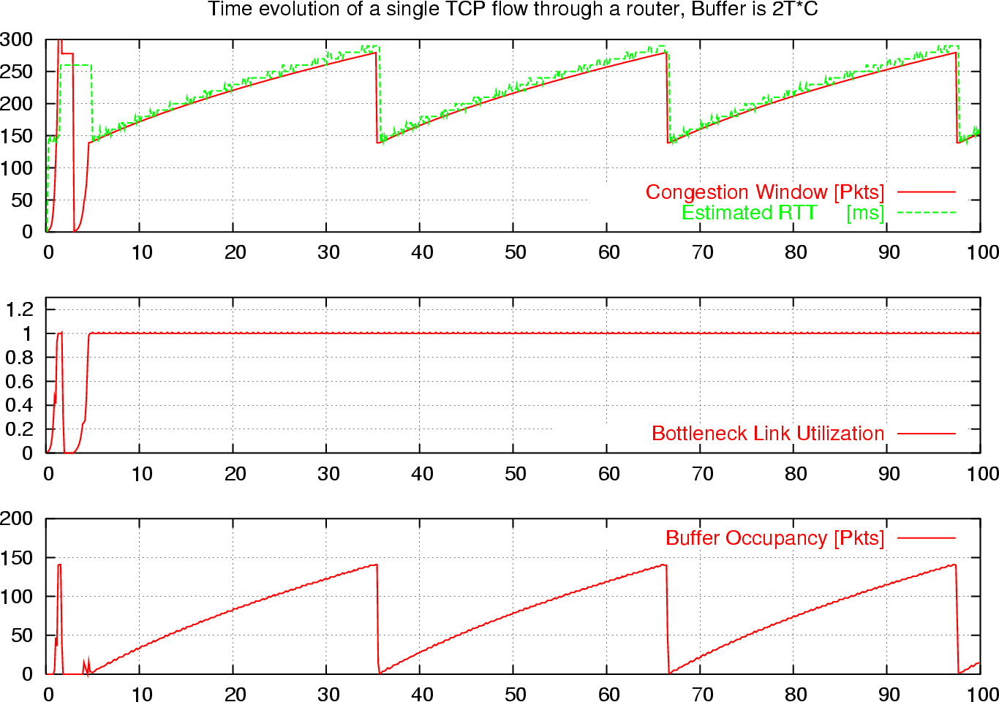
What is really looks like…
Notes:
Why?????

Slide 35
Components of TCP
Slow-Start: ramp up quickly
Congestion Avoidance: probe bandwidth gently
AIMD
Tractable version:
CWND ← FLOOR[CWND/2] on loss
CWND ← CWND+1/FLOOR[CWND]

Slide 36
One Final Phase: Fast Recovery
The problem: congestion avoidance too slow in recovering from an isolated loss
This last feature improves performance, but is not conceptually important

Slide 37
Example
Consider a TCP connection with:
CWND=10 packets
Last ACK was for packet # 101
i.e., receiver expecting next packet to have seq. no. 101
10 packets [101, 102, 103,…, 110] are in flight
Packet 101 is dropped
What ACKs do they generate?
And how does the sender respond?

Slide 38
Timeline
ACK 101 (due to 102) cwnd=10 dupACK#1 (no xmit)
ACK 101 (due to 103) cwnd=10 dupACK#2 (no xmit)
ACK 101 (due to 104) cwnd=10 dupACK#3 (no xmit)
RETRANSMIT 101 ssthresh=5 cwnd= 5
ACK 101 (due to 105) cwnd=5 (no xmit)
ACK 101 (due to 106) cwnd=5 (no xmit)
ACK 101 (due to 107) cwnd=5 (no xmit)
ACK 101 (due to 108) cwnd=5 (no xmit)
ACK 101 (due to 109) cwnd=5 (no xmit)
ACK 101 (due to 110) cwnd=5 (no xmit)
ACK 111 (due to 101) ⬅ only now can we transmit new packets
Plus no packets in flight so no ACKs for another RTT
Note that you do not
restart dupACK counter
on same packet!

Slide 39
Solution: Fast Recovery
Idea: Grant the sender temporary “credit” for each dupACK so as to keep packets in flight (each ACK due to arriving pkt)
If dupACKcount = 3
ssthresh = cwnd/2
cwnd = ssthresh + 3
While in fast recovery
cwnd = cwnd + 1 for each additional duplicate ACK
Exit fast recovery after receiving new ACK
set cwnd = ssthresh (which had been set to cwnd/2 after loss)

Slide 40
Example
Consider a TCP connection with:
CWND=10 packets
Last ACK was for packet # 101
i.e., receiver expecting next packet to have seq. no. 101
10 packets [101, 102, 103,…, 110] are in flight
Packet 101 is dropped

Slide 41
Timeline
ACK 101 (due to 102) cwnd=10 dup#1
ACK 101 (due to 103) cwnd=10 dup#2
ACK 101 (due to 104) cwnd=10 dup#3
REXMIT 101 ssthresh=5 cwnd= 8 (5+3)
ACK 101 (due to 105) cwnd= 9 (no xmit)
ACK 101 (due to 106) cwnd=10 (no xmit)
ACK 101 (due to 107) cwnd=11 (xmit 111)
ACK 101 (due to 108) cwnd=12 (xmit 112)
ACK 101 (due to 109) cwnd=13 (xmit 113)
ACK 101 (due to 110) cwnd=14 (xmit 114)
ACK 111 (due to 101) cwnd = 5 (xmit 115) ⬅ exiting fast recovery
Packets 111-114 already in flight (and now sending 115)
ACK 112 (due to 111) cwnd = 5 + 1/5 ← back in congestion avoidance

