Slide 1
CS 168 Even More Congestion Control
Fall 2016
Scott Shenker
CS168.io
http://inst.eecs.berkeley.edu/~cs168/fa16/

Slide 2

Ssssshhhhhhhhhhhhhhh

Slide 3
TCP “Phases”
Slow-start
Enter on timeout
Leave when CWND > sshresh (to Cong. Avoid.)
The > only applies here….
Congestion Avoidance
Leave when timeout
Fast Recovery
Enter when dupACK=3
Leave when New ACK or Timeout

Slide 4
TCP State Machine
timeout
slow start
congstn. avoid.
new ACK
dupACK
cwnd > ssthresh
timeout
dupACK
new ACK
timeout
new ACK
dupACK=3
dupACK=3
fast recovery
dupACK

Slide 5
TCP State Machine
timeout
slow start
congstn. avoid.
new ACK
dupACK
cwnd > ssthresh
timeout
dupACK
new ACK
timeout
new ACK
dupACK=3
dupACK=3
fast recovery
dupACK

Slide 6
TCP State Machine
timeout
slow start
congstn. avoid.
new ACK
dupACK
cwnd > ssthresh
timeout
dupACK
new ACK
timeout
new ACK
dupACK=3
dupACK=3
fast recovery
dupACK

Slide 7
TCP State Machine
timeout
slow start
congstn. avoid.
new ACK
dupACK
cwnd > ssthresh
timeout
dupACK
new ACK
timeout
new ACK
dupACK=3
dupACK=3
fast recovery
dupACK

Slide 8
Comment from last time
You leave Slow-Start only when CWND > ssthresh
But you remain in congestion avoidance even when CWND = ssthresh

Slide 9
TCP Flavors
TCP-Tahoe
CWND =1 on triple dupACK
TCP-Reno
CWND =1 on timeout
CWND = CWND/2 on triple dupack
TCP-newReno
TCP-Reno + improved fast recovery
TCP-SACK
incorporates selective acknowledgements
Our default assumption

Slide 10
Interoperability
How can all these algorithms coexist? Don’t we need a single, uniform standard?
What happens if I’m using Reno and you are using Tahoe, and we try to communicate?
What happens if I’m using Tahoe and you are using SACK?

Slide 11
Any Questions?

Slide 12
TCP Throughput Equation

Slide 13
A Simple Model for TCP Throughput
cwnd
Loss
½ W_{max} RTTs between drops
A
Avg. ¾ W_{max} packets per RTTs
1
time
RTT

Slide 14
A Simple Model for TCP Throughput
cwnd
Loss
½ W_{max} RTTs between drops
A
Avg. ¾ W_{max} packets per RTTs
time

Slide 15
Why Care About TCP Eqtn?
It tells you about the asymptotic behavior of TCP
At low drop rates (or high speeds)
You can use it (and similar eqtns) to see how design changes impact asymptotic behavior
Does changing additive constant change power law?
Does changing multiplicative constant change power law?
What would change the power law?

Slide 16
A Critical Analysis of TCP

Slide 17
The Many Failings of TCP CC
Cumulative ACKs are stupid
Fills up queues (large delays)
Depends on losses (noncongestive losses)
Does not scale to high-speed
Produces irregular saw-tooth behavior
Depends on RTT (unfair)
Takes a long time to reach steady state
Easy to cheat
Relies on homogeneity for performance/fairness

Slide 18
(1) Cumulative ACK Stupidity
When we have cumulative ACKs, we must:
Guess which data has arrived
Play games with CWND to send additional packets
TCP SACK:
Selective Acknowledgements
Think: complete listing of all received packets
Would remove need for “fast recovery”
Could design very simple CC algorithm
Just slow-start, congestion avoidance, fast-retransmit
Much more robust to drops (almost never time out)

Slide 19
(2) TCP fills up queues
TCP only slows down when queues fill up
Means that delays are large for everyone
And many packets are dropped when buffer fills
Not always, but it does tend to increase packet drops
Alternative: Random Early Drop (LBL)
Drop packets on purpose before queue is full
This was a very clever idea….

Slide 20
Random Early Drop (or Detection)
Measure avg queue size A with exp. weighting
Allows short bursts of packets without over-reacting
Drop probability is a function of A
No drops if A is very small
Low drop rate for moderate A’s
Drop everything if A is too big
Drop probability applied to incoming packets
Intuition: link is fully utilized well before buffer is full

Slide 21
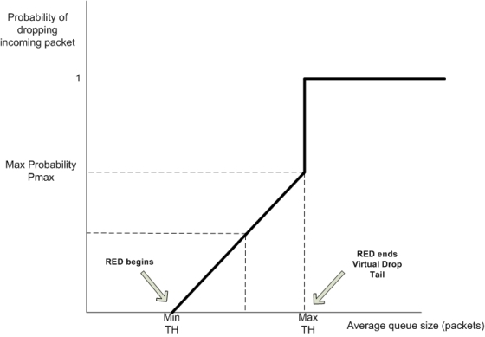
RED Dropping Probability

Slide 22
Advantages of RED
Keeps queues smaller, while allowing bursts
Just using small buffers in routers can’t do the latter
Reduces synchronization between flows
Not all flows are dropping packets at once
Increases/decreases are more gentle
Now being used to reduce buffer-bloat
“buffer-bloat”: experiencing large delays
Try uploading large file from home…
Notes:
…

Slide 23
Why Isn’t RED Fair?
RED gives all flows roughly the same drop rate
The TCP equation gives the following
Resulting throughputs depend on RTT…

Slide 24
History of RED
RED proposed (Floyd and Jacobson)
Huge support from research community
Operators find it hard to configure, see few advantages
Adaptive RED (Floyd)
Self-configuring version of RED. Largely ignored.
CoDel (Nichols and Jacobson)
Cleaner self-configuring version of RED.
Lots of press (bufferbloat)
Implementors adopt FQ-CoDel
Karma’s a bitch!

Slide 25
(3) Non-congestion-related Losses?
Can use Explicit Congestion Notification (ECN)
Bit in IP packet header (actually two)
TCP receiver returns this bit in ACK
When RED router would drop, it sets bit instead
Congestion semantics of bit exactly like that of drop
Advantages:
Doesn’t confuse corruption with congestion
Doesn’t confuse recovery with rate adjustment

Slide 26
(4) Does AIMD work at high speed?
Throughput = (MSS/RTT) sqrt(3/2p)
Assume that RTT = 100ms, MSS=1500bytes
What value of p is required to go 100Gbps?
Roughly 2 x 10⁻¹²
How long between drops?
Roughly 16.6 hours
How much data has been sent in this time?
Roughly 6 petabits
These are not practical numbers!

Slide 27
Adapting TCP to High Speed
One approach:
Let AIMD “constants” depend on CWND
At very high speeds,
Increase CWND by more than MSS in a RTT
Decrease CWND by less than ½ after a loss
We will discuss other approaches later…

Slide 28
High-Speed TCP Proposal (Floyd)
Bandwidth | AvgCwnd (pkts) | Increase a(w) | Decrease b(w)
1.5 Mbps | 12.5 | 1 | 0.50
10 Mbps | 83 | 1 | 0.50
100 Mbps | 833 | 6 | 0.35
1 Gbps | 8333 | 26 | 0.22
10 Gbps | 83333 | 70 | 0.10

Slide 29
High-Speed TCP

Slide 30
This changes the TCP Equation
Throughput ~ p^{-.8} (rather than p^{-.5})
Packet drops every tens of seconds
To achieve high throughput:
Don’t need such a tiny drop rate…
Can ramp up more quickly
How can this coexist with normal TCP?
Only invoke new parameters at large window sizes
Competes fairly with normal TCP at normal speeds

Slide 31
(5) Sawtooth Behavior Uneven
TCP throughput is “choppy”
Repeated swings between W/2 to W
Some apps would prefer sending at a steady rate
e.g., streaming apps
A solution: “Equation-Based Congestion Control”
Ditch TCP’s increase/decrease rules and just follow the equation
Measure drop percentage p, and set rate accordingly
Following the TCP equation ensures we’re “TCP friendly”
i.e., use no more than TCP does in similar setting

Slide 32
These Problems Are All Solved
With published and often standardized solutions
TCP-SACK
RED (and its many variants)
ECN
High-Speed TCP
Equation-based congestion control (EBCC)
Datagram congestion control protocol (DCCP)
Some widely used, others not….

Slide 33
Any Questions?

Slide 34
(6) Bias Against Long RTTs
Flows get throughput inversely proportional to RTT
TCP unfair in the face of heterogeneous RTTs!
A1
B1
100ms
200ms
A2
bottleneck
link
B2

Slide 35
Possible Solutions?
Make additive constant proportional to RTT
But people don’t really care about this….

Slide 36
(7) How do short flows fare?
50% of flows have < 1500B to send; 80% < 100KB
Short flows are slowed down by slow-start
It takes several round-trips to send 8 packets!
Handshake, CWND=1, CWND=2, CWND=4, CWND=8
Too few packets to trigger dupACKs
Isolated loss may lead to timeouts
At typical timeout values of ~500ms…
...might severely impact flow completion time

Slide 37
Possible Solutions?
Larger initial window?
Google proposed moving from ~4KB to ~15KB
Covers ≈90% of HTTP Web
Decreases delay by ~5%
Recursively cautious congestion control (RC3)
Run normal TCP at normal priority
Send aggressively at lower priorities
With a limit on each priority level
Ramps up to full speed immediately, no harm to others
I failed at providing better QoS; this exploits worse QoS!

Slide 38
(8) Cheating
TCP was designed assuming a cooperative world
No attempt was made to prevent cheating
Many ways to cheat, will present three

Slide 39
Cheating #1: ACK-splitting (Rcvr)
Sender
Receiver
Round-
Trip
Time
(RTT)
Data 1:1461
Rule: grow window by one
full-sized packet for each
valid ACK received
Send M (distinct) ACKs for one packet
Growth factor proportional
to M
What’s the fix?
ACK 486
ACK 973
ACK 1461
Data 1461:2921
Data 2921:4381
Data 4381:5841
Data 5841:7301

Slide 40
10 line change to Linux TCP
(Courtesy of
Stefan Savage)

Slide 41
Cheating #2: Increasing CWND Faster
y
C
x increases by 2 per RTT
y increases by 1 per RTT
Limit rates:
x = 2y
x

Slide 42
Cheating #3: Open Many Connections
x
A
B
y
D
E
Assume
A starts 10 connections to B
D starts 1 connection to E
Each connection gets about the same throughput
Then A gets 10 times more throughput than D

Slide 43
Cheating
Either sender or receiver can independently cheat!
Why hasn’t Internet suffered congestion collapse yet?
How can we prevent cheating?
Verify TCP implementations?
Controlling end points is hopeless!
So what should we do?

Slide 44
(9) Converse of Cheating
To be fair, need to be TCP-friendly
Everyone uses “similar” CC algorithm
Slows down innovation!

Slide 45
Any Questions?

Slide 46
How do you solve these problems?
Bias against long RTTs
Slow to ramp up (for short flows)
Cheating
Need for uniformity

Slide 47
Get the Network Involved!
Routers can help by:
Providing guidance for speed to send at
Providing isolation/fairness
Guidance for sending rate deals with
Slow to ramp up
Bias against long RTTs
Providing Isolation/Fairness deals with
Cheating
Need for uniformity

Slide 48
Routers tell hosts how fast to send
Packets carry “rate field”
Routers insert “fair share” f in packet header
End-hosts set sending rate (or window size) to f
Hopefully (still need some policing of endhosts!)
This is the basic idea behind the “Rate Control Protocol” (RCP) from Dukkipati et al. ’07

Slide 49
A Few More Details
How does this work?
Router estimates rate f that will use its capacity
Adaptive process of guessing (why not exact?)
This is what it tells hosts
Why does this work?
Flows get immediately up to speed
And no need to “probe” (gently or otherwise)
How do you evaluate the resulting performance?
Flow completion time!

Slide 50
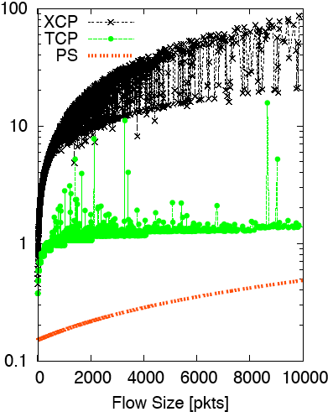
Flow Completion Time: TCP vs. RCP (Ignore XCP)
Flow Duration (secs) vs. Flow Size
RCP

Slide 51
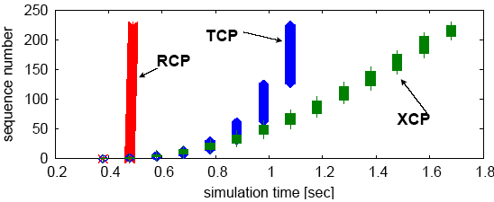
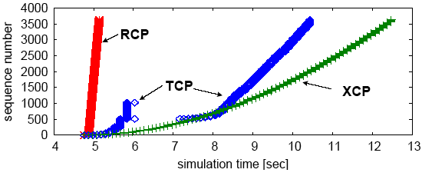
Why the improvement?

Slide 52
Any Questions?

Slide 53
How can routers ensure each flow gets its “fair share”?

Slide 54
Isolation
Treat each “flow” separately
For now, flows are packets between same Source/Dest.
Each flow has its own FIFO queue in router
Service flows in a round-robin fashion
When line becomes free, take packet from next flow
Assuming all flows are sending MTU packets, all flows can get their fair share

Slide 55
Benefits
Each flow can use their own adjustment algorithm
Perhaps aided by the router telling them how fast to send
This solves the innovation problem!
People can experiment with any CC algorithm
And the cheating problem!
No matter what you do, you can’t get more than your share

Slide 56
Four Challenges
What is fair?
How to implement fairness in general
Going beyond round-robin
Are there simpler ways to implement this?
And what’s wrong with this approach?

Slide 57
Four Challenges
What is fair?
How to implement fairness in general
Going beyond round-robin
Are there simpler ways to implement this?
And what’s wrong with this approach?

Slide 58
Fairness
When all flows want the same rate, fair is easy
Fair share = C/N
C = capacity of link
N = number of flows
Notes:
This is fair share per link. This is not a global fair share.
When not all flows have the same demand?
Either flow isn’t high bandwidth
Or limited by C/N on some other link

Slide 59
Example 1
Requests: ri Allocations: ai
C=20
Requests: r1=6, r2=5, r3=4
Solution: a1=6, a2=5, a3=4
When bandwidth is plentiful, everyone gets their request
This is the easy case

Slide 60
Example 2
C=12
Requests: r1=6, r2=5, r3=4
One solution: a1=4, a2=4, a3=4
Everyone gets the same
Why not proportional to their demands?
ai = (12/15)ri
Asking for more gets you more!
Not incentive compatible (i.e., cheating works)

Slide 61
Example 3
C=14; Requests: r1=6, r2=5, r3=4
a3=4 (can’t give more than a flow wants)
Remaining bandwidth is 10, with demands 6 and 5
From previous example, if both want more than their share, they both get half
a1=a2=5

Slide 62
Max-Min Fairness
Given set of bandwidth demands r_{i} and total bandwidth C, max-min bandwidth allocations are:
a_{i} = min(f, r_{i})
where f is the unique value such that Sum(a_{i}) = C
or set f to be infinite if no such value exists
This is what round-robin service gives
if all packets are MTUs
Property:
If you don’t get full demand, no one gets more than you
Use it or lose it: you don’t get credit for not using link

Slide 63
Example
Assume link speed C is 10mbps
Have three flows:
Flow 1 is sending at a rate 8mbps
Flow 2 is sending at a rate 6mbps
Flow 3 is sending at a rate 2mbps
How much bandwidth should each get?
According to max-min fairness?

Slide 64
Example
C = 10; r₁ = 8, r₂ = 6, r₃ = 2; N = 3
C/3 = 3.33 →
Can service all of r₃
Remove r₃ from the accounting: C = C – r₃ = 8; N = 2
C/2 = 4 →
Can’t service all of r₁ or r₂
So hold them to the remaining fair share: f = 4
8
f = 4:
min(8, 4) = 4
min(6, 4) = 4
min(2, 4) = 2
10
4
6
4
2
2

Slide 65
Four Challenges
What is fair?
How to implement fairness in general
Going beyond round-robin
Are there simpler ways to implement this?
And what’s wrong with this approach?

Slide 66
Dealing with different packet sizes
Mental model: Bit-by-bit round robin (“fluid flow”)
Can you do this in practice?
No, packets cannot be preempted
But we can approximate it
This is what “fair queuing” routers do

Slide 67
Fair Queuing (FQ)
For each packet, compute the time at which the last bit of a packet would have left the router if flows are served bit-by-bit
Then serve packets in the increasing order of their deadlines

Slide 68
Example
Flow 1
(arrival traffic)
1
2
3
4
5
6
time
Flow 2
(arrival traffic)
1
2
3
4
5
time
Service
in fluid flow
system
1
2
1
2
3
4
5
6
3
4
5
time
FQ Packet
system
1
2
1
3
2
3
4
4
5
5
6
time

Slide 69
Fair Queuing (FQ)
Implementation of round-robin generalized to case where not all packets are MTUs
Weighted fair queueing (WFQ) lets you assign different flows different shares
WFQ is implemented in almost all routers
Not true in the 1980-90s, when CC was being developed
Mostly used to isolate larger granularities (e.g., per-prefix)

Slide 70
FQ vs. FIFO
FQ advantages:
: cheating flows don’t benefit
Bandwidth share does not depend on RTT
Flows can pick any rate adjustment scheme they want
Disadvantages:
More complex than FIFO: per flow queue/state, additional per-packet book-keeping

Slide 71
Four Challenges
What is fair?
How to implement fairness in general
Going beyond round-robin
Are there simpler ways to implement this?
And what’s wrong with this approach?

Slide 72
Fairness Through Dropping
Traditional FQ uses scheduling to achieve fairness
But note that dropping is sufficient to give fairness
Assume a set of incoming rates ri
Dropping at rates pi = 1-f/ri yields fairness
ri(1-pi) = f

Slide 73
Contrast with RED
RED: all flows have same drop probability
FQ via dropping: per-flow drop probabilities

Slide 74
Two Dropping Approaches
Estimate rate ri at edge, stick in packet header
Then individual routers drop with probability 1=f/ri
Where each router computes its on f
Estimate rate at every router using “shadow buffer”
See how many packets of a flow are in shadow buffer
Use this to estimate ri
Why does this work?
Implemented on significant fraction of Cisco product line

Slide 75
Four Challenges
What is fair?
How to implement fairness in general
Going beyond round-robin
Are there simpler ways to implement this?
And what’s wrong with this approach?

Slide 76
Why is Scott a Moron?
Or why does Bob Briscoe think so?

Slide 77
flow rate fairness dismantling a religion <draft-briscoe-tsvarea-fair-01.pdf>
status: individual draft
final intent: informational
intent next: tsvwg WG item after (or at) next draft
Bob Briscoe
Chief Researcher, BT Group
IETF-68 tsvwg Mar 2007

Slide 78
Giving equal shares to “flows” is silly
What if you have 8 flows, and I have 4…
Why should you get twice the bandwidth?
What if your flow goes over 4 congested hops, and mine only goes over 1?
Why not penalize for using more scarce bandwidth?
And what is a flow anyway?
TCP connection
Source-Destination pair?
Source?

Slide 79
Charge people for congestion!
Use ECN as congestion markers
Whenever I get ECN bit set, I have to pay $$$
No debate over what a flow is, or what fair is…
Idea started by Frank Kelly, backed by much math
Great idea: simple, elegant, effective
Never going to happen…

Slide 80
Summary of Router Assisted CC
Adjustment: helps get flows up to speed
Huge improvement in FTC performance
Isolation: helps protect flows from cheaters
Gives each flow fair share
Allows innovation in CC algorithms

Slide 81
Next Week
Interdomain routing (and multicast)

