Slide 1

GlobKart Inventory Management System an Office Inventory Tool Designed in PHP
SUMMER TRAINING PROJECT
@ Globtier Infotech PVT LTD
Made by- Supervised and tested by-
Kartikeya Misra Abhay Pratap Singh
Btech 2nd Yr (IT) Senior Developer
IET Lucknow Globtier Infotech Pvt Ltd.

Slide 2
Introduction
GlobKart IMS is an inventory management web interface tool designed inPHP script and styled through JQuery (Bootstrap) libraries.
The main function of this tool is to manage all kinds of Items present at a small or large workplace or an office. One can also refer it as an Office Inventory Management Tool.
Its another important Functionality is to manage the Office Members according to their Departments and their roles (designations) and also monitoring the Item and Utility distribution to the respective members.
This tool is very useful for Head of Departments or Managers to maintain records of the office commodities and employees.
This tool is made to make dynamic Inventory Monitoring along with reporting, also the database associated with this tool is a dynamic one.

Slide 3
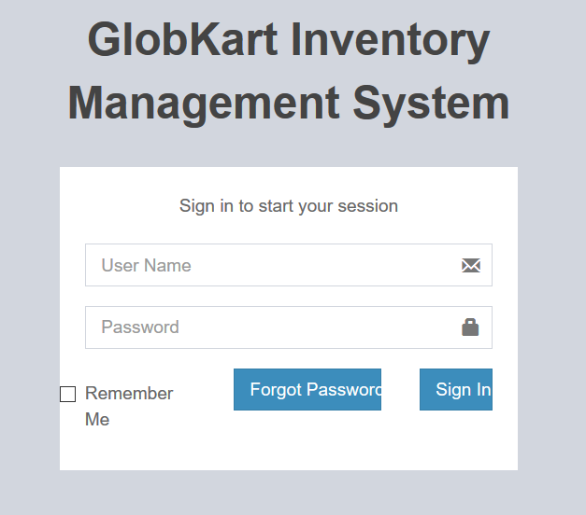
Login Page

Slide 4
In Above Page
The user have to Insert his/her ‘Username’ and ‘Password’ and then click ‘Login’ button to login to the GKIMS tool.
User can also use ‘Remember’ me checkbox to easy login by save his credentials to the browser.
If User forgotten his/her password ,then he can use ‘Forgot Password’button to mail his/her password to the Email ID previously specified by User.

Slide 5
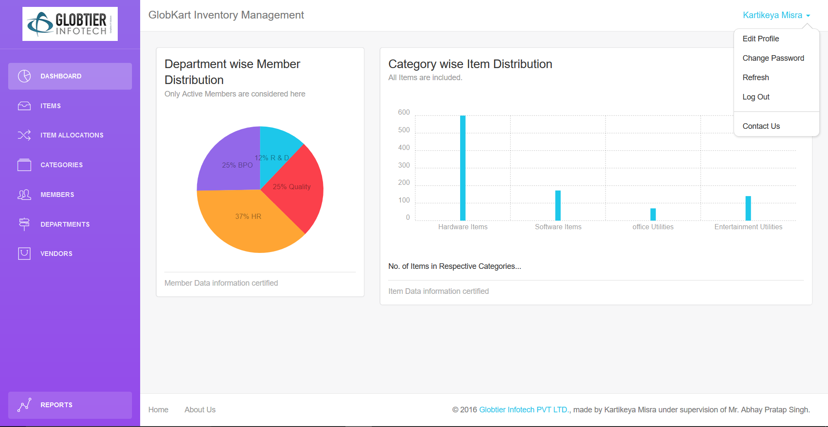
Home Page or Dashboard

Slide 6
Dashboard
In Dashboard there is a Dynamic reporting Pi-graph showing the department wise ‘%’ Active member distribution, on the left.
Also a Dynamic repoting Bar-graph showing the Category wise Item Quantity Distribution, on the right.
The Left aligned Sidebar ,topmost Header bar and footer bar in bottom are described in the following slides.

Slide 7
Sidebar
The left aligned sidebar is giving various options to use the dynamic lists provided in this tool such as,
Dashboard
Items
Item Allocations
Categories
Members
Departments
Vendors
Reports

Slide 8
Header and Footer
The header bar is placed in the topmost of the page displaying the tool name and a Dropdown with the user’s full name as its title.
The Dropdown Box provides options to ‘Edit Use Profile’, ‘Change Password’, ‘Refresh’, ‘Log out’ and ‘contact us’. The respective pages are described in next few slides.
The footer bar is placed in the bottom of the page providing you the option to follow our firm on ‘Facebook’, ‘Twitter’ and ‘Google+’.

Slide 9
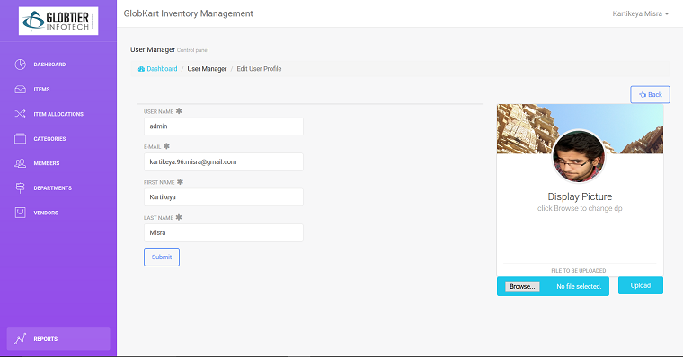
Dropdown Box Option: “Edit Profile”
Here user can edit his/her personal information like first name, Last Name, Email Address and Username Also He can Add a Profile Picture displayed on right side of the page.

Slide 10
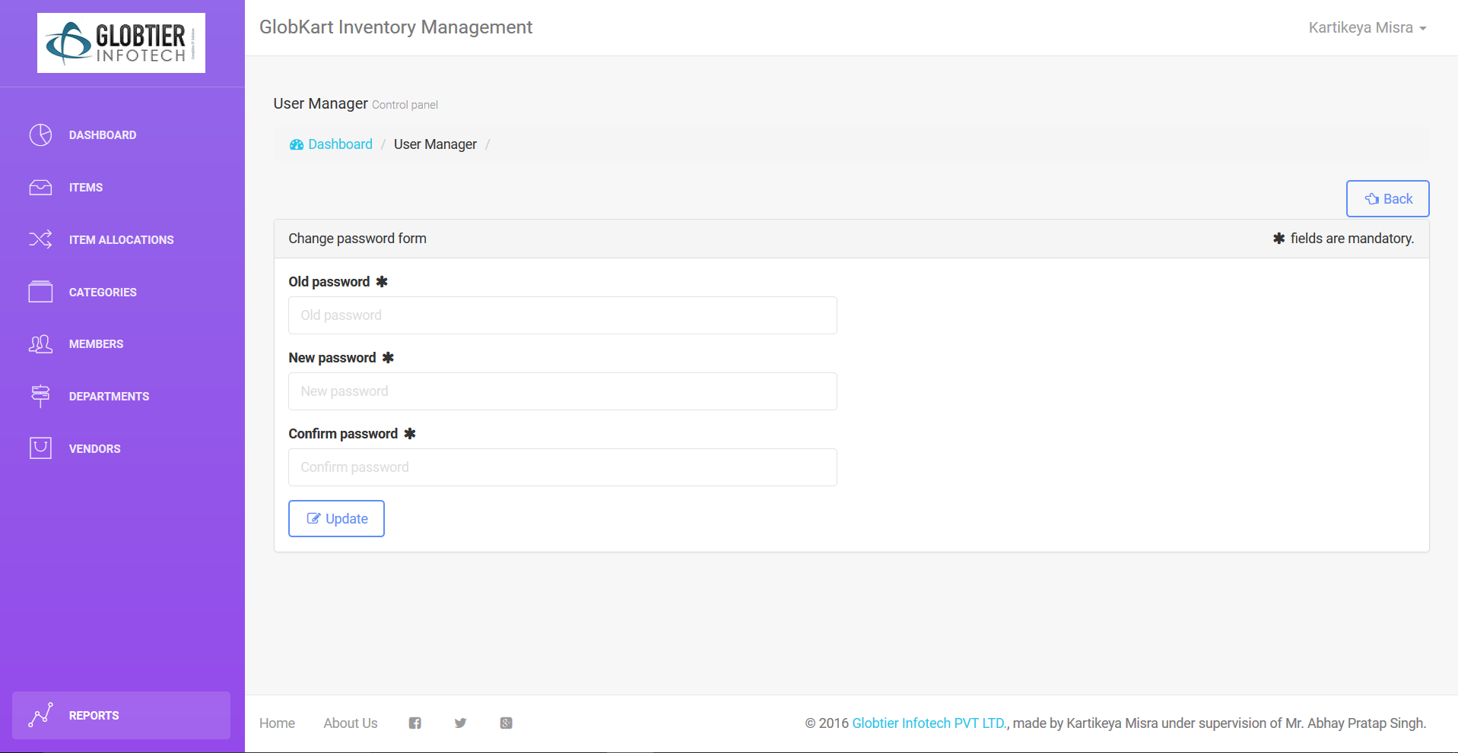
Dropdown Box Option: “Change Password”
This page gives an otion to upadate the old password with a new one by filling a simple above shown change password form.

Slide 11
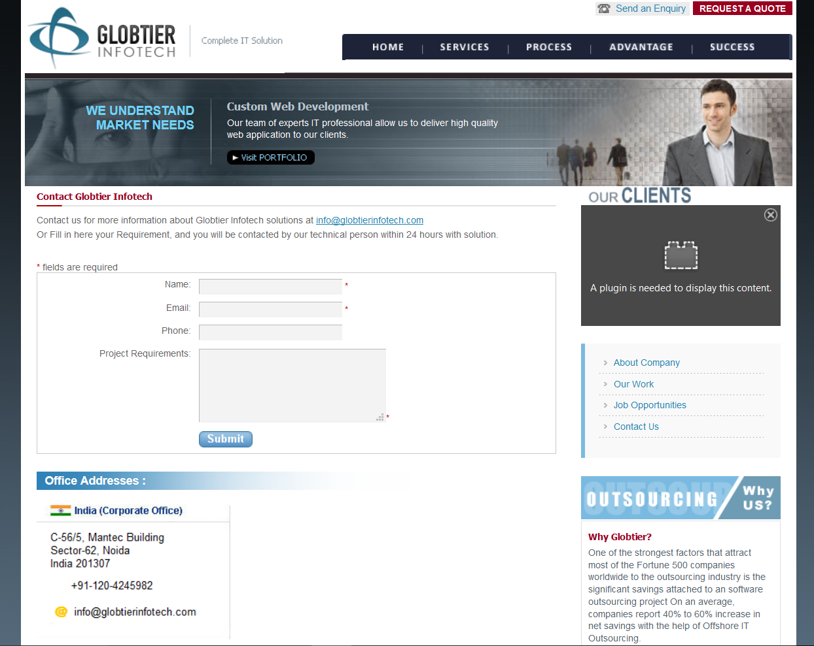
Dropdown Box Option: “Contact Us”
This options pops your web page to our official site where our all contact details are available, as shown above.

Slide 12
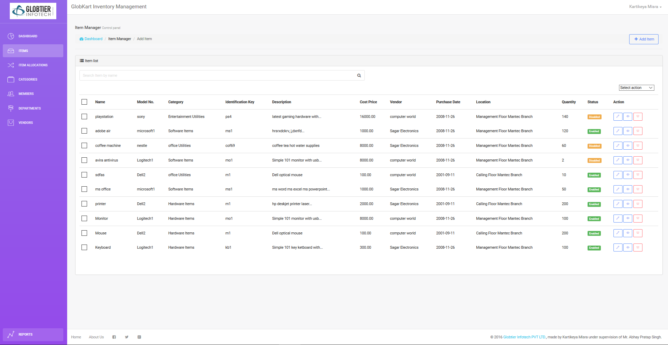
List- ‘ITEMS’

Slide 13
In Above Page
The list of all Office Inventory Items is shown with some of their attributes like Name, Model No., Category, Description etc. as shown above.
You can also add new items through a button given above.
Details of each Item can be edited, viewed or deleted through different pages as shown in following slides….

Slide 14
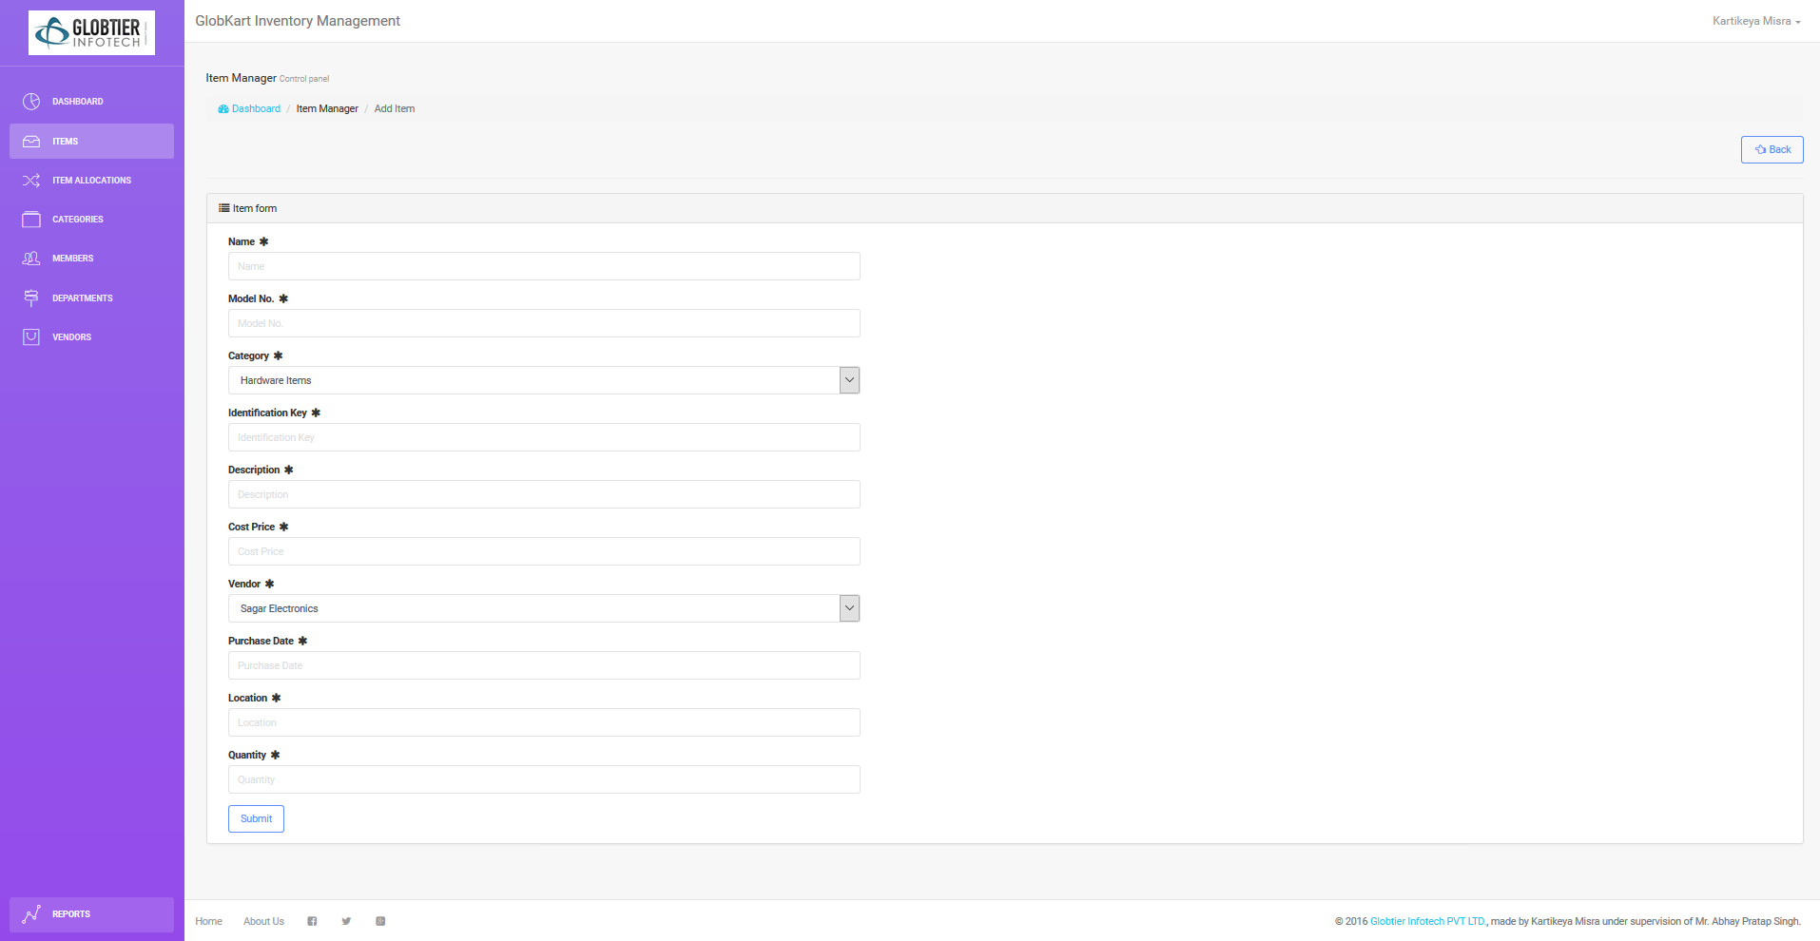
Add Item
Fill a simple form in this page and click submit to add a new Item in the Inventory.Here Form is all about the attributes of the item that is going to be inserted.

Slide 15
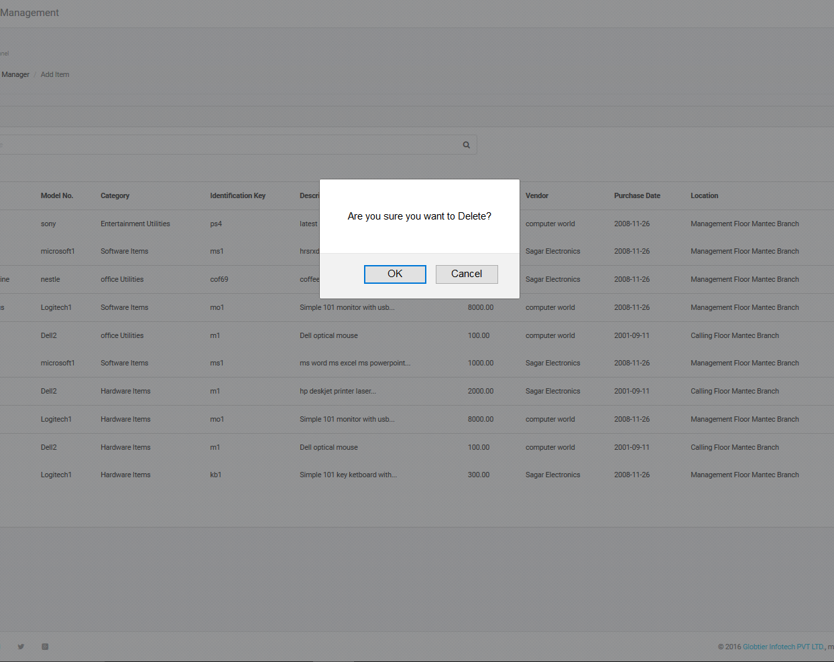
Delete Item
On clicking on delete button provided to every item in the list or by using delete selected option in select action dropdown user can delete items of inventory. Before final delete the above pop box comes out on clicking OK the item will be permanently deleted.

Slide 16
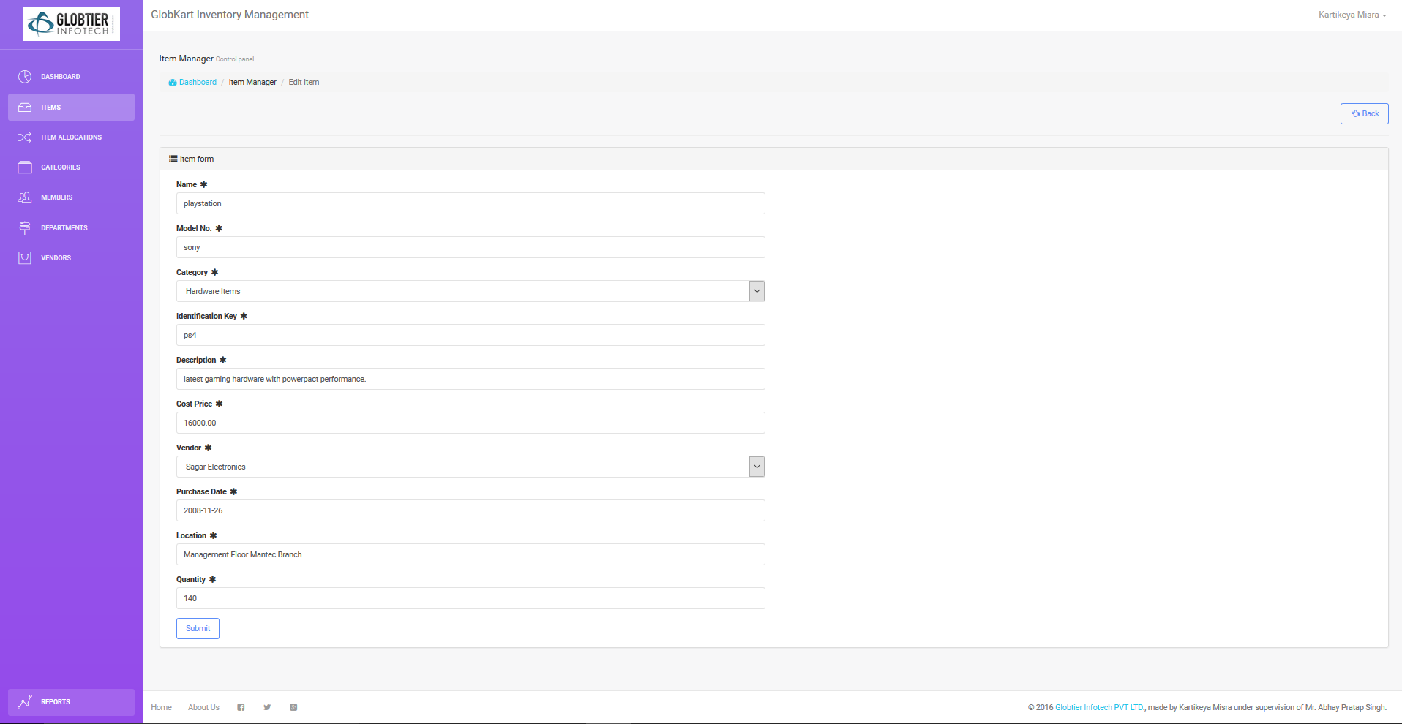
Edit Item
In this page the form is similar to the add item page but here the selected item’s details are previously filled in the fields. We can edit any desired field and on clicking on submit the item’s info would be updated on the database.

Slide 17
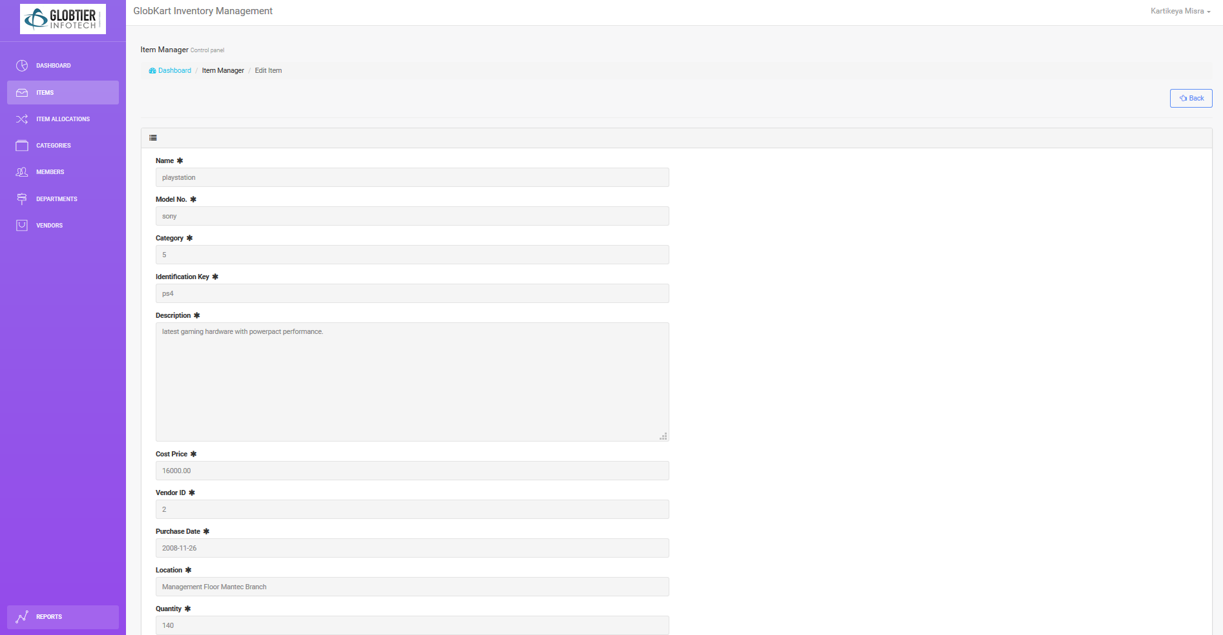
View Item
This also have the same attribute form as the above two . The only difference is that here the form is read only type. No field can be edited, deleted or modified.

Slide 18
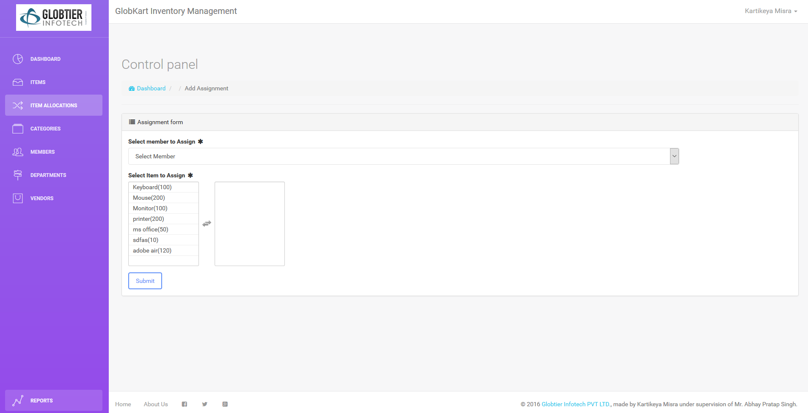
List- ‘ITEM ALLOCATION’

Slide 19
In Above Page
This page is to allocate the Items to the Inventory Members.
The Select Member Dropbox give user options to select a member from member list by is name to allocate items or to undo the allocation.
Note that Every Item can be allocated to a member from item list to member list only once.
On clicking Submit button the new allocation will be done.

Slide 20
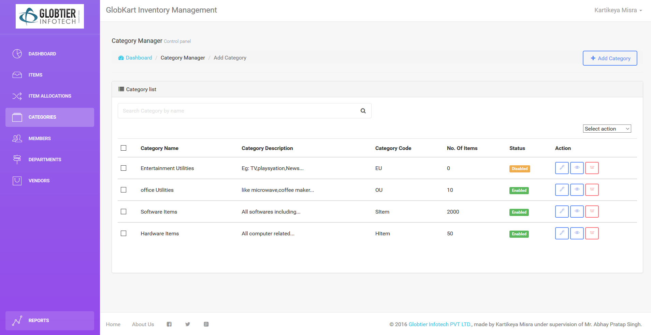
List- ‘CATEGORIES’

Slide 21
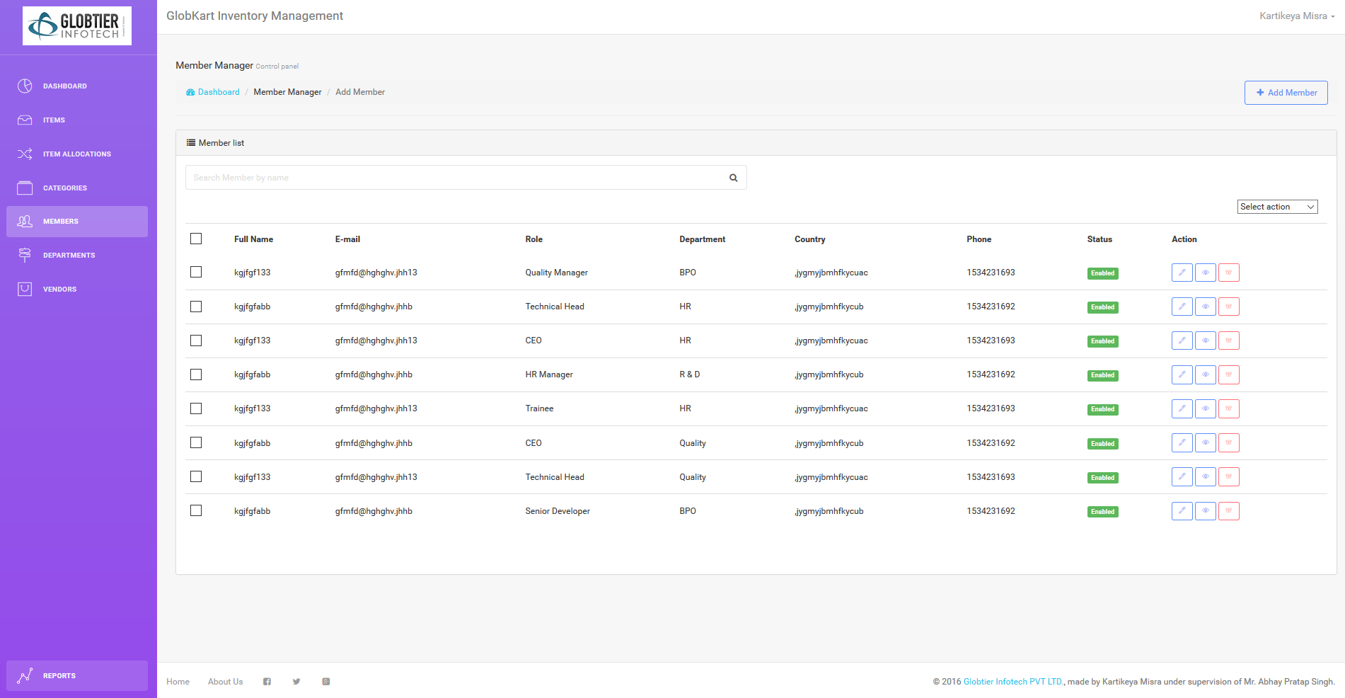
List- ‘MEMBERS’

Slide 22
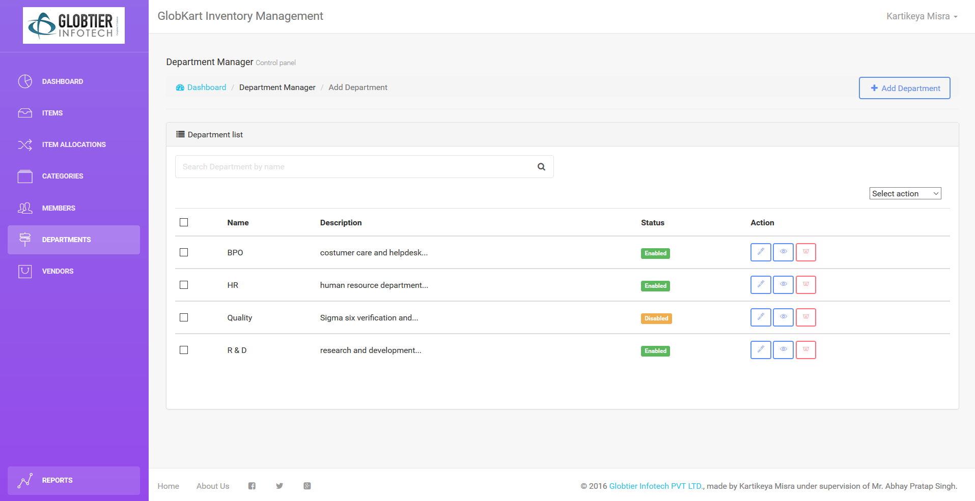
List- ‘DEPARTMENTS’

Slide 23
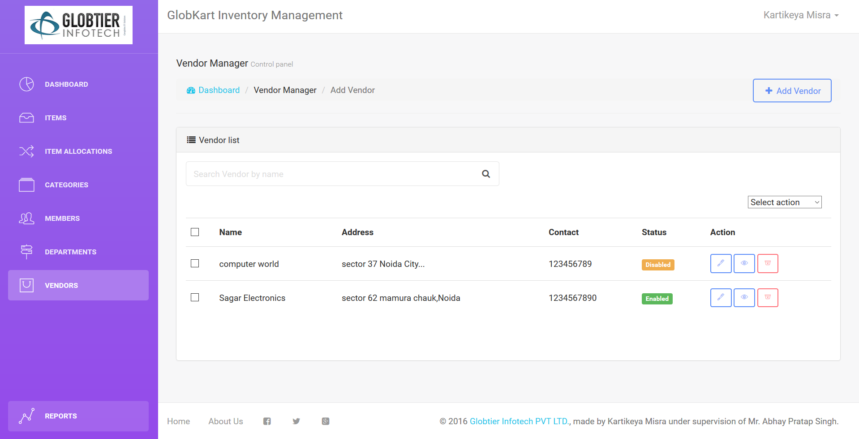
List- ‘VENDORS’

Slide 24
In Above Four Pages
There is ‘Categories’ List which manages the record of categories of inventory items.
There is ‘Members’ List which manages the record of all the members of user’s workplace.
There is ‘Departments’ List which manages the record of all the departments of the workplace by which members of user’s workplace can be characterized.
There is ‘Vendors’ List which manages the record of all the vendors of the workplace by which vendors of various inventory items can be monitored as well as managed.
NOTE : All Above Four Lists have same functionalities of add, edit, view and delete as the Item List.Every list is associated to a unique table in inventory database.

Slide 25
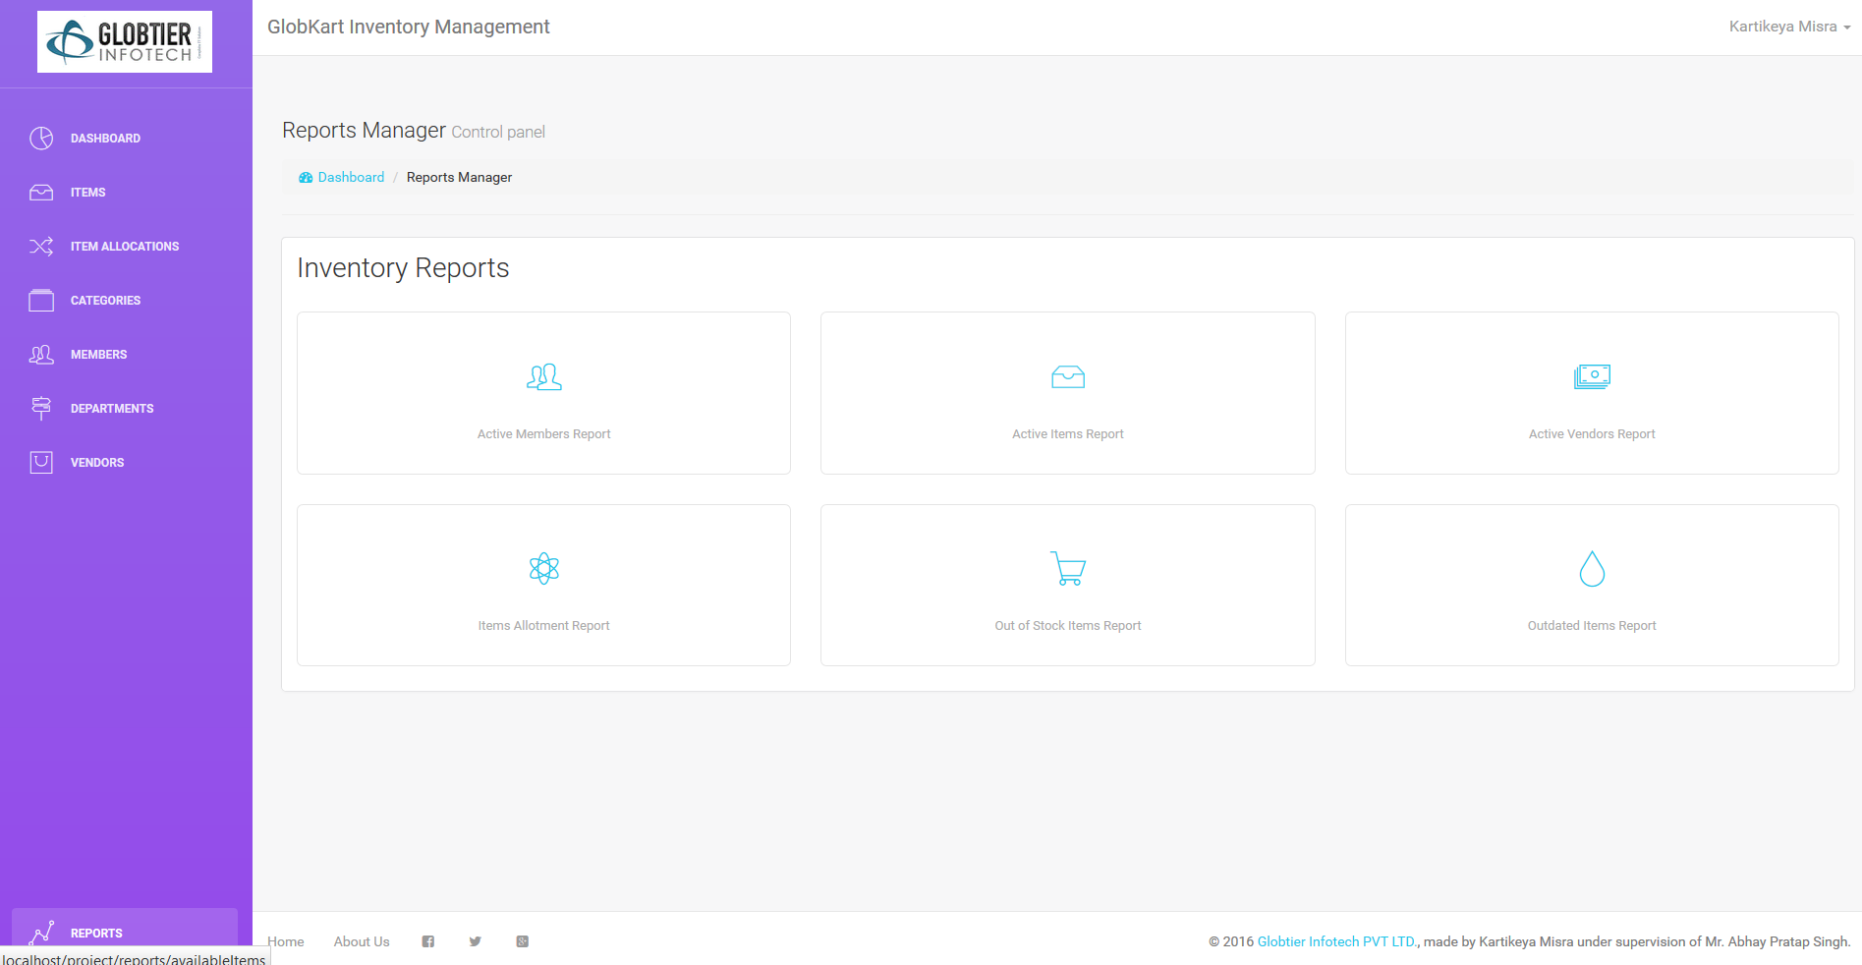
List- ‘REPORTS’

Slide 26
In Above Page
Total six Reports can be generated,which are as follows,
Active Members Report
Active Items Report
Active Vendors Report
Items Allotment Report
Out of Stock Items Report
Outdated Iitems Report
All above six Reports are of same pattern and same functionalities. Lets take ‘Active Members Report’ as an Eaxample,

Slide 27
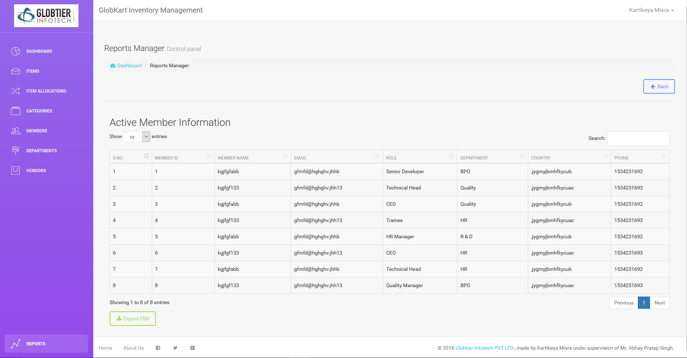
Active Member Report

Slide 28
In Above Page
This Page shows another list but it is different from previous lists, They are static Reporting lists, here Records cannot be modified or deleted but can only be viewed.
Here By search box anything can be searched through any keyword.
‘Export CSV’ button can be used to generate the Excel format reports to be documented in hard copy if needed.
Following Slides are related to above detailing,

Slide 29
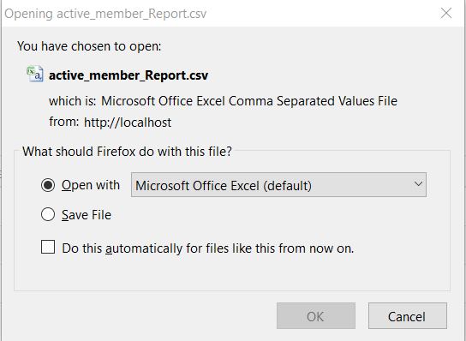
Export Box
The above box appears on clicking the ‘Export CSV’ button,this gives options for handling the csv format excel file.

Slide 30
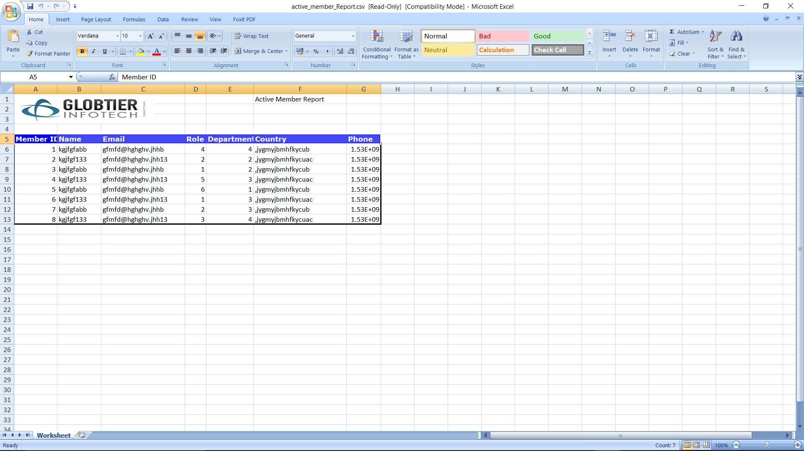
Exported .CSV Excel Sheet
The Above Image shows the Excel sheet in which the inventory data is sen through GKIMS tool.

Slide 31
THANK YOU!
Summer Training Project: GlobKart IMS
By Kartikeya Misra ,Summer Trainee
@Globtier Infotech Pvt Ltd.
During: Semester Gap 2016 Summers….

