Slide 1
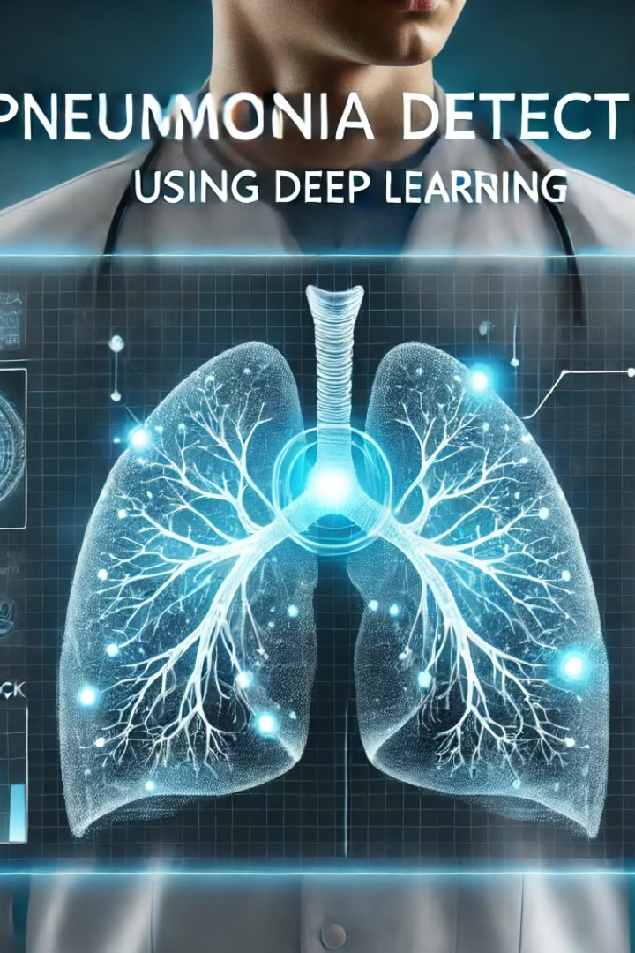


Pneumonia Detection Using Deep Learning
Team Name: Alpha Model
Presented by : Dr . Laila Ahmed (2025)
Designed and Presented by Mahmoud Ayman
Submission Date: March 19, 2025

Slide 2

Introduction
🔹 What is Pneumonia?
A lung infection that affects millions worldwide.
Early detection is crucial for treatment.
🔹 Why Use AI?
Faster and more accurate diagnosis.
Helps doctors make better decisions.

Slide 3
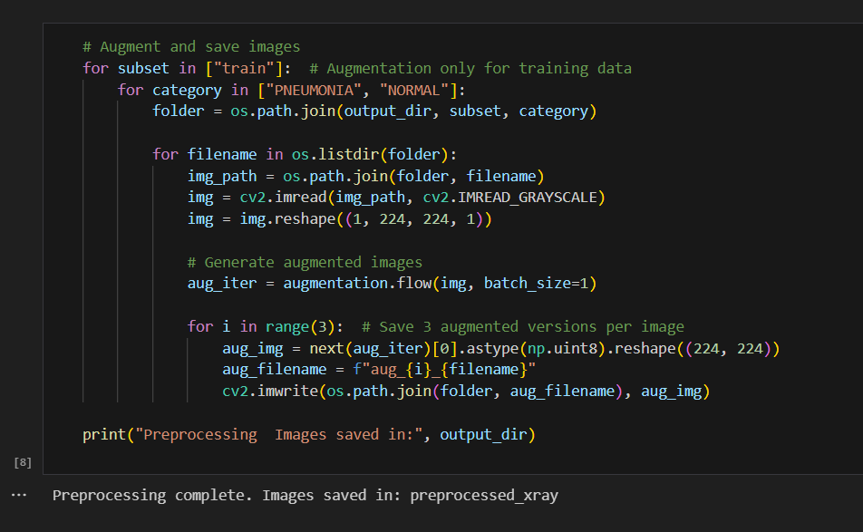
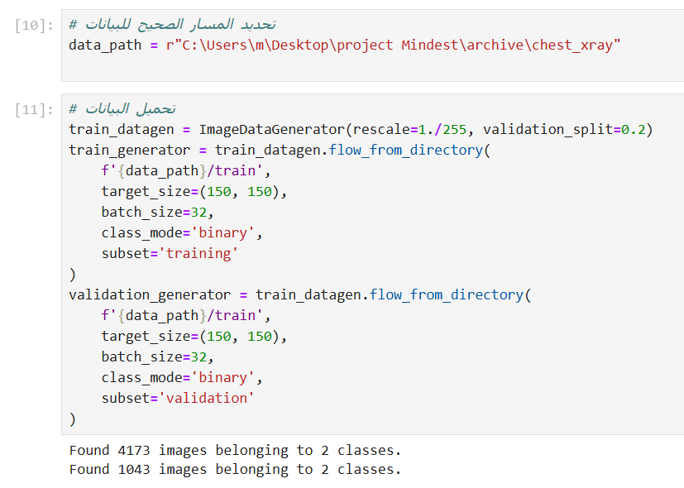
Dataset & Preprocessing
🔹 Dataset: Chest X-ray images (Normal vs Pneumonia). 🔹 Preprocessing Steps: ✅ Rescaling images (Normalization). ✅ Data Augmentation (Rotation, Zoom, Flip). ✅ Splitting into Training & Validation sets.

Slide 4
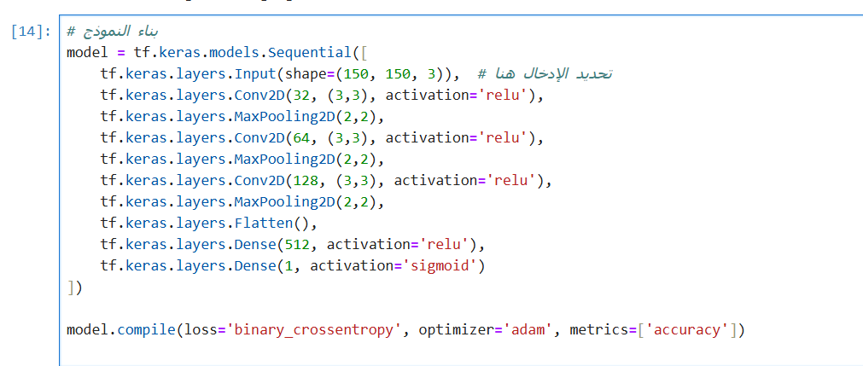
Model Architecture
🔹 Deep Learning Model: CNN (Convolutional Neural Network) ✅ Layers Used:
Conv2D, Batch Normalization, MaxPooling
Flatten, Dense, Dropout ✅ Activation Function: ReLU & Sigmoid ✅ Optimizer: Adam

Slide 5
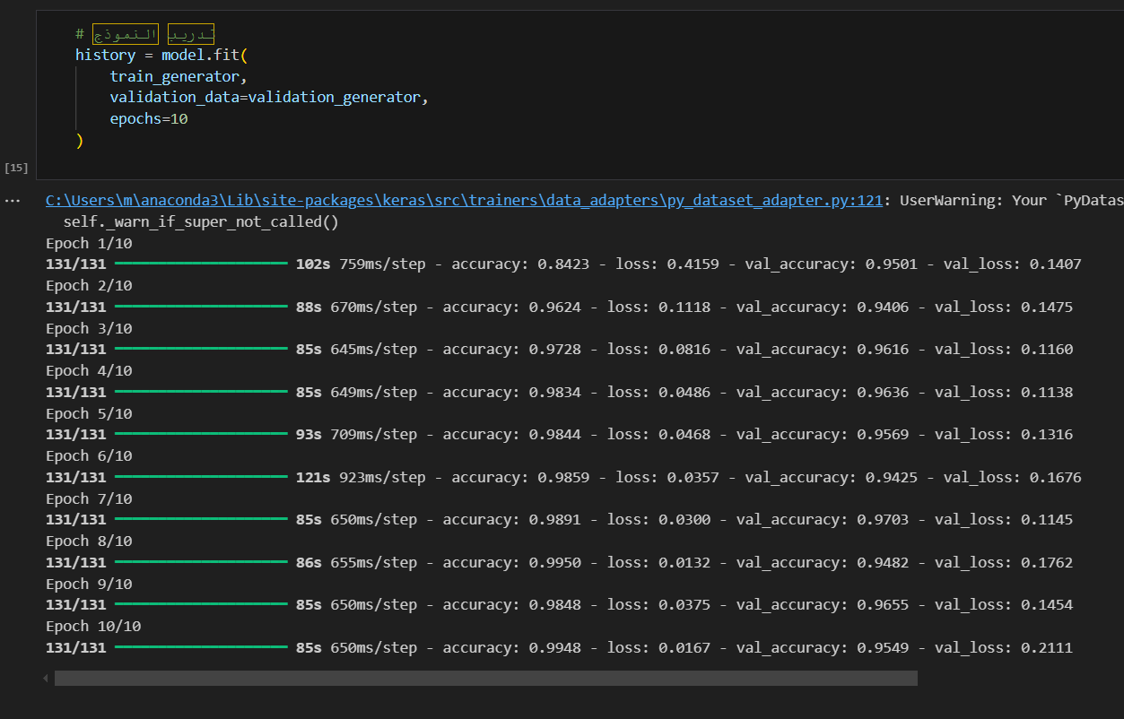


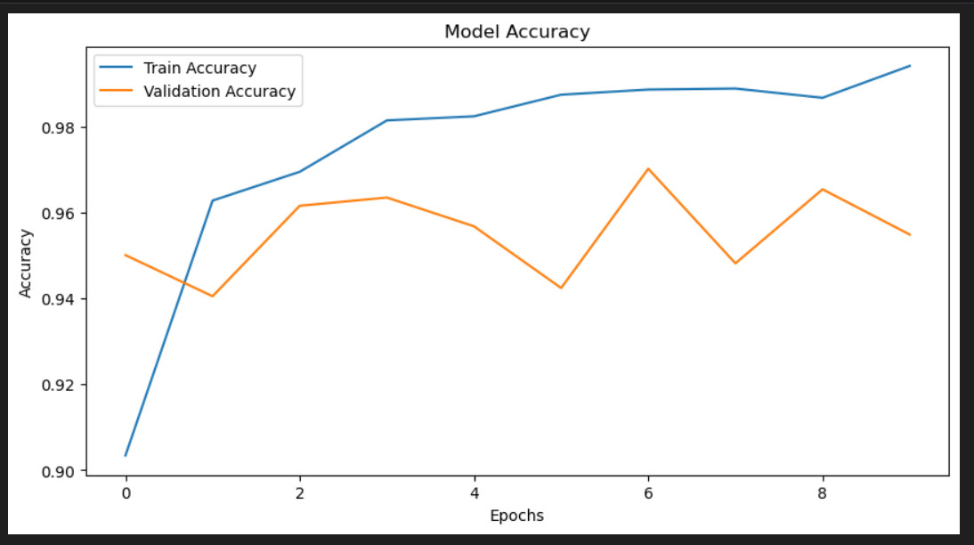
Training & Performance
🔹 Training Details: ✅ Loss Function: Binary Crossentropy ✅ Optimizer: Adam ✅ Epochs: 10 (with Early Stopping)
🔹 Results: ✅ Good Accuracy on Validation Data ✅ Model learns to differentiate Normal & Pneumonia

Slide 6
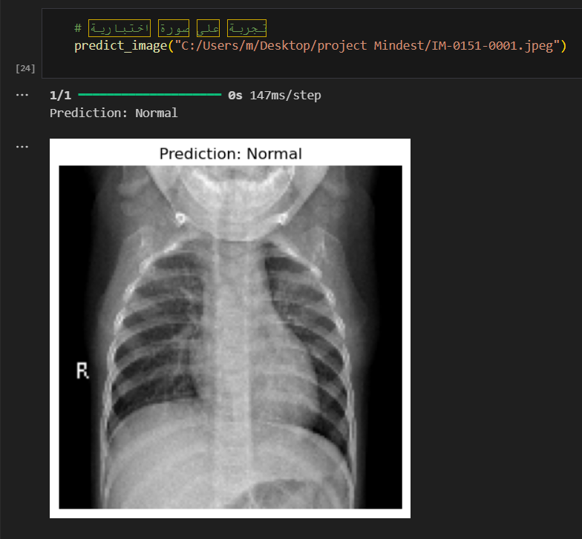
Predictions & Demo
🔹 How the Model Works? ✅ Input: Chest X-ray Image ✅ Model Prediction: Normal / Pneumonia ✅ Confidence Score Displayed
📌 Example Image + Prediction Output Screenshot

Slide 7





Conclusion & Future Work
🔹 Summary: ✅ AI can assist doctors in pneumonia diagnosis. ✅ Our model provides promising accuracy.
🔹 Future Improvements:
✅ More data for better generalization.
✅ Deploy the model in a web/app interface.

Slide 8


