Slide 1
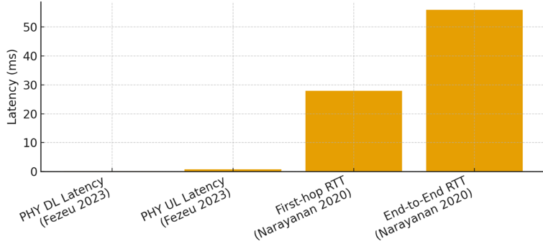
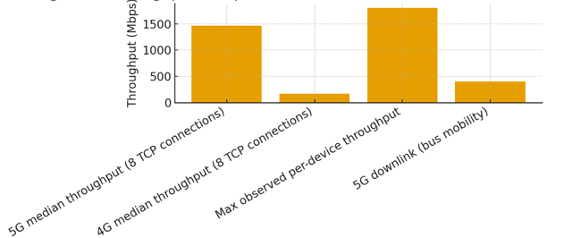
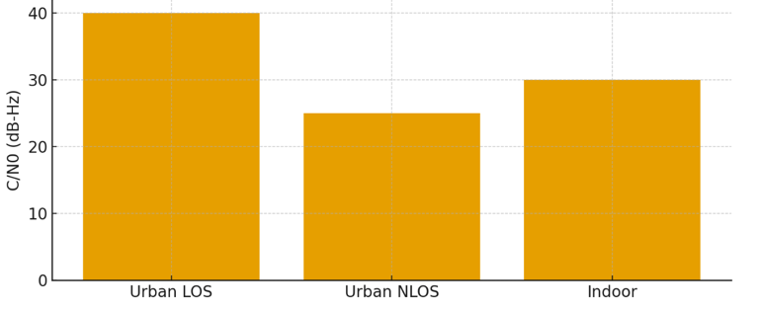
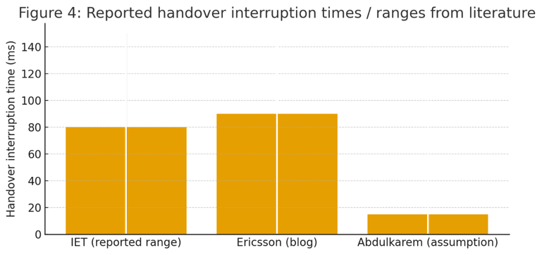

Comparative Study of 5G and 6G Network
Performance in Urban Environments
ID: 2XXX
Hassan Alqahtani, Abdulaziz Almutairi, Nawaf Alghamdi
Department of Computer Networks and Communications King Faisal University
Abstract
This poster presents a comparative study of 5G network performance and the expected capabilities of 6G in urban environments. Real measurement data from the literature were analyzed using key performance metrics such as latency, throughput, signal-to-noise ratio, and handoff delay. The results highlight the limitations of current 5G deployments in dense urban areas and illustrate how future 6G technologies aim to improve performance and reliability.
Keywords
5G, 6G, urban networks, latency, throughput
I. INTRODUCTION
5G networks provide high data rates and low latency, but their performance in dense urban environments is often limited by signal blockage, congestion, and user mobility. As cities grow more complex, evaluating real-world network behavior becomes essential. 6G networks are expected to address these challenges through improved latency, reliability, and intelligent network control.
Fig. 1. 5G latency measurements
II. Principle
This work compares the performance of current 5G networks with the expected capabilities of 6G in urban environments using key performance metrics such as latency, throughput, signal quality, and handoff delay.
Fig. 2. Throughput comparison
III. Methodology and Experiments
• Urban environments with different building densities and mobility conditions were selected to represent realistic deployment scenarios.
• Performance data for 5G networks were obtained from real measurement studies reported in the literature.
• Key performance metrics, including latency, throughput, signal-to-noise ratio (SNR), and handoff delay, were extracted for analysis.
• MATLAB was used to process the collected data, remove outliers, and generate comparative visualizations.
• Cloud platforms such as AWS IoT Core or Firebase were utilized for data storage and organization.
Fig. 3. 5G (C/N0) Measurements in different environments
IV. Results and Analyses
The results illustrate the impact of urban environments on 5G performance and highlight the expected improvements targeted by future 6G systems.
Table I. Measured 5G/4G performance metrics
Metric | Scenario | Value
DL Throughput | Median (urban) | ~1467 Mbps
DL Throughput | Peak LOS | ~1800 Mbps
Mobility Throughput | Urban mobility | ~400 Mbps
Latency (PHY DL) | 5G NR | 0.09 ms
Latency (PHY UL) | 5G NR | 0.76 ms
First-hop RTT | Commercial 5G | 28 ms
End-to-end RTT | Commercial 5G | 56 ms
SNR (LOS) | Outdoor | 40 dB-Hz
SNR (NLOS) | Outdoor | 25 dB-Hz
SNR (Indoor) | Indoor | 30 dB-Hz
Handover Delay | Empirical range | 10–150 ms
Handover Delay | Peak | ~90 ms
Handover Delay | Simulation | 15 ms
Fig. 4. Reported handover interruption (times / ranges)
V. Conclusion
The study shows that although 5G networks can achieve high peak performance, their real-world operation in dense urban environments is often limited by signal blockage, mobility, and frequent handovers. The expected advancements of 6G networks aim to address these challenges by improving latency, reliability, and mobility support, making future wireless systems more suitable for complex urban scenarios.
References
[1] C.-X. Wang et al., IEEE Communications Surveys & Tutorials, 2023.
[2] Y. Lu et al., IEEE Access, 2020.
[6] A. Zreikat et al., Sensors, 2024.
Acknowledgements
The authors would like to thank Dr. Abdullah Albuali, Department of Computer Networks and Communications, King Faisal University, for his valuable guidance and supervision of this research. We also acknowledge King Faisal University for providing the resources and support necessary to complete this work.
Author email: 223003175@student.kfu.edu.sa, 223014463@student.kfu.edu.sa, 223035370@student.kfu.edu.sa
2023 IEEE International Conference on Applied Superconductivity and Electromagnetic Devices, Tianjin, China, 27-29 October 2023

