Slide 1

SecureVault
Secure Messaging / Vault
CS 320 Programming Project
GUI · AES-based encryption · key handling · attack demo · functional tests
Group Members:
Hassan Mohammed Alqahtani 223003175
Abdulaziz Mathkar Almutiri 223014463
Nawaf Sultan Alghamdi 223035370

Slide 2

Project fit to the guideline
Built to match the programming-project checklist directly.
GUI interface for messages and files
Encryption system with password-based key handling
Attack demo: wrong password and modified payload
10 functional tests with recorded results
GitHub-ready folder structure and demo video
Local and test data only
Core choice
AES-256 for protecting local messages and local vault files.
PBKDF2-HMAC-SHA256 derives the key from the user password before encryption.
SecureVault
2

Slide 3
System design
Small layered structure so each module has one clear role.
GUI
Crypto
Vault
Tests
Tkinter tabs
Message · File · Attack
PBKDF2
AES-256 encrypt/decrypt
Local .svault files
JSON payloads
10 automated cases
pass/fail output
The GUI collects input, the crypto layer protects content, the vault stores local files, and the tests verify both correct and incorrect behavior.
SecureVault
3

Slide 4
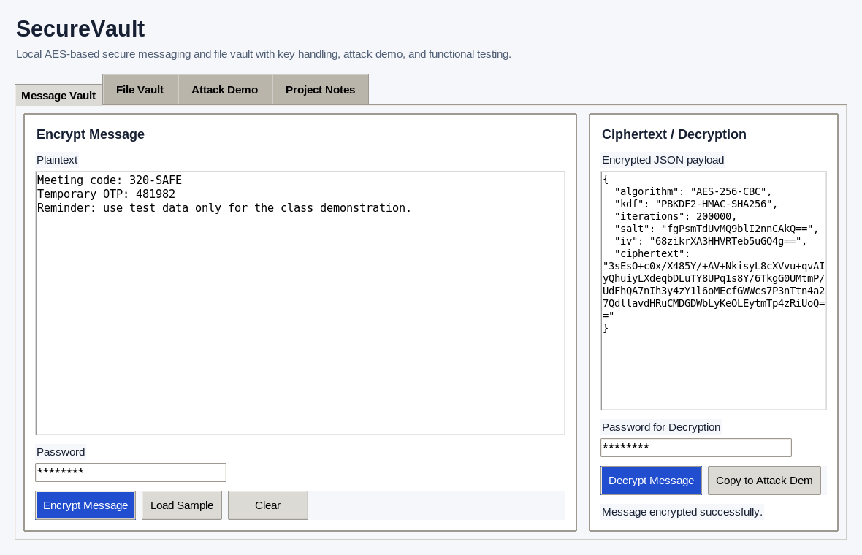
Message Vault
Encrypt plain text, show ciphertext, then recover it with the correct password.
User writes the plaintext message.
Password is transformed into a key with PBKDF2.
AES-256 encrypts the padded message bytes.
Output is stored as a JSON ciphertext payload.
Correct password returns the original plaintext.
What the lecturer sees
Readable input turns into unreadable ciphertext, then returns only with the right secret.
SecureVault
4

Slide 5
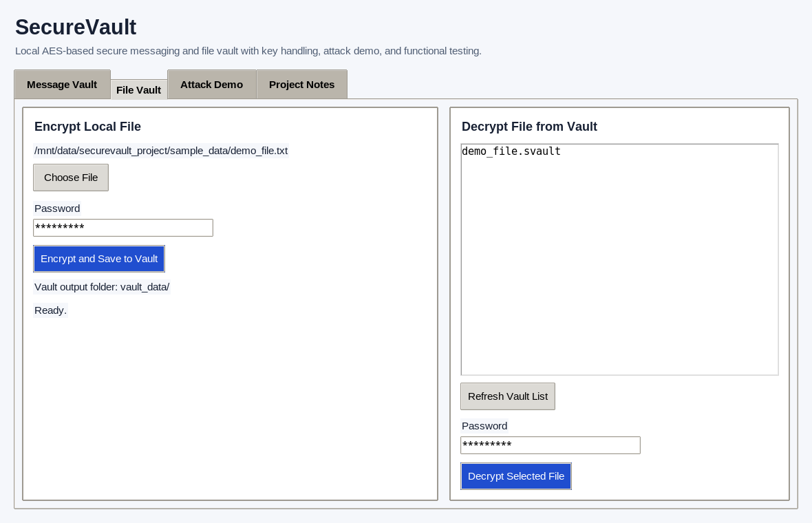
File Vault
Local file protection using the same password-based workflow.
Workflow
Choose a local test file
Derive a fresh key from the password
Encrypt the file bytes
Save to vault_data as .svault
Decrypt to recover the original filename
Safe scope
The project uses only local and test files, matching the course safety rule.
SecureVault
5

Slide 6
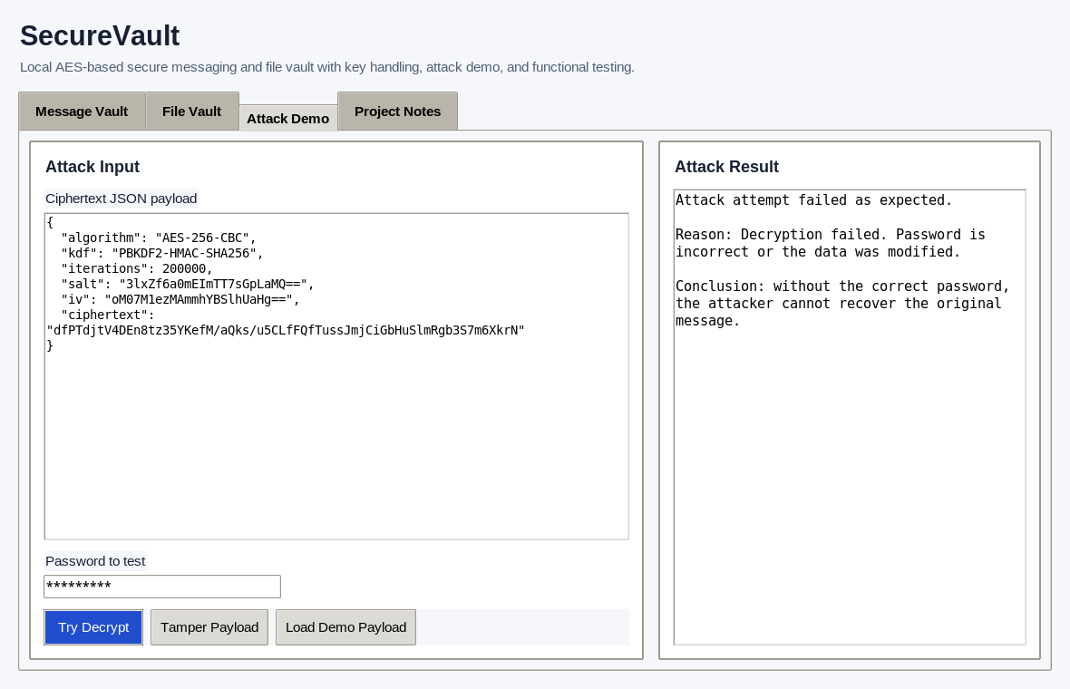
Attack demo
The demo is defensive: it shows what fails when the secret is wrong.
Two checks
Wrong password → decryption fails
Tampered payload → decryption fails
No plaintext is shown to the attacker
Why it matters
This proves that the vault does not reveal data unless the correct secret is provided.
SecureVault
6

Slide 7
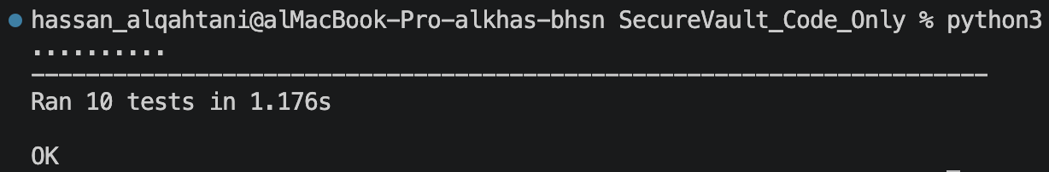
Testing & Results
Automated tests cover both success and failure paths.
message round-trip
wrong password handling
tampered payload handling
file recovery
empty password rejection
randomized ciphertext output
10 / 10
tests passed
SecureVault
7

Slide 8
Conclusion
SecureVault satisfies the selected project idea with a working GUI, AES-based protection, key handling, attack demonstration, test cases, a report, and a video demo package.
Recommended live demo order
1) message vault
2) file vault
3) attack demo
4) tests
SecureVault
8

