Slide 1
Banking Fraud Detection using Machine Learning Techniques
Author
Mohamed Sayed Abdelwahab
Masters of Computer Science
Mohamedaboalarbe@fcis.bsu.edu.eg

Slide 2
Outline
Overview
Problem and History
Solution
Data set Description
Challenges
Results
Mohamedaboalarbe@fcis.bsu.edu.eg

Slide 3
Overview
Hackers and crooks around the world are always looking into new ways of committing financial fraud at each minute.
Fraud detection in banking is a critical activity that can span a series of fraud schemes and fraudulent activity from bank employees and customers alike.
We will use machine learning and data analytics to encounter this problem.
Mohamedaboalarbe@fcis.bsu.edu.eg

Slide 4
Problem and History
According to Financial Fraud UK report, in 2016 financial fraud losses across payment cards, remote banking and cheques resulted in astonishing £768.8 million, an increase of 2% compared to 2015. At the same time, prevented fraud totaled £1.38 billion in 2016 Report.
experts predict online credit card fraud to soar to a whopping $32 billion in 2020 (Ref). This amount is superior to the profits posted recently by some worldwide household, blue chip companies in 2017, such as Coca-Cola ($2 billions), Warren Buffet’s Berkshire Hathaway ($24 billions) and JP Morgan Chase ($23.5 billions).
Over the past decade, the financial services industry has invested heavily in using big data and data analytics in their fight against fraudsters.
Mohamedaboalarbe@fcis.bsu.edu.eg

Slide 5
Solution
The main objective is creating a model that has enough intelligence in order to properly classify transactions as either legit or fraudulent, based on transaction details. It helps merchants and banks reduce the number of payment fraud cases and helps merchants grow their revenues.
Mohamedaboalarbe@fcis.bsu.edu.eg

Slide 6
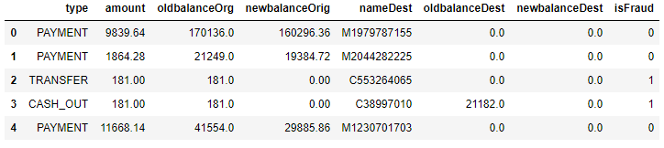
Data set Description
We will run our algorithm on 50000 random sample of the dataset
Mohamedaboalarbe@fcis.bsu.edu.eg

Slide 7
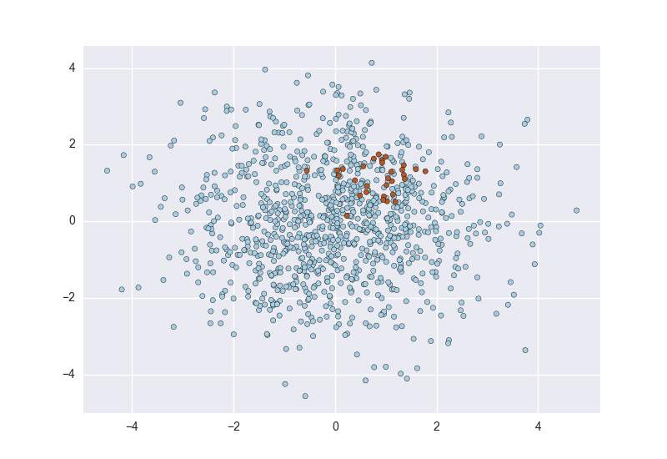
Challenges
Imbalanced Data
From 50000 samples, we have:
- 49900 is not fraud.
- only 100 is fraud.
Mohamedaboalarbe@fcis.bsu.edu.eg

Slide 8
Challenges –Cont.
There are many ways of dealing with imbalanced data. Such as following approaches:
Oversampling — SMOTE
One popular way to deal with imbalanced data is by oversampling. To oversample means to artificially create observations in our data set belonging to the class that is under represented in our data.
Under sampling — RandomUnderSampler
Undersampling works by sampling the dominant class to reduce the number of samples. One simple way of undersampling is randomly selecting a handful of samples from the class that is overrepresented.
Mohamedaboalarbe@fcis.bsu.edu.eg

Slide 9
Challenges –Cont.
We will use the first approach “Oversampling” in this model.
One common technique is SMOTE (Synthetic Minority Oversampling Technique).
At a high level, SMOTE creates synthetic observations of the minority class (in this case, fraudulent transactions).
At a lower level, SMOTE performs the following steps:
Finding the k-nearest-neighbors for minority class observations (finding similar observations).
Randomly choosing one of the k-nearest-neighbors and using it to create a similar, but randomly tweaked, new observations.
Mohamedaboalarbe@fcis.bsu.edu.eg

Slide 10
Results
We have split our data set into 70 % train and 30 % test to estimate the accuracy of the model.
Applying the random forest classifier algorithm.
Finally we got accuracy 99 %.

Slide 11
Thanks!
Questions?
Mohamedaboalarbe@fcis.bsu.edu.eg

