Slide 1
Loan Prediction

Slide 2
Analysis
Let’s know some analytics of data

Slide 3
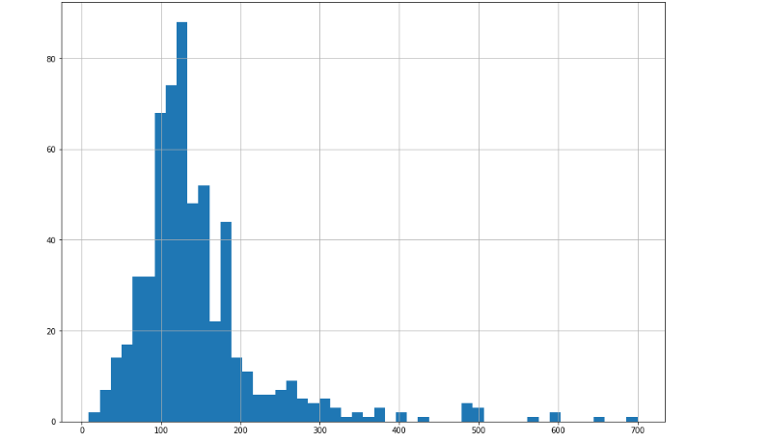
Pie chart of loan Amount

Slide 4
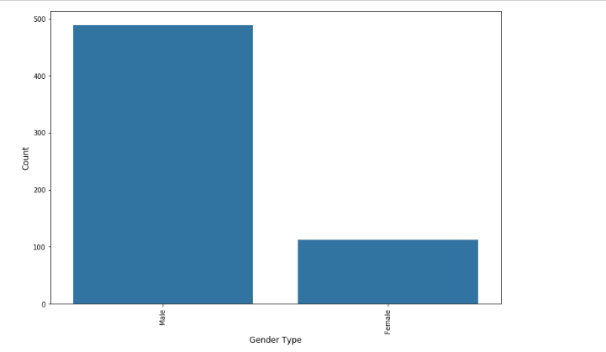
Count of each Gender

Slide 5
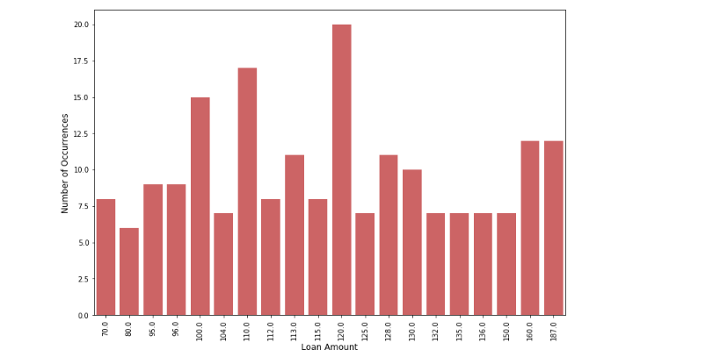
Number of occurence of loan amount

Slide 6
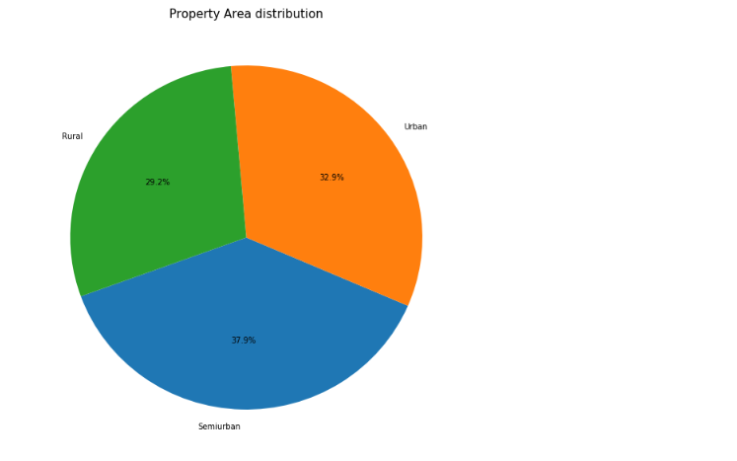

Slide 7
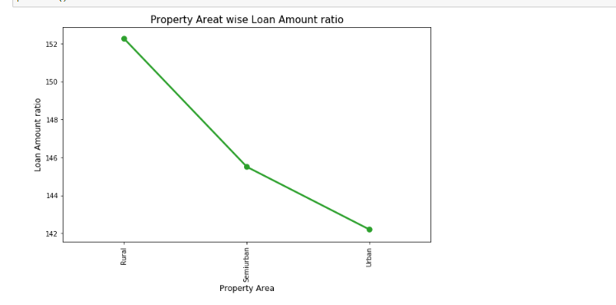

Slide 8
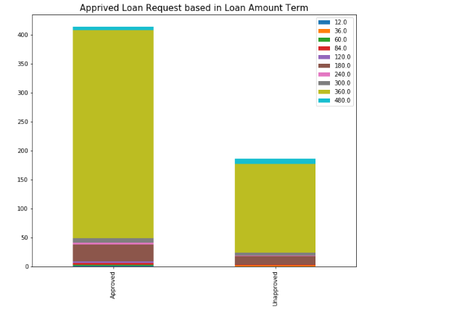

Slide 9
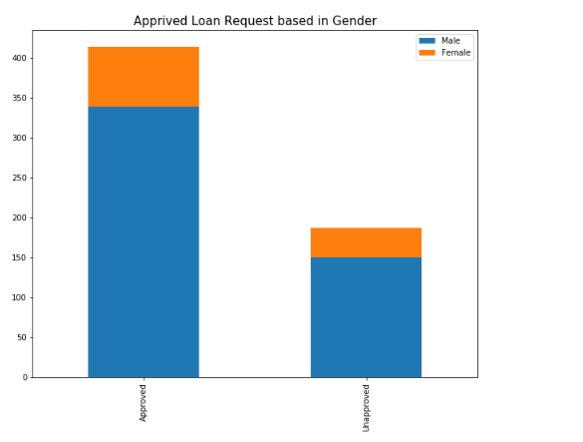

Slide 10
Models
Predicting selling products by using this models :
-Logistic Regression
-K Neighbors Classifier
-Gaussian NB
-SVC
-Random forest
-Decision Tree

Slide 11
Model Selection
We notice that More features effect on results:
Education', 'Co Applicant Income', 'Credit History','Property Area'
We also used PCA , LDA and correlation to choose affecting features

Slide 12
Evaluation
classification Report Result with all Features:
DecisionTreeClassifier %76
RandomForestClassifier %80
SVC (kernel='linear') %84
SVC (kernel='rbf') %84
LogisticRegression %85
MLPClassifier %83

Slide 13
Evaluation
classification Report Result After correlation:
DecisionTreeClassifier %75
RandomForestClassifier %78
SVC (kernel='linear') %84
SVC (kernel='rbf') %85
LogisticRegression %85
MLPClassifier %85

Slide 14
Evaluation
classification Report Result After using LDA:
DecisionTreeClassifier %76
RandomForestClassifier %76
SVC (kernel='linear') %85
SVC (kernel='rbf') %84
LogisticRegression %85
MLPClassifier %85

Slide 15
Evaluation
classification Report Result After using PCA:
DecisionTreeClassifier %75
RandomForestClassifier %76
SVC (kernel='linear') %84
SVC (kernel='rbf') %85
LogisticRegression %85
MLPClassifier %85

Slide 16
Reporting
We notice that Highest Accuracy=0.85

