Slide 1
Welcome!!

Slide 2



LogoType
Next Technology Leaders
Recommendation Application
project for Big Data Science Track DEC 2018

Slide 3
Under supervision of :
Dr. Doaa Hassan
Eng. Sayed A. Omar

Slide 4
Team Members
Mohamed Sayed Abdelwahab
Mahmoud Abdallh Tawfik
Abdulruhman Mohammed Abdelmoniem
Mohammed Hilal

Slide 5
Agenda
1
Introduction
2
Problem Definition
3
Technologies used in the project
4
Proposed solution
5
Architecture
6
Results

Slide 6
Introduction

Slide 7
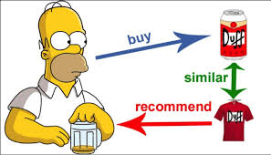
Introduction
In today’s world, every customer is faced with multiple choices. For example, If I’m looking for a product to buy it without any specific idea of what I want, there’s a wide range of possibilities.

Slide 8
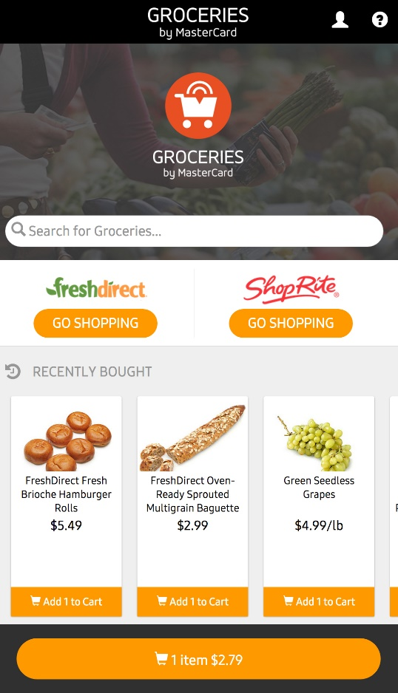
Cont. Introduction
But if there was a site or app which could
recommend me item based on what I have bought previously, that would be a massive help
Instead of wasting time on various sites.

Slide 9




Examples

Slide 10
Problem Definition

Slide 11
Problem Definition
Companies spent money on advertising and sometimes high portion of this money doesn’t make an effect because these advertising go to the customers that don’t prefer these products, so we want to make an application that would recommend products to the most desirable Customers that have high probability to buy these items.

Slide 12

Cont. Problem Definition
User Can’t Find products that he need it with easy way and Market sale less

Slide 13
Proposed solution

Slide 14
Proposed solution
Our solution is to make a recommendation application that
recommend the grocery items to the customers according to their needs, so company can recommend the best products
for their customer that have high probability to buy these products.

Slide 15
Technologies used

Slide 16
Technologies used in the project
Python V.3 Programming Language.
Machine Learning.
Association Rule
Apriori Algorithm
Apache Spark & Databricks
Android Studio.
Api.
Juypter Notebook
Tableau Software

Slide 17
Apriori Algorithm

Slide 18
Apriori Algorithm
Candidate itemsets are generated using only the large itemsets of the previous pass without considering the transactions in the database.
The large itemset of the previous pass is joined with itself to generate all itemsets whose size is higher by 1.
Each generated itemset that has a subset which is not large is deleted The remaining itemsets are

Slide 19
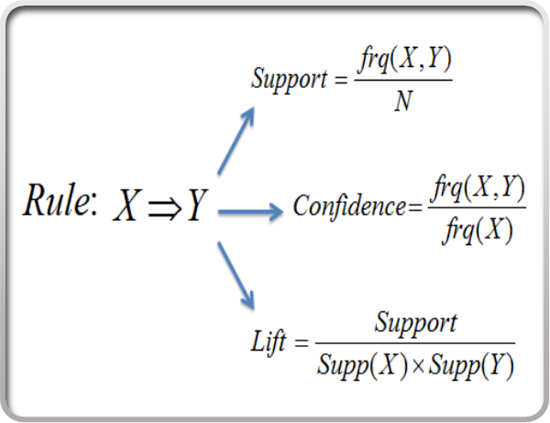
Apriori Algorithm equations

Slide 20
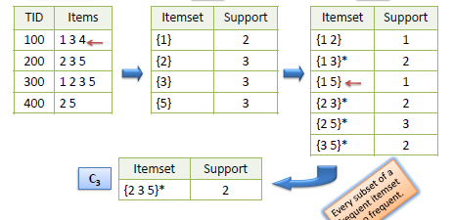
Cont. Apriori Algorithm
The Apriori algorithm takes advantage of the fact that any subset of a frequent itemset is also a frequent itemset. The algorithm can therefore, reduce the number of candidates being considered by only exploring the itemsets whose support count is greater than the minimum support count. All infrequent itemsets can be pruned if it has an infrequent subset.

Slide 21
Data Set
Description of Data Set
orders (32 m rows, 206k users):
order_id:
product_id:
add_to_cart_order:
reordered:
products (50k rows):
product_id: product identifier
product_name: name of the product
In our Model We use only 7000000 for Data Science Model because our devices can’t load this large number of Rows , In Big Data We use 7M and 10M to make Punch Mark between Data Science using Juypter and Big Data using Apache Spark & Databricks

Slide 22
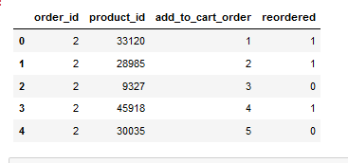
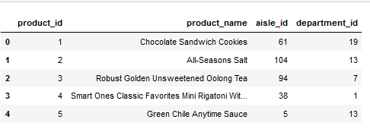
Data Set
We use data set for Grocery Market

Slide 23
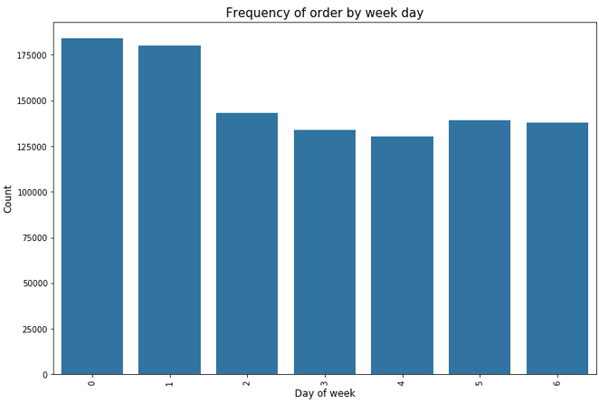
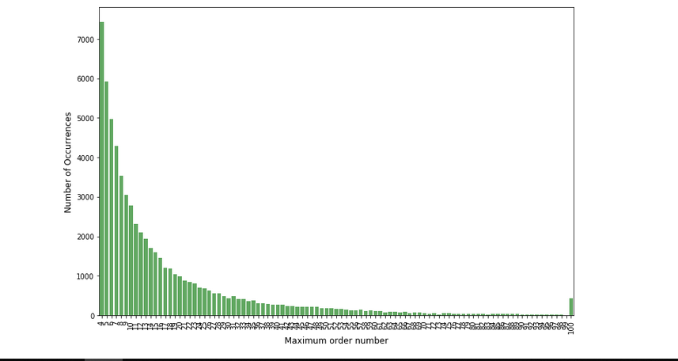
Descriptive Statistic of our Data Set

Slide 24
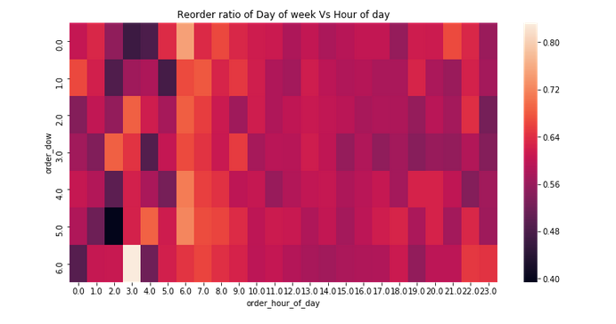
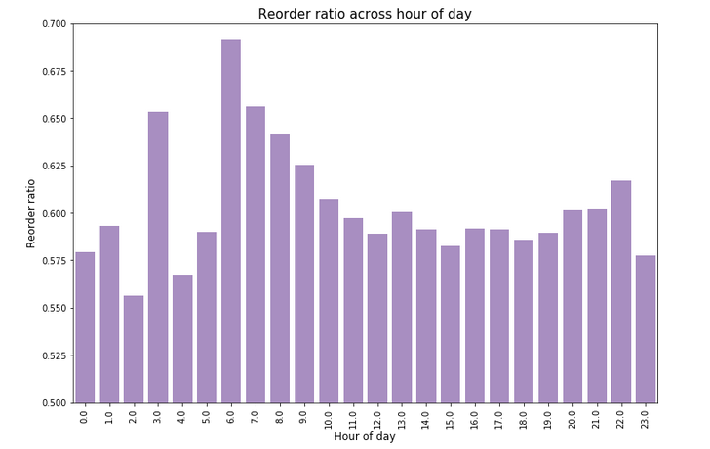
Cont. Descriptive Statistic of our Data Set

Slide 25
Project Architecture

Slide 26
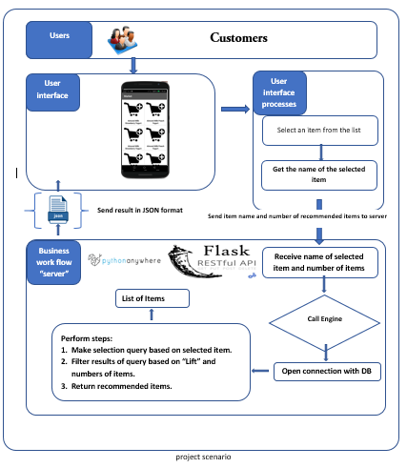
Project Architecture

Slide 27
Results

Slide 28
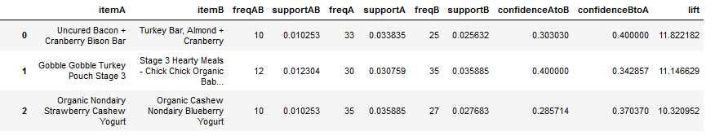
Result
After Preform the algorithm in our data set We get this result in our Model
We recommend item B to user who buy item A based on lift value

Slide 29
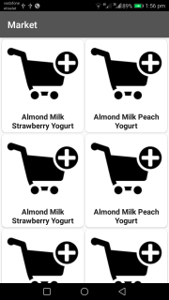
Mobile App Demo

Slide 30
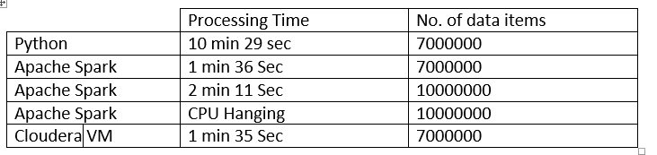
We have run the algorithm on local machine of the following properties:
Operating System: Windows 10 Pro 64-bit (10.0).
Processor: Intel(R) Core(TM) i5-2520M CPU @ 2.50GHz (4 CPUs), 2.5GHz.
Memory: 6G RAM.
Display Memory: 1664 MB.
Shared Memory: 1632 MB.

Slide 31
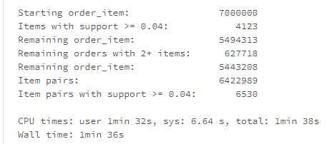
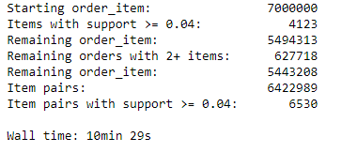
Performance of our Model in python Juypter and Apache Spark

Slide 32
Thank you

