Slide 1
Project Members
-أحمد ابوبكر أحمد الزمر 20210019
-يوسف مصطفى محمد سليم 20211112
-محمود علي محمود احمد20210871
- محمود فتحي عيد عبد الغني 20210874
- حسن محمد حسن عبدالحميد 20210292
- احمد ابراهيم اسماعيل محمد 20210015

Slide 2
The two datasets are :
a) Boston House For Numerical Dataset.
b) Eye Diseases Classification Image Dataset(25).

Slide 3
The project involves the following tasks:
For Numerical Dataset:
a) KNN Regression: is a machine learning algorithm used for regression tasks. It is an extension of the K-nearest neighbors classification algorithm, but instead of predicting a class label, it predicts a continuous target variable.
b)Linear Regression: is a statistical modeling technique used to understand and quantify the relationship between a dependent variable and one or more independent variables. It assumes a linear relationship between the independent variables and the dependent variable.
For Image Dataset:
a) K-means: is an unsupervised machine learning algorithm used for clustering tasks. Its objective is to partition a given dataset into K distinct clusters, where each data point belongs to the cluster with the nearest mean.
b) Logistic Regression: is a statistical modeling technique it predicts the probability of an instance belonging to a certain class based on the values of independent variables.

Slide 4
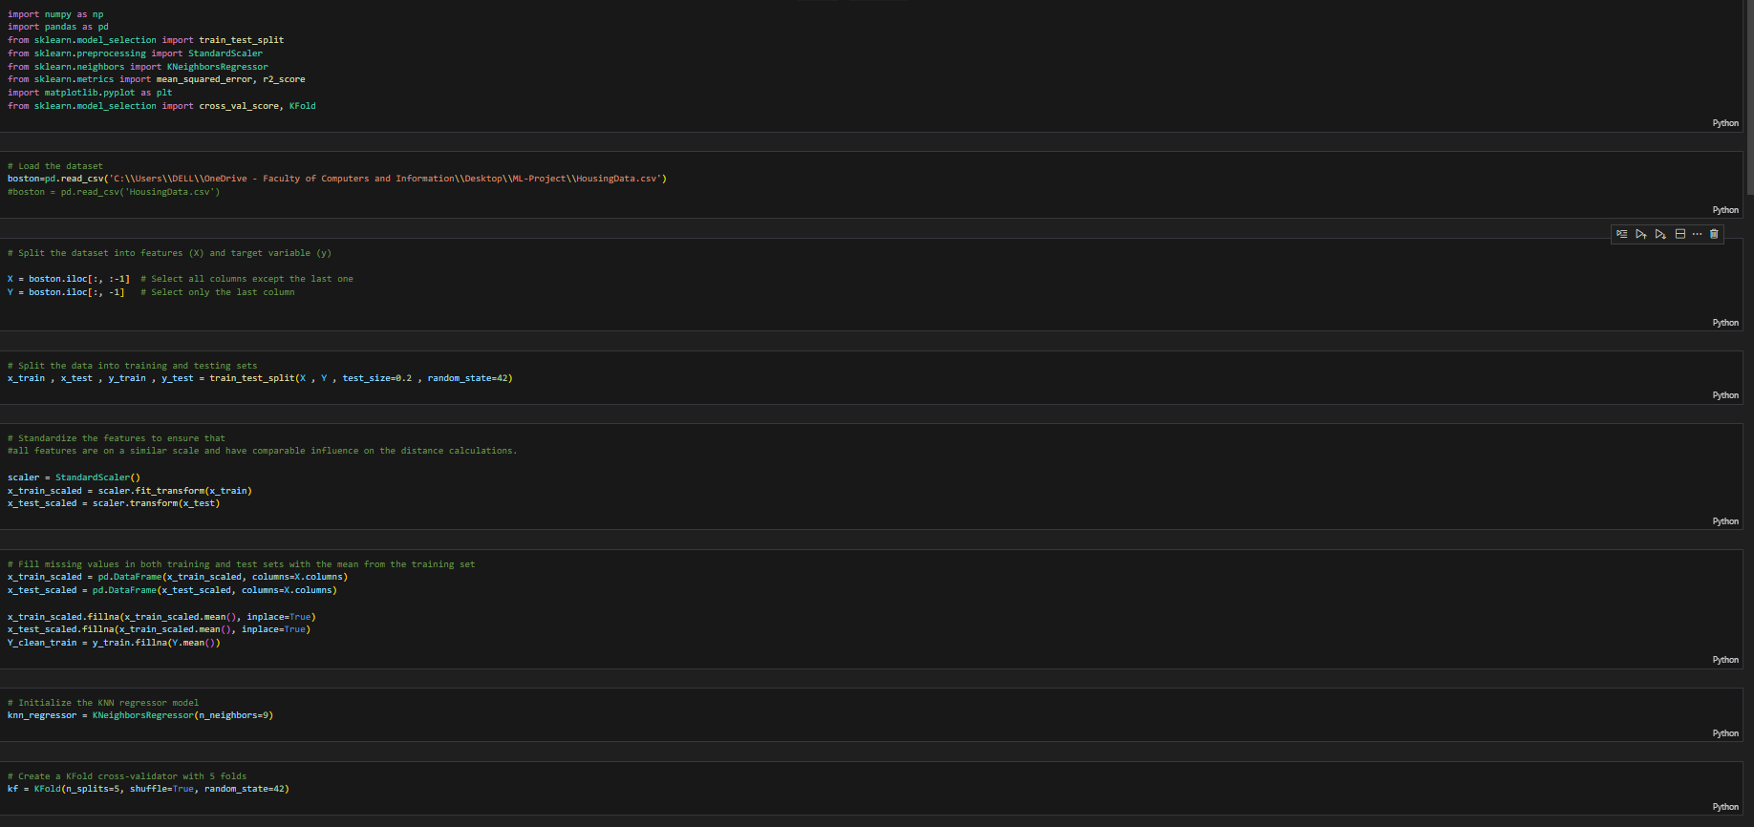
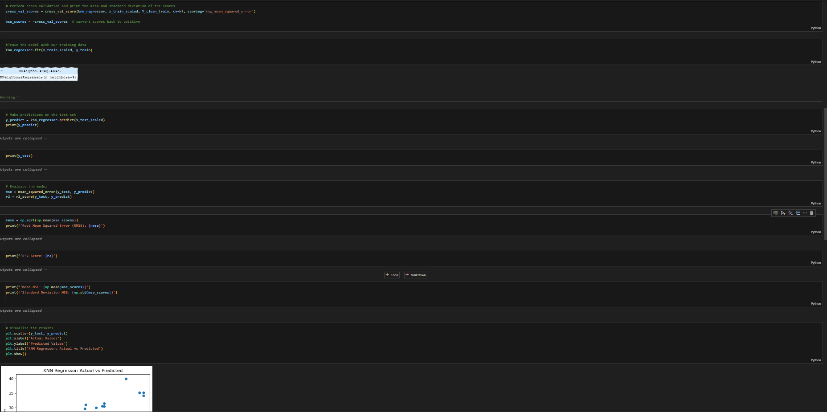
For Numerical Dataset
-KNN Regression:
We split the data to train and test to 20% test and 80% train then we scale the input and fill the missing values and train the model with the training data after that we evaluate the model and lastly we plot the results

Slide 5
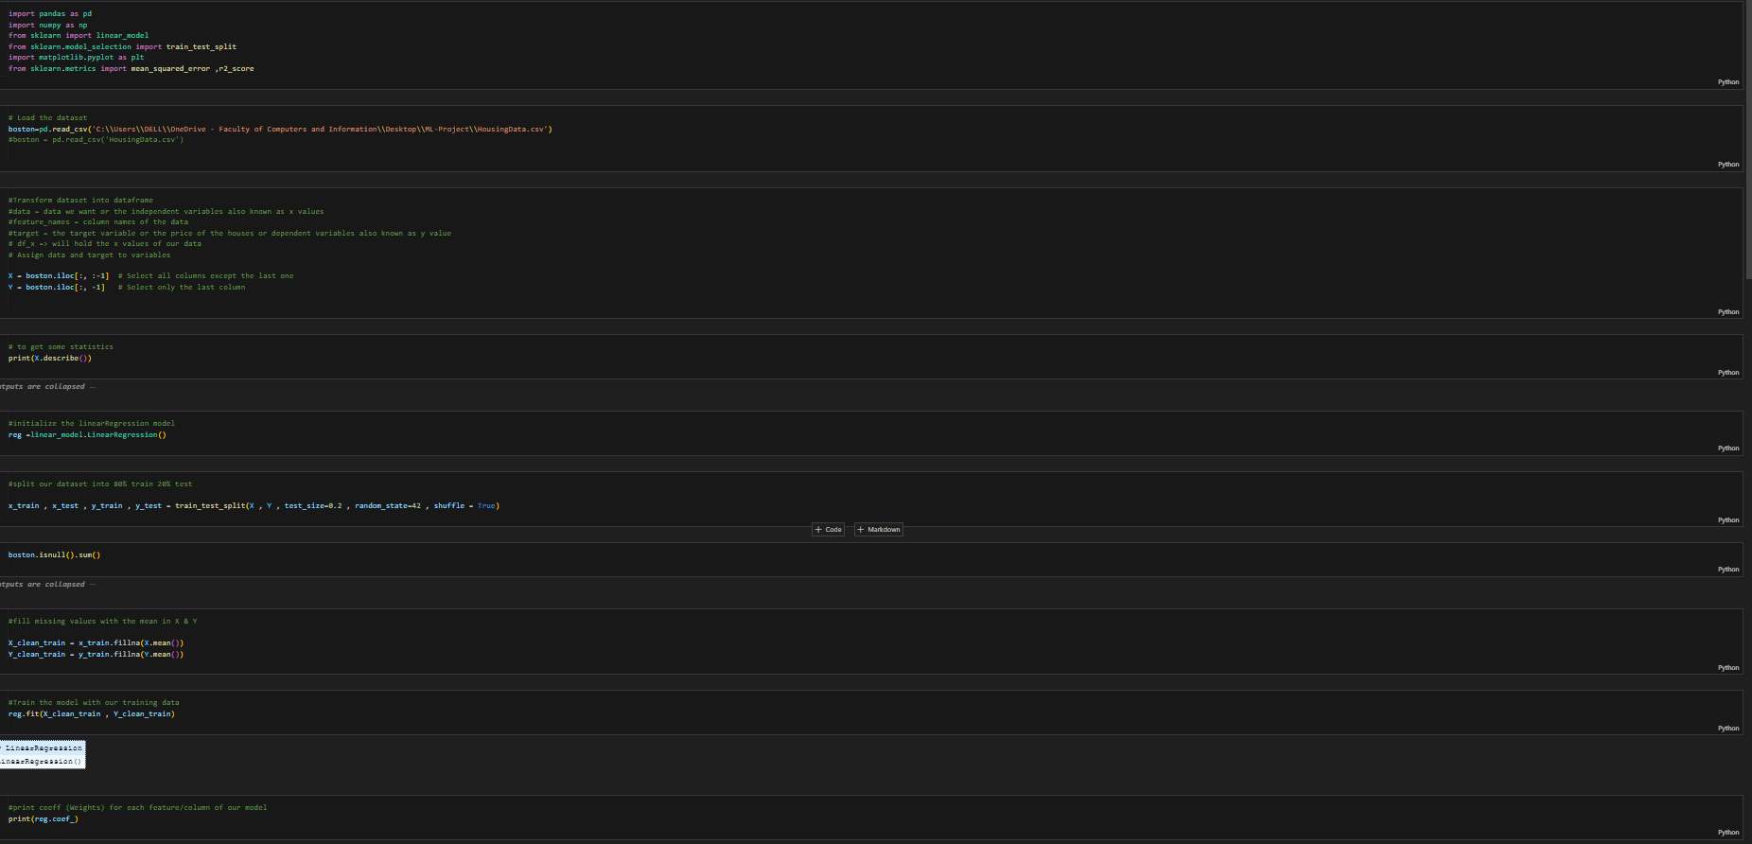
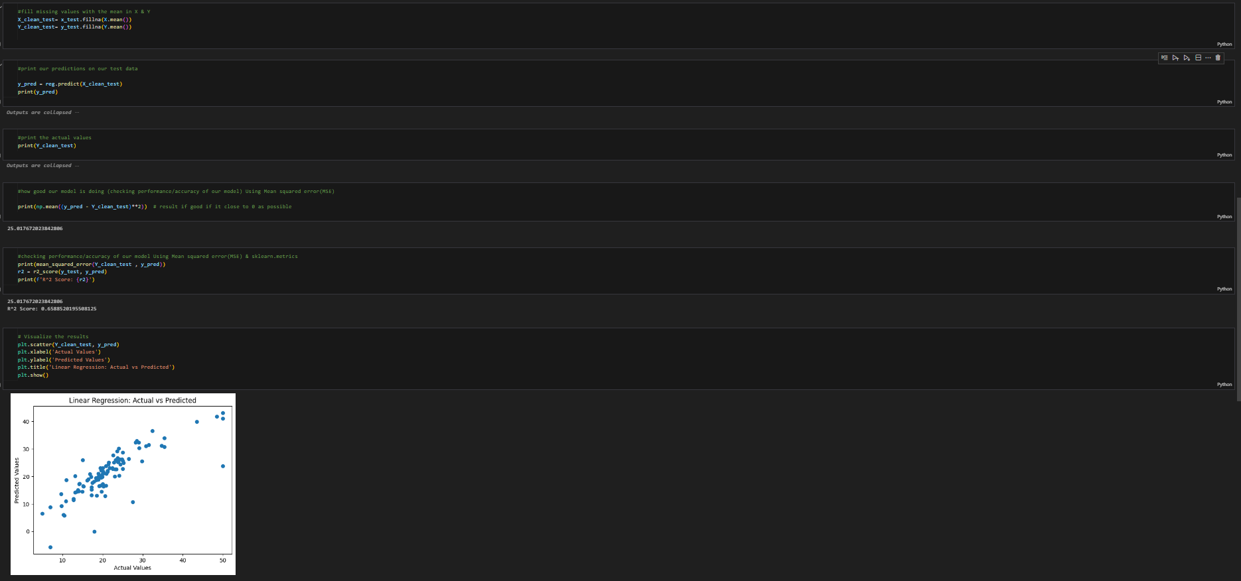
-Linear Regression:
We initialize Linear Regression Model then We split the data to train and test to 20% test and 80% train and fill missing values with the mean then Train the model with our training data and We plot the Results

Slide 6
Then We go to the image Data set in the next slide:

Slide 7
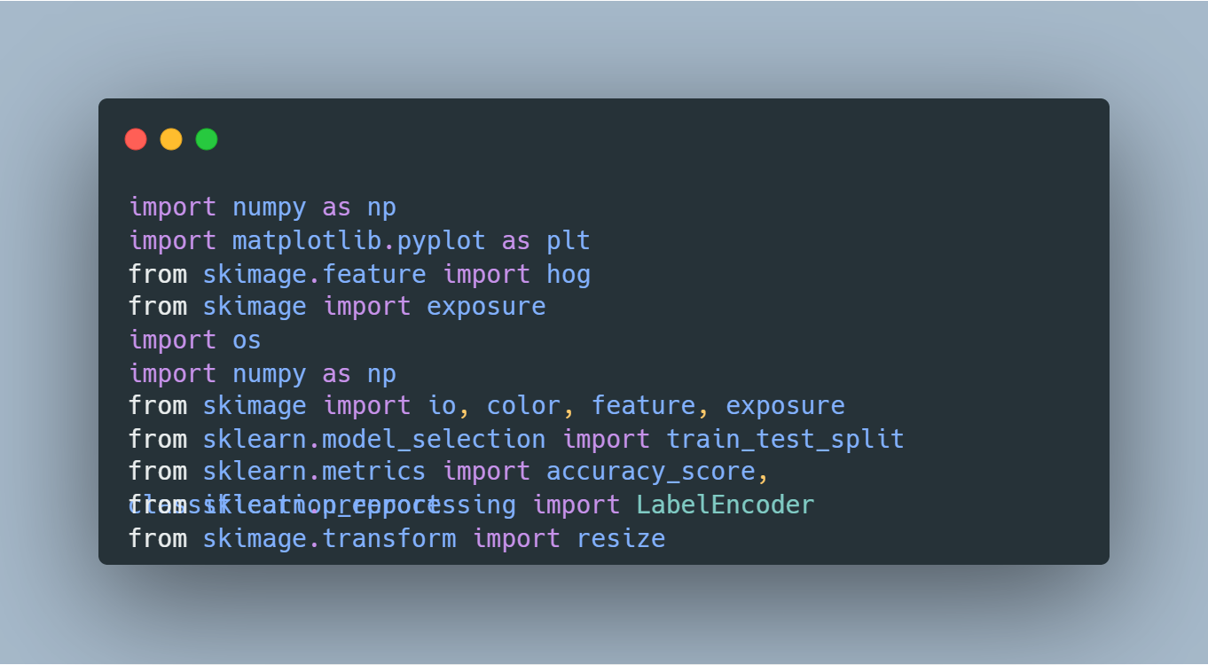
libraries for image processing and machine learning.
This script serves as a foundation for a broader image classification or object detection task. It is expected to be integrated with additional code for model training, evaluation, and deployment.
Libraries Used:
- NumPy: For numerical operations and array handling.
- Matplotlib.pyplot: For creating visualizations.
- Scikit-Image (skimage.feature, skimage, skimage.io, skimage.color, skimage.feature, skimage.exposure): For image processing, including feature extraction and manipulation.
- OS: For interacting with the operating system, facilitating file and directory operations.
- Scikit-Learn (sklearn.model_selection, sklearn.metrics, sklearn.preprocessing): For machine learning tasks, such as train-test splitting, performance evaluation, and label encoding.

Slide 8
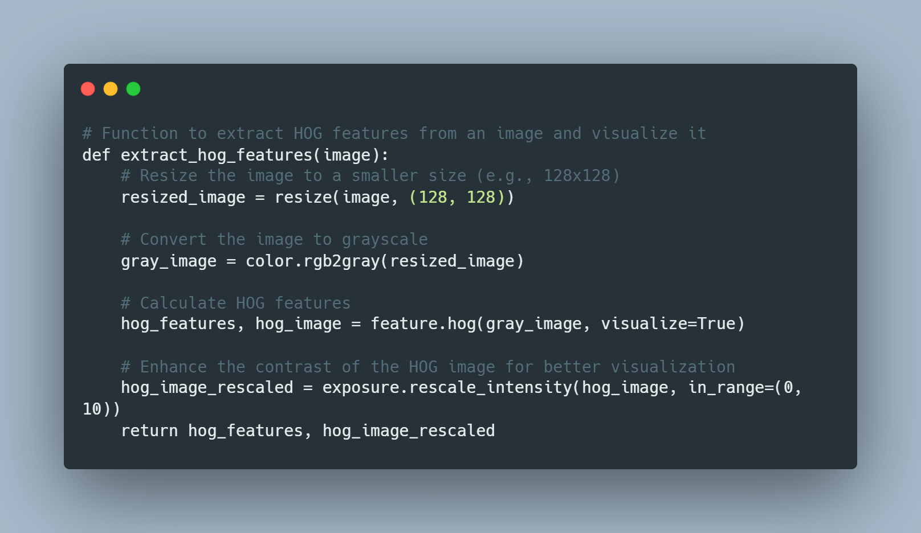
def extract_hog_features(image):
Extracts Histogram of Oriented Gradients (HOG) features from an input image and visualizes the result.
Returns:
- hog_features (numpy.ndarray): 1D array containing the HOG features. - hog_image_rescaled (numpy.ndarray): Rescaled HOG image for visualization.
Usage: hog_features, hog_image_rescaled:
extract_hog_features(input_image)
Converts the image to grayscale for HOG feature calculation.

Slide 9
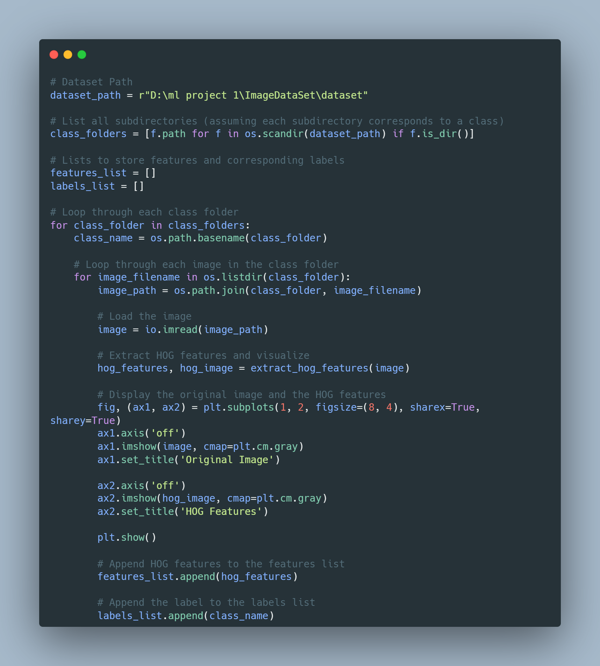

Slide 10
This script processes a dataset of images, extracts Histogram of Oriented Gradients (HOG) features from each image, visualizes the original image alongside its HOG features, and stores the extracted features and corresponding labels.
Dataset Path:
- `dataset_path` is the path to the root directory containing subdirectories, each representing a class.
Features and Labels:
- `features_list`: List to store extracted HOG features.
- `labels_list`: List to store corresponding class labels.
Processing Steps:
1. List all subdirectories in the dataset path, assuming each subdirectory corresponds to a class.
2. Loop through each class folder.
a. For each image in the class folder:
- Load the image.
- Extract HOG features and visualize the original image and HOG features using matplotlib.
- Append the HOG features to the features list.
- Append the class label to the labels list.
Usage:
- Adjust the `dataset_path` variable to the path of your dataset before running the script.

Slide 11
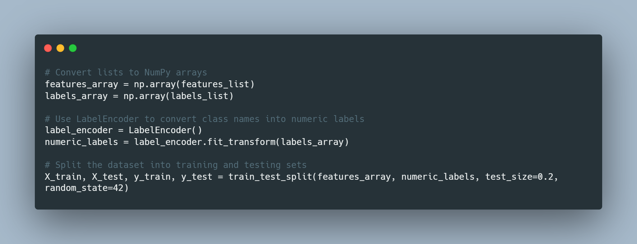

Slide 12
Data Preparation and Splitting Documentation
This script converts the lists of extracted HOG features and corresponding class labels into NumPy arrays. It then uses the LabelEncoder to convert class names into numeric labels. Finally, it splits the dataset into training and testing sets.
Data Conversion and Label Encoding:
- `features_array`: NumPy array containing the extracted HOG features for each image.
- `labels_array`: NumPy array containing the corresponding class labels.
Label Encoding:
- `label_encoder`: An instance of LabelEncoder used to convert class names into numeric labels.
- `numeric_labels`: NumPy array containing the numeric labels obtained by encoding the class names.
Dataset Splitting:
- The dataset is split into training and testing sets using the `train_test_split` function from scikit-learn.
- `X_train`, `X_test`: NumPy arrays containing the features for training and testing, respectively.
- `y_train`, `y_test`: NumPy arrays containing the numeric labels for training and testing, respectively.
Usage:
- Ensure that the features_list and labels_list variables are populated before running this script.
- Adjust the test_size and random_state parameters in the train_test_split function based on your requirements.

Slide 13
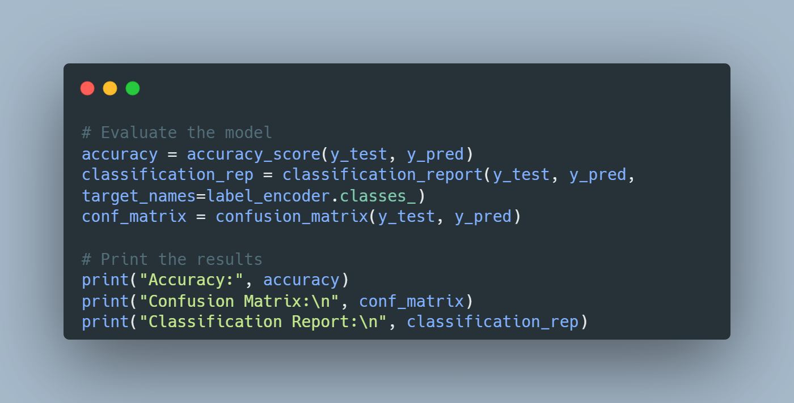
Model Evaluation Documentation
This script evaluates the performance of a Logistic Regression model using various metrics, including accuracy, confusion matrix, and classification report.
Metrics Used:
- `accuracy`: Accuracy score, representing the proportion of correctly predicted instances.
- `conf_matrix`: Confusion matrix, providing a detailed view of true positive, true negative, false positive, and false negative counts.
- `classification_rep`: Classification report, summarizing precision, recall, F1-score, and support for each class.
Usage:
- Ensure that the Logistic Regression model is trained and `y_test` and `y_pred` are available.
- The label_encoder is assumed to be initialized and used for decoding numeric labels.

Slide 14
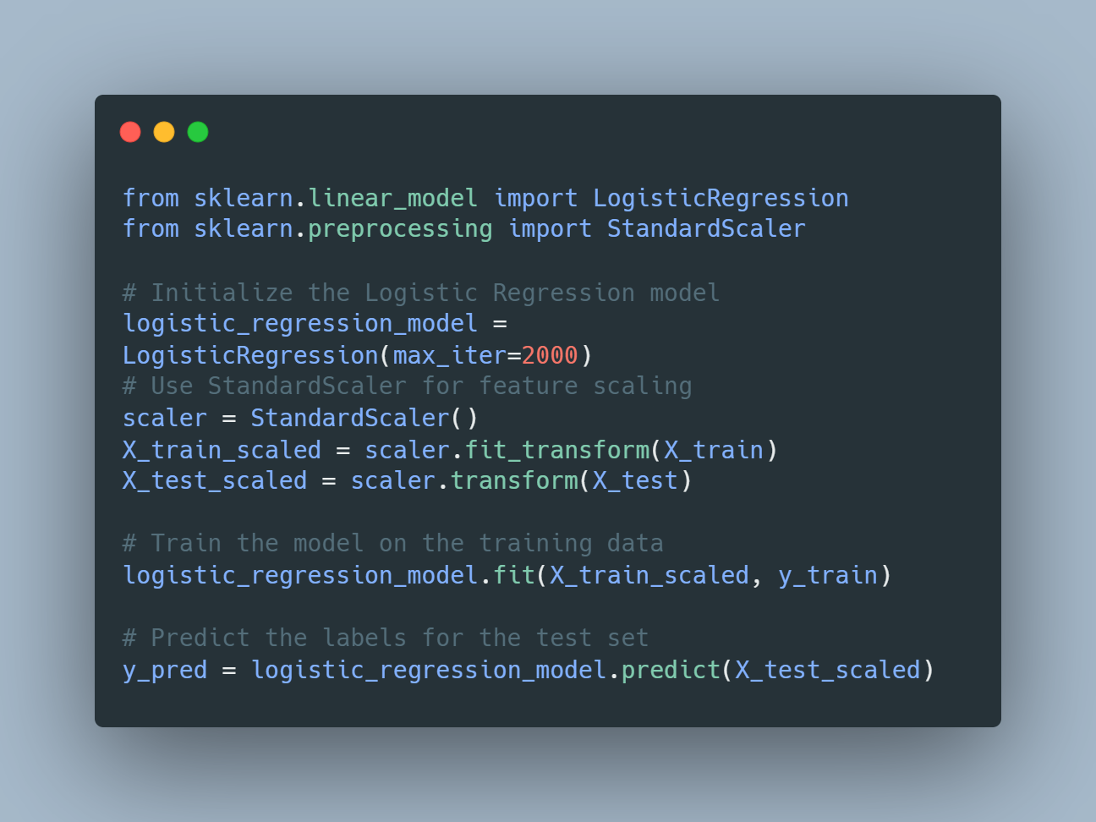

Slide 15
Logistic Regression Model Training and Prediction Documentation
This script initializes and trains a Logistic Regression model on a dataset. It uses the StandardScaler for feature scaling before training the model. Finally, it predicts labels for the test set.
Logistic Regression Model Initialization:
- `logistic_regression_model`: An instance of Logistic Regression initialized with a maximum number of iterations (max_iter=2000).
Feature Scaling:
- `scaler`: An instance of StandardScaler used to scale the features to have zero mean and unit variance.
- `X_train_scaled`: Scaled features for the training set.
- `X_test_scaled`: Scaled features for the test set.
Model Training:
- The Logistic Regression model is trained on the scaled training data using the fit method.
Prediction:
- The model predicts labels for the scaled test set using the predict method.
Usage:
- Ensure that the features (X_train, X_test) and labels (y_train) are properly prepared before running this script.
- Adjust the `max_iter` parameter in LogisticRegression if needed.
- The StandardScaler is used to standardize feature values. Ensure this is suitable for your specific dataset.

Slide 16
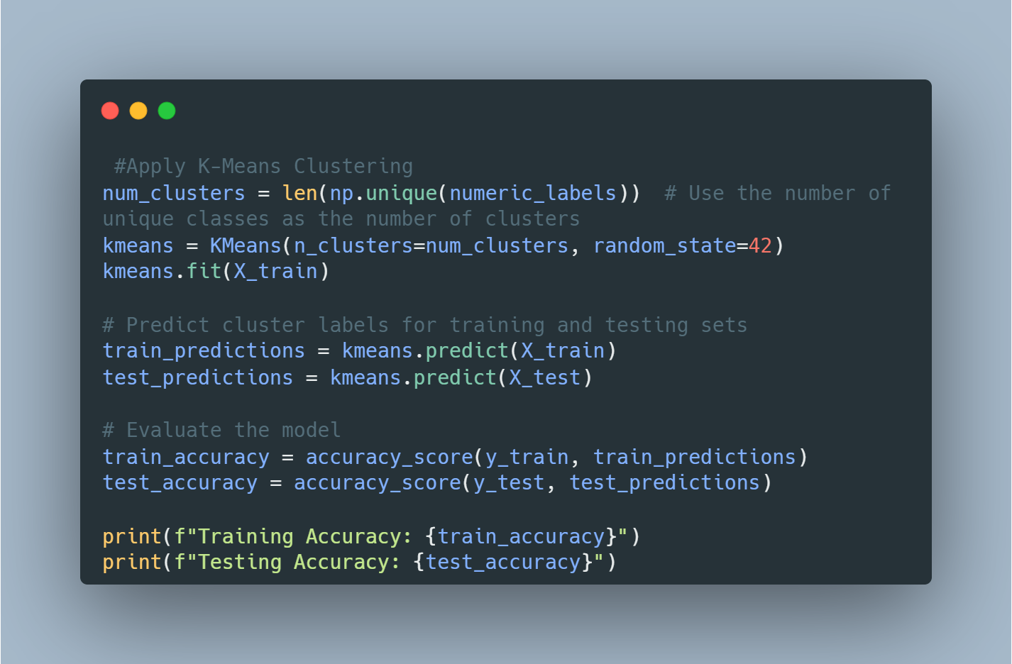

Slide 17
K-Means Clustering and Model Evaluation Documentation
This script applies K-Means clustering to the feature space, using the number of unique classes as the number of clusters. It then predicts cluster labels for both the training and testing sets and evaluates the model's performance.
Steps:
1. Determine the number of clusters based on the unique classes in the dataset.
2. Initialize and fit a K-Means clustering model to the training data.
3. Predict cluster labels for both the training and testing sets.
4. Evaluate the model using accuracy scores for the training and testing sets.
Usage:
- Ensure that the features (X_train, X_test) and labels (y_train) are properly prepared.
- The number of clusters is determined by the number of unique classes in the dataset.
- Adjust the random_state parameter in KMeans for reproducibility.

Slide 18
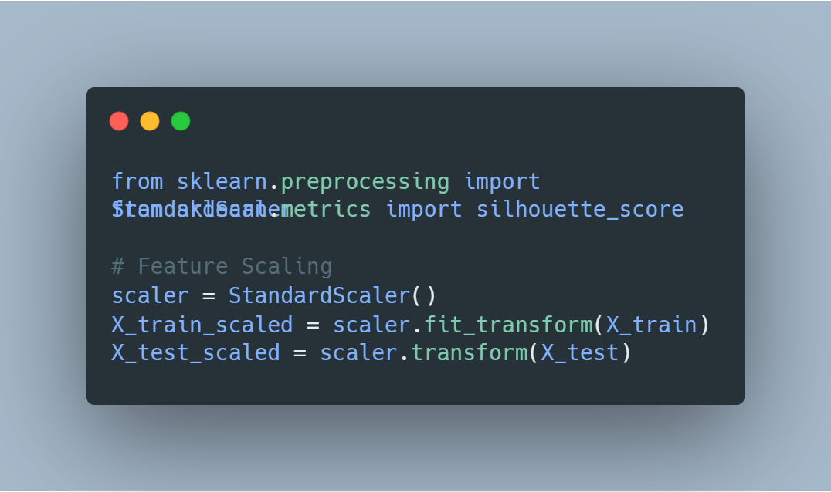
feature Scaling Documentation
This script applies feature scaling to the dataset using the StandardScaler from scikit-learn. Feature scaling ensures that the features have zero mean and unit variance, which is especially important for algorithms sensitive to feature scales, such as K-Means clustering.
Steps:
1. Initialize an instance of StandardScaler.
2. Fit the scaler on the training data and transform both training and testing sets.
3. Standardization ensures that the features are centered around zero and have a standard deviation of 1.
Usage:
- Ensure that the features (X_train, X_test) are properly prepared before applying feature scaling.
- The scaler is fit on the training data, and the same transformation is applied to both training and testing sets.

Slide 19


